Slide 1
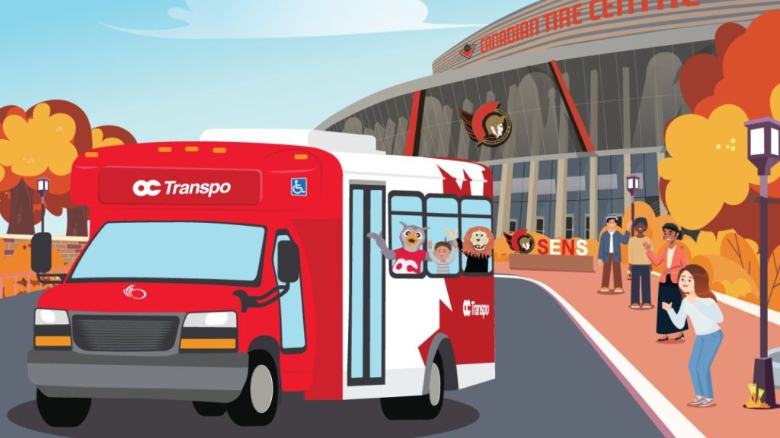
Public Transit Fleet Management System (PTFMS)
Final Project – CST8288 020 – Summer 2025
Group 3
Team Members:
1. Viet Quynn Nguyen – 041088250
2. Sreelakshmi Manoj – 041141760
3. Deepanshu – 041155408
4. Ramandeep Kaur – 041151322

Slide 2
Project Overview
The Public Transit Fleet Management System (PTFMS) is a web-based application developed to help transit agencies monitor, track, and optimize the operations of buses, electric light rail, and diesel-electric trains.
It integrates GPS tracking, energy monitoring, predictive maintenance alerts, and route optimization to enhance reliability and efficiency.

Slide 3
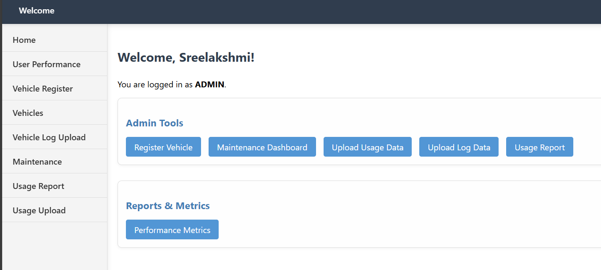
System Features
• User Registration & Role-Based Login
• Vehicle Management (Add/Edit Vehicles)
• GPS-Based Tracking & Logging
• Fuel/Energy Usage Monitoring
• Predictive Maintenance Alerts
• Reporting & Performance Dashboards

Slide 4
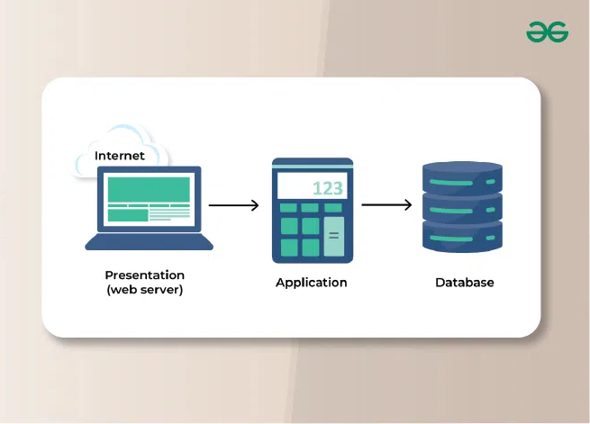
System Architecture
The system follows a 3-tier architecture:
1. Presentation Layer – JSP Frontend & Admin Dashboard
2. Business Logic Layer – Java Servlets
3. Data Layer – MySQL Database

Slide 5
Technology Stack
• Java 21
• Java Servlets
• MySQL 8.0.40
• Apache Tomcat 9.0.90
• NetBeans (Maven Project)
• HTML/CSS for Frontend Styling

Slide 6
Design Patterns Implemented
• DAO – Data Access Layer abstraction
• Builder – Complex object creation (e.g., Vehicle)
• Strategy – Maintenance and Report strategies
• Observer – Real-time alert system
• Command – Execute vehicle maintenance tasks

Slide 7

Application Flow
1. Login / Register Page with Role-based access
2. Welcome Dashboard
3. Admin Tools (Vehicle Registration, Maintenance, Data Upload)
4. Reports & Metrics (Usage, Performance)
5. Logout and Session Security

Slide 8

Conclusion & Future Enhancements
PTFMS is a scalable and modular solution for fleet management in public transit systems.
Future Enhancements:
• AI-based predictive analytics
• Mobile app for operators
• Integration with traffic and weather APIs

