Slide 1
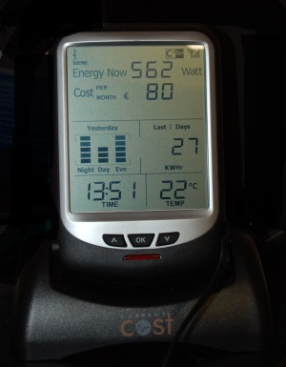
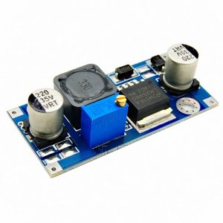

Slide 2

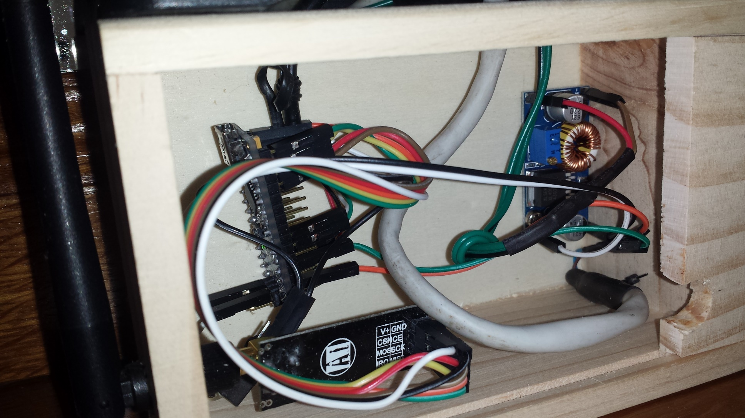
RJ 45
DATA
EnviR
VDD
DC-DC STEP DOWN
ARDUINO NANO
NRF24L01+

Slide 3
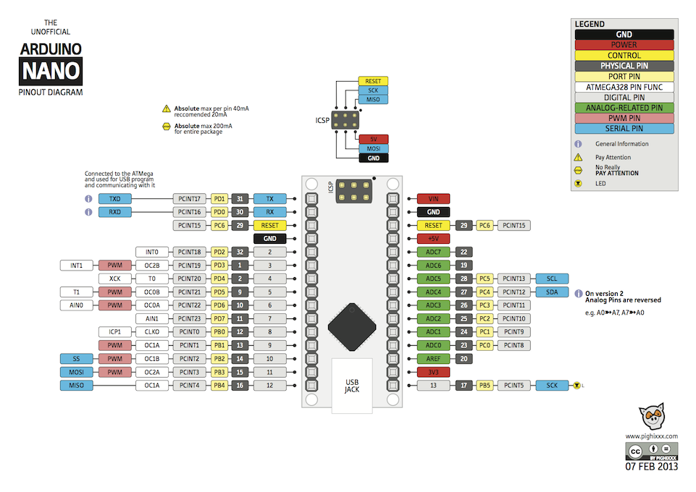

Slide 4

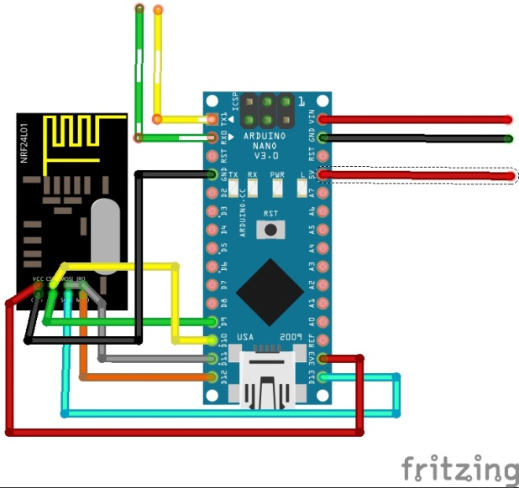
+5V
POWER
RJ45
+3,6V
+5V

Slide 5
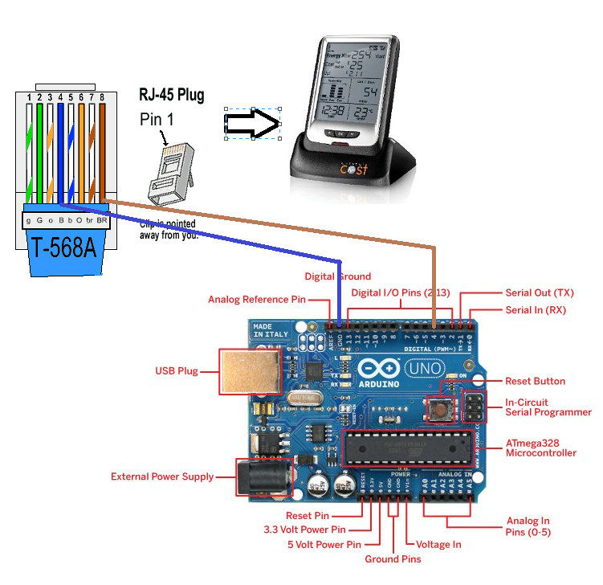

Slide 6
LM2596 DC-DC Step Down CC-CV Adjustable Power Supply Module Output DC 1.5V-35V
CURRENT COST Ecran d'affichage EnviR, Noire

