Slide 1
AUSIGN: An Auslan Interpreter Glove
Empowering communication through wearable technology
BY RAHUL RAMACHANDRAN AND ENZO MORIGUCHI

Slide 2
WHY DOES AUSIGN EXIST?
Limitations of Current Solutions
User Needs
Real-time Auslan-to-speech
Portable, offline, affordable
Emotion/context inference
Intuitive, day-long use
Expensive (e.g. Brightsign glove ≈ $6,800 AUD)
Mostly support ASL, not Auslan
Require phones/internet, lack context awareness

Slide 3
WHO IS AUSIGN FOR?
Target: Auslan users aged 25–59 needing daily, affordable communication tools
User Validation
(21 Respondents)
Market Opportunity
16,000 Auslan users (2021 Census)
3.6M Australians with hearing loss → 7.8M by 2060
Interpreter costs ≈ $127.50/hr
Existing solutions out of stock, ASL-only
67% currently use aids
Avg usefulness: 6.1/10
Openness to new devices: 8.2/10
62% interested in AUSIGN

Slide 4
Key Requirements
≤ 50g per glove
≥ 12 hours battery life
≥ 90% translation accuracy
≤ 2 seconds latency
Offline functionality
Under $100 manufacturing cost
Customizable settings (volume, dialect)
Emergency signal support

Slide 5
Product and Design Concepts
Design Highlights
Flex sensors + IMU = accurate gesture detection
Heartbeat sensor = emotional context
ESP32 = processing + Bluetooth for personalization
Onboard speaker + optional LCD feedback
Custom mapping of signs
Emergency button (e.g., “Help”)

Slide 6
Unique Selling Points
Auslan-specific – Not ASL-focused like competitors
Context-aware – Heart rate input for emotion detection
Gesture + Motion Fusion – Flex + IMU improves accuracy
Lightweight & Comfortable – Under 50g
Bluetooth-Enabled – Mobile app for personalization
Offline Support – Usable without internet
Custom Sign Training – Adaptable to regions/users
Affordable – Sub-$100 vs $6,800 competition

Slide 7
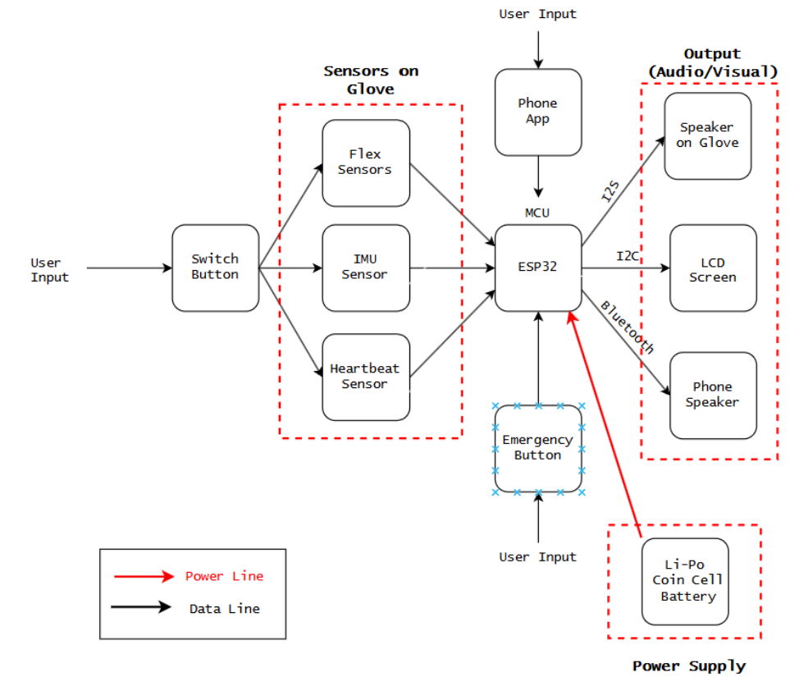
High-Level Block Diagram

Slide 8
Technical Components
Subsystem | Component | Notes
MCU | ESP32-WROOM-32 | I2C, UART, ADC, Bluetooth
Finger Sensor | 3” Flex Sensors | 25k–100kΩ resistance range
Motion Sensor | MPU6050 IMU | 6-axis detection
Biometric Sensor | MAX30102 | Heart rate & oximeter
Output | 3W Speaker, 20×4 LCD | Compact + intuitive UI
Power | TP4056 + LiPo + MT3608 | USB charging + 5V boost
Input | Tactile Push Button | Emergency signal

Slide 9
Financial Plan
Per Unit Manufacturing Estimate
ESP32: $8
Flex Sensors ×5: $20
MPU6050: $5
MAX30102: $6
Speaker + Amp: $4
LCD: $7
Power Circuit (TP4056 + MT3608): $3
Misc (PCB, Glove Material, Button): $15
→ Total: ~$68 AUD
Selling Price: $150–200 AUD
NPV: Viable pricing based on competitor comparison
Profit Margin: ≥ 100%, with accessibility focus

Slide 10
Development Plan
Week 6–7
Hardware Integration (Flex + IMU + HR + Speaker)
Sensor Calibration
Week 8
Real-time Auslan-to-Speech Mapping
Bluetooth App UI + Emergency Button Logic
Week 9
Context Awareness Logic (Heart rate threshold)
Output testing with user trials
Week 10
Final Testing + Demo
User Feedback + Iteration
Presentation and Documentation
Team Allocation:
Hardware: Enzo
Firmware + Possible ML Model: Rahul
App + UI: Rahul
PCB: Enzo
Integration & Testing: Both

