Slide 1
ROOT ACCESS
A Cybersecurity-Themed OOP Hacking Simulation Game
Developed By:
- Fariha Tasnim Miti (2243081060)
- Md. Rakib (2243081064)
Course: Object-Oriented Programming
Language: C#

Slide 2
Introduction
What is Root Access?
A console-based hacking simulation game.
Player completes challenges to gain system access.
Progresses through 3 main levels:
Password Cracking
Firewall Bypass
System Exploit

Slide 3
Project Goals
Why We Built This Game ?
- Implement OOP concepts in a real project
- Create a modular, extensible structure
- Simulate cybersecurity-style tasks
- Use advanced OOP features:
* Abstract classes
* Interfaces
* Polymorphism
* Operator & function overloading
* Copy constructors
* Virtual methods
* Static fields

Slide 4
System Architecture Overview
IScorable (Interface)
HackChallenge (Abstract Base Class)
Derived Classes:
  PasswordCracking
  FirewallBypass
  SystemExploit
HackingGame (Game Controller)
Program (Entry Point)
Notes:
First, let me explain our system architecture. We use the IScorable interface for scoring and the HackChallenge abstract class as the base for all challenges. Then, three derived classes— PasswordCracking, FirewallBypass, and SystemExploit—extend this base class. Finally, the HackingGame class manages gameplay, and the Program class starts the application.

Slide 5
Abstract Class: HackChallenge
Features:
Abstract method: StartChallenge()
Virtual methods:
  DisplayHint()
  CalculateScore()
Properties: ChallengeName, DifficultyLevel
Static member: TotalChallengesCreated
Operator overloading: > and <
Implements interface IScorable
Copy constructor for object duplication
Notes:
Next, the HackChallenge class defines the common structure for all challenges. It includes an abstract method for starting challenges and virtual methods for hints and scoring. In addition, static members, operator overloading, and a copy constructor ensure flexibility and consistency.

Slide 6
Interface Implementation
Interface :IScorable
Provides scoring contract:
int CalculateScore(int attempts);
Advantages:
- Consistency
- Flexibility
- Loose coupling
Notes:
After that, we implemented the IScorable interface. It defines a standard scoring method that every challenge follows. As a result, scoring remains consistent while allowing different implementations.

Slide 7
Inheritance and Polymorphysom
Derived Classes:
- PasswordCracking
- FirewallBypass
- SystemExploit
Each Overrides:
- StartChallenge()→custom challenge loop
- DisplayHint()→challenge specific hint
- CalculateScore()→different scoring rules
Result:
- Runtime polymorphism
- Unique behavior for each challenge

Slide 8
Game Flow
Game Process:
1. Start at Level 1
2. Generate appropriate challenge
3. User attempts until success
4. Score calculated based on attempts
5. Progress to Levels 2 and 3
6. Display final statistics
Total games played .
Total challenge created
Features:
- Function overloading
- Dynamic scoring system
- Progressive difficulty

Slide 9
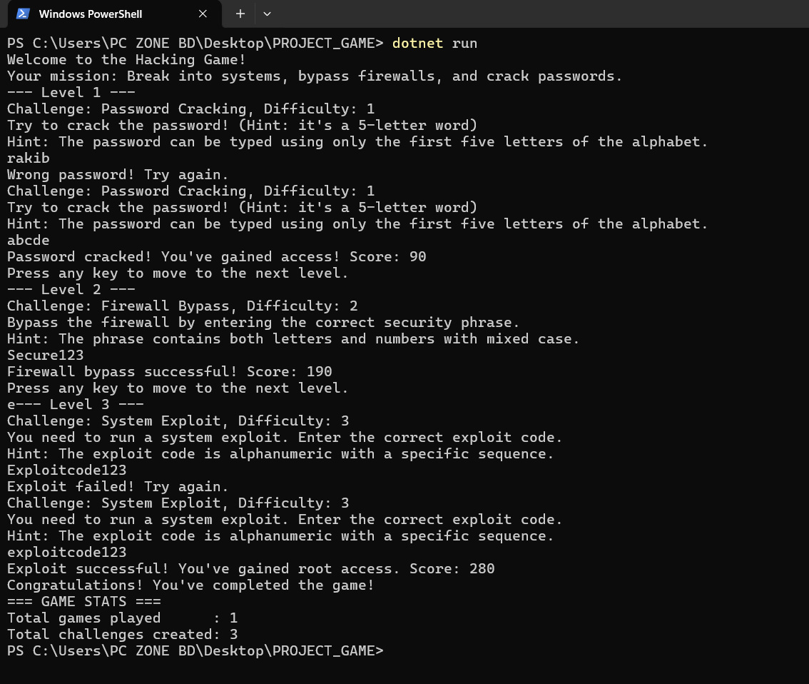
Demo and Output
Demo Includes:
- Level initialization
- Hints generated
- User input handling
- Success/failure feedback
- Score updates
- Level progression visuals

Slide 10
Conclusion
Achievements:
- Fully applied OOP in a practical project
- Built a flexible & maintainable architecture
- Successfully implemented advanced OOP features
- Delivered a functional hacking simulation game
Root Access showcases how OOP enables powerful and modular software design.

Slide 11


