Slide 1
Sorting

Slide 2
BUBBLE SORT
In this sorting algorithm, multiple swapping take place in one iteration. Smaller elements move or ‘bubble’ up to the top of the list.
In this method ,we compare the adjacent elemnent of the list to be sorted , if the item on top is greater than the item immediately below it, they are swapped.

Slide 3
Example
Suppose the following numbers are stored in an array A:
32, 51, 27, 85, 66, 23, 13, 57
Pass 1. We have the following comparison:
(a) Compare Al and A2 Since 32 < 51, the list is not altered.
(b) Compare A2 and A3 Since 51 > 27, interchange 51 and 27 as follows:
32, (27), (51), 85, 66, 23, 13, 57
(c) Compare A3 and A4. Since 51 < 85, the list is not altered.
(d) Compare A4 and A5. Since 85 > 66, interchange 85 and 66 as follows:
32, 27, 51, (66), (85), 23, 13, 57
(e) Compare A5 and A6. Since 85 > 23, interchange 85 and 23 as follows:
32, 27, 51, 66, (23), (85), 13, 57
(f) Compare A6 and A7. Since 85 > 13, interchange 85 and 13 as follows:
32, 27, 51, 66, 23, (13), (85), 57
(g) Compare A7 and A8. Since 85 > 57, interchange 85 and 57 as follows:
32, 27, 51, 66, 23, 13, (57), (85)

Slide 4
At the end of Pass 2, the second largest number, 66, has moved its way down to the next-to-last position.
27, 33, 51, 23, 13, 57, 66, 85
At the end of Pass 3, the third largest number, 57, has moved its way down to its position in the list.
27, 33, 23, 13, 51, 57, 66, 85
At the end of Pass 4, the fourth largest number, 51, has moved its way down to its position in the list.
27, 23, 13, 33, 51, 57, 66, 85
At the end of Pass 5, the fifth largest number, 33, has moved its way down to its position in the list.
23, 13, 27, 33, 51, 57, 66, 85
At the end of Pass 6, the sixth largest number, 27, has moved its way down to its position in the list.
13, 23, 27, 33, 51, 57, 66, 85
At the end of Pass 7 (last pass), the seventh largest number, 23, has moved its way down to its position in the list.
13, 23, 27, 33, 51, 57, 66, 85

Slide 5
BUBBLE SORT
Algorithm: (Bubble Sort) BUBBLE (A, N)
Repeat Steps 2 and 3 for K = 1 to N-1.
Set PTR := 1. [Initializes pass pointer PTR.]
Repeat while PTR ≤ N – K.
        If A [PTR] > A[PTR+1], then:
Interchange A[PTR] & A[PTR+1].
[End of IF structure.]
        Set PTR := PTR + 1.
[End of While loop.]
[End of Step 1 loop.]
Exit.

Slide 6
Complexity
The first pass requires (n-1) comparisons to fix the highest element to its location, the second pass requires (n-2)……kth pass requires (n-k) and the last pass requires only one comparison to fixed at its proper position.
Therefore the total comparisons are
F(n)=(n-1)+(n-2)+(n-3)+……+(n-k)+….+3+2+1
=n(n-1)/2
=O(n ² )

Slide 7
SELECTION SORT
In this sorting we find the smallest element in this list and put it in the first position.
Then find the second smallest element in the list and put it in the second position. And so on.

Slide 8
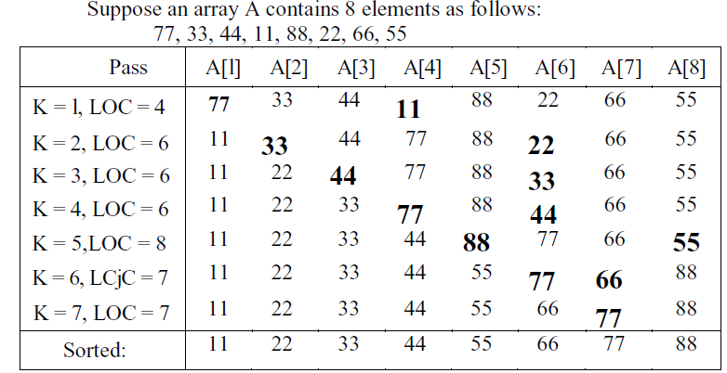

Slide 9
SELECTION SORT
Algorithm: (Selection Sort) SELECTION (A, N)
Repeat Steps 2 and 3 for K = 1,2,3,…,N-1.
Call MIN(A,K,N,LOC).
[Interchange A[K] and A[LOC].]
[End of Step 1 loop.]
Exit.

Slide 10
SELECTION SORT
Procedure: MIN(A, K, N, LOC)
Set MIN : = A[K] and LOC:=K.
Repeat for J = K+1, K+2,….,N.
If MIN > A[J], then:
Set MIN := A[J] and LOC:=J.
[End of loop.]
Return.

Slide 11
Complexity of selection sort
The first pass requires (n-1) comparisons to find the location loc of smallest element, the second pass requires (n-2)……kth pass requires (n-k) and the last pass requires only one comparison.
Therefore the total comparisons are
F(n)=(n-1)+(n-2)+(n-3)+……+(n-k)+….+3+2+1
=n(n-1)/2
=O(n ² )

Slide 12
INSERTION SORT
The insertion sort works just like its name suggest-it inserts each item its proper place in the final list.
During the first iteration, the element position 2nd is compared with the element at the 1st position.
During the second iteration, the element at the position 3rd is compared with the element at the 2nd and 1st positions.
This process is repeated for all the elements in the array up to (n-1) iterations.
This method is widely used by card players.

Slide 13
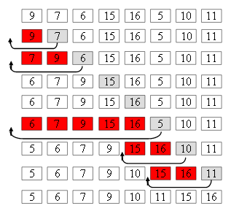
Example

Slide 14
INSERTION SORT
Algorithm: INSERTION(A, N)
Repeat Steps 2 to 4 for K = 2,3,…, N.
Set TEMP := A[K] and PTR := K – 1.
Repeat while TEMP<A[PTR]
(a) Set A[PTR+1] := A[PTR].
(b) Set PTR := PTR – 1.
[End of Loop.]
Set A[PTR + 1] := TEMP.
[End of Step 1 loop.]
Exit

Slide 15
Complexity of insertion sort
The first pass requires 1 comparison, the second pass requires 2……kth pass requires k and the last pass requires (n-1) comparisons.
Therefore the total comparisons are
F(n)=1+2+3+……+(n-1)
=n(n-1)/2
=O(n ² )

