Slide 1

Contentful
Pre Sales Analysis.

Slide 2
Topic Covered.
Software Development Approaches
Why Headless?
Exciting feature of headless
List of Headless CMS in market
Why Contentful is a good choice
More goodies under the hood
Why Altudo is best choice for contentful

Slide 3
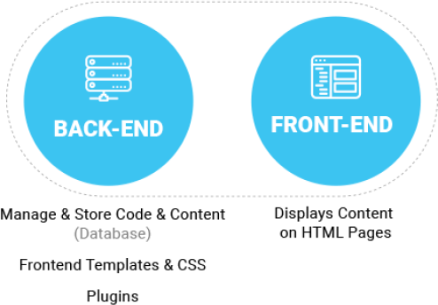
Software Development Approaches
Traditional/Coupled CMS, example: Drupal, Wordpress
Architectural Approach: Tightly links the back end to the front end.
Storage: Content is created, managed, and stored—along with all digital assets—on the site’s back end.
Editor platform: Your editors are writing and publishing on the back end of the same system your website visitors are viewing.

Slide 4
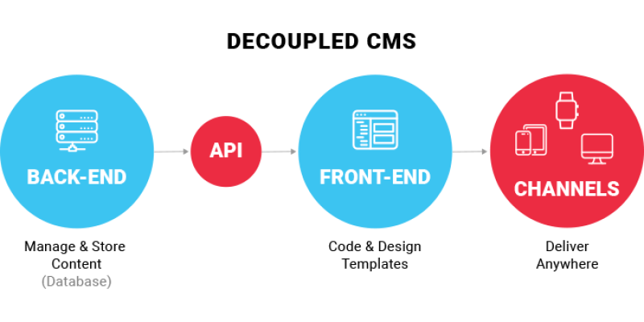
Software Development Approaches
Decoupled CMS Approach
Architectural Approach: Separates the back-end and front-end management of a website into two different systems.
Storage: Content is created, managed, and stored—along with all digital assets—on the site’s back end.
Editor platform: Your editors are writing and publishing on the back end of the same system your website visitors are viewing.

Slide 5
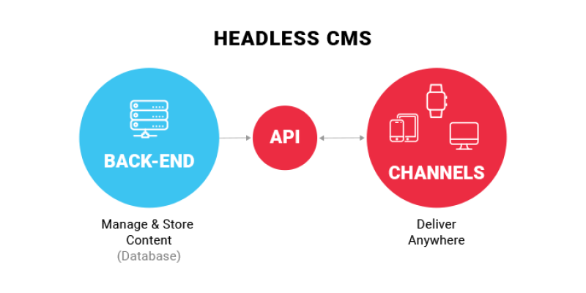
Software Development Approaches
Headless CMS Architecture
Architectural Approach: Content-only data source and has no functionality within the CMS to present content to an end user on it’s own.
Storage: Cloud storage where the content is created, managed, and stored—along with all digital assets only without frontend code.
Editor platform: Your editors are writing and publishing on the back end of the different ecosystem.

Slide 6


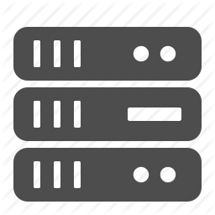
Why Headless?
Problems with traditional/Coupled CMS approach
Page Centric: Content never meant to leave the website.
All in one: Monolithic core and customizations make it hard to integrate and upgrade.
Single server: Architected to run on individual server instead of a scalable distributed cloud

Slide 7



Why Headless?
How headless is solving problem?
Modular Approach: Built to make content reusable and channel independent.
Microservice: API-driven design allows powerful integrations with third parties.
Cloud Service: Decoupled and scalable management and delivery of content.

Slide 8
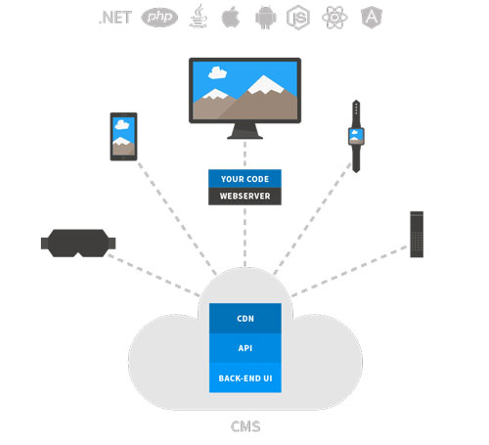
Exciting Features of Headless
Futuristic approach
Ready to be distributed to any digital platform. No more swapping between multiple CMSes.
Enjoy the new powerful presentation features of any language any time you want without affecting data and other presentation.

Slide 9

Exciting Features of Headless
You get fast, real fast
Cuts software development and delivery time, bringing fresh experiences to your customers more often.
Separating Data from presentation layer serves faster user experience.
Direct communication with devices brings faster experience.

Slide 10

Exciting Features of Headless
Really Cost effective
Cutting the development time saves development cost.
Only pay for the service which you use.
Ease in environment shifting reduce the overall cost.

Slide 11

Exciting Features of Headless
Better Security
Often the API used to provide content is read-only. This provides a level of security.
Headless CMS is likely on a different server and a different domain.
Backend team only concentrate on security of data.

Slide 12
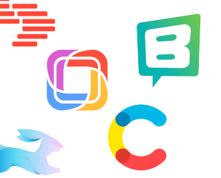
List of headless CMS in market
Better Security
Contentful
Storyblok
Prismic
Directus
Kentico cloud
Squidex
Butter CMS

Slide 13
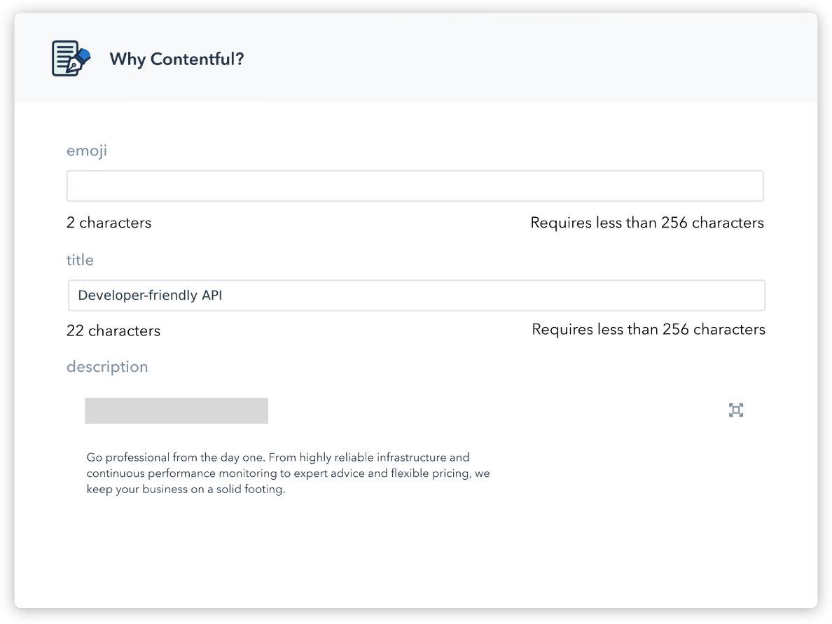
Why Contentful a good choice
Advanced caching mechanism: Integrated tightly with external CDNs to deliver API payloads in the sub-100 ms range
Microservices architecture: The fully decoupled write & read APIs ensure a fault-tolerant service that evolves without breaking your CMS or apps.
RESTful API: stateless API with compact JSON payloads gives you full programmatic control over your content management system, including assets, translations and other versions.

Slide 14
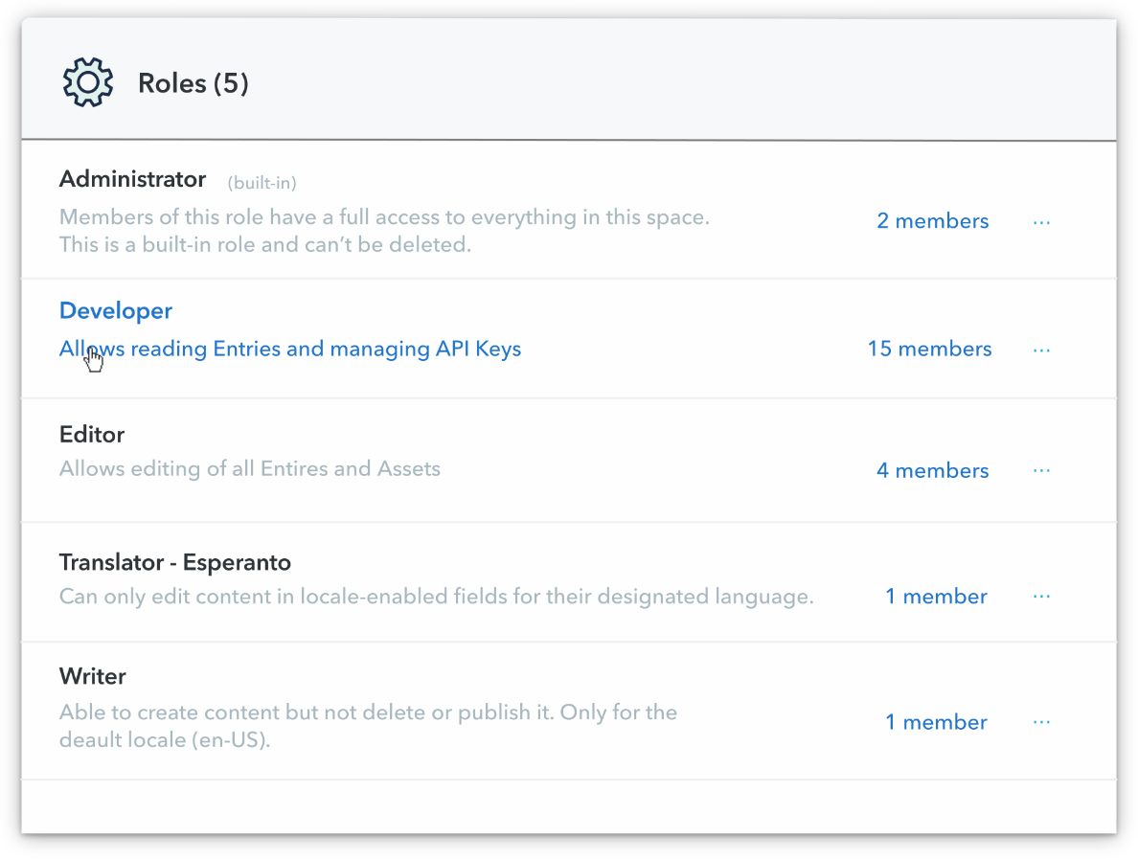
Why Contentful a good choice
Advanced Rich text editor: A beautiful web app built for authoring all types of content - text, location, dates, collections, JSON snippets, and more.
Multi-language: Publishing in multiple languages is stressful, but granular locale settings help you launch on time, every time.
Role and permissions: The default roles and access rights keep your content safe and team members productive at every stage of your business journey.

Slide 15
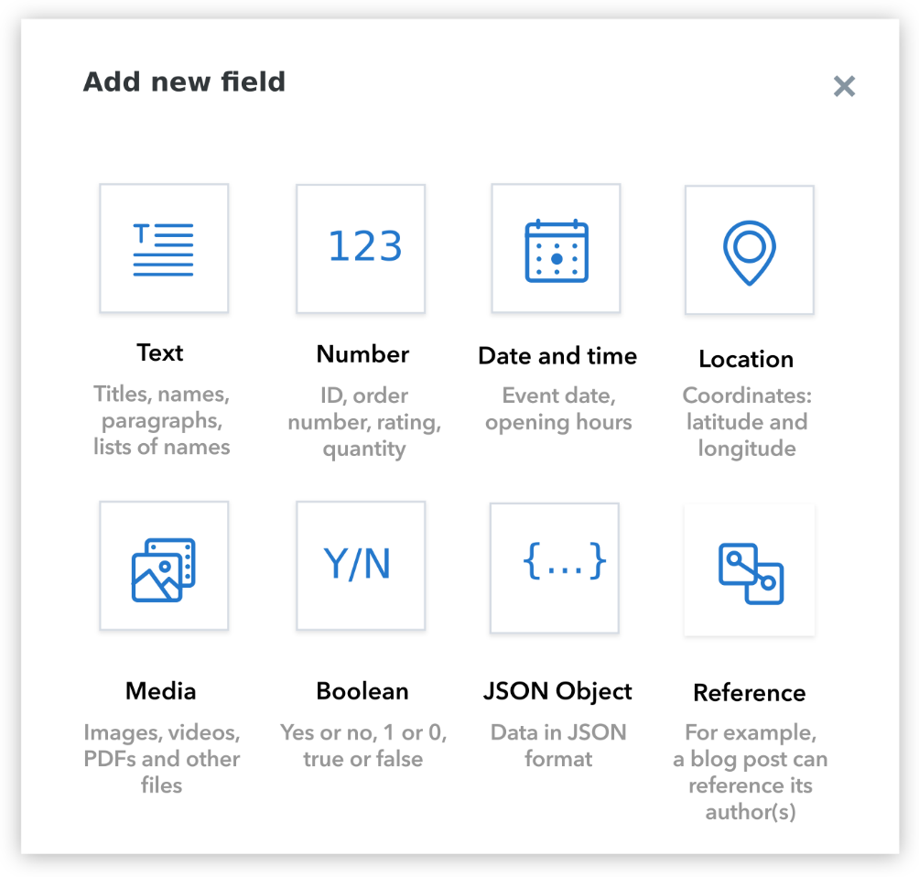
Why Contentful a good choice
Content Modeling: Create custom content types, pick and choose individual fields, and arrange entries in flexible hierarchies.

Slide 16
More goodies under the hood
Quick deployment: Skip the legwork with libraries and demo apps built for popular use cases.
Secure previews: Preview drafts and completed entries without worrying about leaks or service disruptions.
Multiple API keys: Use multiple access tokens to limit content access by device or environment type.
Media library: Host & manage all your assets in one place, update source files without breaking public links.

Slide 17
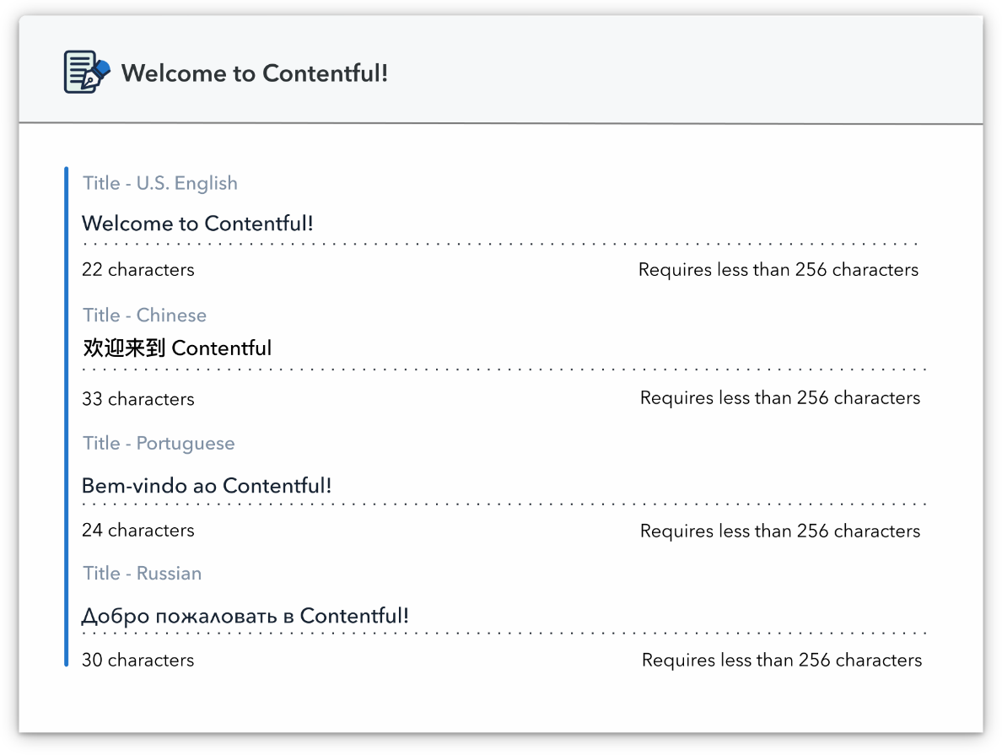
More goodies under the hood
The power of Markdown: Write faster and publish wider with the built-in Markdown editor.
Third-party integrations: Enable teams to work with externally-hosted content directly in the web app.
SDKs galore:With read & write SDKs for popular languages available out of the box, you can go straight to prototyping.
Your project, your rules:UI extensions allow you to customize the web app with new ways of creating, managing, and consuming content.

Slide 18
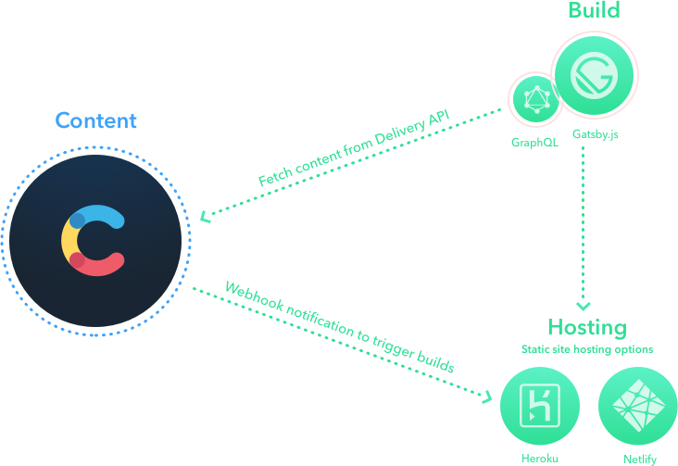
More goodies under the hood
Mix'n'match your stack: Powerful, configurable webhooks allow you to integrate Contentful with any API service out there.

