Slide 1

Contentful
Pre Sales Analysis.

Slide 2
Topic Covered.
Software Development Approaches
Why this new Concept?

Slide 3
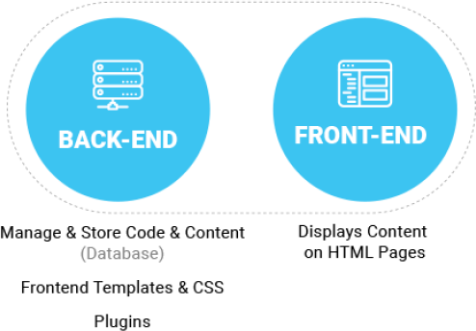
Software Development Approaches
Traditional/Coupled CMS, example: Drupal, Wordpress
Architectural Approach: Tightly links the back end to the front end.
Storage: Content is created, managed, and stored—along with all digital assets—on the site’s back end.
Editor platform: Your editors are writing and publishing on the back end of the same system your website visitors are viewing.

Slide 4
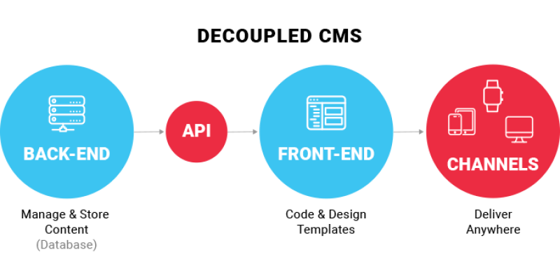
Software Development Approaches
Decoupled CMS Approach
Architectural Approach: Separates the back-end and front-end management of a website into two different systems.
Storage: Content is created, managed, and stored—along with all digital assets—on the site’s back end.
Editor platform: Your editors are writing and publishing on the back end of the same system your website visitors are viewing.

Slide 5
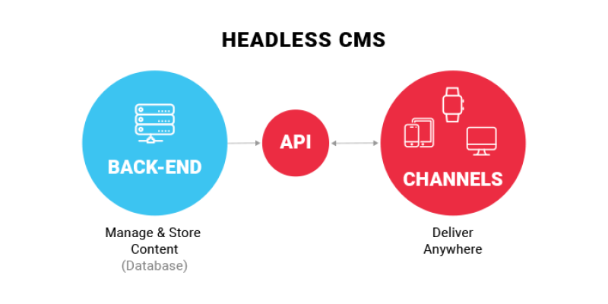
Software Development Approaches
Headless CMS Architecture
Architectural Approach: Content-only data source and has no functionality within the CMS to present content to an end user on it’s own.
Storage: Cloud storage where the content is created, managed, and stored—along with all digital assets only without frontend code.
Editor platform: Your editors are writing and publishing on the back end of the same different ecosystem.

Slide 6


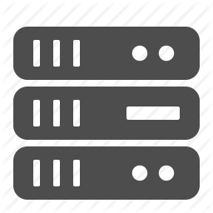
Why new Concept??
Problems with traditional approach
Page Centric: Content never meant to leave the website.
All in one: Monolithic core and customizations make it hard to integrate and upgrade.
Single server: Architected to run on individual server instead of a scalable distributed cloud

Slide 7

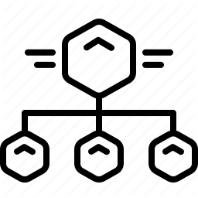

Why new Concept??
How contentful contribute in solving problem?
Modular Approach: Built to make content reusable and channel independent.
Microservice: API-driven design allows powerful integrations with third parties.
Cloud Service: Decoupled and scalable management and delivery of content.

