Slide 1

Profit Simulation Inventory Management and Pricing Strategies
Richard Tseng

Slide 2
Business Value of Simulation
Purpose of Simulation: simulation can be used to predict the future behavior of a “system” and determine what you can do to influence that future behavior.
Business Value: unlike most predicting models, simulation gives you a systematical view rather than a point of forecast.
Notes:
You can use simulation to test the result of a business decision. By anwsering the business questions, we can use simulation to create business value. It is unlike most predicting models

Slide 3
Real Application of Simulation
Analysis
Collecting and visualizing data
Building models
Answering questions based on the predictions
What influence the tobacco manufacturing time?
What is the demand of tobacco in the future?
How does increasing one more production line influence our profit in the future?
Other business questions …
Notes:
Using the analysis of predictive models as the simulation parameters and test the result of different business decisions.
Sometimes we can only answer one problem at a time when we got these model

Slide 4
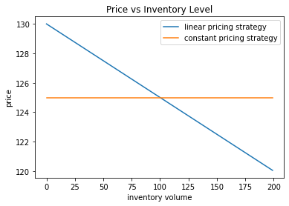
Project Overview
Maximize our profit by choosing the combination of pricing strategy and inventory refill strategy
Pricing strategy: constant price / linear price (affected by current inventory level)
Refill strategy: refill our inventory when there is 30%, 15% or 8% invertory left
6 strategy combinations and we will simulate each combination for 1000 times
Choose the combination of strategies with the highest average profit

Slide 5
Discrete Event Simulation
Poisson Process:
Exponential Distribution: the probability distribution of the time between events
Homogeneous Poisson Process: the arrival rate of a poisson process does not change by time – the manufacturing time of tobacco
Nonhomogeneous Poisson Process: the arrival rate is a function of time – the demand of tobacco (people probably buy more tobacco during holiday season)
Notes:
The method we are going to use is discrete event simulation and the core of discrete event simulation is poisson process.
The poisson process means there are a lot of events and the interval time between events follows exponential distribution

Slide 6
Settings
The company is a fruit store that only sells oranges.
Inventory
Maximum Inventory level: 200 units
Start Unit: 50 units
Refill Unit: 50 units
Freshness Score: (100, 0~5d), (60, 6~10d), (20, 11~15d), (0, above 16d)
Queue - First In First Out

Slide 7
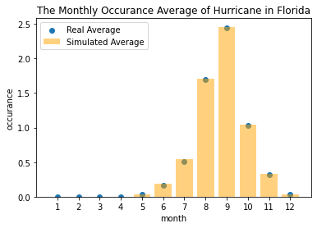
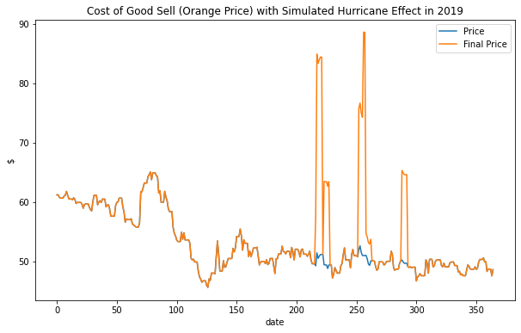
Settings
Supply:
Orange price: 2019 Orange Juice Future Price
Natural Disaster (Hurricane): simulated from NOAA Florida Hurricane Historical data
Damage Level: Uniform(0, 1) and will make a 5 days orange price strike

Slide 8
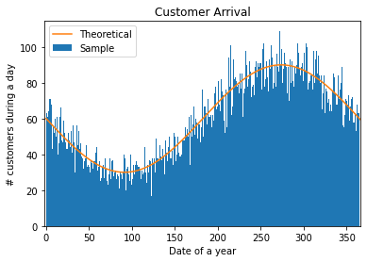
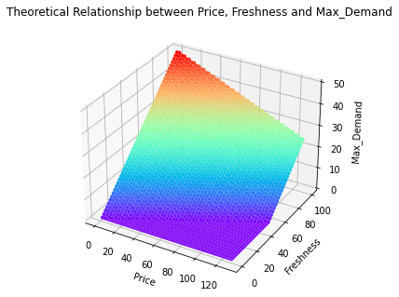
Settings
Demand
Daily customer arrival: follow a nonhomogeneous poisson process
Willingness: depends on current orange price and freshness

Slide 9
Business Problems
how many customers come without buying anything (arrived but didn’t buy any oranges)
how many days the inventory level equals to 0
how many times we refill the inventory
how many times we cannot fulfill customers' demand (the inventory level is smaller than the demand)
what is the average orange freshness we sell to our customers
how many units of orange are decayed and throwed away
what is the effect of hurricane on the revenue of recommended strategy?
what is the fixed/dynamic price elasticity for the business?

Slide 10
Simulation Results
By using linear Pricing and setting refill level at 8%, we can get the highest average profit.
The best strategy is 12 times higher than the worst one.
Pricing / Refill level / Average Profit | 8% | 15% | 30%
Constant pricing | 77939.50 | 62440.08 | 6780.92
Linear pricing | 81808.64 | 65786.06 | 8442.41

Slide 11
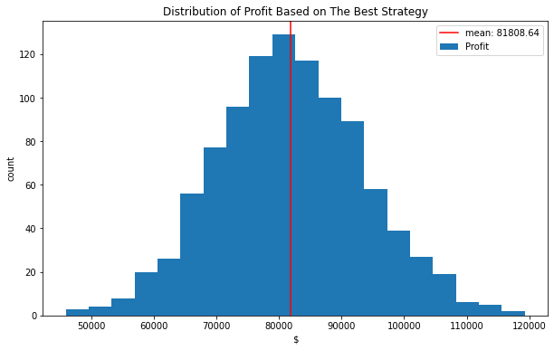
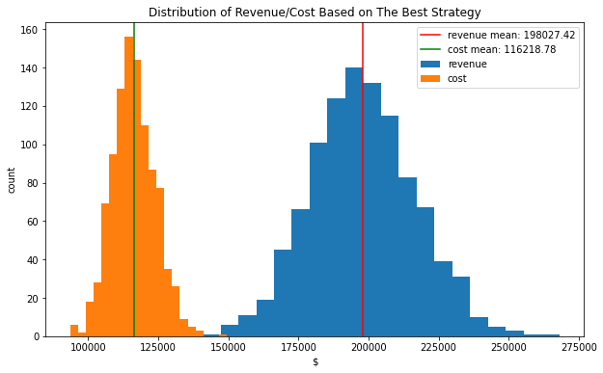
Simulation Results
The expected revenue is $198k and the expected cost is $116k. This makes the expected yearly profit around $82k. And the gross margin is around 41%

Slide 12
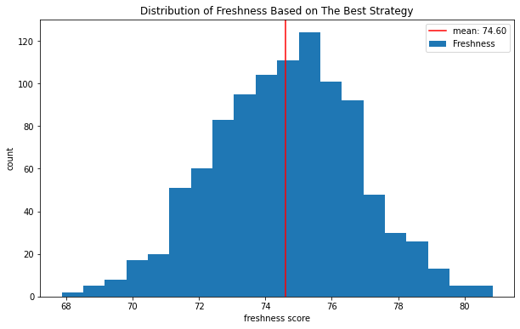
Simulation Results
What is the average orange freshness we sell to our customers
The average freshness level is 74.6 out of 100. As a result, the company may face risk of losing customers if they have higher expectations of freshness.

Slide 13
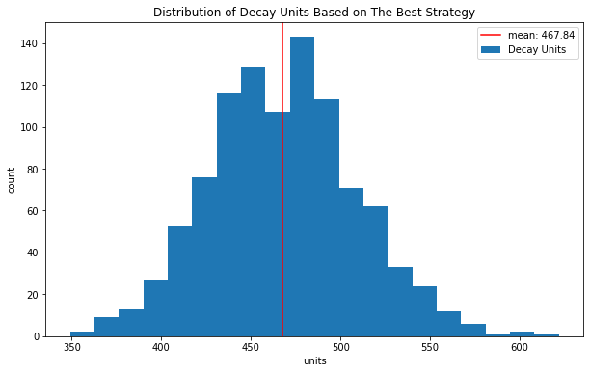
Simulation Results
How many units of orange are decayed and throwed away per year
The average number of decayed oranges is around 467 units. This is worth of $14~$20k revenue according to the average selling price.

Slide 14
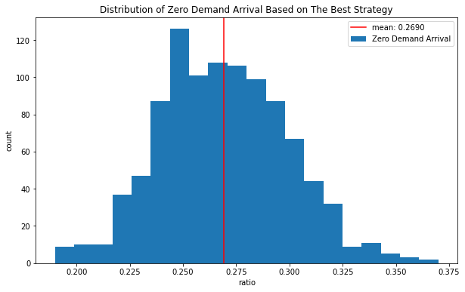
Simulation Results
How many customers come without buying anything (arrived but didn’t buy any oranges)
Nearly a quart of customers did not buy any orange.
Notes:
The company will need to compare the benefit of carrying out aggressive marketing and enhancing the inventory techniques.

Slide 15
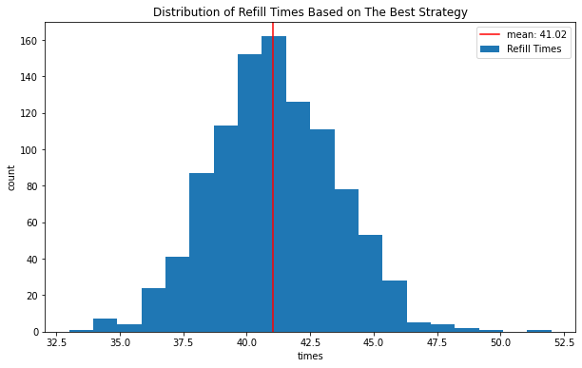
Simulation Results
How many times did we refill the inventory
The average inventory refill times is around 41 times per year.
Every 8-9 days, the company will need to refill again, and the frequency will change correspondingly during the peak and trough.

Slide 16
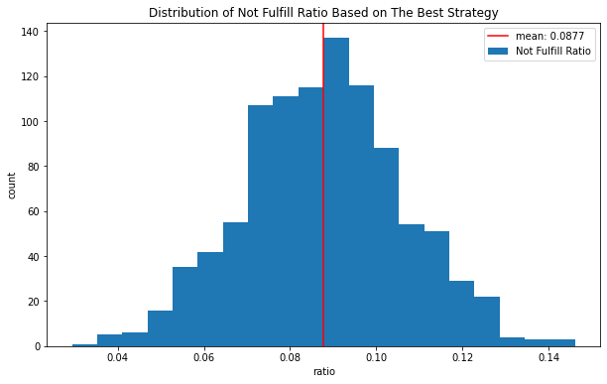
Simulation Results
How many times we cannot fulfill customers' demand (the inventory level is smaller than the demand)
The probability that the company cannot meet the customer’s demand due to lack of inventory is 9%.
Notes:
To evaluate the ratio, we should compare the value with other competitors.

Slide 17
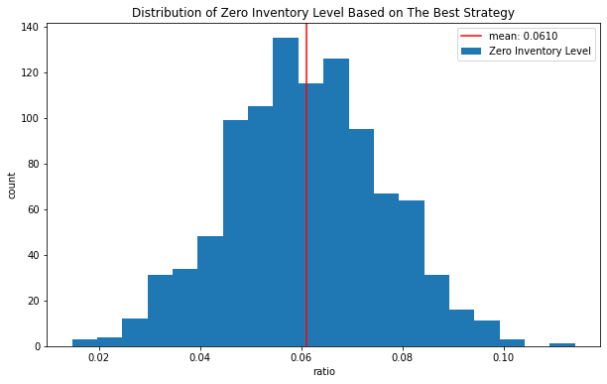
Simulation Results
How many days the inventory level equals to 0?
The probability that the company will end a day without any oranges is around 6%.
To some extent, the current supply chain is efficient enough to meet the demand.

Slide 18
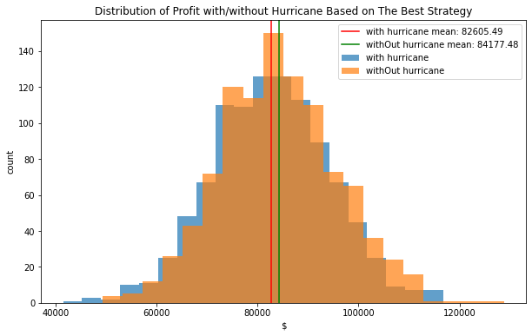
Simulation Results
What is the effect of hurricane on the best strategy?
The effect of hurricane is around $1.5k profit annually, which is around 2% profit. Therefore, the influence of natural disaster is under control.

Slide 19
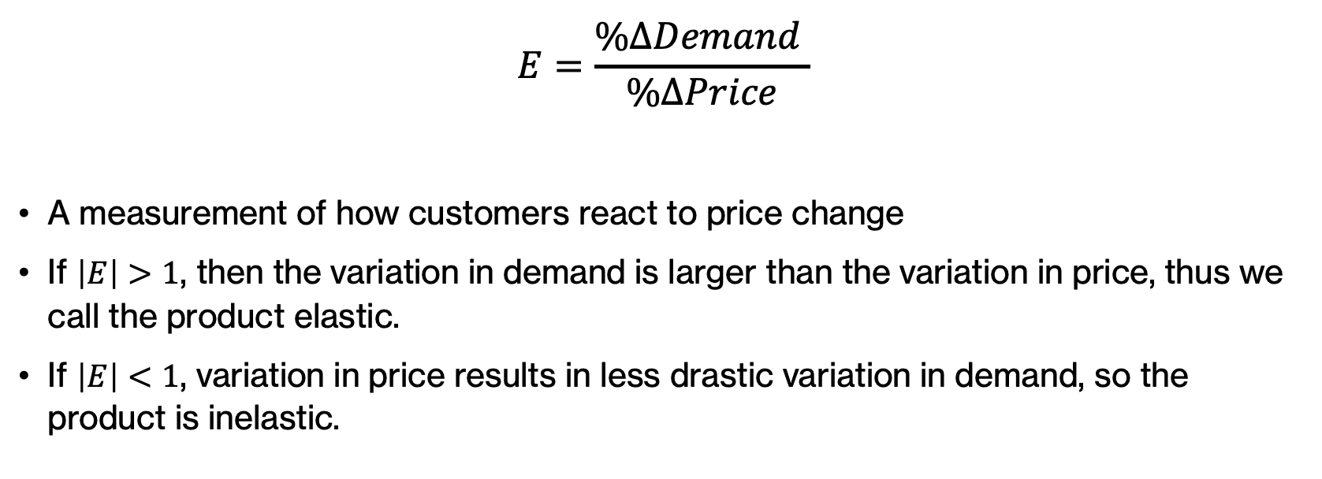
Price Elasticity
$$E=\frac{\%ΔDemand }{\%ΔPrice}$$
A measurement of how customers react to price change
If $\left|E\right|>1$, then the variation in demand is larger than the variation in price, thus we call the product elastic.
If $\left|E\right|<1$, variation in price results in less drastic variation in demand, so the product is inelastic.

Slide 20
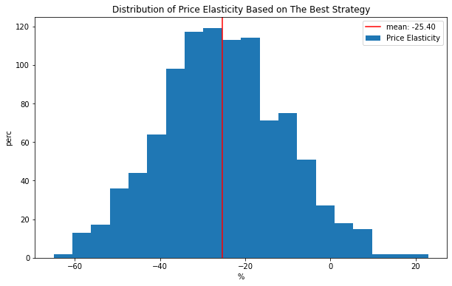
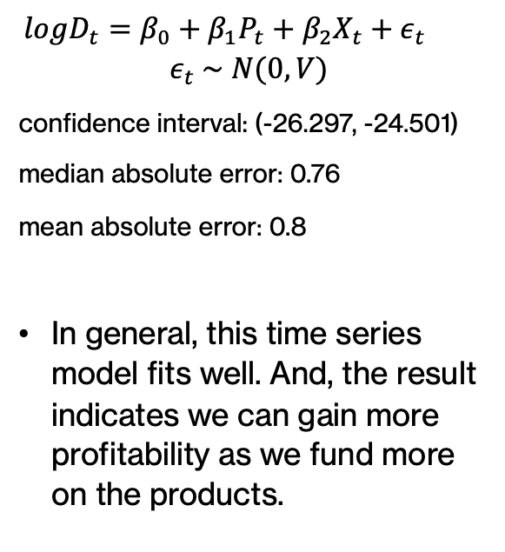
Fixed Price Elasticity
$$logD_{t}=β_{0}+β_{1}P_{t}+β_{2}X_{t}+ε_{t}$$
$$ε_{t} \sim N(0, V)$$
confidence interval: (-26.297, -24.501)
median absolute error: 0.76
mean absolute error: 0.8
In general, this time series model fits well. And, the result indicates we can gain more profitability as we fund more on the products.

Slide 21
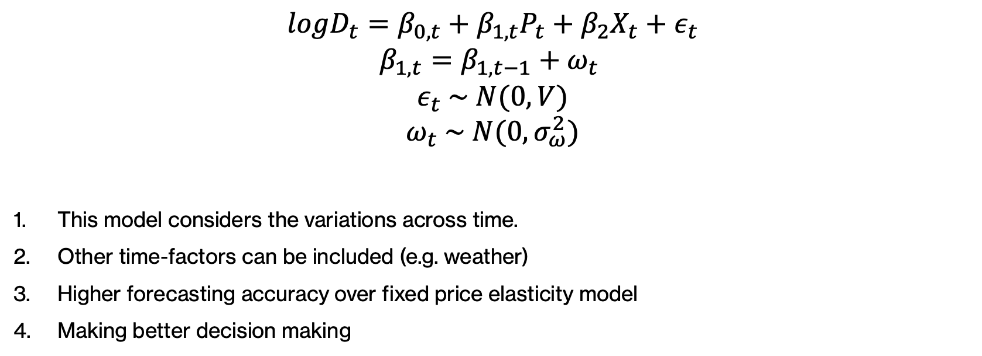
Dynamic Price Elasticity
$$logD_{t}=β_{0, t}+β_{1,t}P_{t}+β_{2}X_{t}+ε_{t}$$
$$β_{1, t}=β_{1,t−1}+ω_{t}$$
$$ε_{t} \sim N(0, V)$$
$$ω_{t} \sim N(0, σ_{ω}^{2})$$
This model considers the variations across time.
Other time-factors can be included (e.g. weather)
Higher forecasting accuracy over fixed price elasticity model
Making better decision making
Notes:
One of the biggest limitations of current price elasticity models is that they fail to account for variations across time.

Slide 22
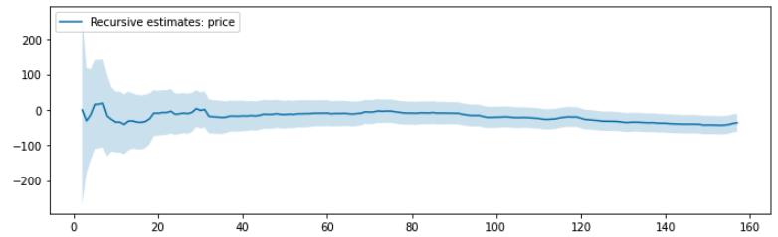
Dynamic Price Elasticity
median absolute error: 0.7
mean absolute error: 0.83
We failed to reject the null hypothesis of stable parameters at 5% level (app.)

Slide 23
Conclusions
The best strategy is 11 times higher than the worst one.
To increase profit, we should make more complicated inventory strategies.
The supply chain is efficient for the current condition.
The influence of hurricane is under control.
According to both price elasticity models, our product is competitive on the market. After optimization, we can gain more profitability by decreasing the selling price.
The settings are relatively simple. In real case, we should also consider the risk of management fault, unexpected competitions, extreme climate change and so on.

Slide 24
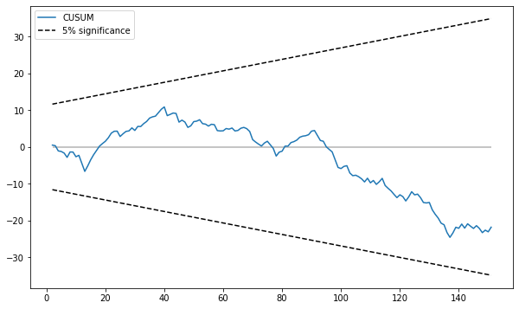
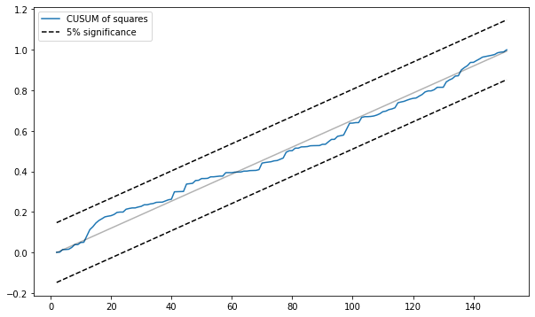
Appendix
CUSUM and CUSUM of squares show we failed to reject the null hypothesis
Ho: the price elasticity is stable over time
H1: the price elasticity is not stable over time

