Slide 1

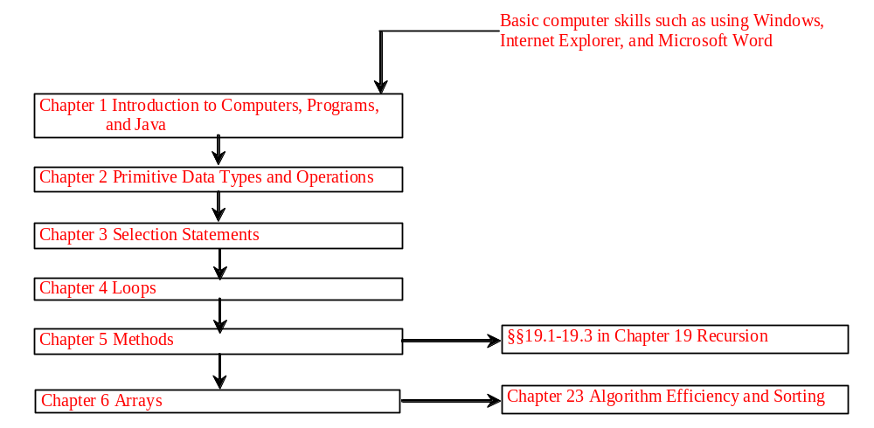
Chapter 3 Control Statements

Slide 2
Objectives
To declare boolean type and write Boolean expressions (§3.2).
To distinguish between conditional and unconditional && and || operators (§3.2.1).
To use Boolean expressions to control selection statements (§3.3-3.5).
To implement selection control using if and nested if statements (§3.3).
To implement selection control using switch statements (§3.4).
To write expressions using the conditional operator (§3.5) .
To display formatted output using the System.out.printf method and to format strings using the String.format method (§3.6).
To know the rules governing operand evaluation order, operator precedence, and operator associativity (§§3.7-3.8) .

Slide 3
The boolean Type and Operators
Often in a program you need to compare two values, such as whether i is greater than j. Java provides six comparison operators (also known as relational operators) that can be used to compare two values. The result of the comparison is a Boolean value: true or false.
boolean b = (1 > 2);

Slide 4
Comparison Operators
Operator Name
< less than
<= less than or equal to
> greater than
>= greater than or equal to
== equal to
!= not equal to

Slide 5
Boolean Operators
Operator Name
! not
&& and
|| or
^ exclusive or

Slide 6
Examples
System.out.println("Is " + num + " divisible by 2 and 3? " +
((num % 2 == 0) && (num % 3 == 0)));
System.out.println("Is " + num + " divisible by 2 or 3? " +
((num % 2 == 0) || (num % 3 == 0)));
System.out.println("Is " + num +
" divisible by 2 or 3, but not both? " +
((num % 2 == 0) ^ (num % 3 == 0)));

Slide 7
Example: Determining Leap Year?
This program first prompts the user to enter a year as an int value and checks if it is a leap year.
A year is a leap year if it is divisible by 4 but not by 100, or it is divisible by 400.
(year % 4 == 0 && year % 100 != 0) || (year % 400 == 0)
LeapYear
Run

Slide 8
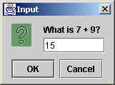
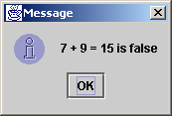
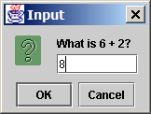
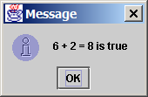
Example: A Simple Math Learning Tool
This example creates a program to let a first grader practice additions. The program randomly generates two single-digit integers number1 and number2 and displays a question such as “What is 7 + 9?” to the student, as shown below. After the student types the answer in the input dialog box, the program displays a message dialog box to indicate whether the answer is true or false.
AdditionTutor
Run

Slide 9
The & and | Operators
&&: conditional AND operator
&: unconditional AND operator
||: conditional OR operator
|: unconditional OR operator
exp1 && exp2
(1 < x) && (x < 100)
(1 < x) & (x < 100)

Slide 10
The & and | Operators
If x is 1, what is x after this expression?
(x > 1) & (x++ < 10)
If x is 1, what is x after this expression?
(1 > x) && ( 1 > x++)
How about (1 == x) | (10 > x++)?
(1 == x) || (10 > x++)?

Slide 11
Selection Statements
if Statements
switch Statements
Conditional Operators

Slide 12

TIP

Slide 13

CAUTION

Slide 14
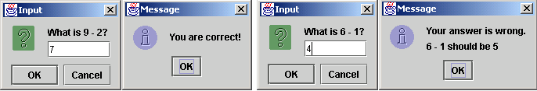

Example: An Improved Math Learning Tool
This example creates a program to teach a first grade child how to learn subtractions. The program randomly generates two single-digit integers number1 and number2 with number1 > number2 and displays a question such as “What is 9 – 2?” to the student, as shown in the figure. After the student types the answer in the input dialog box, the program displays a message dialog box to indicate whether the answer is correct, as shown in figure.
SubtractionTutor

Slide 15
Example: Guessing Birth Date
The program can guess your birth date. Run to see how it works.
GuessBirthDate

Slide 16
Conditional Operator, cont.
(booleanExp) ? exp1 : exp2

Slide 17
Formatting Output
JDK 1.5
Feature
Use the new JDK 1.5 printf statement.
  System.out.printf(format, items);
Where format is a string that may consist of substrings and format specifiers. A format specifier specifies how an item should be displayed. An item may be a numeric value, character, boolean value, or a string. Each specifier begins with a percent sign.

Slide 18

Frequently-Used Specifiers
JDK 1.5
Feature
Specifier Output Example
%b a boolean value true or false
%c a character 'a'
%d a decimal integer 200
%f a floating-point number 45.460000
%e a number in standard scientific notation 4.556000e+01
%s a string "Java is cool"

Slide 19
Creating Formatted Strings
System.out.printf(format, item1, item2, ..., itemk)
String.format(format, item1, item2, ..., itemk)
String s = String.format("count is %d and amount is %f", 5, 45.56));

Slide 20
Operator Precedence
var++, var--
+, - (Unary plus and minus), ++var,--var
(type) Casting
! (Not)
*, /, % (Multiplication, division, and remainder)
+, - (Binary addition and subtraction)
<, <=, >, >= (Comparison)
==, !=; (Equality)
& (Unconditional AND)
^ (Exclusive OR)
| (Unconditional OR)
&& (Conditional AND) Short-circuit AND
|| (Conditional OR) Short-circuit OR
=, +=, -=, *=, /=, %= (Assignment operator)

