Slide 1
Chapter 1
Functions and Graphs
Review

Slide 2
Function
Vertical Line Test
One-to-one
Horizontal Line Test
Domain
Range
Inverse function
Restricting a domain to make a one-to-one function

Slide 3
Composite functions
Degree, y-intercept, zeros for a polynomial function

Slide 4
Trigonometric functions and identities
Solving trigonometric equations
Solving logarithmic equations

Slide 5
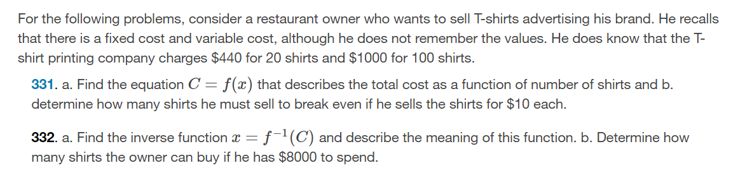

Slide 6
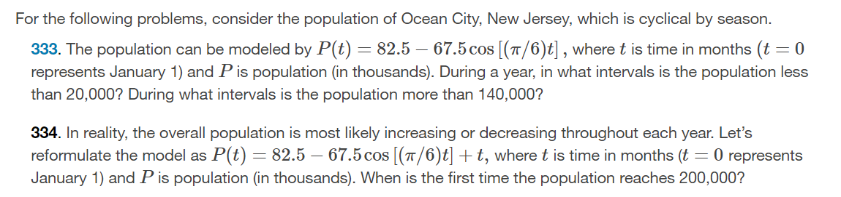

Slide 7
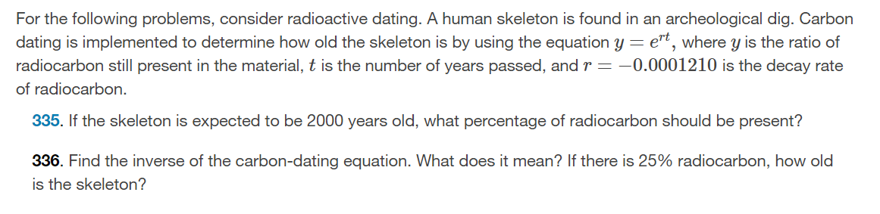

Slide 8
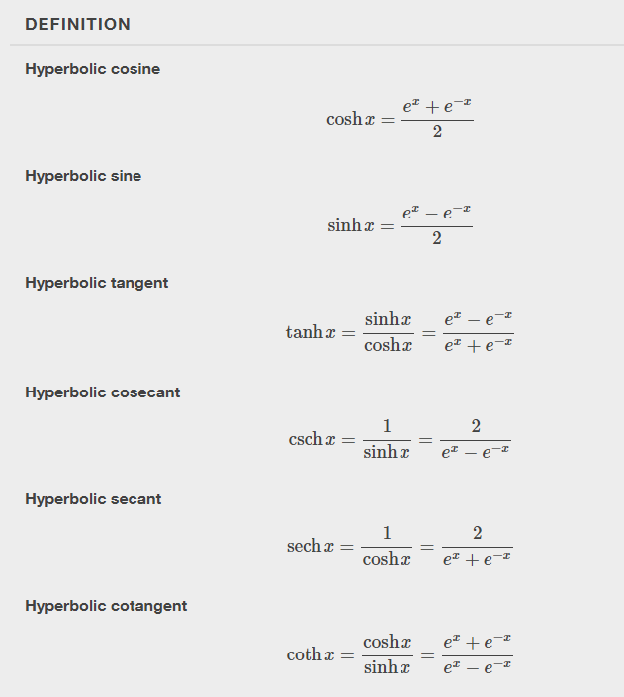
Hyperbolic Functions

Slide 9
This resource is an adaptation of the OpenStax Calculus Volume 1 open textbook and is © Susan Aydelotte under a CC BY-NC-SA 4.0 International license; it may be reproduced or modified for noncommercial purposes only but must be attributed to OpenStax, Rice University and any changes must be noted. Any adaptation must be shared under the same type of license.

