Slide 1
參數檢定
2021/04/30

Slide 2
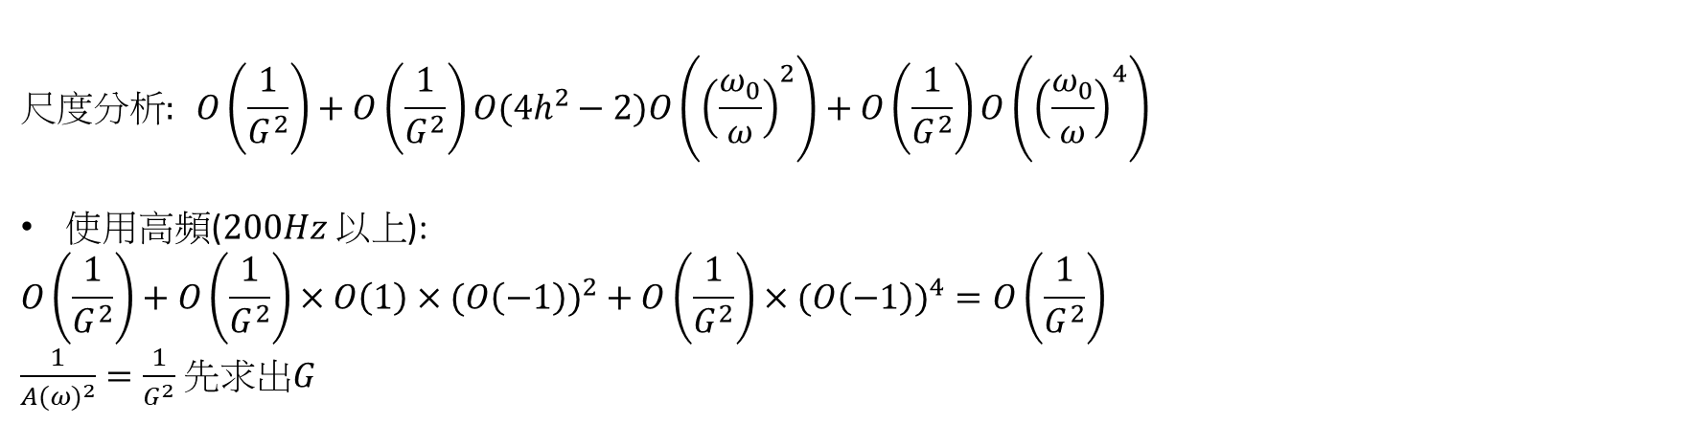
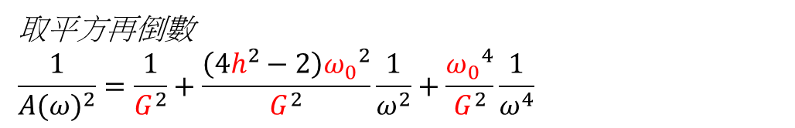
尺度分析
$$A\left(ω\right)=\frac{Gω^{2}}{\sqrt{{ω_{0}}^{4}−2{ω_{0}}^{2}ω^{2}+ω^{4}+4h^{2}{ω_{0}}^{2}ω^{2}}}=響應曲線不同頻率的振幅$$
取平方再倒數
$$\frac{1}{{A(ω)}^{2}}=\frac{1}{G^{2}}+\frac{\left(4h^{2}−2\right){ω_{0}}^{2}}{G^{2}}\frac{1}{ω^{2}}+\frac{{ω_{0}}^{4}}{G^{2}}\frac{1}{ω^{4}}$$
$$尺度分析: O\left(\frac{1}{G^{2}}\right)+O\left(\frac{1}{G^{2}}\right)O(4h^{2}−2)O\left({\left(\frac{ω_{0}}{ω}\right)}^{2}\right)+O\left(\frac{1}{G^{2}}\right)O\left({\left(\frac{ω_{0}}{ω}\right)}^{4}\right)$$
使用高頻($200Hz 以上$):
$$O\left(\frac{1}{G^{2}}\right)+O\left(\frac{1}{G^{2}}\right)×O\left(1\right)×({O\left(−1\right))}^{2}+O\left(\frac{1}{G^{2}}\right)×({O\left(−1\right))}^{4}=O\left(\frac{1}{G^{2}}\right)$$
$\frac{1}{{A(ω)}^{2}}=\frac{1}{G^{2}}$ 先求出$G$

Slide 3
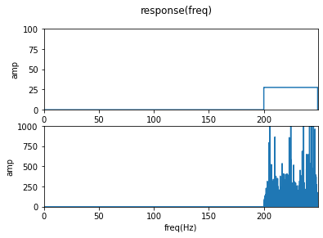
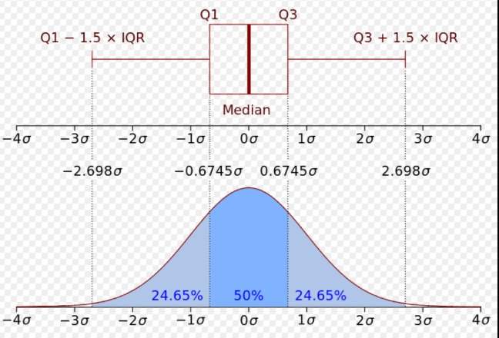
拿掉離均值再迴歸

Slide 4

G結果
$\frac{1}{{A(ω)}^{2}}=\frac{1}{G^{2}}$
$\frac{1}{{A(ω)}^{2}}=$0.003024
G=18.18536
16.82526

Slide 5
G結果
$\frac{1}{{A(ω)}^{2}}=\frac{1}{G^{2}}$
18.27272
18.28787
16.68998

Slide 6

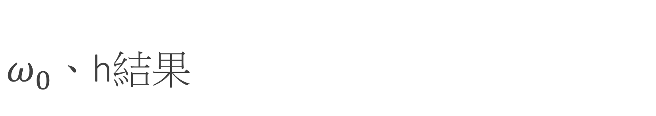
$ω_{0}、$h結果
$$A\left(ω\right)=\frac{Gω^{2}}{\sqrt{{ω_{0}}^{4}−2{ω_{0}}^{2}ω^{2}+ω^{4}+4h^{2}{ω_{0}}^{2}ω^{2}}}=響應曲線不同頻率的振幅$$
取平方再倒數
$$\frac{1}{{A(ω)}^{2}}=\frac{1}{G^{2}}+\frac{\left(4h^{2}−2\right){ω_{0}}^{2}}{G^{2}}\frac{1}{ω^{2}}+\frac{{ω_{0}}^{4}}{G^{2}}\frac{1}{ω^{4}}$$
$$尺度分析: O\left(\frac{1}{G^{2}}\right)+O\left(\frac{1}{G^{2}}\right)O(4h^{2}−2)O\left({\left(\frac{ω_{0}}{ω}\right)}^{2}\right)+O\left(\frac{1}{G^{2}}\right)O\left({\left(\frac{ω_{0}}{ω}\right)}^{4}\right)$$

Slide 7
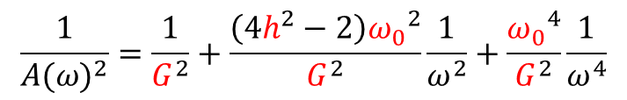
$ω_{0}、$h結果
$$\frac{1}{{A(ω)}^{2}}=\frac{1}{G^{2}}+\frac{\left(4h^{2}−2\right){ω_{0}}^{2}}{G^{2}}\frac{1}{ω^{2}}+\frac{{ω_{0}}^{4}}{G^{2}}\frac{1}{ω^{4}}$$
G | h | W0
18.25742 | 0.376327 | 78.27752

