Slide 1
2021/04/16

Slide 2
內容
檢定振幅響應:
分高低頻率迴歸(用一組自製的數據去做做看)
分析實驗數據
噪訊(5min)--X、Y、Z方向

Slide 3
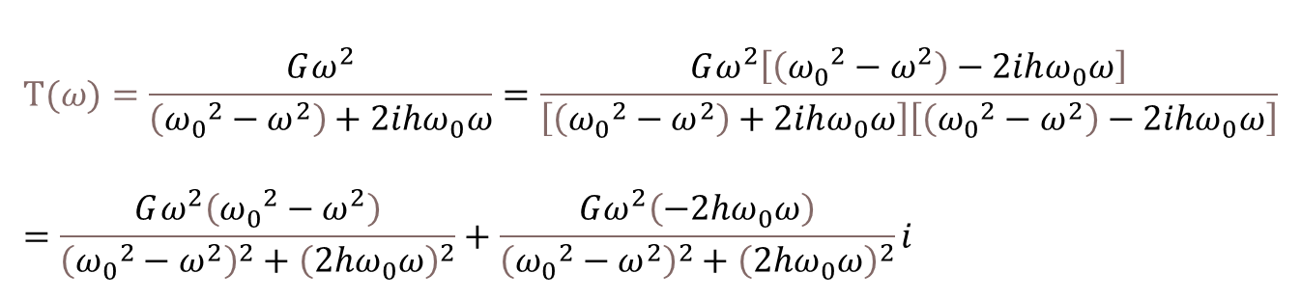
振幅響應
$$T(ω)=\frac{Gω^{2}}{\left({ω_{0}}^{2}−ω^{2}\right)+2ihω_{0}ω}=\frac{Gω^{2}\left[\left({ω_{0}}^{2}−ω^{2}\right)−2ihω_{0}ω\right]}{\left[\left({ω_{0}}^{2}−ω^{2}\right)+2ihω_{0}ω\right]\left[\left({ω_{0}}^{2}−ω^{2}\right)−2ihω_{0}ω\right]}=\frac{Gω^{2}\left({ω_{0}}^{2}−ω^{2}\right)}{{\left({ω_{0}}^{2}−ω^{2}\right)}^{2}+{\left(2hω_{0}ω\right)}^{2}}+\frac{Gω^{2}\left(−2hω_{0}ω\right)}{{\left({ω_{0}}^{2}−ω^{2}\right)}^{2}+{\left(2hω_{0}ω\right)}^{2}}i$$
$取振幅: \frac{Gω^{2}}{\sqrt{{\left({ω_{0}}^{2}−ω^{2}\right)}^{2}+{\left(2hω_{0}ω\right)}^{2}}}=\frac{Gω^{2}}{\sqrt{{ω_{0}}^{4}−2{ω_{0}}^{2}ω^{2}+ω^{4}+4h^{2}{ω_{0}}^{2}ω^{2}}}$
取振幅平方再倒數: $\frac{{ω_{0}}^{4}−2{ω_{0}}^{2}ω^{2}+ω^{4}+4h^{2}{ω_{0}}^{2}ω^{2}}{G^{2}ω^{4}}=\frac{1}{G^{2}}+\frac{\left(4h^{2}−2\right){ω_{0}}^{2}}{G^{2}}\frac{1}{ω^{2}}+\frac{{ω_{0}}^{4}}{G^{2}}\frac{1}{ω^{4}}$

Slide 4
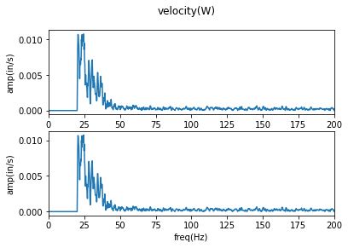
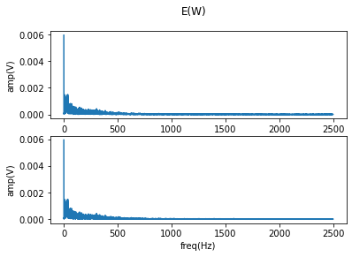
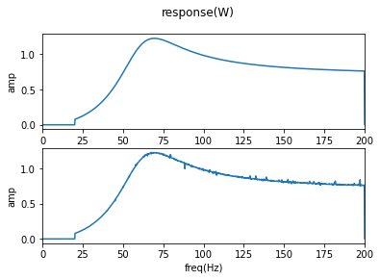
迴歸方法
1Hz ~ 249Hz全取
取振幅平方再倒數: $\frac{{ω_{0}}^{4}−2{ω_{0}}^{2}ω^{2}+ω^{4}+4h^{2}{ω_{0}}^{2}ω^{2}}{G^{2}ω^{4}}=\frac{1}{G^{2}}+\frac{\left(4h^{2}−2\right){ω_{0}}^{2}}{G^{2}}\frac{1}{ω^{2}}+\frac{{ω_{0}}^{4}}{G^{2}}\frac{1}{ω^{4}}$

Slide 5
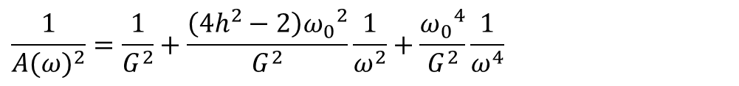

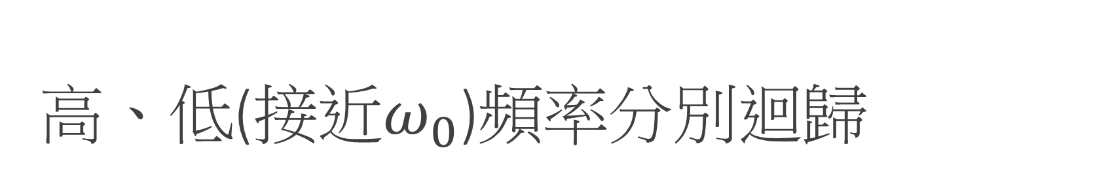

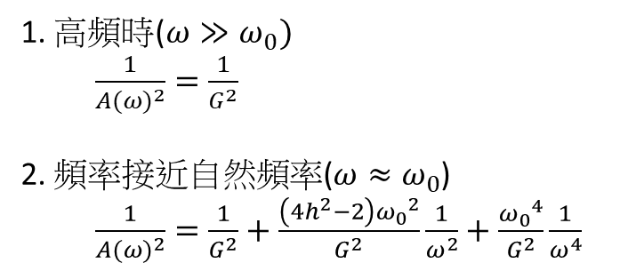
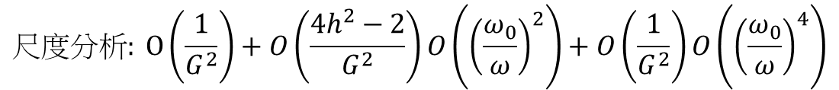
高、低(接近$ω_{0}$)頻率分別迴歸
$$\frac{1}{{A(ω)}^{2}}=\frac{1}{G^{2}}+\frac{\left(4h^{2}−2\right){ω_{0}}^{2}}{G^{2}}\frac{1}{ω^{2}}+\frac{{ω_{0}}^{4}}{G^{2}}\frac{1}{ω^{4}}$$
$$尺度分析: O\left(\frac{1}{G^{2}}\right)+O\left(\frac{4h^{2}−2}{G^{2}}\right)O\left({\left(\frac{ω_{0}}{ω}\right)}^{2}\right)+O\left(\frac{1}{G^{2}}\right)O\left({\left(\frac{ω_{0}}{ω}\right)}^{4}\right)$$
1. 高頻時($ω≫ω_{0})$
$\frac{1}{{A(ω)}^{2}}=\frac{1}{G^{2}}$
2. 頻率接近自然頻率($ω≈ω_{0}$)
$\frac{1}{{A(ω)}^{2}}=\frac{1}{G^{2}}+\frac{\left(4h^{2}−2\right){ω_{0}}^{2}}{G^{2}}\frac{1}{ω^{2}}+\frac{{ω_{0}}^{4}}{G^{2}}\frac{1}{ω^{4}}$
$$Y1=a_{0}$$
$$Y2=a_{0}+a_{1}X+a_{2}X^{2}$$

Slide 6
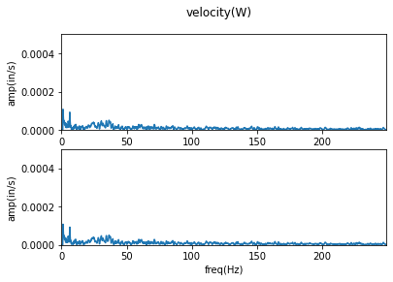

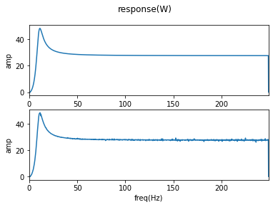
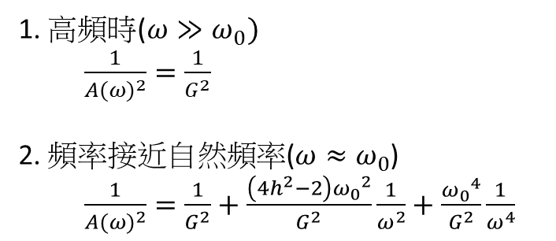
自製數據
1. 高頻時($ω≫ω_{0})$
$\frac{1}{{A(ω)}^{2}}=\frac{1}{G^{2}}$
2. 頻率接近自然頻率($ω≈ω_{0}$)
$\frac{1}{{A(ω)}^{2}}=\frac{1}{G^{2}}+\frac{\left(4h^{2}−2\right){ω_{0}}^{2}}{G^{2}}\frac{1}{ω^{2}}+\frac{{ω_{0}}^{4}}{G^{2}}\frac{1}{ω^{4}}$
8~12Hz
>200Hz

Slide 7
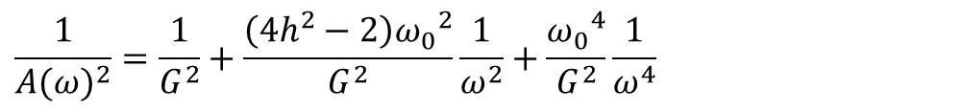
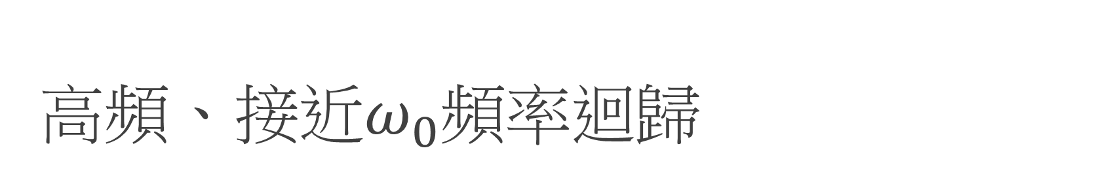
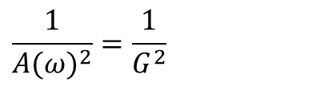
高頻、接近$ω_{0}頻率$迴歸
$$\frac{1}{{A(ω)}^{2}}=\frac{1}{G^{2}}$$
$$\frac{1}{{A(ω)}^{2}}=\frac{1}{G^{2}}+\frac{\left(4h^{2}−2\right){ω_{0}}^{2}}{G^{2}}\frac{1}{ω^{2}}+\frac{{ω_{0}}^{4}}{G^{2}}\frac{1}{ω^{4}}$$
Y=0.0013
G | h | W0
27.6079 | 0.300029 | 62.831

Slide 8
實驗數據
環境噪訊X、Y、Z

Slide 9
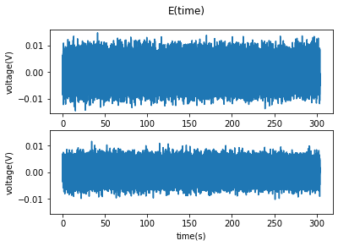
X方向

Slide 10
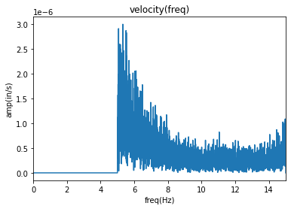
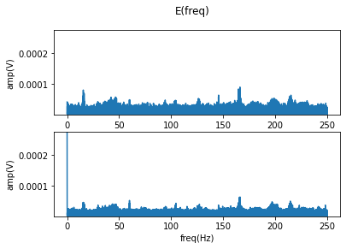
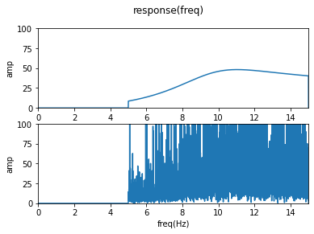
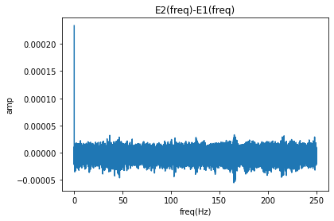
接近自然頻率

Slide 11
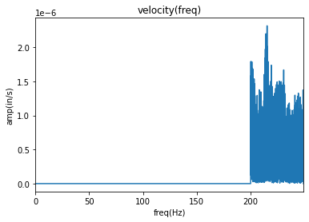
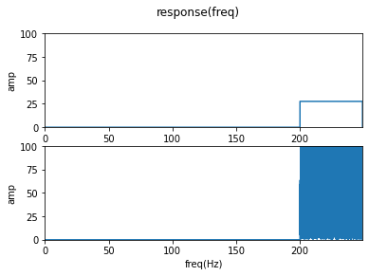
高頻

Slide 12
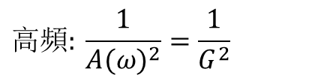
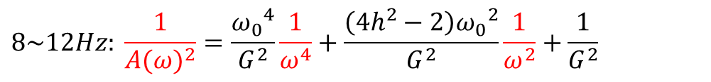
迴歸結果
$$高頻: \frac{1}{{A(ω)}^{2}}=\frac{1}{G^{2}}$$
$$8\sim 12Hz: \frac{1}{{A(ω)}^{2}}=\frac{{ω_{0}}^{4}}{G^{2}}\frac{1}{ω^{4}}+\frac{\left(4h^{2}−2\right){ω_{0}}^{2}}{G^{2}}\frac{1}{ω^{2}}+\frac{1}{G^{2}}$$
G | h | W0
18.25742 | 0.279116 | 83.09545

Slide 13
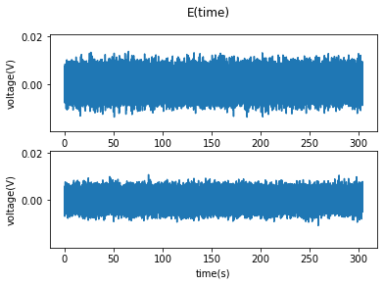
Y方向

Slide 14
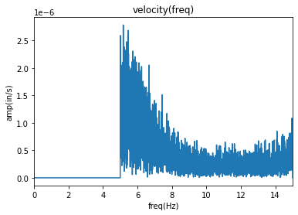
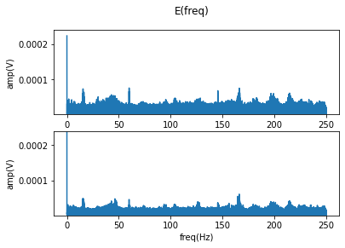
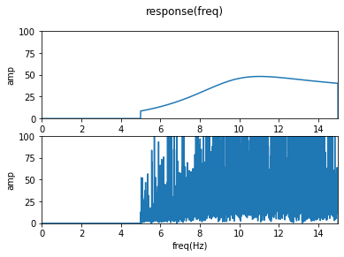
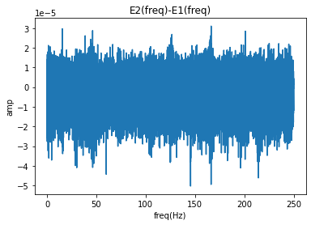
接近自然頻率

Slide 15
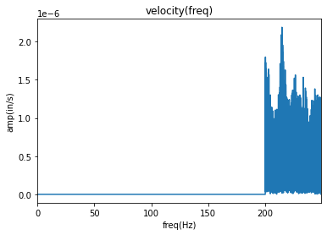
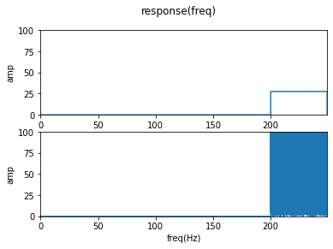
高頻

Slide 16
迴歸結果

Slide 17
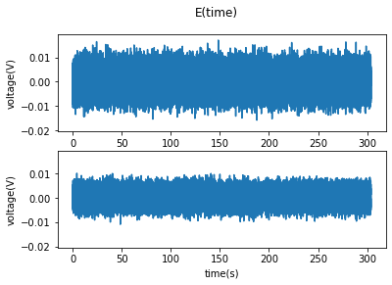
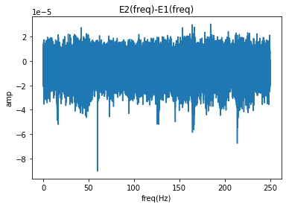
Z方向

Slide 18
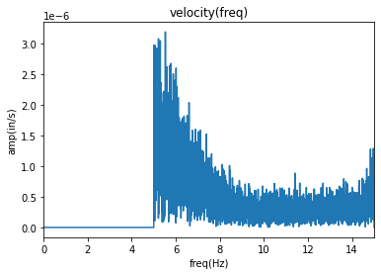
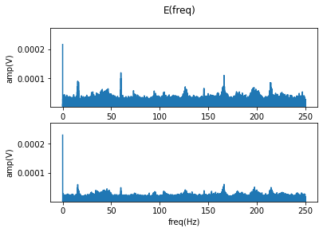
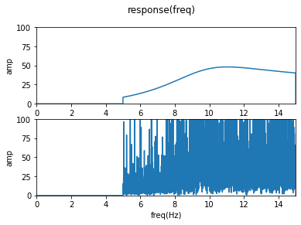
接近自然頻率

Slide 19

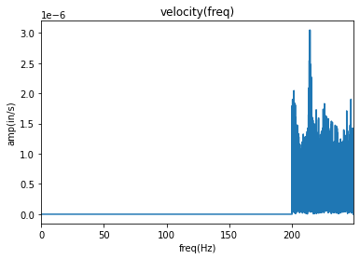
高頻

Slide 20
迴歸結果

