Slide 1
參數組猜測
2021/05/14

Slide 2
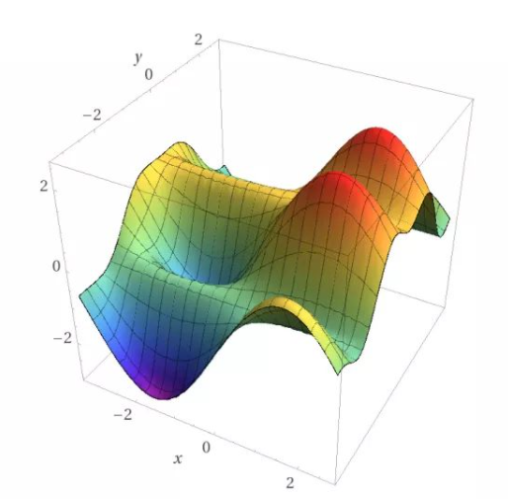
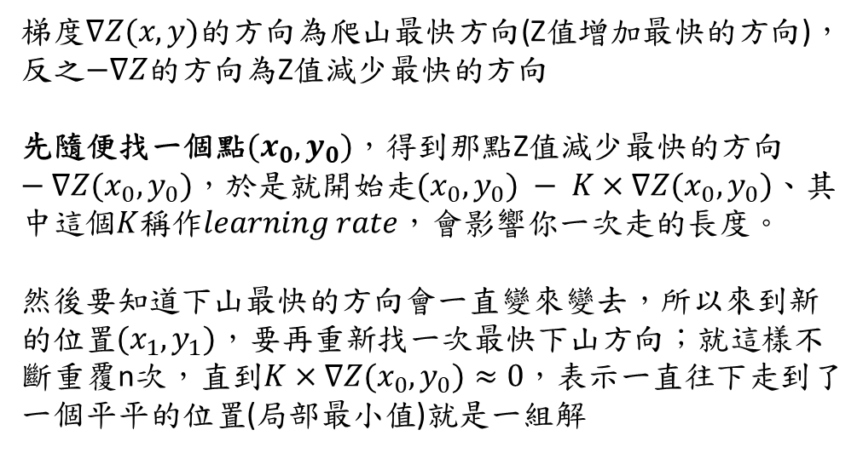
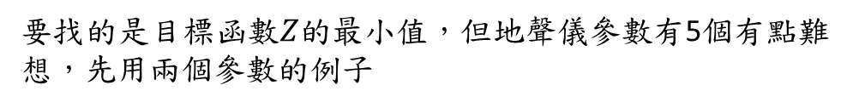
最陡下降法(SDM)
要找的是目標函數$Z$的最小值，但地聲儀參數有5個有點難想，先用兩個參數的例子
$$Z=f(x,y)$$
梯度$∇Z(x,y)$的方向為爬山最快方向(Z值增加最快的方向)，反之$−∇Z$的方向為Z值減少最快的方向
先隨便找一個點$(x_{0},y_{0})$，得到那點Z值減少最快的方向$−∇Z(x_{0},y_{0})$，於是就開始走$(x_{0},y_{0}) − K×∇Z(x_{0},y_{0})$、其中這個$K$稱作$learning rate$，會影響你一次走的長度。
然後要知道下山最快的方向會一直變來變去，所以來到新的位置$(x_{1},y_{1})$，要再重新找一次最快下山方向；就這樣不斷重覆n次，直到$K×∇Z(x_{0},y_{0})≈0$，表示一直往下走到了一個平平的位置(局部最小值)就是一組解

Slide 3
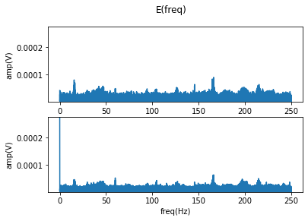
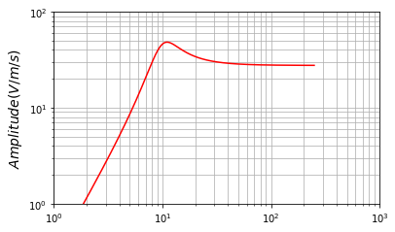
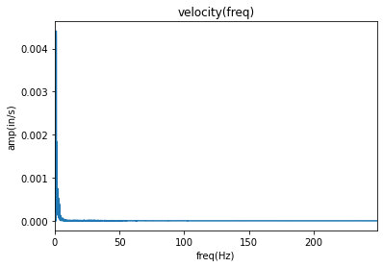
參數組猜測概念
?

Slide 4
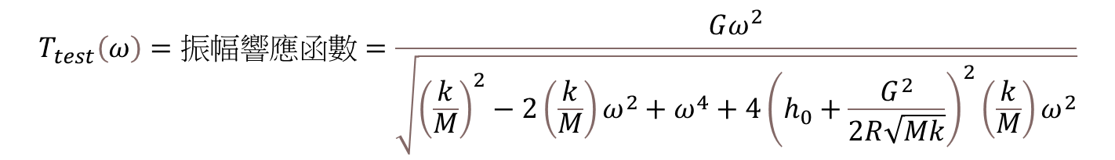
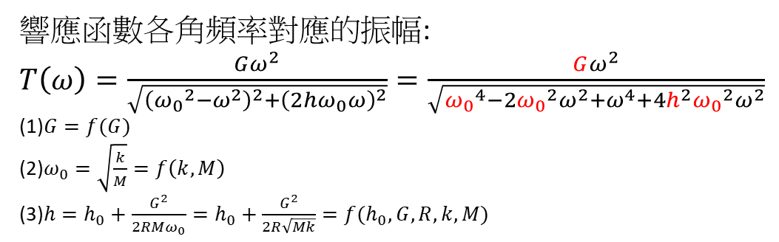
數學化
響應函數各角頻率對應的振幅:
$T\left(ω\right)=\frac{Gω^{2}}{\sqrt{{\left({ω_{0}}^{2}−ω^{2}\right)}^{2}+{\left(2hω_{0}ω\right)}^{2}}}=\frac{Gω^{2}}{\sqrt{{ω_{0}}^{4}−2{ω_{0}}^{2}ω^{2}+ω^{4}+4h^{2}{ω_{0}}^{2}ω^{2}}}$
(1)$G=f(G)$
(2)$ω_{0}=\sqrt{\frac{k}{M}}=f\left(k,M\right)$
(3)$h=h_{0}+\frac{G^{2}}{2RMω_{0}}=h_{0}+\frac{G^{2}}{2R\sqrt{Mk}}=f(h_{0},G,R,k,M)$
$$T_{test}\left(ω\right)=振幅響應函數=\frac{Gω^{2}}{\sqrt{{\left(\frac{k}{M}\right)}^{2}−2\left(\frac{k}{M}\right)ω^{2}+ω^{4}+4{\left(h_{0}+\frac{G^{2}}{2R\sqrt{Mk}}\right)}^{2}{\left(\frac{k}{M}\right)ω}^{2}}}$$
$G$: 電壓敏感係數、M:質量、k:彈性係數、R:電線電阻、 $h_{0}$:開路阻尼(跟空氣阻力有關)

Slide 5
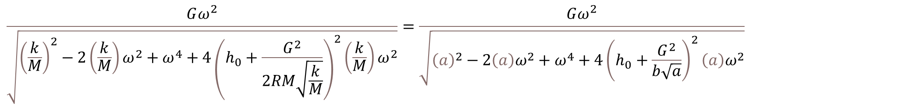
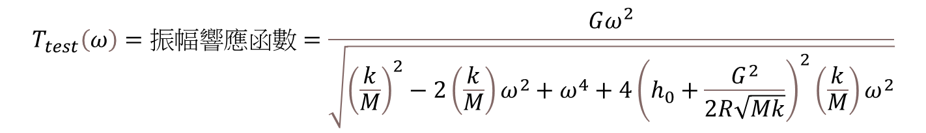

數學化
$$T_{test}\left(ω\right)=振幅響應函數=\frac{Gω^{2}}{\sqrt{{\left(\frac{k}{M}\right)}^{2}−2\left(\frac{k}{M}\right)ω^{2}+ω^{4}+4{\left(h_{0}+\frac{G^{2}}{2R\sqrt{Mk}}\right)}^{2}{\left(\frac{k}{M}\right)ω}^{2}}}$$
$$\frac{Gω^{2}}{\sqrt{{\left(\frac{k}{M}\right)}^{2}−2\left(\frac{k}{M}\right)ω^{2}+ω^{4}+4{\left(h_{0}+\frac{G^{2}}{2RM\sqrt{\frac{k}{M}}}\right)}^{2}{\left(\frac{k}{M}\right)ω}^{2}}}=\frac{Gω^{2}}{\sqrt{{\left(a\right)}^{2}−2\left(a\right)ω^{2}+ω^{4}+4{\left(h_{0}+\frac{G^{2}}{b\sqrt{a}}\right)}^{2}{\left(a\right)ω}^{2}}}$$
$2RM、G$、 $h_{0}$、 $\frac{k}{M}$

Slide 6
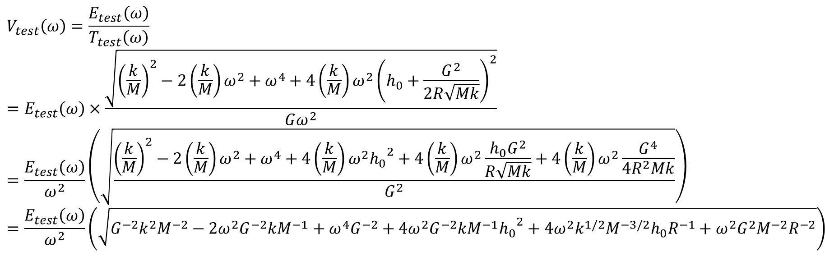
數學化
$$E_{test}\left(ω\right)=測量到的電壓時域轉成頻域:振幅\left(已知的值\right)$$
$$V_{test}\left(ω\right)=\frac{E_{test}\left(ω\right)}{T_{test}\left(ω\right)}$$
$$=E_{test}\left(ω\right)×\frac{\sqrt{{\left(\frac{k}{M}\right)}^{2}−2\left(\frac{k}{M}\right)ω^{2}+ω^{4}+4{{\left(\frac{k}{M}\right)ω}^{2}\left(h_{0}+\frac{G^{2}}{2R\sqrt{Mk}}\right)}^{2}}}{Gω^{2}}$$
$$=\frac{E_{test}\left(ω\right)}{ω^{2}}\left(\sqrt{\frac{{\left(\frac{k}{M}\right)}^{2}−2\left(\frac{k}{M}\right)ω^{2}+ω^{4}+4{\left(\frac{k}{M}\right)ω}^{2}{h_{0}}^{2}+4{\left(\frac{k}{M}\right)ω}^{2}\frac{h_{0}G^{2}}{R\sqrt{Mk}}+4{\left(\frac{k}{M}\right)ω}^{2}\frac{G^{4}}{4R^{2}Mk}}{G^{2}}}\right)$$
$$=\frac{E_{test}\left(ω\right)}{ω^{2}}\left(\sqrt{G^{−2}k^{2}M^{−2}−2ω^{2}G^{−2}kM^{−1}+ω^{4}G^{−2}+4ω^{2}G^{−2}kM^{−1}{h_{0}}^{2}+4ω^{2}k^{1/2}M^{−3/2}h_{0}R^{−1}+ω^{2}G^{2}M^{−2}R^{−2}}\right)$$

Slide 7
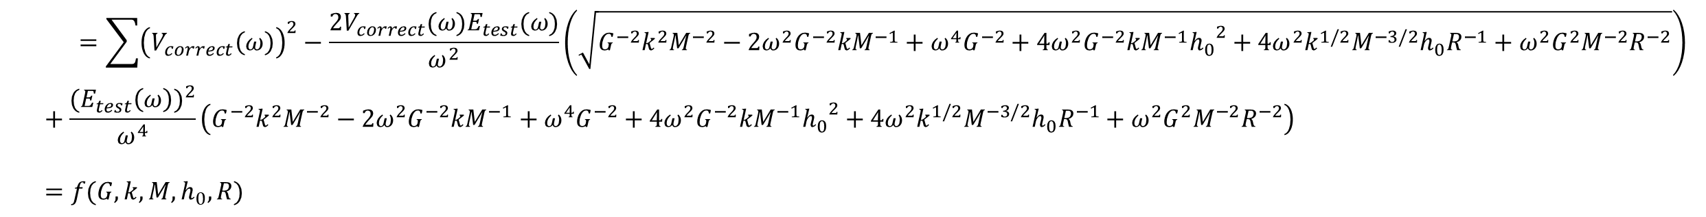
數學化(目標函數)
$$\left.Z=\sum_{各種頻率總和}{{\left(V_{correct}\left(ω\right)− V_{test}\left(ω\right)\right)}^{2}}=\sum{{{\left(V\right.}_{correct}}^{2}−2V_{correct}V_{test}}+{V_{test}}^{2}\right)$$
$$=\sum{{\left(V_{correct}\left(ω\right)\right)}^{2}−\frac{2V_{correct}(ω)E_{test}(ω)}{ω^{2}}\left(\sqrt{G^{−2}k^{2}M^{−2}−2ω^{2}G^{−2}kM^{−1}+ω^{4}G^{−2}+4ω^{2}G^{−2}kM^{−1}{h_{0}}^{2}+4ω^{2}k^{1/2}M^{−3/2}h_{0}R^{−1}+ω^{2}G^{2}M^{−2}R^{−2}}\right)}+\frac{({E_{test}\left(ω\right))}^{2}}{ω^{4}}\left(G^{−2}k^{2}M^{−2}−2ω^{2}G^{−2}kM^{−1}+ω^{4}G^{−2}+4ω^{2}G^{−2}kM^{−1}{h_{0}}^{2}+4ω^{2}k^{1/2}M^{−3/2}h_{0}R^{−1}+ω^{2}G^{2}M^{−2}R^{−2}\right)$$
$$=f(G,k,M,h_{0}, R)$$

Slide 8
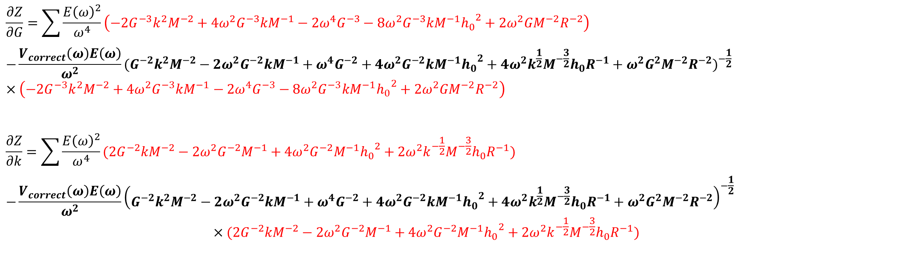
目標函數梯度
$$\frac{∂Z}{∂G}=\sum{\frac{{E\left(ω\right)}^{2}}{ω^{4}}\left(−2G^{−3}k^{2}M^{−2}+4ω^{2}G^{−3}kM^{−1}−2ω^{4}G^{−3}−8ω^{2}G^{−3}kM^{−1}{h_{0}}^{2}+2ω^{2}GM^{−2}R^{−2}\right)}$$
$$−\frac{V_{correct}\left(ω\right)E\left(ω\right)}{ω^{2}}{(G^{−2}k^{2}M^{−2}−2ω^{2}G^{−2}kM^{−1}+ω^{4}G^{−2}+4ω^{2}G^{−2}kM^{−1}{h_{0}}^{2}+4ω^{2}k^{\frac{1}{2}}M^{−\frac{3}{2}}h_{0}R^{−1}+ω^{2}G^{2}M^{−2}R^{−2})}^{−\frac{1}{2}}×\left(−2G^{−3}k^{2}M^{−2}+4ω^{2}G^{−3}kM^{−1}−2ω^{4}G^{−3}−8ω^{2}G^{−3}kM^{−1}{h_{0}}^{2}+2ω^{2}GM^{−2}R^{−2}\right)$$
$$\frac{∂Z}{∂k}=\sum{\frac{{E\left(ω\right)}^{2}}{ω^{4}}}(2G^{−2}kM^{−2}−2ω^{2}G^{−2}M^{−1}+4ω^{2}G^{−2}M^{−1}{h_{0}}^{2}+2ω^{2}k^{−\frac{1}{2}}M^{−\frac{3}{2}}h_{0}R^{−1})$$
$$−\frac{V_{correct}\left(ω\right)E\left(ω\right)}{ω^{2}}{\left(G^{−2}k^{2}M^{−2}−2ω^{2}G^{−2}kM^{−1}+ω^{4}G^{−2}+4ω^{2}G^{−2}kM^{−1}{h_{0}}^{2}+4ω^{2}k^{\frac{1}{2}}M^{−\frac{3}{2}}h_{0}R^{−1}+ω^{2}G^{2}M^{−2}R^{−2}\right)}^{−\frac{1}{2}}$$
$$×(2G^{−2}kM^{−2}−2ω^{2}G^{−2}M^{−1}+4ω^{2}G^{−2}M^{−1}{h_{0}}^{2}+2ω^{2}k^{−\frac{1}{2}}M^{−\frac{3}{2}}h_{0}R^{−1})$$

Slide 9
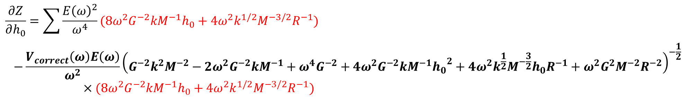
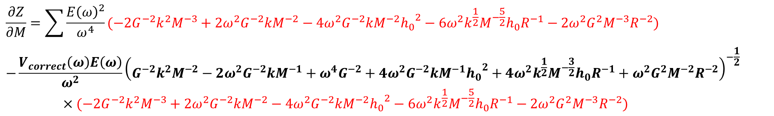
目標函數梯度
$$\frac{∂Z}{∂M}=\sum{\frac{{E\left(ω\right)}^{2}}{ω^{4}}}(−2G^{−2}k^{2}M^{−3}+2ω^{2}G^{−2}kM^{−2}−4ω^{2}G^{−2}kM^{−2}{h_{0}}^{2}−6ω^{2}k^{\frac{1}{2}}M^{−\frac{5}{2}}h_{0}R^{−1}−2ω^{2}G^{2}M^{−3}R^{−2})$$
$$−\frac{V_{correct}\left(ω\right)E\left(ω\right)}{ω^{2}}{\left(G^{−2}k^{2}M^{−2}−2ω^{2}G^{−2}kM^{−1}+ω^{4}G^{−2}+4ω^{2}G^{−2}kM^{−1}{h_{0}}^{2}+4ω^{2}k^{\frac{1}{2}}M^{−\frac{3}{2}}h_{0}R^{−1}+ω^{2}G^{2}M^{−2}R^{−2}\right)}^{−\frac{1}{2}}$$
$$×(−2G^{−2}k^{2}M^{−3}+2ω^{2}G^{−2}kM^{−2}−4ω^{2}G^{−2}kM^{−2}{h_{0}}^{2}−6ω^{2}k^{\frac{1}{2}}M^{−\frac{5}{2}}h_{0}R^{−1}−2ω^{2}G^{2}M^{−3}R^{−2})$$
$$\frac{∂Z}{∂h_{0}}=\sum{\frac{{E\left(ω\right)}^{2}}{ω^{4}}}(8ω^{2}G^{−2}kM^{−1}h_{0}+4ω^{2}k^{1/2}M^{−3/2}R^{−1})$$
$$−\frac{V_{correct}\left(ω\right)E\left(ω\right)}{ω^{2}}{\left(G^{−2}k^{2}M^{−2}−2ω^{2}G^{−2}kM^{−1}+ω^{4}G^{−2}+4ω^{2}G^{−2}kM^{−1}{h_{0}}^{2}+4ω^{2}k^{\frac{1}{2}}M^{−\frac{3}{2}}h_{0}R^{−1}+ω^{2}G^{2}M^{−2}R^{−2}\right)}^{−\frac{1}{2}}$$
$×(8ω^{2}G^{−2}kM^{−1}h_{0}+4ω^{2}k^{1/2}M^{−3/2}R^{−1})$

Slide 10
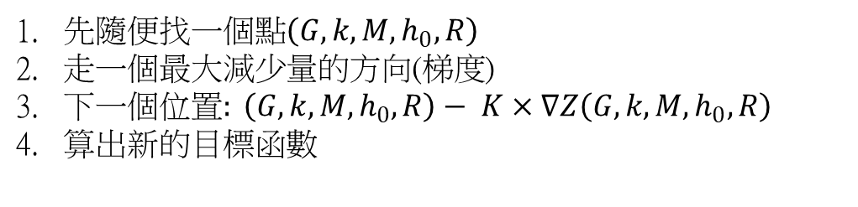
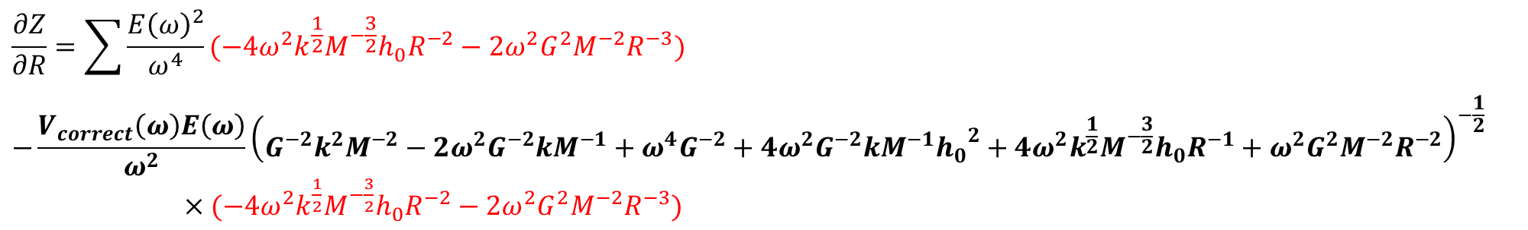
目標函數梯度
$$\frac{∂Z}{∂R}=\sum{\frac{{E\left(ω\right)}^{2}}{ω^{4}}}(−4ω^{2}k^{\frac{1}{2}}M^{−\frac{3}{2}}h_{0}R^{−2}−2ω^{2}G^{2}M^{−2}R^{−3})$$
$$−\frac{V_{correct}\left(ω\right)E\left(ω\right)}{ω^{2}}{\left(G^{−2}k^{2}M^{−2}−2ω^{2}G^{−2}kM^{−1}+ω^{4}G^{−2}+4ω^{2}G^{−2}kM^{−1}{h_{0}}^{2}+4ω^{2}k^{\frac{1}{2}}M^{−\frac{3}{2}}h_{0}R^{−1}+ω^{2}G^{2}M^{−2}R^{−2}\right)}^{−\frac{1}{2}}$$
$×(−4ω^{2}k^{\frac{1}{2}}M^{−\frac{3}{2}}h_{0}R^{−2}−2ω^{2}G^{2}M^{−2}R^{−3})$
先隨便找一個點$\left(G,k,M,h_{0},R\right)$
走一個最大減少量的方向(梯度)
下一個位置$: \left(G,k,M,h_{0},R\right)− K×∇Z\left(G,k,M,h_{0},R\right)$
算出新的目標函數

Slide 11
結果

Slide 12
自製一組數據
起始: 儀器原始(正確)數據
Learning rate: 100000
走的次數: 100次

