Slide 1
響應(response)

Slide 2
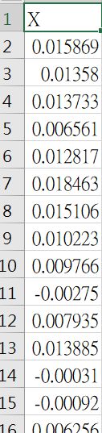
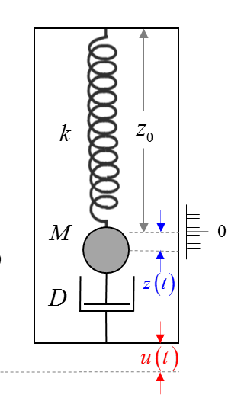
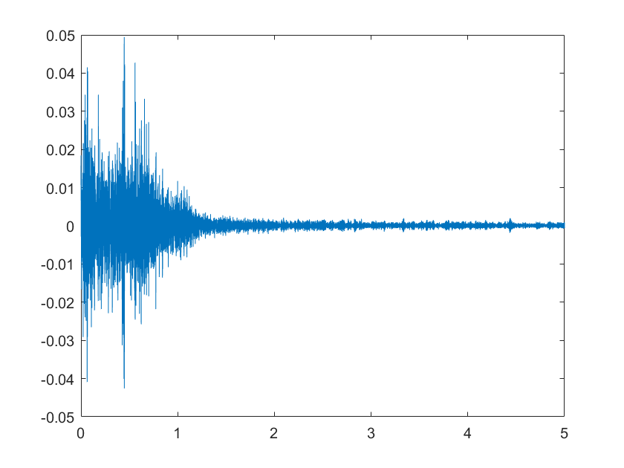
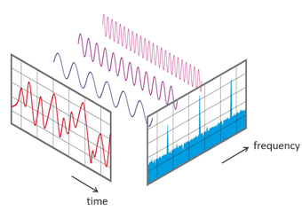
簡介
紀錄球震動--> 地表震動

Slide 3
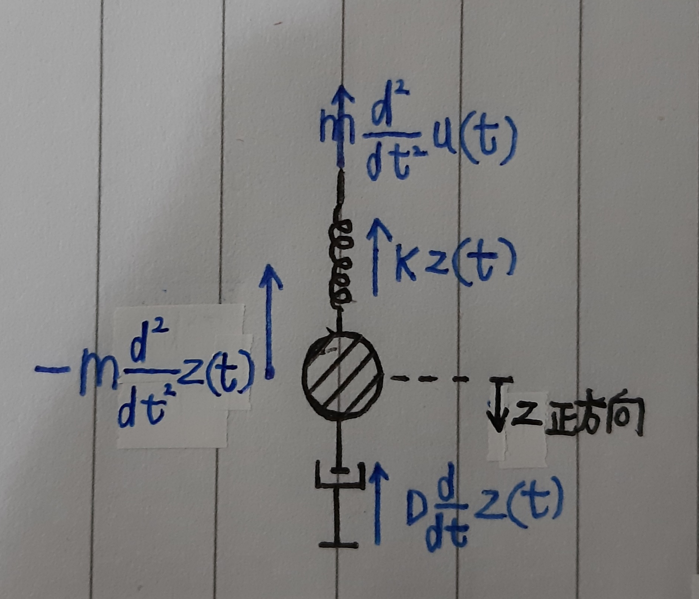

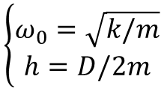


如何得到響應
$$m\frac{d^{2}}{dt^{2}}u\left(t\right)+Kz\left(t\right)+D\frac{d}{dt}z\left(t\right)=−m\frac{d^{2}}{dt^{2}}z\left(t\right)$$
$$\ddot{z}\left(t\right)+\frac{D}{m}\dot{z}\left(t\right)+\frac{K}{m}z\left(t\right)=\ddot{u}(t)$$
$$\left\{\begin{aligned}ω_{0}=\sqrt{k/m} \\ h=D/2m\end{aligned}\right.$$
$$\ddot{z}\left(t\right)+2h\dot{z}\left(t\right)+{ω_{0}}^{2}z\left(t\right)=−\ddot{u}(t)$$

Slide 4
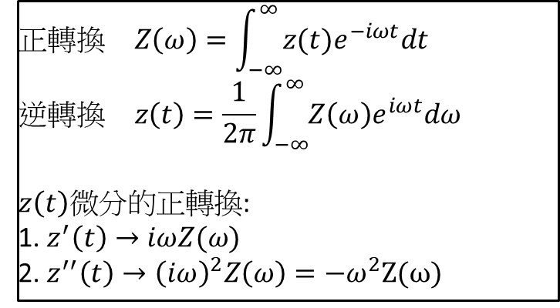

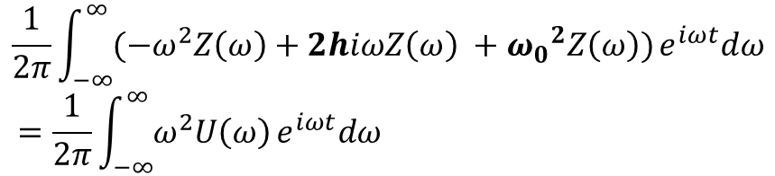
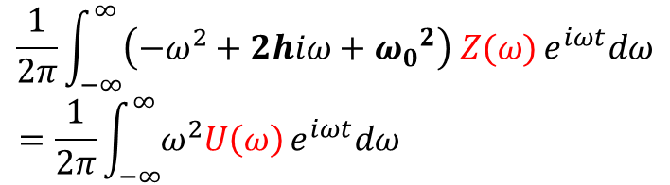
如何得到響應
$$\ddot{z}\left(t\right)+2h\dot{z}\left(t\right)+{ω_{0}}^{2}z\left(t\right)=−\ddot{u}(t)$$
$$正轉換 Z\left(ω\right)=\int_{−∞}^{∞}{z(t)e^{−iωt}dt}$$
$$逆轉換 z\left(t\right)=\frac{1}{2π}\int_{−∞}^{∞}{Z\left(ω\right)e^{iωt}dω}$$
$z\left(t\right)微分的正轉換$:
1. $z^{′}\left(t\right)→iωZ(ω)$
2. $z^{′′}\left(t\right)→{\left(iω\right)}^{2}Z\left(ω\right)=−ω^{2}Z(ω)$
$$\frac{1}{2π}\int_{−∞}^{∞}{(−ω^{2}Z\left(ω\right)+2hiωZ\left(ω\right) +{ω_{0}}^{2}Z\left(ω\right))}e^{iωt}dω$$
$$=\frac{1}{2π}\int_{−∞}^{∞}{ω^{2}U\left(ω\right)}e^{iωt}dω$$
$$\frac{1}{2π}\int_{−∞}^{∞}{\left(−ω^{2}+2hiω+{ω_{0}}^{2}\right) Z(ω)}e^{iωt}dω$$
$$=\frac{1}{2π}\int_{−∞}^{∞}{ω^{2}U\left(ω\right)}e^{iωt}dω$$

Slide 5
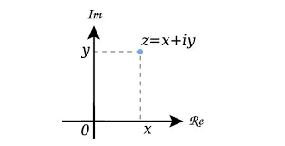

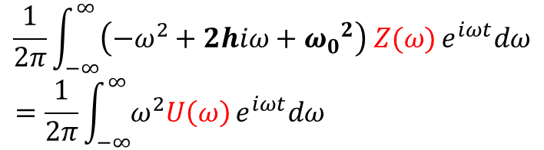
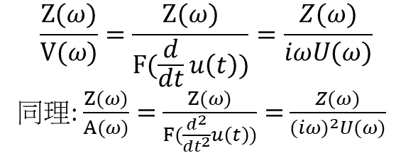
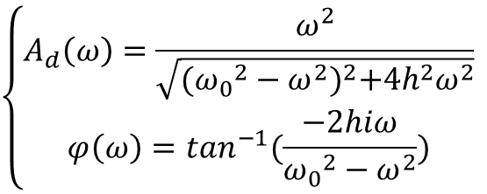
如何得到響應
$$\frac{1}{2π}\int_{−∞}^{∞}{\left(−ω^{2}+2hiω+{ω_{0}}^{2}\right) Z(ω)}e^{iωt}dω$$
$$=\frac{1}{2π}\int_{−∞}^{∞}{ω^{2}U\left(ω\right)}e^{iωt}dω$$
$$\frac{Z(ω)}{U\left(ω\right)}=\frac{ω^{2}}{\left({ω_{0}}^{2}−ω^{2}+2hiω\right)}=\frac{ω^{2}\left({ω_{0}}^{2}−ω^{2}−2hiω\right)}{{({ω_{0}}^{2}−ω^{2})}^{2}+4h^{2}ω^{2}}=A_{d}(ω)e^{iφ(ω)}$$
${r_{1}(ω)e}^{iφ_{1}(ω)}÷{r_{2}(ω)e}^{iφ_{2}(ω)}=\frac{r_{1}}{r_{2}}$ $e^{i{(φ}_{1}−φ_{2})}$
$$\left\{\begin{aligned}A_{d}\left(ω\right)=\frac{ω^{2}}{\sqrt{{({ω_{0}}^{2}−ω^{2})}^{2}+4h^{2}ω^{2}}} \\ φ\left(ω\right)=\tan^{−1}(\frac{−2hiω}{{ω_{0}}^{2}−ω^{2}})\end{aligned}\right.$$
$$\frac{Z(ω)}{V(ω)}=\frac{Z(ω)}{F(\frac{d}{dt}u\left(t\right))}=\frac{Z(ω)}{iωU(ω)}$$
同理: $\frac{Z(ω)}{A(ω)}=$ $\frac{Z(ω)}{F(\frac{d^{2}}{dt^{2}}u\left(t\right))}=$ $\frac{Z(ω)}{{(iω)}^{2}U(ω)}$

Slide 6
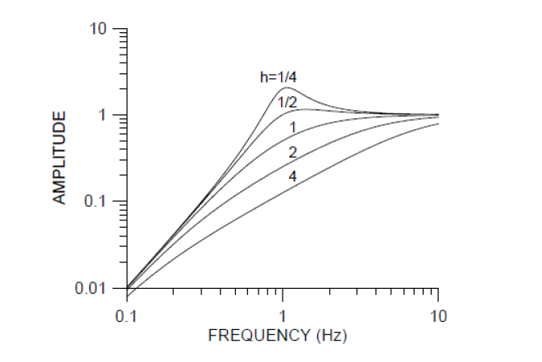
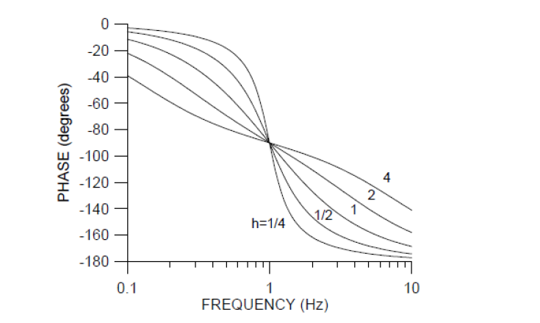
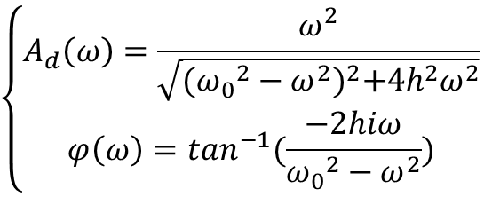
響應函數
$$\left\{\begin{aligned}A_{d}\left(ω\right)=\frac{ω^{2}}{\sqrt{{({ω_{0}}^{2}−ω^{2})}^{2}+4h^{2}ω^{2}}} \\ φ\left(ω\right)=\tan^{−1}(\frac{−2hiω}{{ω_{0}}^{2}−ω^{2}})\end{aligned}\right.$$

Slide 7
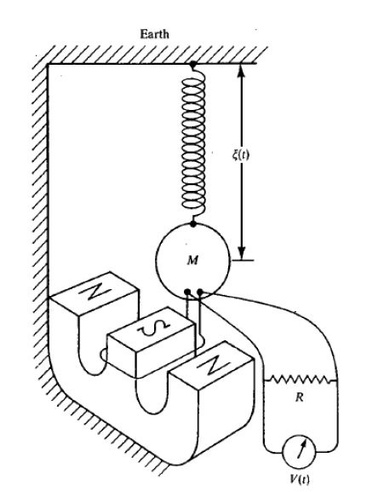

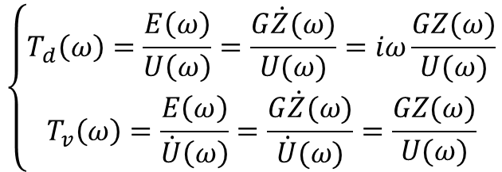
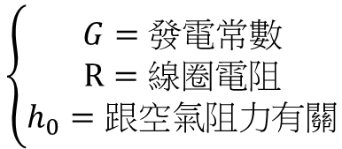

電磁感應式地震儀(速度型)
$\ddot{z}\left(t\right)+2h\dot{z}\left(t\right)+{ω_{0}}^{2}z\left(t\right)=−\ddot{u}\left(t\right)$，(原h=D/2m $ω_{0}$)
$$\left\{\begin{aligned}G=發電常數 \\ R=線圈電阻 \\ h_{0}=跟空氣阻力有關\end{aligned}\right.$$
$$h=h_{0}+\frac{G^{2}}{2mRω_{0}}$$
$$\left\{\begin{aligned}T_{d}\left(ω\right)=\frac{E\left(ω\right)}{U\left(ω\right)}=\frac{G\dot{Z}(ω)}{U(ω)}=iω\frac{GZ(ω)}{U(ω)} \\ T_{v}\left(ω\right)=\frac{E\left(ω\right)}{\dot{U}\left(ω\right)}=\frac{G\dot{Z}(ω)}{\dot{U}(ω)}=\frac{GZ(ω)}{U(ω)}\end{aligned}\right.$$
$E=$電壓

Slide 8
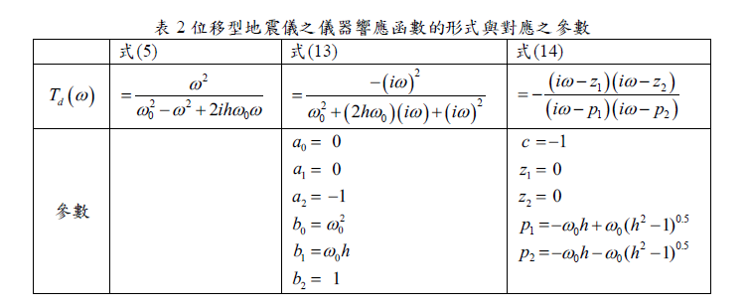
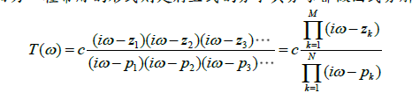
儀器響應的標準規範
z: 零點
p: 極點

Slide 9
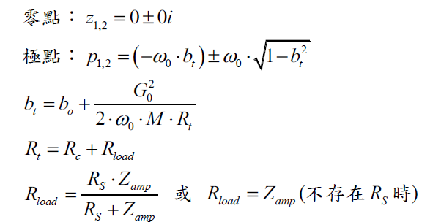
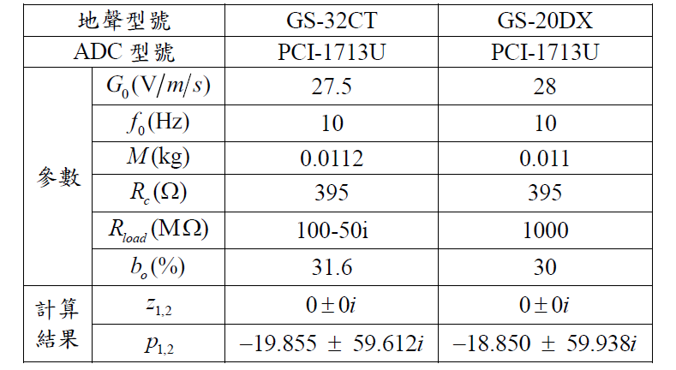
GS-32CT、GS-20DX(速度型)

Slide 10
