Slide 1

Exploratory Data Analysis of Facebook Data

Slide 2


Facebook Dataset Description
The Facebook dataset consists the information about its users around the world.
Various features of Facebook application are present in the dataset like, Age, Gender, Tenure, Likes etc.
The dataset comprises of 99003 observations of 15 columns.

Slide 3
Problem Statement
We have to give insights about the application usage behavior by users and to come up with database solution.
Who are more active on Facebook, Male or Female.
Which app users prefer most, Mobile app or Web app.

Slide 4
About Facebook
Facebook, is an American online social media and social networking service company, founded by Mark Zuckerberg.
The Facebook service can be accessed from devices with Internet connectivity, such as computers and smartphones.
After registering, users can create a customized profile revealing information about themselves.
They can post text, photos and multimedia which is shared with any other users that have agreed to be their "friend".
Facebook is one of the world's most valuable companies.

Slide 5
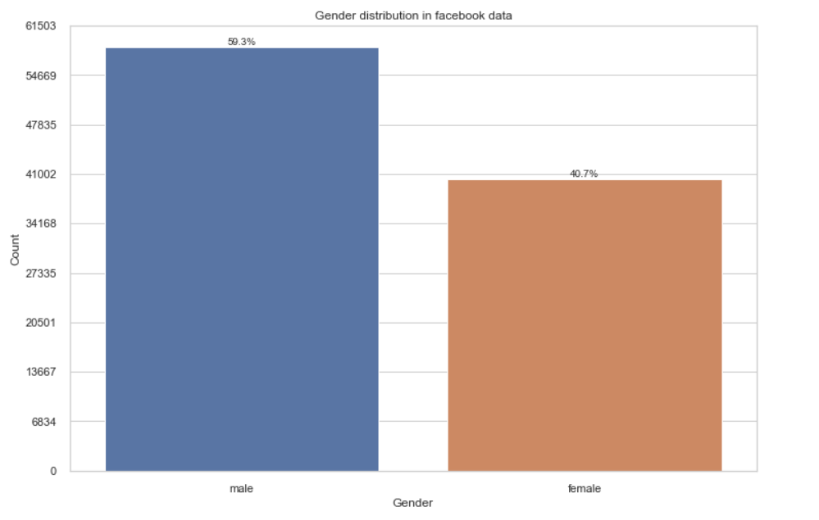
Gender distribution in dataset
Male : 59.3%
Female : 40.7%

Slide 6
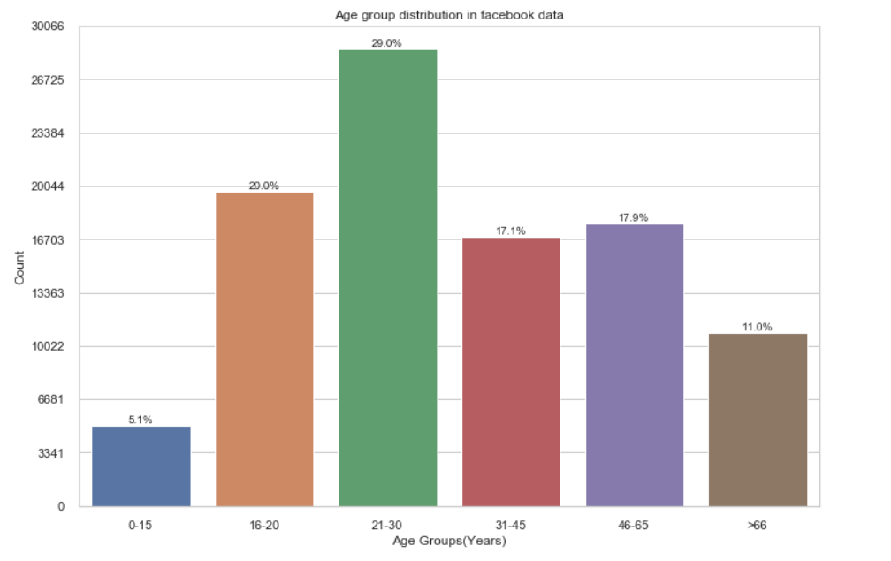
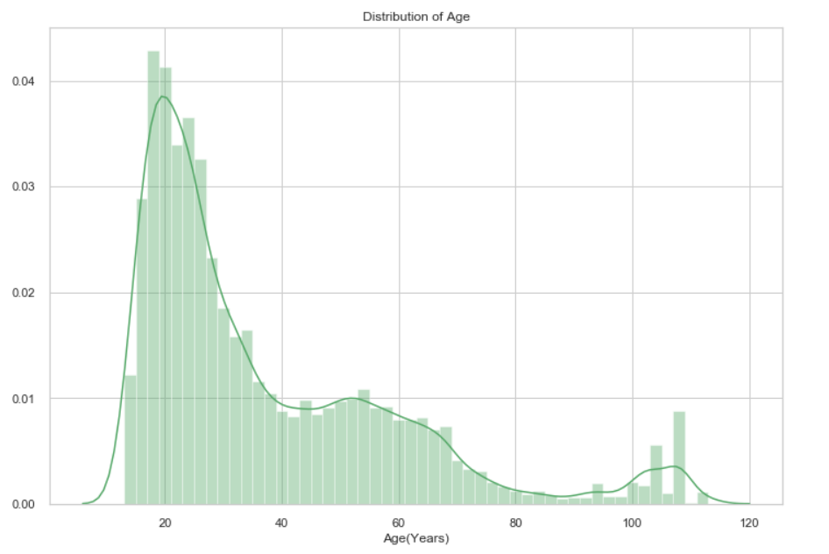
Number of users among different age group
Age group 21-30 years has maximum number of users followed by 16-20 years

Slide 7
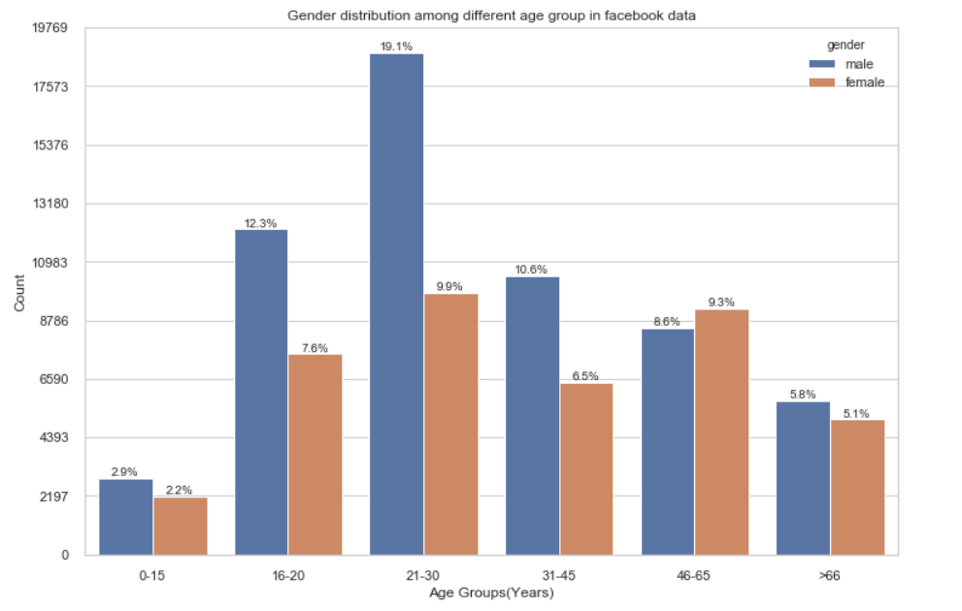
Gender distribution among different age group
Male users are more in almost all age group

Slide 8
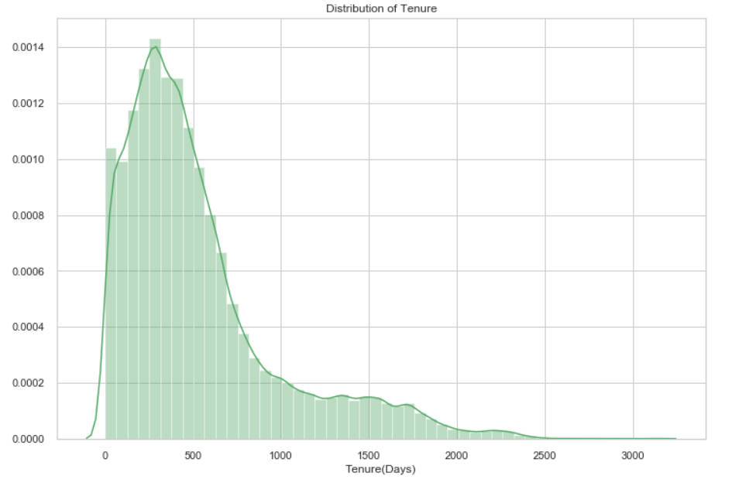
Tenure distribution
Dataset contains more entries with Tenure between 100-600 days

Slide 9
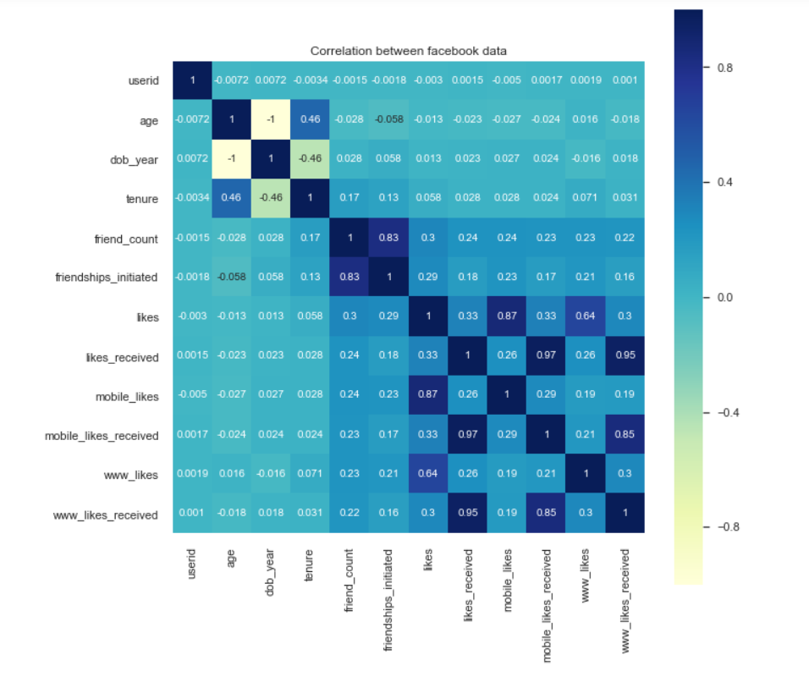
Data correlation between each other
Correlation between various data and their relative indices

Slide 10
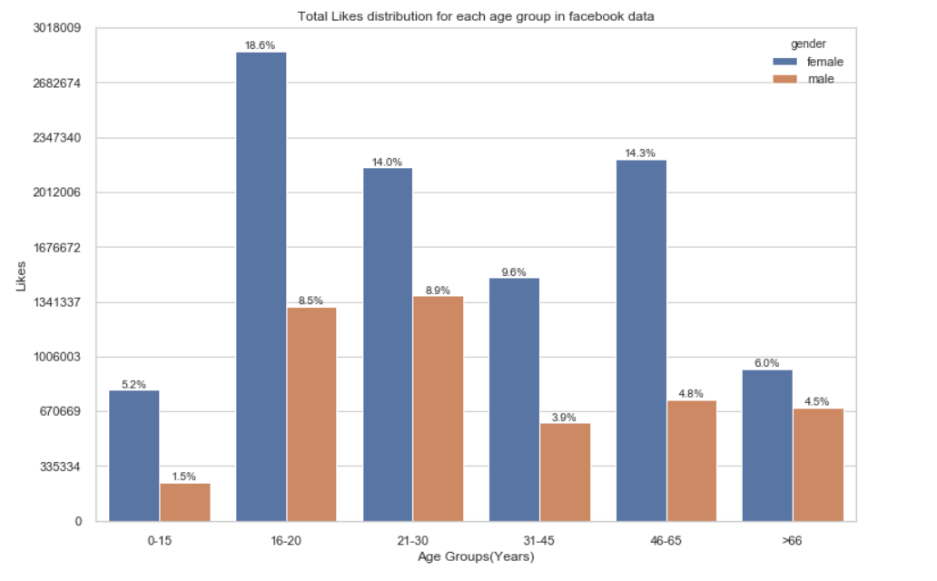
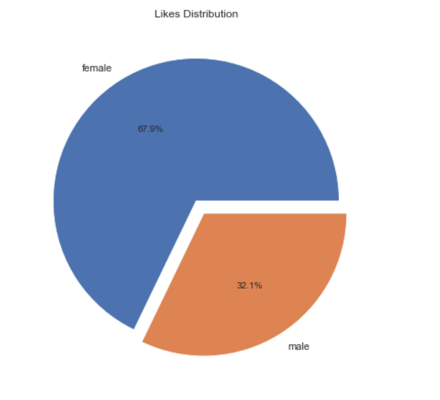
Total Likes distribution among each age group
Total Likes by Male are 32.1%
Total Likes by Female are 67.9%

Slide 11
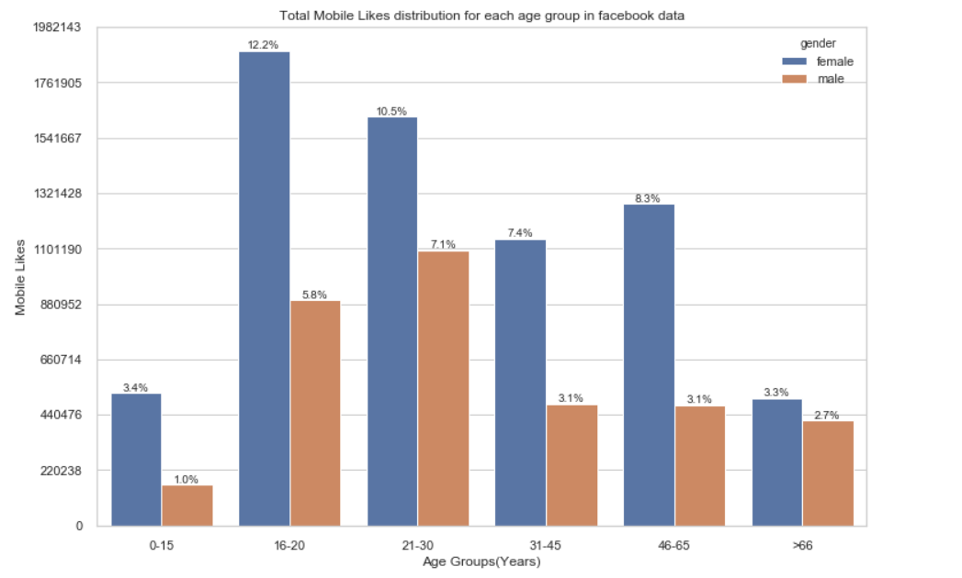
Total Mobile Likes distribution among each age group
Mobile Likes are 67.9% of Total Likes
Mobile Likes by Male are 22.8% of Total Likes
Mobile Likes by Female are 45.1% of Total Likes

Slide 12
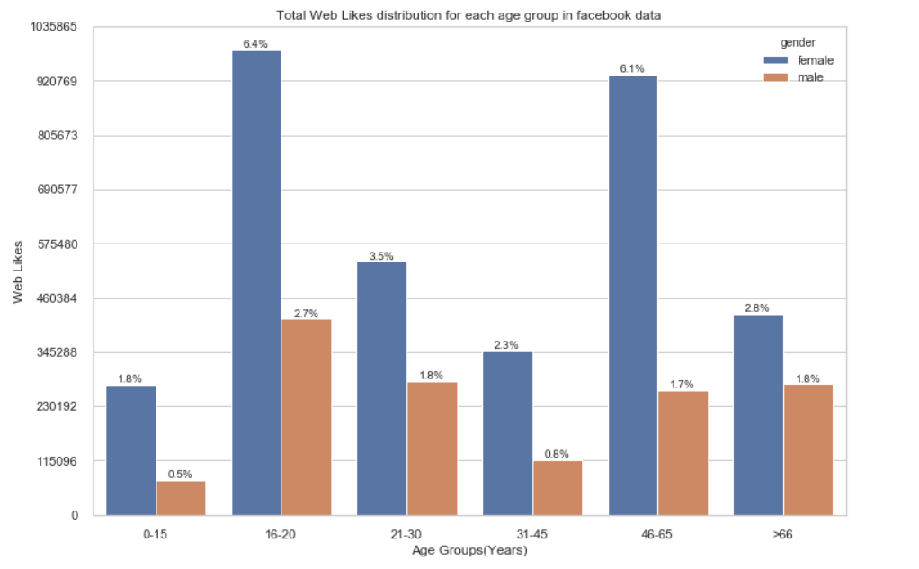
Total Web Likes distribution among each age group
Web Likes are 32.1 % of Total Likes
Web Likes by Male are 9.3% of Total Likes
Web Likes by Female are 22.8% of Total Likes

Slide 13
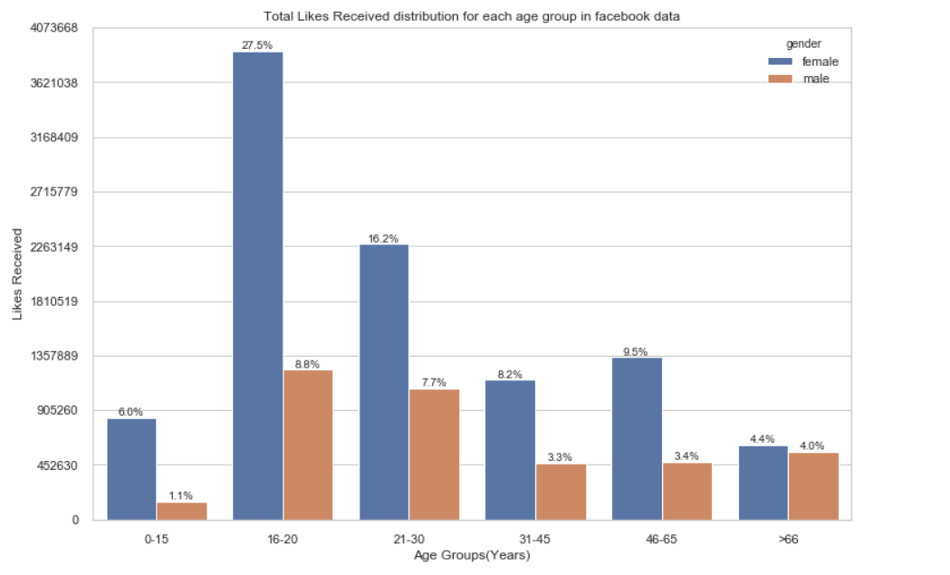
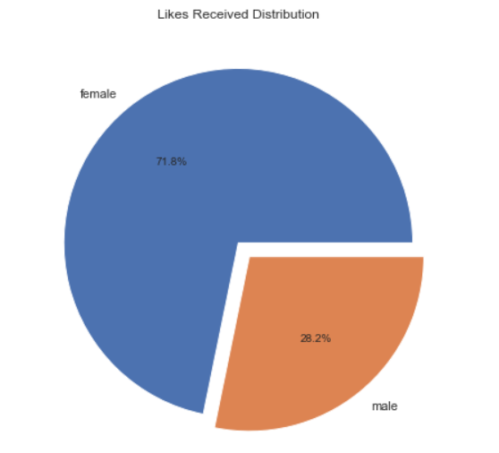
Like Received distribution among each age group
Likes Received by Male are 28.2%
Likes Received by Female are 71.8%
Though number of Male are more in the dataset, still Female received more likes

Slide 14
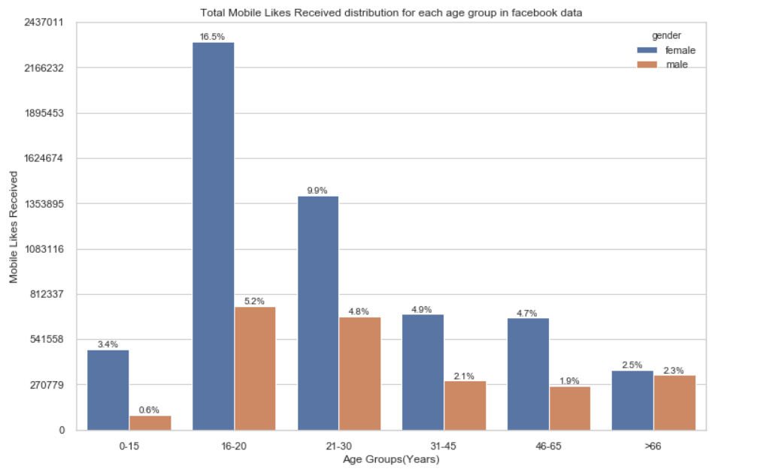
Mobile Likes Received distribution among each age group
Mobile Likes Received are 58.8% of Total Likes Received
Mobile Likes Received by Male are 16.9% of Total Likes Received
Mobile Likes Received by Female are 41.9% of Total Like Received

Slide 15
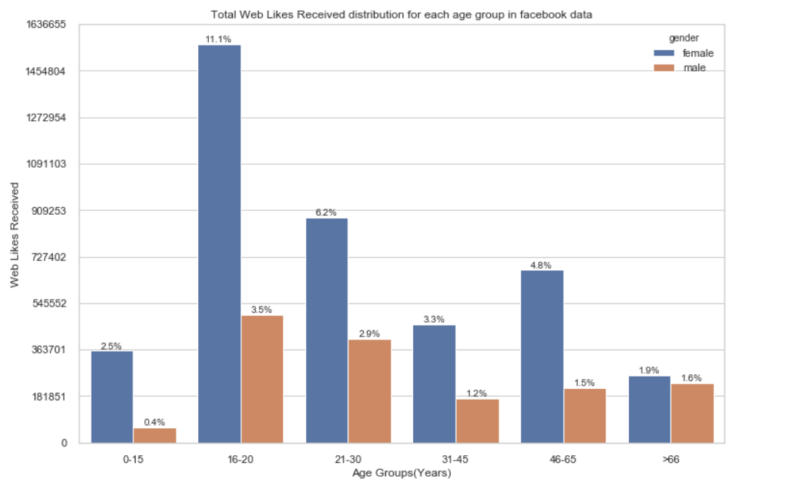
Web Likes Received distribution among each age group
Web Likes Received are 40.9% of Total Likes Received
Web Likes Received by Male are 11.1% of Total Likes Received
Web Likes Received by Female are 29.8% of Total Like Received

Slide 16
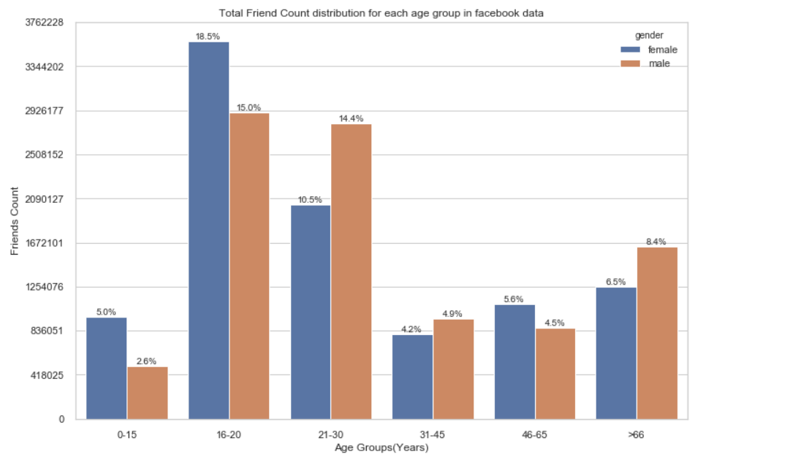
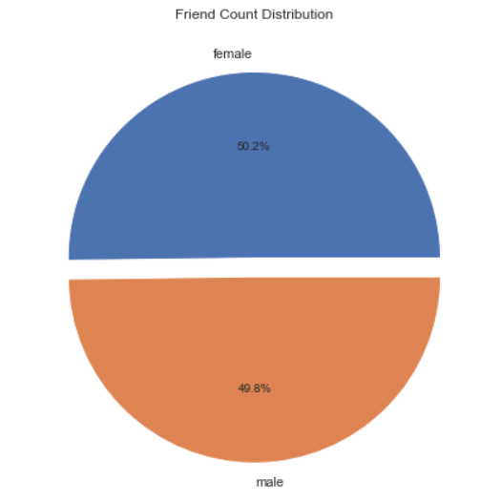
Total Friend Count distribution in dataset
Friend count of Female are 50.2%
Friend count of Male are 49.8%
Though number of Male are more in the dataset, still Female have more Friend Count

Slide 17
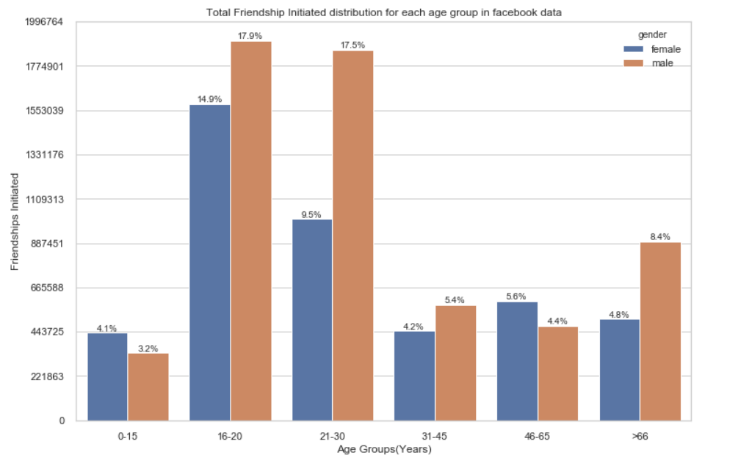
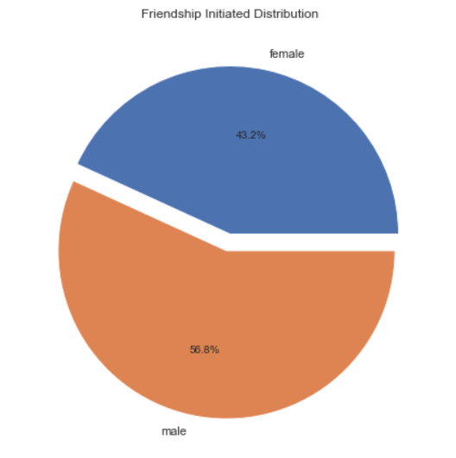
Friendship initiated distribution among each age group
Friend Request Sent by Male are 56.8%
Friend Request Sent by Female are 43.2%
Male sends more Friend Request than Female

Slide 18
Observation
Facebook dataset contains 59.3% Male and 40.7% Female data
The age group 21-30 years has maximum number of users followed by 16-20 years
Male users are more active in almost all group as per the dataset except the age group 46-65 years, in which more Female data is present
The dataset contains more entries with Tenure between 100-600 days
We have seen various correlation between data
The total likes given by Female is 67.9% whereas only 32.1% by Male
Female of age group 16-20(18.6%) and 46-65(14.3%) years have liked more
Out of all likes, mobile app likes are 67.9% and web likes are only 32.1%
The total likes received by Female is 71.8% whereas Male have received only 28.2%
Here we can see that, though number of Male are more in the dataset, still Female received more likes
The Female of age group 16-20 years have received maximum numbers of likes 27.5%, followed by 16.2% by age group 21-30 years
Out of all, received likes by mobile app are 58.8% and by web 40.9%
Though number of Male are more in the dataset, still Female have more Friend Count 50.2%
The Female of age group 16-20 years have maximum friend counts 18.5%
Male have sent more friend request than Female, i.e. Male 56.8% and Female 43.2%
The Male of age group 16-20 years and 21-30 years have sent more friend request with 17.9% and 17.5% respectively

Slide 19
Conclusion
Maximum users prefer to use Facebook Mobile app rather than Web application
So Facebook will allocate more resources and manpower to manage and monitor Mobile application rather than Web application
Facebook can deploy extra features to their Mobile app first, as more users are active through Mobile app
Female are more active on Facebook as compared to Male
So Facebook will prefer to create a different database for Female users
Also Female uploads more pictures and videos on Facebook so it require a huge database
Whereas Male database can be of little lesser size

Slide 20
Thank You
Rahul Kumar
+91-7903500361
r9aman@gmail.com

