Slide 1
Datastore

Slide 2
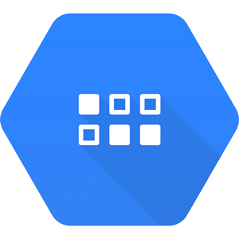
What is Google Cloud Datastore?
Google Cloud Datastore (Cloud Datastore) is a highly scalable, fully managed NoSQL database service offered by Google on the Google Cloud Platform.
Cloud storage is something that allows you to save data and files in an off-site location that you access either through the public internet or a dedicated private network connection.
This is very cost-effective for businesses since physical files can replaced with cloud storage records.
Cloud Datastore is built upon Google's Bigtable and Megastore technology. Google Cloud Datastore allows the user to create databases either in Native or Datastore Mode. Native Mode is designed for mobile and web apps, while Datastore Mode is designed for new server projects.

Slide 3
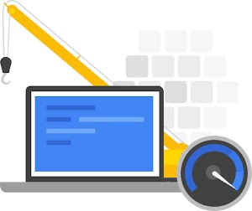


Simple and integrated
With Datastore's RESTful interface, data can easily be accessed by any deployment target. You can build solutions that span across App Engine and Compute Engine and rely on Datastore as the integration point.
Fast and highly scalable
Focus on building your applications without worrying about provisioning and load anticipation. Datastore scales seamlessly and automatically with your data, allowing applications to maintain high performance as they receive more traffic.
Easy-to-use query language
Datastore is a schemeless database, which allows you to worry less about making changes to your underlying data structure as your application evolves. Datastore provides a powerful query engine that allows you to search for data across multiple properties and sort as needed.
// List Google companies with fewer than 400 employees.
var companies = query.filter('name =', 'Google').filter('size <', 400);

Slide 4
Features
Rich admin dashboard: View entity statistics, query your database, view indexes, and back up/restore your data.
Diverse data types: Datastore supports a variety of data types, including integers, floating-point numbers, strings, dates, and binary data, among others.
Multiple access methods: Access your data via our JSON API, open source clients, or community-maintained ORMs (Objectify, NDB).
ACID transactions: Ensure the integrity of your data by executing multiple datastore operations in a single transaction with ACID characteristics, so all the grouped operations succeed or all fail.
Fully managed: Datastore is fully managed, which means Google automatically handles sharding and replication in order to provide you with a highly available and consistent database.

Slide 5
Here are a few best practices that can help you work with Cloud Datastore more effectively
API Calls
Use batch operations—these are more efficient because they use the same overhead as one operation.
Roll back failed transactions—if there is another request for the same resources, this will improve the latency of the retry operation.
Use asynchronous calls—like in Firestore, prefer to use asynchronous calls if there is no data dependency of the result of a query.
Entities
Do not write to an entity group more than once per second, to avoid timeouts for strongly consistent reads, which will negatively affect performance for your application. If you are using batch writes or transactions, these count as one write operation.
Sharding and Replication
For hot Datastore keys, you can use sharding or replication to read keys at a higher rate than allowed by Bigtable, the underlying storage. For example, you replicate keys three times to enable 3X faster read throughput. Or you can use sharding to break up the key range into several parts.

