Slide 1
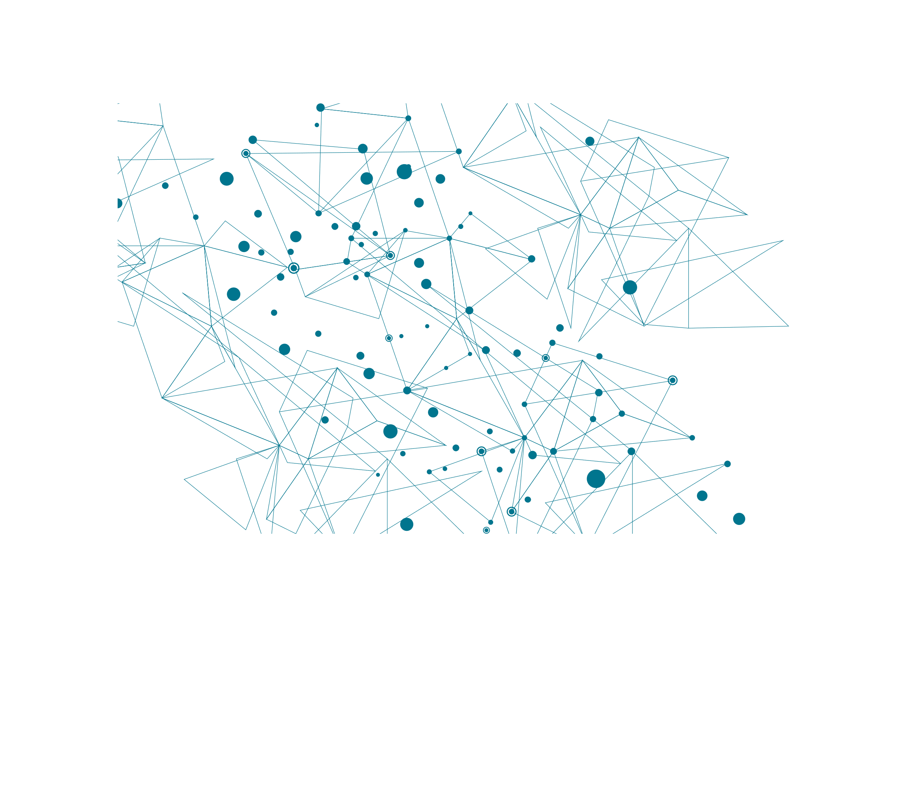
52
Amitesh Patil
54
Kshitij Patil
Cash
Flow
Minimization
56
Pranit Patil
77
Vivek Pundkar

Slide 2
Problem statement
A has to pay ₹10 to B
Given the number of friends who have to give or take some amount of money from one another. Design an algorithm by which the total cash flow among all the friends is minimized.
C has to pay ₹10 to B
A has to pay ₹20 to B
A has to pay ₹10 to C
B
₹10
₹10
A
₹20
B
A
₹10
C

Slide 3

Algorithm
1.
Get input; number of people involved in transaction and number of transaction performed
2.
Find what is the total money everyone has borrowed or owed and store in data structure
3.
Find the two persons that are credited maximum and debted maximum. Start settling debts by simulating that the transaction will take place between two of them. Remove both the entries.
If both amounts are unequal, add them into the data structure.
Else repeat step 3.

Slide 4
Algorithm
Step1:
Step2:
Step3:
A
-30
A has to pay ₹20 to B
A
-30
C has to pay ₹10 to B
B
+30
D
-10
A has to pay ₹10 to C
D has to pay ₹10 to C
C
+10
-30
+30
B
+30
₹30
A
B
0
0
A
Settled!
B

Slide 5
Illustration
Repeating step3:
Settlements:
D
-30
+30
-10
A
₹30
B
C
+10
0
0
A
Settled!
B
-10
+10
-10
+10
D
₹10
C
₹10
D
C
0
0
0
0
D
Settled!
C
D
C
Settled!

Slide 6
Analysis
Data structures:
map<string, int> : For finding the total amount everyone will pay/receive.
Taking input: total_transactions*log(total_ transactions)
set<pair<int, string>> : for minimizing the transaction.
Inserting values: total_friends*log(total_friends)
Algortihm:
Settling the debts: total_friends *log(total_friends)
Time Complexity of the code: NlogN

Slide 7
Conclusion

