Slide 1
Update on Isotopes from Ward Experiment (2010 & 2012)
Batt 15-Jan-2013

Slide 2
Topic Slides
Resource Use by Year 3-5
Isotopic Signatures by Year 6-9
Resource Use by Month 10-16
That DOM Mystery 17-20

Slide 3
Resource Use by Year
Ran a mixing model for each consumer using ¹³C, ¹⁵N, and ²H data.
Phytoplankton end member was estimated as in Batt et al 2012
Samples from different months of the same year were pooled together
End Member Key
Terr. = Terrestrial end members (alder, sedge, tamarack, various trees from database)
Phyto. = All phytoplankton (both epi and meta)
Epi. Phyt. = Epilimnetic phytoplankton
Meta. Phyt. = Metalimnetic phytoplankton
Macroph. = All macrophytes (both submersed & floating)
Float Mac = floating macrophytes (watershield, yellow lily, fragrant lily)
Sub Mac = submersed macrophyte (3 potamogeton species, chara, najas)
DOM = dissolved organic matter from epi and meta
Periphyton = attached algae scraped from tiles

Slide 4
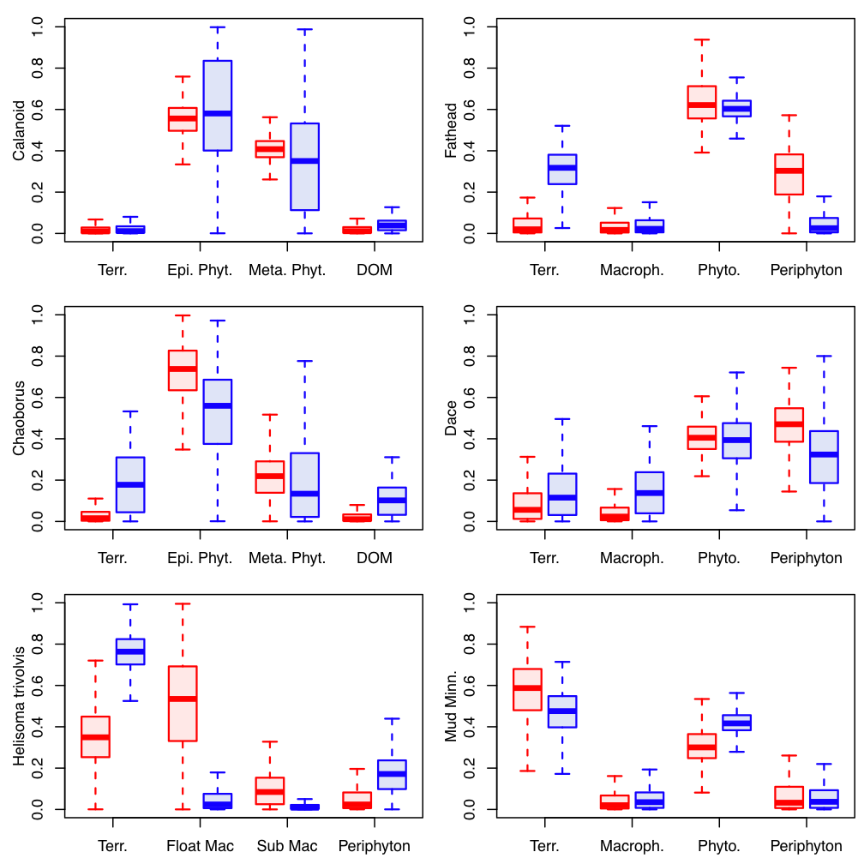
Resource Use by Year
Boxplots of posterior distributions of resources used by 6 consumers in 2 years.
Red=2010
Blue=2012

Slide 5
Resource Use by Year
Summary
Calanoids stayed the same between years. The phytoplankton error bars are bigger in 2012 b/c the epi and meta end members are more similar in 2012 than in 2010
Chaoborus had slightly higher allochthony/ higher use of DOM
Helisoma trivolvis (the snail) once again wins the award for the most surprising result. Snail allochthony increased massively, and use of floating-leafed macrophytes decreased. Use of periphyton also increased slightly.
Pimephales promelas (fatheads) became more allochthonous, and made less use of periphyton.
Phoxinus spp. (dace) stayed the same for the most part. Perhaps slight increase in allochthony and macrophytes, slight decrease in periphyton.
Umbra limi (mud minnow) stayed the same. Perhaps slight increase in allochthony, slight decrease in phytoplankton.
I haven’t included bullheads (complicated trophic level) or mesocyclops (not a lot of samples) here.

Slide 6
Summary of Isotopic Signatures

Slide 7
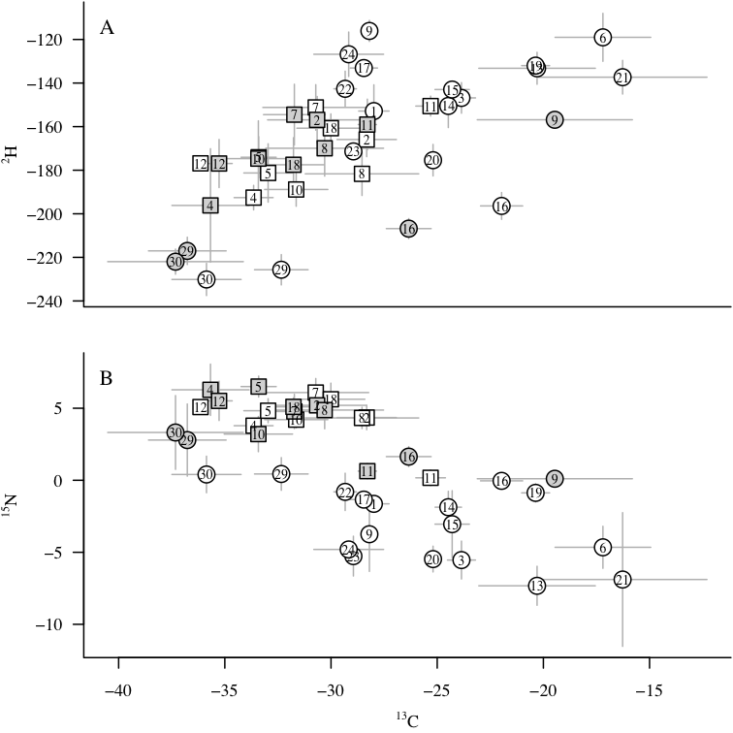
Isotopic Signatures by Year
DOM 2010
Float
Macro
Squares=Consumers
Circles=End Members
Open=2010 (or both years for terrestrial and macrophytes)
Shaded=2012
Sub
Macro
Terres.
DOM 2012
Zoops
Periphyton
Phytos

Slide 8
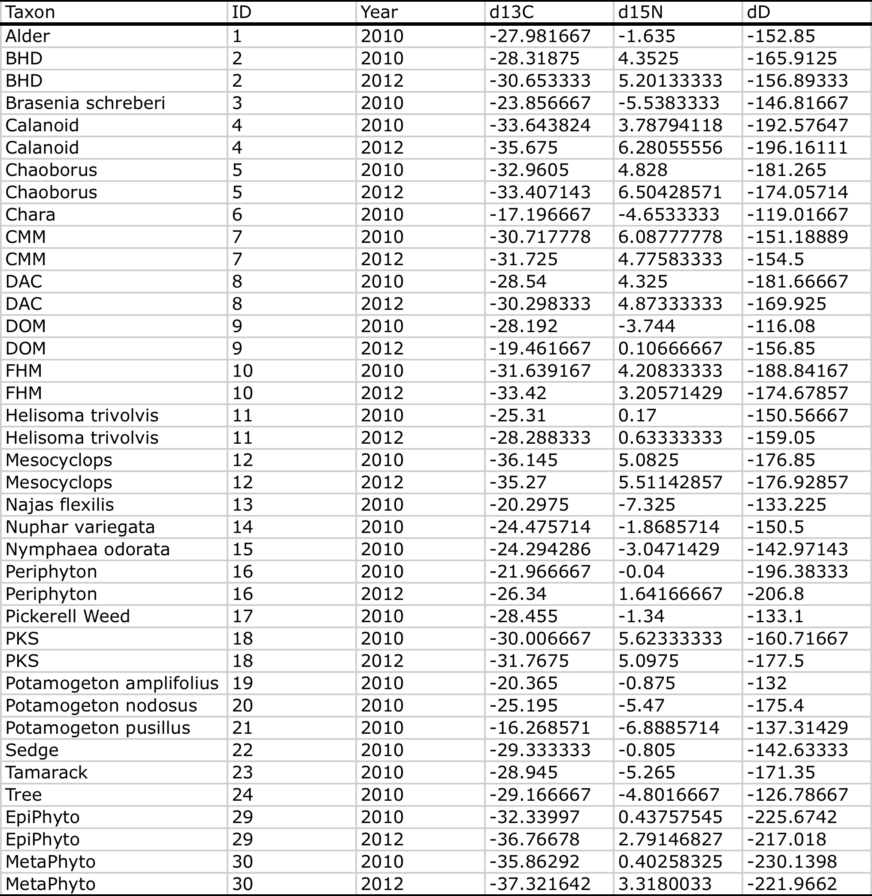
Isotopic Signatures by Year
The “ID” column is the key to the previous graph
BHD=Bullhead
CMM=Mud minnow
DAC=Dace
FHM=Fathead
PKS=Pumpkinseed
“Tree” samples were actually from 2001, and were taken from the isotope database.

Slide 9
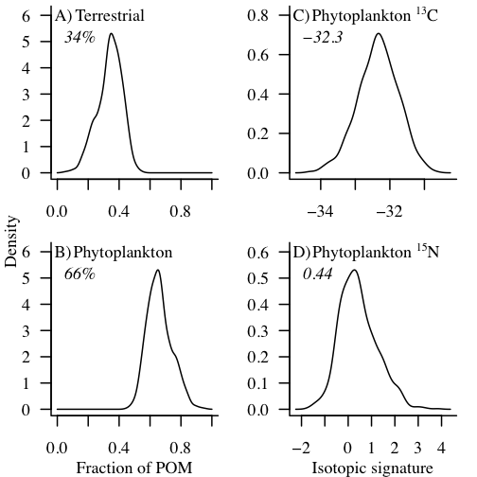
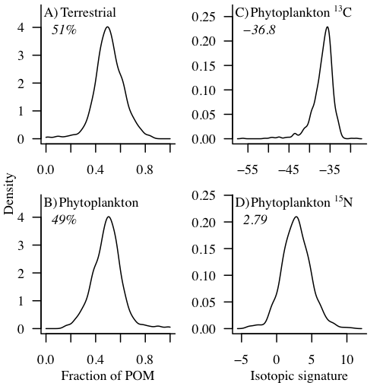
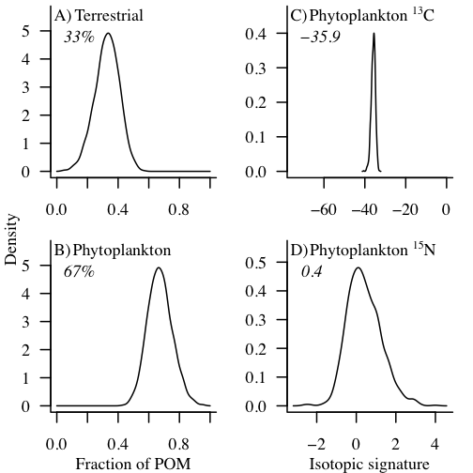
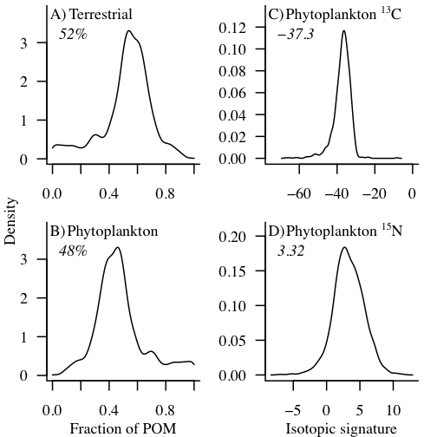
Isotopic Signatures by Year
2010
2012
POM Composition & Phytoplankton Posteriors
Epilimnion
Metalimnion

Slide 10
Resource use broken down by month

Slide 11
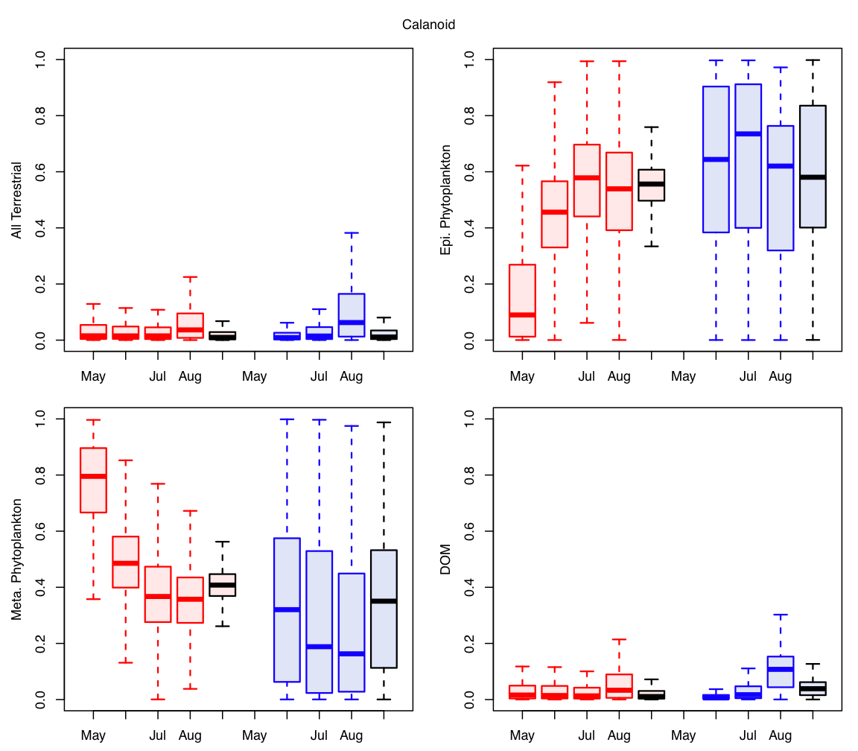
Resource Use by Month
Calanoid Resource Use
Red=2010
Blue=2012
Black lines = pooled across months

Slide 12
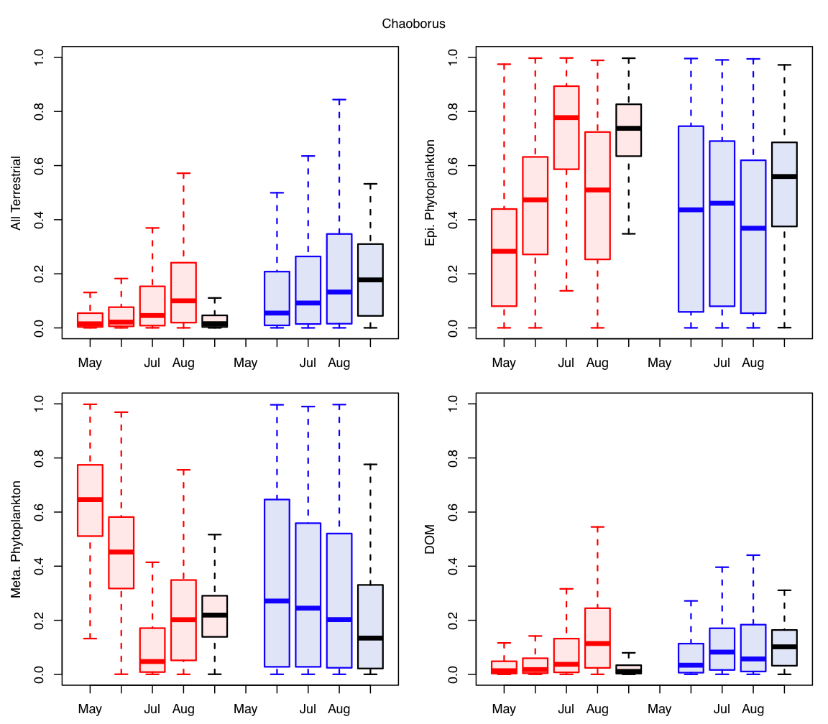
Resource Use by Month
Chaoborus Resource Use
Red=2010
Blue=2012
Black lines = pooled across months

Slide 13
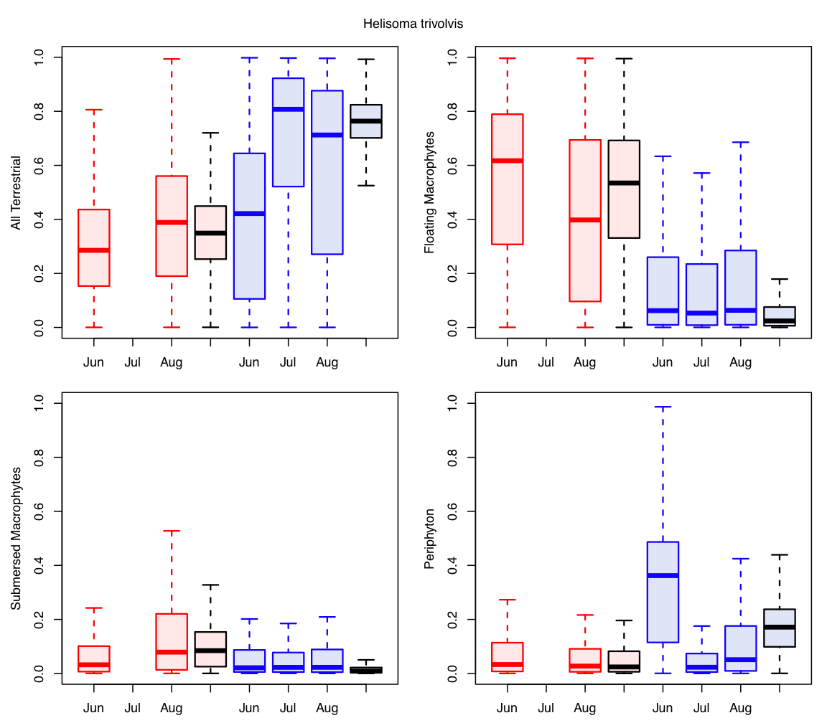
Resource Use by Month
Snail Resource Use
Red=2010
Blue=2012
Black lines = pooled across months

Slide 14
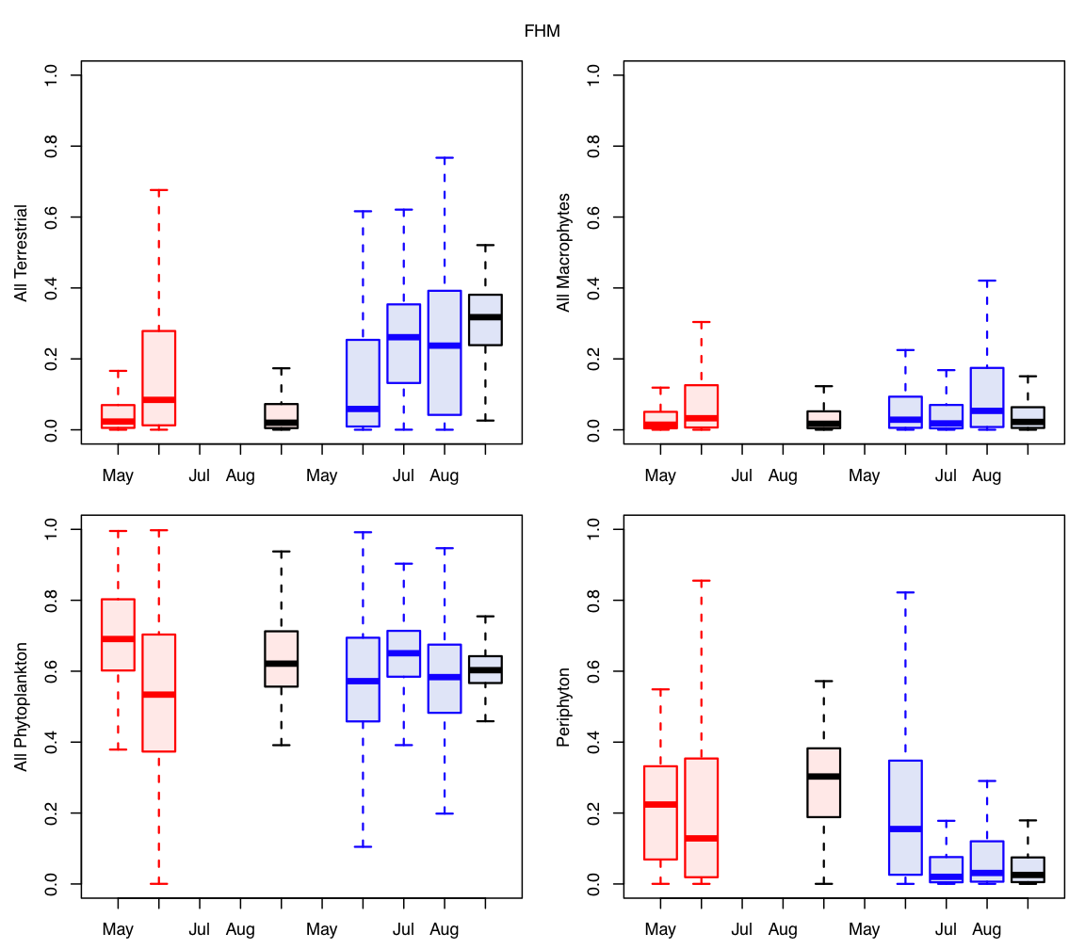
Resource Use by Month
Fathead Resource Use
Red=2010
Blue=2012
Black lines = pooled across months

Slide 15
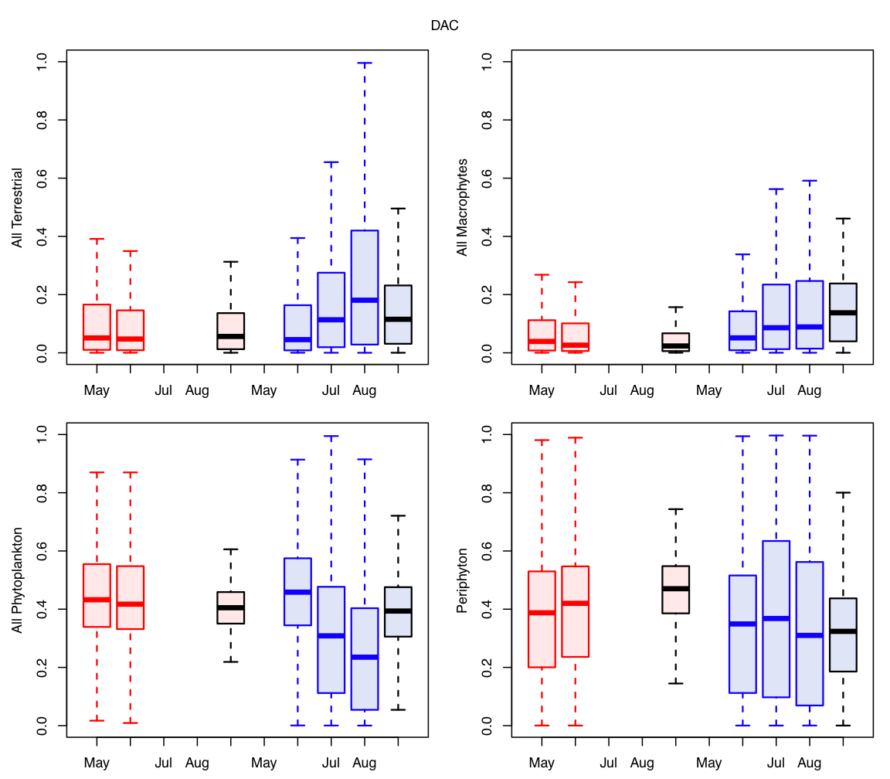
Resource Use by Month
Dace Resource Use
Red=2010
Blue=2012
Black lines = pooled across months

Slide 16
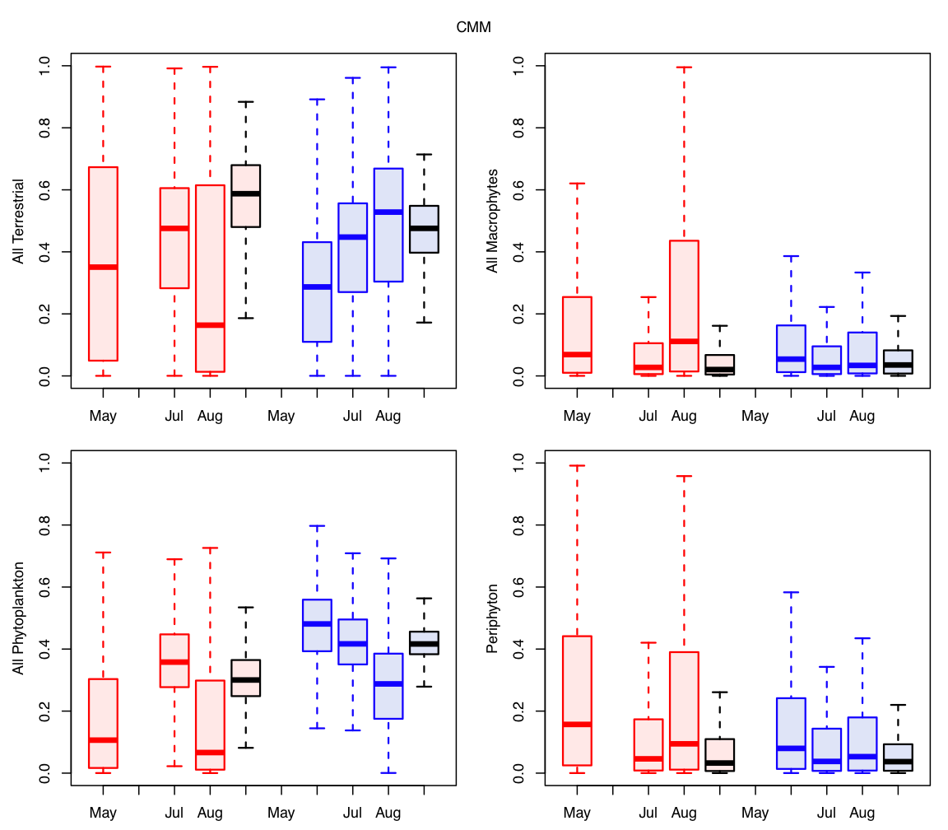
Resource Use by Month
Mud Minnow Resource Use
Red=2010
Blue=2012
Black lines = pooled across months

Slide 17
DOM Mystery

Slide 18
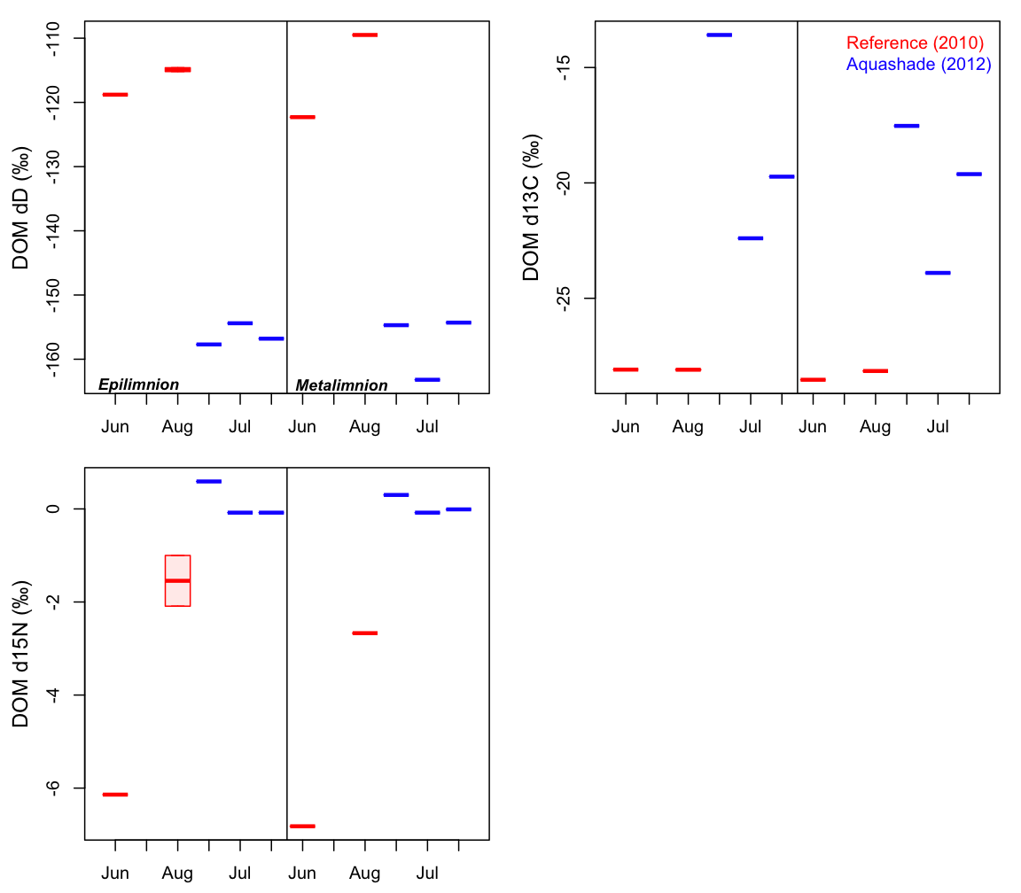
The isotopic signature changed in weird ways. It became way more depleted in dD in 2012, but Aquashade has a signature of -64 (the change isn’t due to the Aquashade component of DOM). Also, while dD became more depleted, 13C became more enriched. I.e., this isn’t a terrestrial-phytoplankton trade off

Slide 19
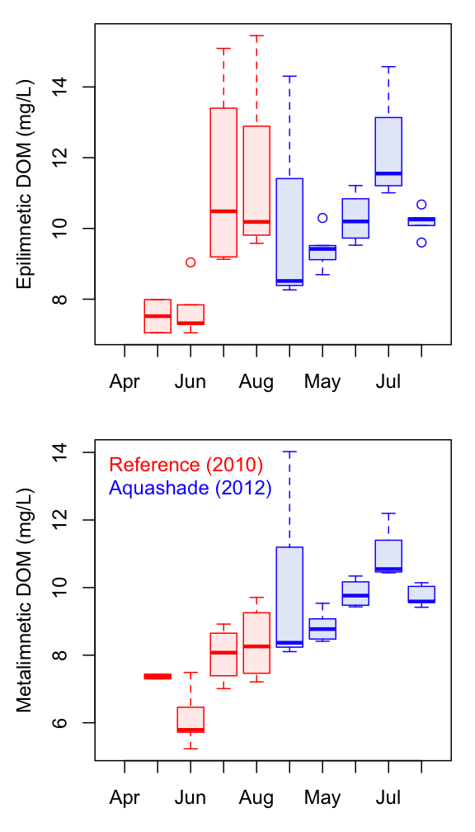
DOM concentration over time. We added ~1.5 to 2 mg/L of Aquashade in 2012.

Slide 20
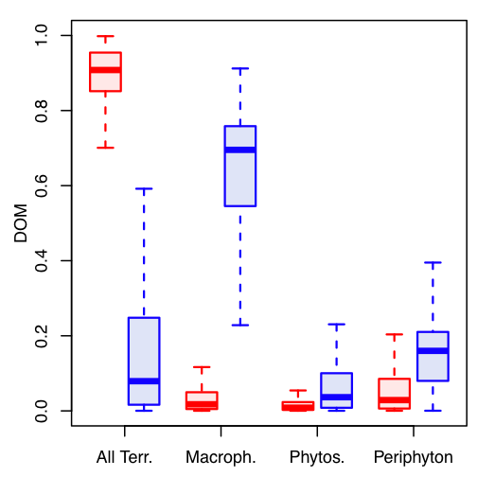
Red=2010
Blue=2012
Here are the mixing model results for the composition of DOM.
I didn’t back-out the Aquashade signature for this analysis, but if I did, it would probably make the 2012 DOM a little less macrophyte and a little more periphyton.

