Slide 1
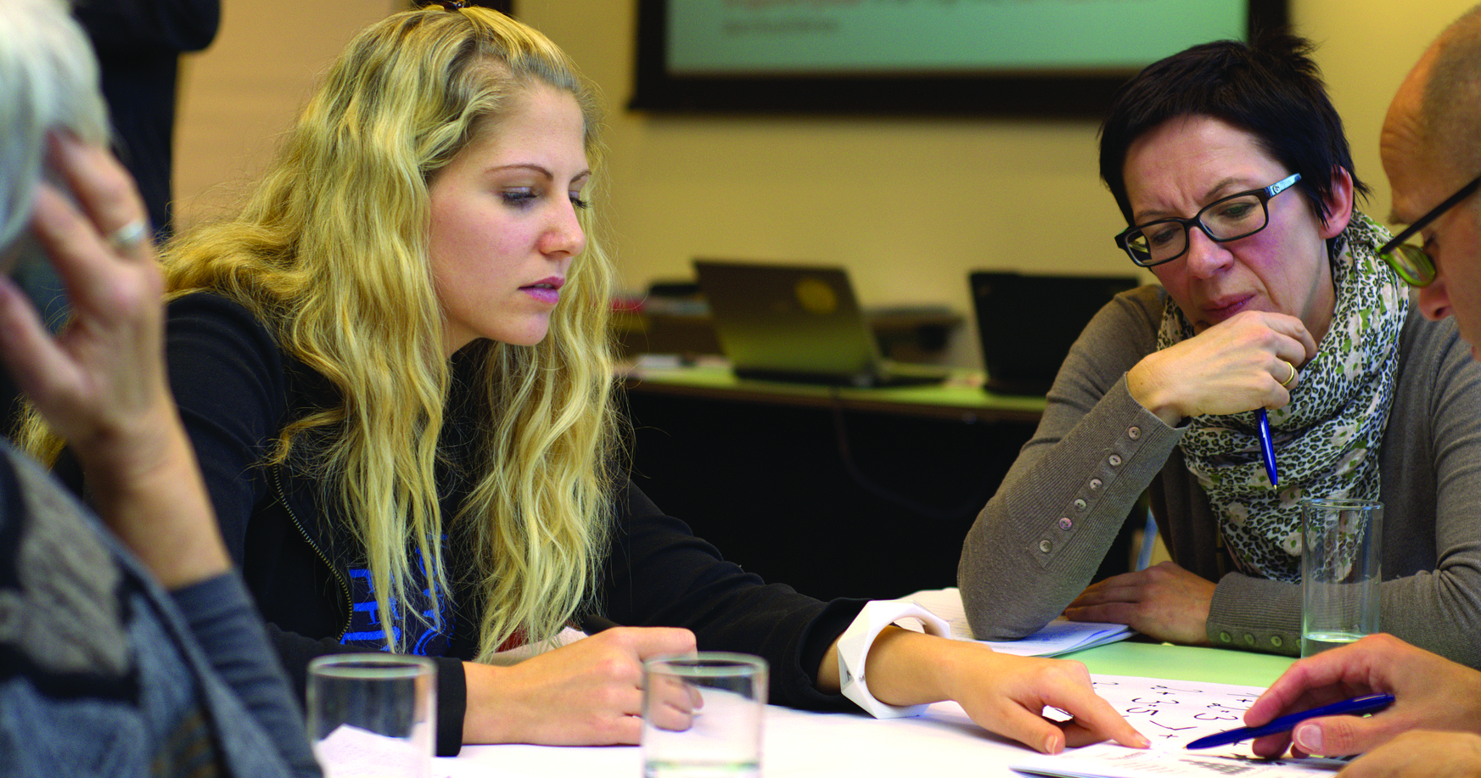
The Best Programming Languages
ricky brown, Hamid nahli, jesse law, Mimi Southwood, Nichelle garvey
It 115, group 2
SPRING 2022

Slide 2
Team and Project Management

Slide 3
JESSE - How did you change Code Compare?
GitHub -> Code Compare
READ.ME
CONTRIBUTING.md
License
index.html
styles.css
Powerpoint presentation
Secondary Survey repo

Slide 4
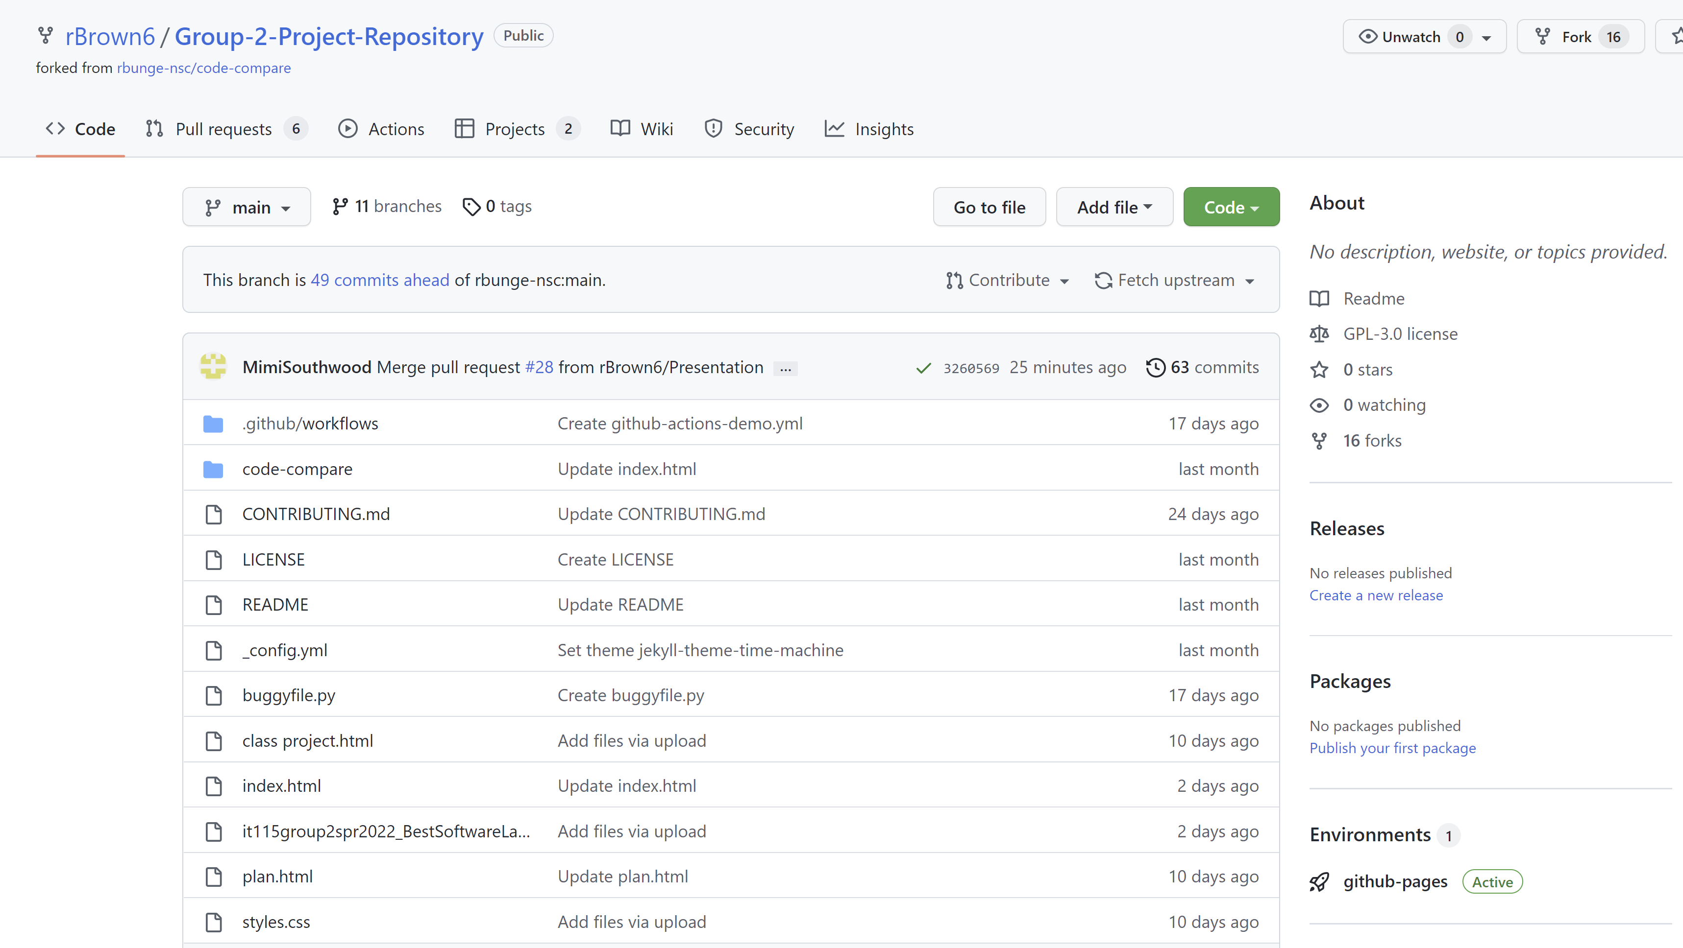
MIMI – Team Collaboration, Project Management, Roles, Project Page
Collaboration
GitHub – files, updates
Email - communication
Project management – plan.html
Roles – Division of Group Project deliverables – plan.html
Content
Project page - index.html
Survey – separate repo

Slide 5
MIMI – Project Page, Content
Team Contributions
Mission
Programming language recommendations
Survey results

Slide 6
NICOLE – Testing, Bug Tracking, and Updating and Fixing Code
4. Bug reports project board

Slide 7
NICOLE – Bug reports project board

Slide 8
RICKY – Web Server Hosting, Process for Configuring Web Server

Slide 9
RICKY – Super-linter workflow

Slide 10
HAMID – Deploying Code to the Server, URL for Testing

Slide 11
HAMID / RICKY – Summary of Project Pages, Assets

Slide 12
Team Recommendations
HTML – Ricky Brown
CSS – Nicole Garvey
JavaScript – Jesse Law
SQL – Mimi Southwood
Python – Hamid Nahli

Slide 13
Our Survey
RESULTS?

Slide 14
Thank you!

