Slide 1
The Assembly Challenge for Space-Based Solar Power
Why current methods can't scale
Current Reality
The Scale Problem
The Bottleneck
Not enough expert astronauts
Human EVAs are dangerous, expensive, limited
Pre-assembled modules don't scale to km-size
ISS (450 tons)
1 GW SBSP = 2.44 km² array
→ 40+ missions
→ 160+ spacewalks
→ 13 years
→
24,400
modules
ISS
Only ~128 active astronauts worldwide
0.1% failure = 24 modules needing repair
Without autonomous assembly, gigawatt-scale SBSP remains impossible

Slide 2
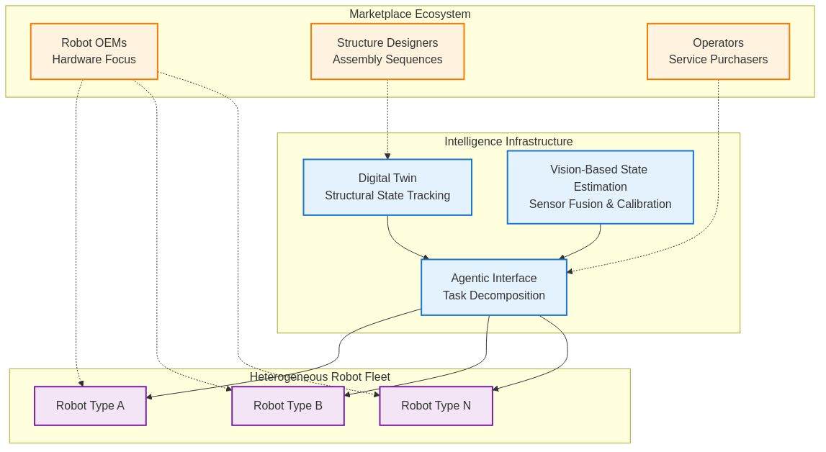
Research Focus: Robot-Agnostic Intelligence Infrastructure
Core Technical Contributions
Digital twin framework for real-time structural state tracking
Physics-based simulation of 10⁶+ component interactions
Hierarchical representation: component → module → subsystem
Vision-based state estimation to minimize sim-to-real gap
Multi-modal sensor fusion (RGB-D, thermal, force/torque)
Online model calibration using assembly anomalies
Standardized agentic interface for heterogeneous robots
Task decomposition: structure-level → robot-specific commands
Protocol-agnostic: ROS2, SpaceWire, custom interfaces
Physics-based simulation of 10⁶+ component interactions
Hierarchical representation: component → module → subsystem
Multi-modal sensor fusion (RGB-D, thermal, force/torque)
Online model calibration using assembly anomalies
Task decomposition: structure-level → robot-specific commands
Protocol-agnostic: ROS2, SpaceWire, custom interfaces
[Architecture Diagram]
Enabling Multi-Sided Marketplace
Robot OEMs: Focus on hardware reliability, not task planning
Structure designers: Define assembly sequences, not robot control
Operators: Purchase assembly/maintenance-as-a-service
Validation Approach
Earth-based testbed with 3+ heterogeneous robots
Mock SBSP truss assembly (100+ components)
Metrics: Assembly time, error recovery, cross-robot compatibility

Slide 3
About the Author
Hendrik Wirthwein
[LinkedIn Photo]
Bachelor of Computer Engineering
TU Berlin
Research Focus
Thesis on Multi-Agent Reinforcement Learning for Flexible Job Shop Problem
TU Berlin
Contact
Fraunhofer
hendrik.wirthwein@outlook.com

