Slide 1
General Services Web Portal Help Guide AAA Property Services
April 2013

Slide 2
Learn About....
Logging into the AAA Web Portal
Services provided by AAA Properties Services
Route Maintenance Program
Creating a Service Request
Reviewing Service Tickets (open/closed)
Reviewing a Calendar of Scheduled Services
Creating a Bid Request
Submitting Comments and Complaints
Reporting Afterhours Emergencies

Slide 3
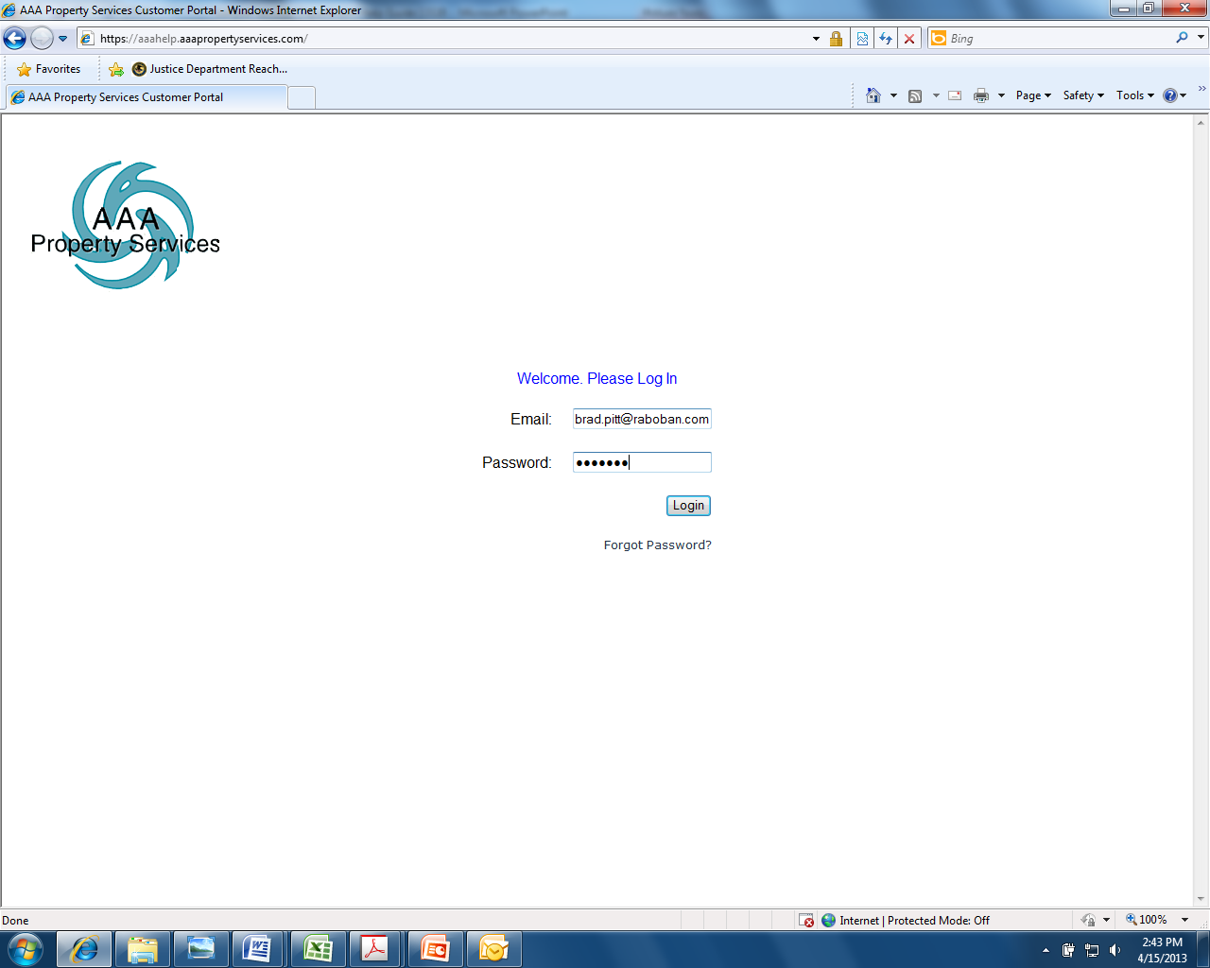
Logging into the AAA Web Portal
Step #1: Locate the AAA Property Services link on Sundial at:
Reference Center/Applications & Tools/
General Services/Facilities Service Requests
Step #2: To access the AAA Web Portal, enter your email address and password.
For initial user set-up, contact AAA Property Services at (800) 892-4784.
Prior approval from your supervisor is REQUIRED.

Slide 4
Services Provided by AAA Property Services
Afterhours Emergency Response
Appliance Repairs
ATM Cleaning
Construction Services
Currency Counter Equipment & Repairs
Door and Gates Repairs
Electrical Work
Elevator Maintenance & Repairs
Encoders Equipment & Repairs
Fire Safety & Extinguishers
Flooring Repairs & Installations
Furniture Moving
Glass Repairs/Replace & Clean-Up
Handyman Repairs
HVAC Repairs & Services
Interior Cleaning/Janitorial
Landscaping
Lighting & Bulb Replacement
Music Services
Painting Services & Touch-ups
Parking Lot Striping
Pest Control
Plumbing Repairs & Emergency Work
Power Washing/Window Cleaning
Roof Repairs & Leaks
Sign Lighting & Maintenance
Water Backflow Testing
Water Purification Systems
Services in red may be included in monthly route maintenance inspections.

Slide 5
Route Maintenance
Most locations have monthly route maintenance inspections. During these inspections, the AAA Property Services technician will inspect the following:
Lighting & Electrical Systems
Plumbing
Cables
Door and Hardware Systems
Furniture
Flooring
Wall Coverings
Graffiti
ATM Cleaning
Ceiling
Fire Extinguishers /Fire, Life & Safety Systems
Janitorial
Parking Lot
Roof Inspections
A complete description of services is located in the front sleeve of the Facility Log, three-ring binder at each location where Route Maintenance inspections occur. General repair items should be logged into the Facility Log and the technician will complete during the monthly service. Additionally, the technician will review the inspection report with onsite management advising on any issues that need submitted as either a Service Request or Bid Request.
IMPORTANT NOTE: Route Maintenance should be used as a first step to resolving any facility issue. The cost of minor repairs and services is included within the Route Maintenance service fee. There are additional fees for Service Requests.

Slide 6
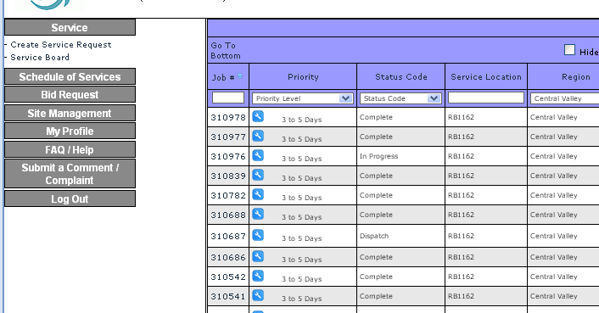
Creating a Service Request Step #1
Service Requests are used to request non-emergency repairs.
Step #1: Select “Service” then “Create Service Request”

Slide 7
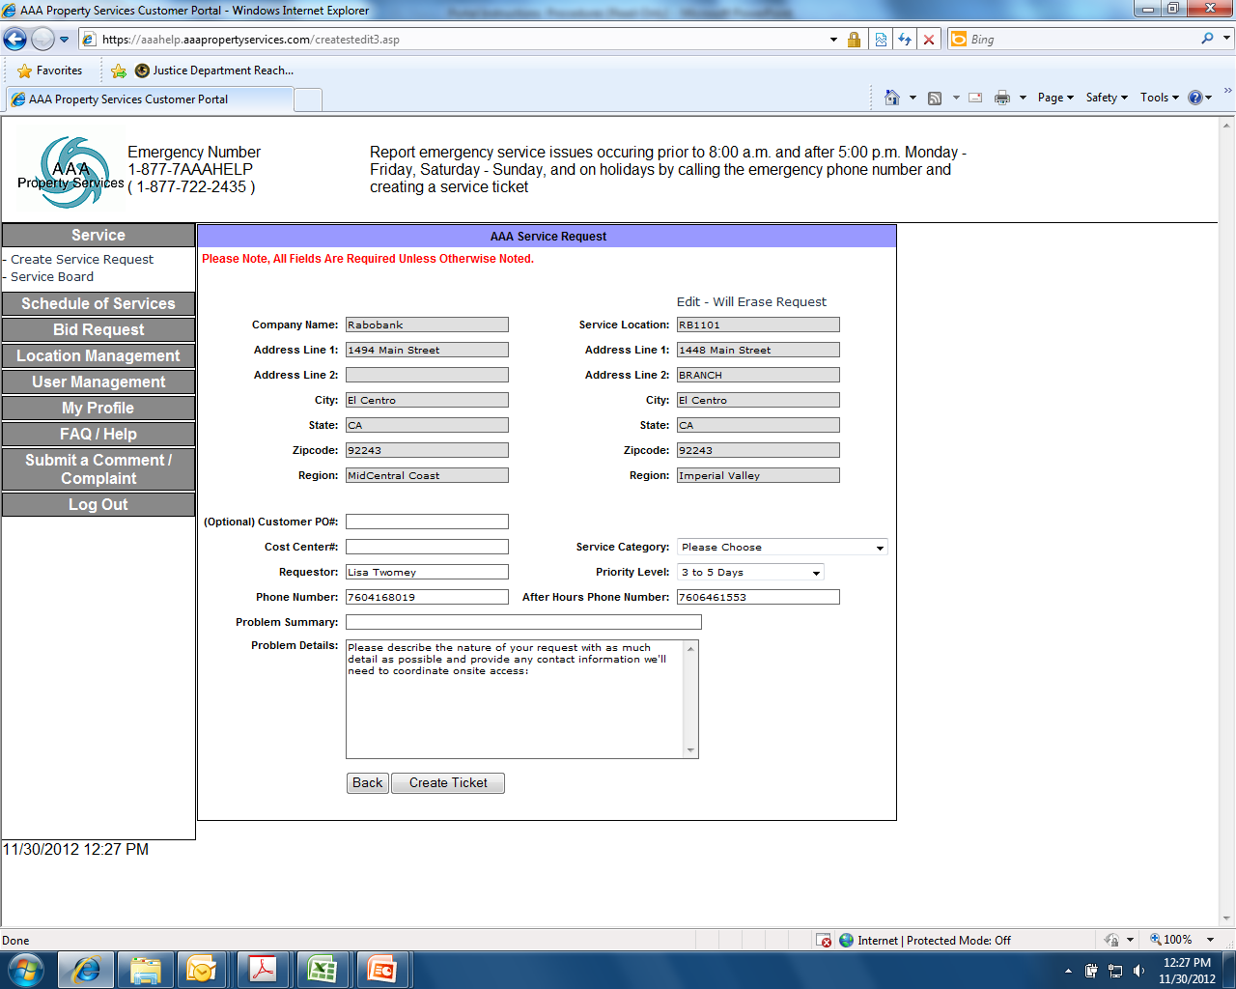
Creating a Service Request Step #2
Step #2: Input the requested information into each field, then select “Create Ticket.” Once completed, an automated email will be forwarded to you.

Slide 8
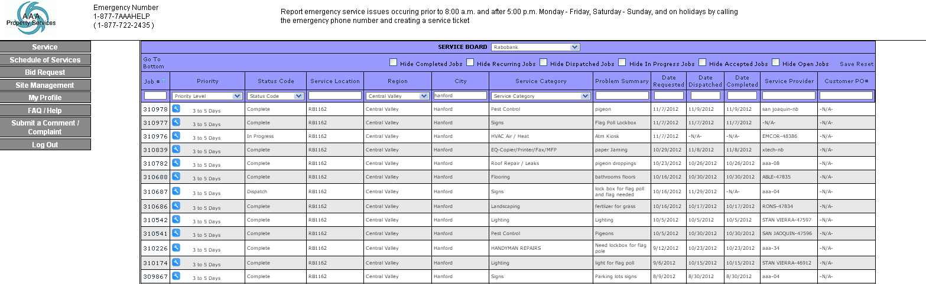
Reviewing Service Tickets Open and Closed
Once you log into the AAA web portal, the Service Board is the first screen.
This details all service requests for your location.

Slide 9
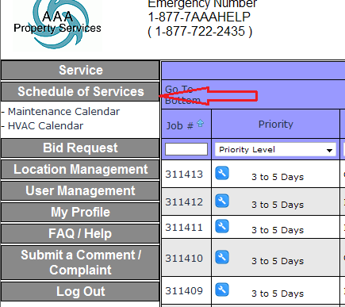
Reviewing Calendar of Scheduled Services
The calendar shows route maintenance and HVAC servicing schedules for all locations.

Slide 10
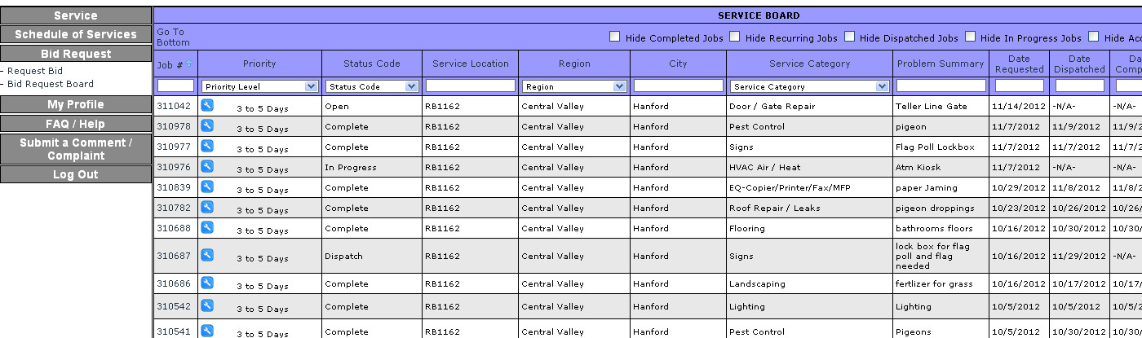
Creating a Bid Request Step #1
Step #1: Select “Request Bid”

Slide 11
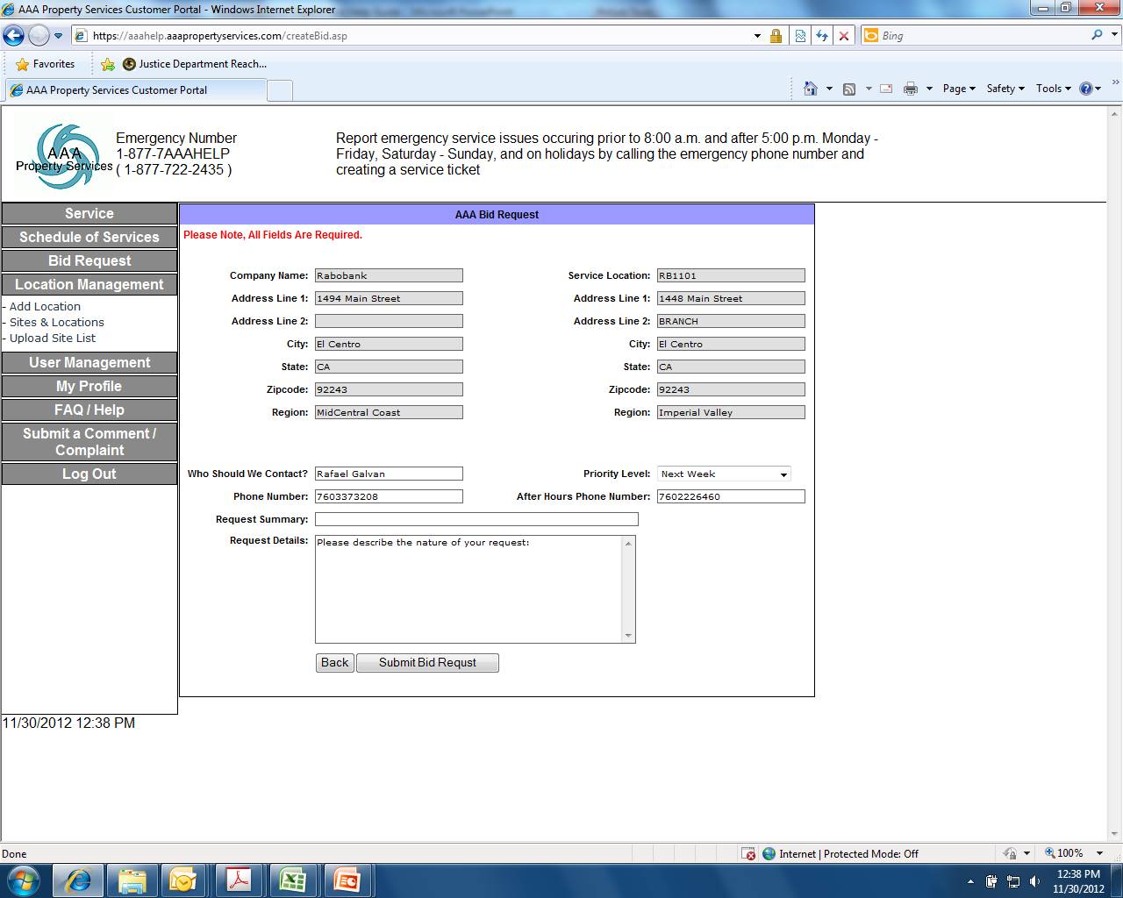
Creating a Bid Request Step #2
Step #2: Input information into each field then select “Submit Bid Request.” Once completed, an automated email will be forwarded to you.

Slide 12
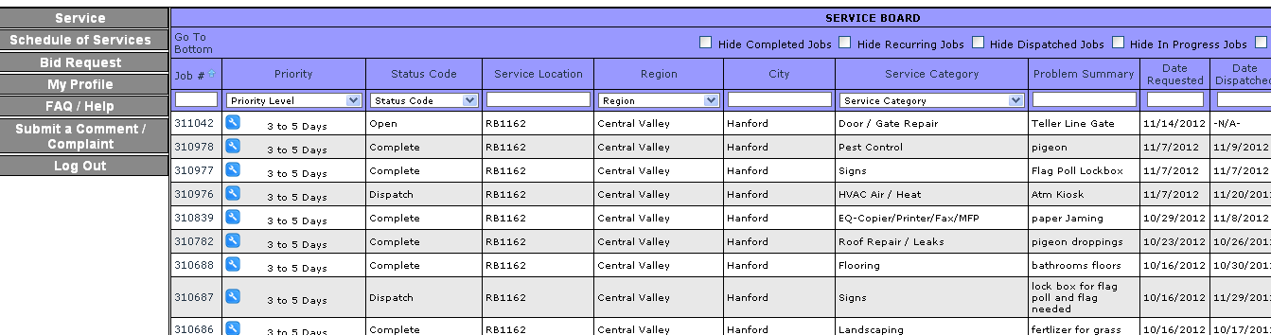
Submitting Comments and Complaints Step #1
Step 1: Select “Submit a Comment/Complaint.”

Slide 13
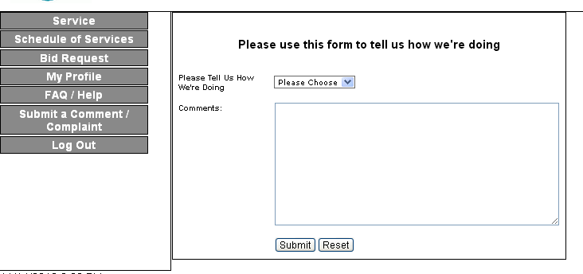
Submitting Comments and Complaints Step #2
Step #2: Input information into each field then select “Submit”.

Slide 14
Reporting Afterhours Emergencies
To report emergency service issues
Before 8:00 a.m. or after 5:00 p.m.
Monday-Friday
OR
Saturday, Sunday and Holidays
877-7AA-AHELP
(877-722-2435)
Note that additional service fees are charged by AAA for emergency repair reporting.

