Slide 1
ECE408 / CS483/CSE408 Spring 2018 Applied Parallel Programming Lecture 1: Introduction

Slide 2
Course Goals
Learn to program massively parallel processors and achieve
High performance
Functionality and maintainability
Scalability across future generations
Technical subjects
Parallel programming basics
Principles and patterns of parallel algorithms
Programming API, tools and techniques
Processor architecture features and constraints
Killer apps

Slide 3
People
Instructors:
Prof. Wen-mei Hwu
215 CSL, w-hwu@illinois.edu, 244-8270
use ECE408 to start your e-mail subject line
Office hours: 1:30-2:30pm Tuesdays; or by appointment
Teaching Assistants:
Carl Pearson (pearson@illinois.edu), Keven Feng (klfeng2@illinois.edu), Lan, Rui (ruilan2@illinois.edu) Wei Ren (weiren2@illinois.edu)
Office hours: Check the course website

Slide 4
Brief Bio of Wen-mei Hwu
Ph.D. from University of California, Berkeley, 1987
Research: Computer Architecture and Parallel Computing
Professor of ECE Illinois since 1987
Chief Scientist Parallel Computing Institute, Co-PI Blue Waters
Director of several research centers, most recently IBM C3SR
Co-Founder, Advisor and Board Member to 8 startups to date
Researcher, teacher, author, technologist, and entrepreneur

Slide 5
How we will run the course
Previously recorded lecture video for each major topical segment is on-line.
In Class Schedule page of course wiki
Your responsibility is to absorb BEFORE corresponding lecture
Lectures by me when I am in town.
View previously recorded lecture videos when I am traveling – One of the TAs will come to class to discuss finer points, answer questions (flipped class).

Slide 6
Web Resources
Website: https://wiki.illinois.edu/wiki/display/ECE408/
Use your Illinois NetID and Password to login
Handouts and lecture slides/recordings
Textbook chapters, documentation, software resources
Note: While we’ll make an effort to post announcements on the web, we can’t guarantee it, and won’t make any allowances for people who miss things in class.
Web board discussions in Piazza
Channel for electronic announcements
Forum for Q&A - the TAs and Professors read the board, and your classmates often have answers
Compass - grades

Slide 7
Grading
Exams: 40%
Exam 1: 20%
Exam 2: 20%
Labs (Machine Problems): 35%
Passing Datasets 90%
Reasonable-looking answers to questions
Project: 25%
Automatic Demo/Functionality/Coding Style: 50%
Automatic Performance Ranking with full functionality: 50%
Detailed Rubric will be posted

Slide 8
Academic Honesty
You are allowed and encouraged to discuss assignments with other students in the class. Getting verbal advice/help from people who’ve already taken the course is also fine.
Any reference to assignments from previous terms or web postings is unacceptable
Any copying of non-trivial code is unacceptable
Non-trivial = more than a line or so
Copying includes reading someone else’s code and then going off to write your own.

Slide 9
Academic Honesty (cont.)
Giving/receiving help on an exam is unacceptable
Penalties for academic dishonesty:
Zero on the assignment/exam for the first occasion
Automatic failure of the course for repeat offenses

Slide 10
Text/Notes
D. Kirk and W. Hwu, “Programming Massively Parallel Processors – A Hands-on Approach,” Morgan Kaufman Publisher, 3rd edition, 2016, ISBN 978-0123814722
all chapters used in this course are in Wiki
NVIDIA, NVidia CUDA C Programming Guide, version 7.5 or later (reference book)

Slide 11
Tentative Schedule (Class Schedule Tab in Wiki)
Week 1:
Tu: Lecture 1: Introduction
Th: Lecture 2: CUDA Intro
Week 2:
Tu: Lecture 3: Data Parallelism Model
Th: Lecture 4: CUDA Memory Model
Due: MP-0, installation, test account, MP-1, vector addition
Week 3:
Tu: Lecture 5: CUDA Memory Model
Th: Lecture 6: Performance Considerations
Due: MP-2, simple matrix multiplication

Slide 12
A major paradigm shift
In the 20th Century, we were able to understand, design, and manufacture what we can measure
Physical instruments and computing systems allowed us to see farther, capture more, communicate better, understand natural processes, control artificial processes…

Slide 13
A major paradigm shift
In the 21st Century, we are able to understand, design, and create what we can compute
Computational models are allowing us to see even farther, going back and forth in time, learn better, test hypothesis that cannot be verified any other way, create safe artificial processes…

Slide 14
Examples of Paradigm Shift
20th Century
Small mask patterns
Electronic microscope and Crystallography with computational image processing
Anatomic imaging with computational image processing
Teleconference
GPS
21st Century
Optical proximity correction
Computational microscope with initial conditions from Crystallography
Metabolic imaging sees disease before visible anatomic change
Tele-emersion
Self-driving cars

Slide 15
Post-Dennard technology pivot – Parallelism and heterogeneity

Slide 16
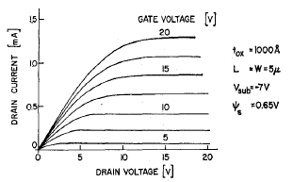
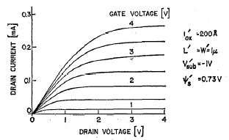
Dennard Scaling of MOS Devices
JSSC Oct 1974, page 256
In this ideal scaling, as L → α*L
V_{DD} → α*V_{DD}, C → α*C, i → α*i
Delay = CV_{DD}/I scales by α, so f → 1/α
Power for each transistor is CV²*f and scales by α²
keeping total power constant for same chip area

Slide 17
Frequency Scaled Too Fast 1993-2003

Slide 18
Total Processor Power Increased (super-scaling of frequency and chip size)

Slide 19
Post-Dennard Pivoting
Multiple cores with more moderate clock frequencies
Heavy use of vector execution
Employ both latency-oriented and throughput-oriented cores
3D packaging for more memory bandwidth

Slide 20
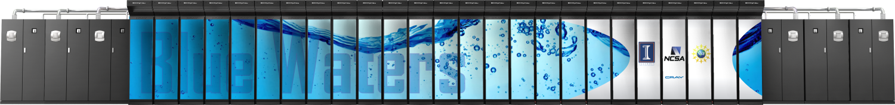

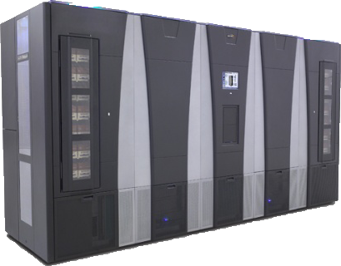
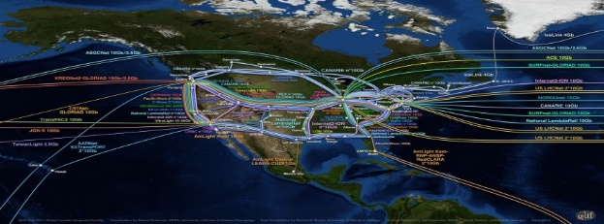
Blue Waters Computing System Operational at Illinois since 3/2013
49,504 CPUs -- 4,224 GPUs
12.5 PF
1.6 PB DRAM
$250M
10/40/100 Gb
Ethernet Switch
IB Switch
>1 TB/sec
120+ Gb/sec
100 GB/sec
WAN
Spectra Logic: 300 PBs
Sonexion: 26 PBs
Notes:
Note just compute – main memory (1.6PB); Disk (26PB); near line (300PB)

Slide 21










Cray XK7 Compute Node
PCIe Gen2
XK7 Compute Node Characteristics
AMD Series 6200 (Interlagos)
NVIDIA Kepler
Host Memory 32GB 1600 MT/s DDR3
NVIDIA Tesla X2090 Memory 6GB GDDR5 capacity
Gemini High Speed Interconnect
Keplers in final installation
HT3
HT3
Z
Y
X

Slide 22
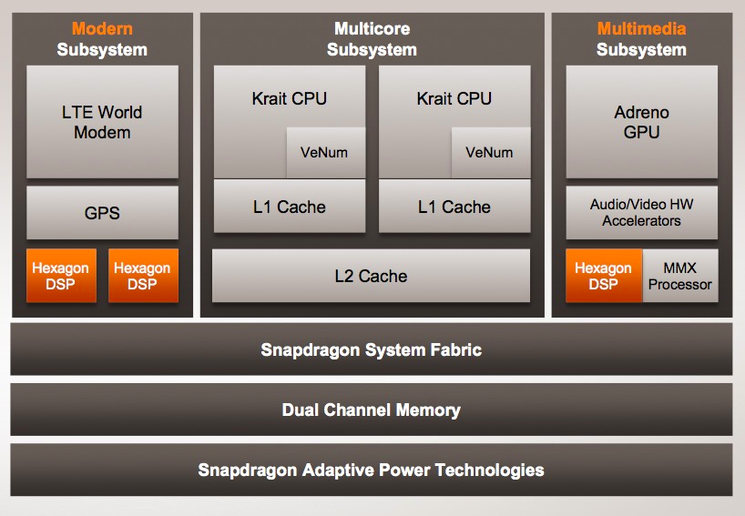
Qualcomm SoC for Mobile

Slide 23
CPUs: Latency Oriented Design
High clock frequency
Large caches
Convert long latency memory accesses to short latency cache accesses
Sophisticated control
Branch prediction for reduced branch latency
Data forwarding for reduced data latency
Powerful ALU
Reduced operation latency
Control
ALU
ALU
ALU
ALU
CPU
Cache
DRAM

Slide 24
GPUs: Throughput Oriented Design
Moderate clock frequency
Small caches
To boost memory throughput
Simple control
No branch prediction
No data forwarding
Energy efficient ALUs
Many, long latency but heavily pipelined for high throughput
Require massive number of threads to tolerate latencies
GPU
DRAM

Slide 25
Applications Benefit from Both CPU and GPU
CPUs for sequential parts where latency matters
CPUs can be 10+X faster than GPUs for sequential code
GPUs for parallel parts where throughput wins
GPUs can be 10+X faster than CPUs for parallel code

Slide 26
Winning Strategies Use Both CPU and GPU
CPUs for sequential parts where latency hurts
CPUs can be 10+X faster than GPUs for sequential code
GPUs for parallel parts where throughput wins
GPUs can be 10+X faster than CPUs for parallel code

Slide 27
Heterogeneous Parallel Computing Applications
Financial Analysis
Scientific Simulation
Engineering Simulation
Data Intensive Analytics
Medical Imaging
Digital Audio Processing
Digital Video Processing
Computer Vision
Machine Learning
Electronic Design Automation
Biomedical Informatics
Statistical Modeling
Ray Tracing Rendering
Interactive Physics
Numerical Methods

Slide 28
Parallel Programming Work Flow
Identify compute intensive parts of an application
Adopt/create scalable algorithms
Optimize data arrangements to maximize locality
Performance Tuning
Pay attention to code portability, scalability, and maintainability

Slide 29
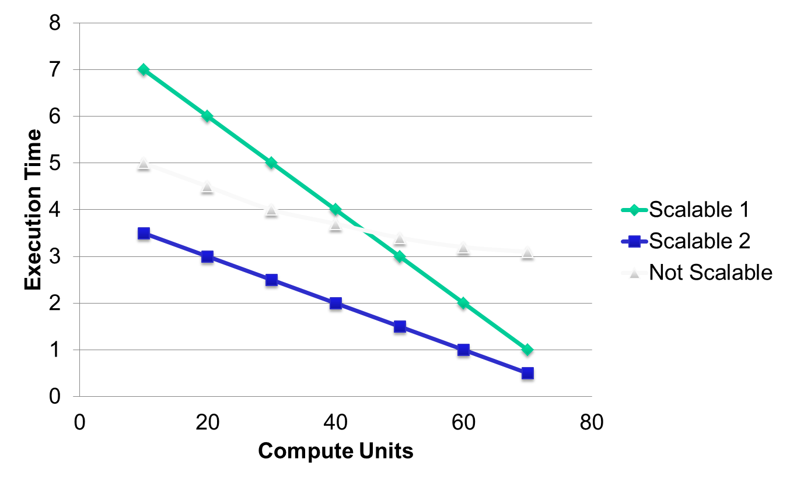
Parallelism Scalability

Slide 30
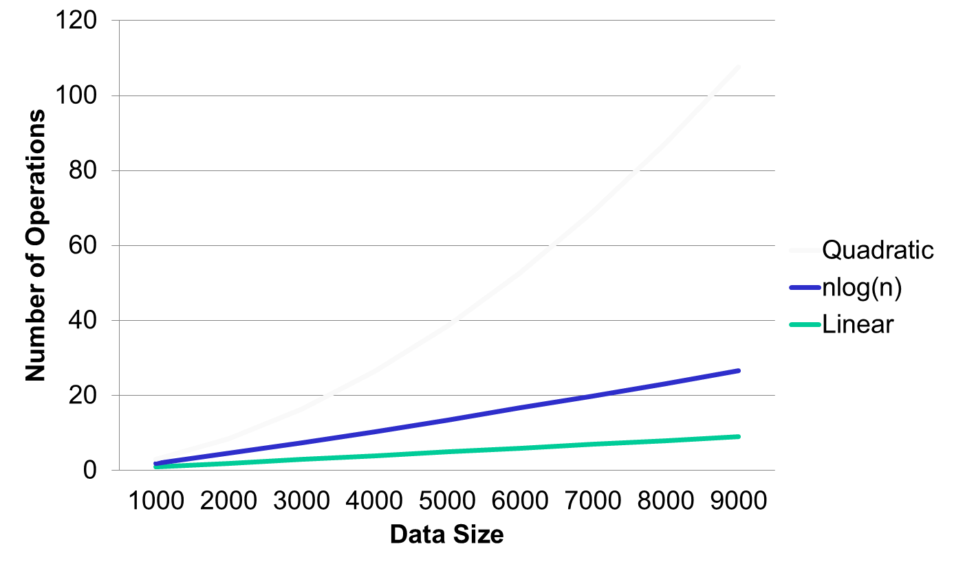
Algorithm Complexity and Data Scalability

Slide 31
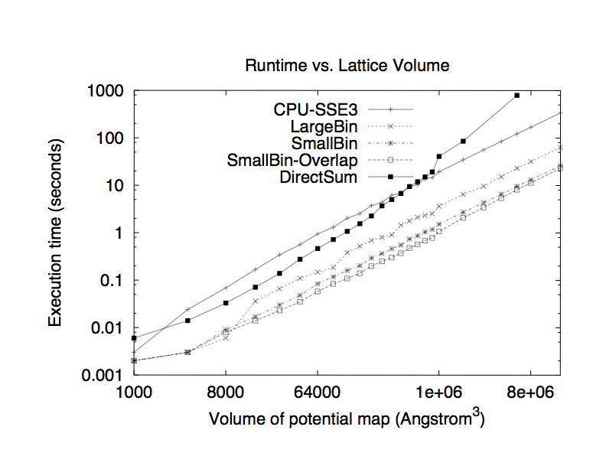
A Real Example of Data Scalability Particle-Mesh Algorithms

Slide 32

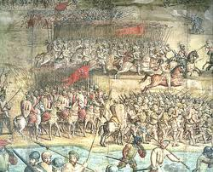
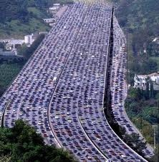
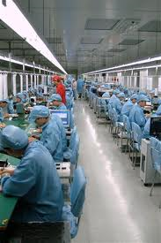
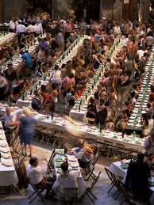

Massive Parallelism - Regularity

Slide 33
Load Balance
The total amount of time to complete a parallel job is limited by the thread that takes the longest to finish
good
bad!

Slide 34


Global Memory Bandwidth
Ideal
Reality

Slide 35


Conflicting Data Accesses Cause Serialization and Delays
Massively parallel execution cannot afford serialization
Contentions in accessing critical data causes serialization

Slide 36
What is the stake?
Scalable and portable software lasts through many hardware generations
Scalable algorithms and libraries can be the best legacy we can leave behind from this era

Slide 37
Any More Questions?

