Slide 1
Java programing
Lecture 1: Overview of Java

Slide 2
My name is Walugembe francis
Welcome to Java .
I am welcoming you to java. You may be coming to this ecosystem from another language, or maybe this is your first programming language.
Whatever road you may have traveled to get here:
welcome. Am glad you’ve arrived.

Slide 3
What is java?
Java is a high-level programming language originally developed by Sun Microsystems (James Gosling)
and released in 1995.
A general-purpose object-oriented language
Based on C/C++
Java runs on a variety of platforms (Windows, Mac OS, and the various versions of UNIX)

Slide 4
Java Features (1)
Object oriented
  Object − Objects have states and behaviors. Example: A dog has states - color, name, breed as well as behavior such as wagging their tail, barking, eating. An object is an instance of a class.
  Class − A class can be defined as a template/blueprint that describes the behavior/state that the object of its type supports.
  Methods − A method is basically a behavior. A class can contain many methods. It is in methods where the logics are written, data is manipulated and all the actions are executed.
  Instance Variables − Each object has its unique set of instance variables. An object's state is created by the values assigned to these instance variables.

Slide 5
Java Features (2)
Interpreted
  java compiler generate byte-codes, not native machine code
  the compiled byte-codes are platform-independent
  java bytecodes are translated on the fly to machine readable instructions in runtime (Java Virtual Machine)
Portable
  same application runs on all platforms
  the sizes of the primitive data types are always the same

Slide 6
Java Features (3)
Reliable
  extensive compile-time and runtime error checking
  no pointers but real arrays. Memory corruptions or unauthorized memory accesses are impossible
  automatic garbage collection tracks objects usage over time
Secure
  usage in networked environments requires more security
  memory allocation model is a major defense
  access restrictions are forced (private, public)

Slide 7
Java Features (4)
Multithreaded
  With Java's multithreaded feature it is possible to write programs that can perform many tasks simultaneously. This design feature allows the developers to construct interactive applications that can run smoothly.
  Dynamic
  Java is considered to be more dynamic than C or C++ since it is designed to adapt to an evolving environment. Java programs can carry extensive amount of run-time information that can be used to verify and resolve accesses to objects on run-time.

Slide 8
Java Disadvantages
Slower than compiled language such as C
  an experiment in 1999 showed that Java was 3 or 4 times slower than C or C++
  title of the article: “Comparing Java vs. C/C++ Efficiency Issues to Interpersonal Issues” (Lutz Prechelt)
  adequate for all but the most time-intensive programs

Slide 9
Environment Setup
For performing the examples discussed in this class, you will need a Pentium 200-MHz computer with a minimum of 64 MB of RAM (128 MB of RAM recommended).
You will also need the following softwares −
Linux 7.1 or Windows xp/7/8 operating system
Java JDK 8
Microsoft Notepad and netbeans

Slide 10
Getting Started: (1)
(1) Create the source file:
  open a text editor, type in the code which defines a class (HelloWorldApp) and then save it in a file (HelloWorldApp.java)
  file and class name are case sensitive and must be matched exactly (except the .java part)
  Example Code: HelloWorldApp.java
  /**
  * The HelloWorldApp class implements an application
  * that displays "Hello World!" to the standard output
  */
  public class HelloWorldApp {
  public static void main(String[] args) {
  // Display "Hello World!"
  System.out.println("Hello World!");
  }
  }
Java is CASE SENSITIVE!

Slide 11
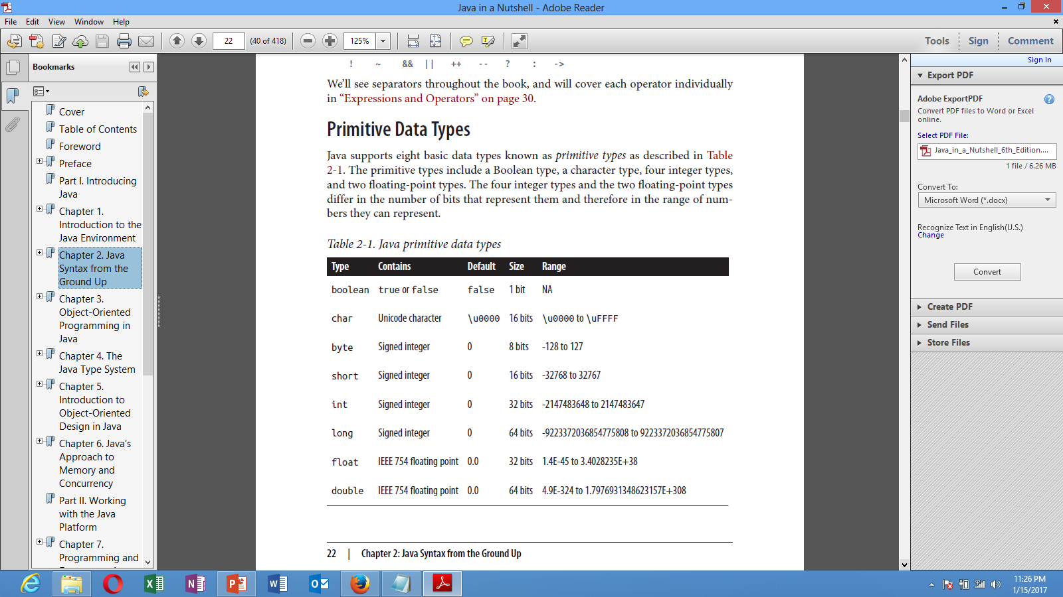
Language basics (1)
Data types
  8 primitive types:
    boolean, byte, short, int, long, float, double, char

Slide 12
Variables
  dataType identifier [ = Expression]:
  Example variable dec
  larations and initializations:
  int a, b, c; // Declares three ints, a, b, and c.
  int a = 10, b = 10; // Example of initialization
  byte B = 22; // initializes a byte type variable B.
  double pi = 3.14159; // declares and assigns a value of PI.
  char a = 'a'; // the char variable a iis initialized with value 'a'

Slide 13
public class Area {
/**
* @param args the command line arguments
*/
public static void main(String[] args) {
// TODO code application logic here
int r;
double pi = 3.14, area;
Scanner s = new Scanner(System.in);
System.out.print("Enter radius of circle:");
r = s.nextInt();
area = pi * r * r;
System.out.println("Area of circle:"+area);
}
}

Slide 14
Basic Syntax
About Java programs, it is very important to keep in mind the following points.
Case Sensitivity − Java is case sensitive, which means identifier Hello and hello would have different meaning in Java.
Class Names − For all class names the first letter should be in Upper Case. If several words are used to form a name of the class, each inner word's first letter should be in Upper Case.
Example: class MyFirstJavaClass

Slide 15
Method Names − All method names should start with a Lower Case letter. If several words are used to form the name of the method, then each inner word's first letter should be in Upper Case.
Example: public void myMethodName()
Program File Name − Name of the program file should exactly match the class name.
When saving the file, you should save it using the class name (Remember Java is case sensitive) and append '.java' to the end of the name (if the file name and the class name do not match, your program will not compile).
Example: Assume 'MyFirstJavaProgram' is the class name. Then the file should be saved as 'MyFirstJavaProgram.java'
public static void main(String args[]) − Java program processing starts from the main() method which is a mandatory part of every Java program.

Slide 16
Java Identifiers
All Java components require names. Names used for classes, variables, and methods are called identifiers.
In Java, there are several points to remember about identifiers. They are as follows −
All identifiers should begin with a letter (A to Z or a to z), currency character ($) or an underscore (_).
After the first character, identifiers can have any combination of characters.
A key word cannot be used as an identifier.
Most importantly, identifiers are case sensitive.
Examples of legal identifiers: age, $salary, _value, __1_value.
Examples of illegal identifiers: 123abc, -salary.

Slide 17
Java Modifiers
Like other languages, it is possible to modify classes, methods, etc., by using modifiers. There are two categories of modifiers −
Access Modifiers − default, public , protected, private
Non-access Modifiers − final, abstract.We will be looking into more details about modifiers in the next section.

Slide 18
Java Variables
Following are the types of variables in Java −
Local Variables
Class Variables (Static Variables)
Instance Variables (Non-static Variables)

