Slide 1
Java programing
Lecture 4:

Slide 2
Java - Loop Control
A loop statement allows us to execute a statement or group of statements multiple times and following is the general form of a loop statement in most of the programming languages.

Slide 3
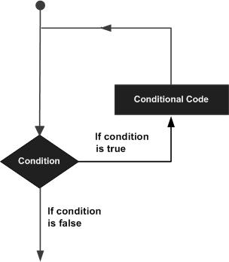
Example

Slide 4
Types of loop
  for loop
  Execute a sequence of statements multiple times and abbreviates the code that manages the loop variable.
  while loop
  Repeats a statement or group of statements while a given condition is true. It tests the condition before executing the loop body.
  do...while loop
  Like a while statement, except that it tests the condition at the end of the loop body.

Slide 5
Loop Control Statements
  1 break statement
  Terminates the loop or switch statement and transfers execution to the statement immediately following the loop or switch.
  2 continue statement
  Causes the loop to skip the remainder of its body and immediately retest its condition prior to reiterating.

Slide 6
Enhanced for loop in Java
As of Java 5, the enhanced for loop was introduced. This is mainly used to traverse collection of elements including arrays.
Syntax
Following is the syntax of enhanced for loop −
for(declaration : expression) {
// Statements
}
Declaration − The newly declared block variable, is of a type compatible with the elements of the array you are accessing. The variable will be available within the for block and its value would be the same as the current array element.
Expression − This evaluates to the array you need to loop through. The expression can be an array variable or method call that returns an array.

Slide 7
public class Test {
public static void main(String args[]) {
int [] numbers = {10, 20, 30, 40, 50};
for(int x : numbers ) {
System.out.print( x );
System.out.print(",");
}
System.out.print("\n");
String [] names = {"James", "Larry", "Tom", "Lacy"};
for( String name : names ) {
System.out.print( name );
System.out.print(",");
}
}
}

Slide 8
Java - Decision Making
Decision making structures have one or more conditions to be evaluated or tested by the program, along with a statement or statements that are to be executed if the condition is determined to be true, and optionally, other statements to be executed if the condition is determined to be false.

Slide 9
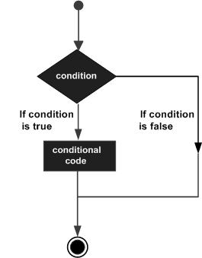
Decision making structure

Slide 10
Statement & Description
if statement
An if statement consists of a boolean expression followed by one or more statements.
if...else statement
An if statement can be followed by an optional else statement, which executes when the boolean expression is false.
nested if statement
You can use one if or else if statement inside another if or else if statement(s).
switch statement
A switch statement allows a variable to be tested for equality against a list of values.

Slide 11
Syntax
if(Boolean_expression) {
// Executes when the Boolean expression is true
}else {
// Executes when the Boolean expression is false
}

Slide 12
Example
public class Test {
public static void main(String args[]) {
int x = 30;
if( x < 20 ) {
System.out.print("This is if statement");
}else {
System.out.print("This is else statement");
}
}
}

Slide 13
The if...else if...else Statement
An if statement can be followed by an optional else if...else statement, which is very useful to test various conditions using single if...else if statement.
When using if, else if, else statements there are a few points to keep in mind.
An if can have zero or one else's and it must come after any else if's.
An if can have zero to many else if's and they must come before the else.
Once an else if succeeds, none of the remaining else if's or else's will be tested.

Slide 14
public class Test {
public static void main(String args[]) {
int x = 30;
if( x == 10 ) {
System.out.print("Value of X is 10");
}else if( x == 20 ) {
System.out.print("Value of X is 20");
}else if( x == 30 ) {
System.out.print("Value of X is 30");
}else {
System.out.print("This is else statement");
}
}
}

Slide 15
The ? : Operator
We have covered conditional operator ? : in the previous chapter which can be used to replace if...else statements. It has the following general form −
Statement & Description
1 Exp1 ? Exp2 : Exp3;

Slide 16
Where Exp1, Exp2, and Exp3 are expressions. Notice the use and placement of the colon.
To determine the value of the whole expression, initially exp1 is evaluated.
If the value of exp1 is true, then the value of Exp2 will be the value of the whole expression.
If the value of exp1 is false, then Exp3 is evaluated and its value becomes the value of the entire expression.

Slide 17
Basic Syntax
About Java programs, it is very important to keep in mind the following points.
Case Sensitivity − Java is case sensitive, which means identifier Hello and hello would have different meaning in Java.
Class Names − For all class names the first letter should be in Upper Case. If several words are used to form a name of the class, each inner word's first letter should be in Upper Case.
Example: class MyFirstJavaClass

Slide 18
Method Names − All method names should start with a Lower Case letter. If several words are used to form the name of the method, then each inner word's first letter should be in Upper Case.
Example: public void myMethodName()
Program File Name − Name of the program file should exactly match the class name.
When saving the file, you should save it using the class name (Remember Java is case sensitive) and append '.java' to the end of the name (if the file name and the class name do not match, your program will not compile).
Example: Assume 'MyFirstJavaProgram' is the class name. Then the file should be saved as 'MyFirstJavaProgram.java'
public static void main(String args[]) − Java program processing starts from the main() method which is a mandatory part of every Java program.

Slide 19
Java Identifiers
All Java components require names. Names used for classes, variables, and methods are called identifiers.
In Java, there are several points to remember about identifiers. They are as follows −
All identifiers should begin with a letter (A to Z or a to z), currency character ($) or an underscore (_).
After the first character, identifiers can have any combination of characters.
A key word cannot be used as an identifier.
Most importantly, identifiers are case sensitive.
Examples of legal identifiers: age, $salary, _value, __1_value.
Examples of illegal identifiers: 123abc, -salary.

Slide 20
Java Modifiers
Like other languages, it is possible to modify classes, methods, etc., by using modifiers. There are two categories of modifiers −
Access Modifiers − default, public , protected, private
Non-access Modifiers − final, abstract.We will be looking into more details about modifiers in the next section.

Slide 21
Java Variables
Following are the types of variables in Java −
Local Variables
Class Variables (Static Variables)
Instance Variables (Non-static Variables)

