Slide 1
Java programing
Lecture:7 Java - Inheritance

Slide 2
Inheritance
Inheritance can be defined as the process where one class acquires the properties (methods and fields) of another. With the use of inheritance the information is made manageable in a hierarchical order.
The class which inherits the properties of other is known as subclass (derived class, child class) and the class whose properties are inherited is known as superclass (base class, parent class).

Slide 3
extends Keyword
extends is the keyword used to inherit the properties of a class. Following is the syntax of extends keyword.
class Super {
.....
.....
}
class Sub extends Super {
.....
.....
}

Slide 4
Sample Code
Following is an example demonstrating Java inheritance. In this example, you can observe two classes namely Calculation and My_Calculation.
Using extends keyword, the My_Calculation inherits the methods addition() and Subtraction() of Calculation class.

Slide 5
Example
class Calculation {
int z;
public void addition(int x, int y) {
z = x + y;
System.out.println("The sum of the given numbers:"+z);
}
public void Subtraction(int x, int y) {
z = x - y;
System.out.println("The difference between the given numbers:"+z);
}
}
public class My_Calculation extends Calculation {
public void multiplication(int x, int y) {
z = x * y;
System.out.println("The product of the given numbers:"+z);
}
public static void main(String args[]) {
int a = 20, b = 10;
My_Calculation demo = new My_Calculation();
demo.addition(a, b);
demo.Subtraction(a, b);
demo.multiplication(a, b);
}
}

Slide 6
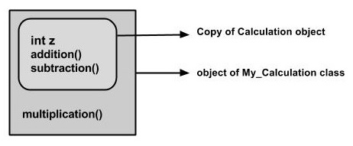
explanation
In the given program, when an object to My_Calculation class is created, a copy of the contents of the superclass is made within it. That is why, using the object of the subclass you can access the members of a superclass.

Slide 7
The Superclass reference variable can hold the subclass object, but using that variable you can access only the members of the superclass, so to access the members of both classes it is recommended to always create reference variable to the subclass.
If you consider the above program, you can instantiate the class as given below. But using the superclass reference variable ( cal in this case) you cannot call the method multiplication(), which belongs to the subclass My_Calculation.
Calculation cal = new My_Calculation();
demo.addition(a, b);
demo.Subtraction(a, b);

Slide 8
Note
A subclass inherits all the members (fields, methods, and nested classes) from its superclass. Constructors are not members, so they are not inherited by subclasses, but the constructor of the superclass can be invoked from the subclass.

Slide 9
The super keyword
The super keyword is similar to this keyword. Following are the scenarios where the super keyword is used.
It is used to differentiate the members of superclass from the members of subclass, if they have same names.
It is used to invoke the superclass constructor from subclass.
Differentiating the Members
If a class is inheriting the properties of another class. And if the members of the superclass have the names same as the sub class, to differentiate these variables we use super keyword as shown below.
super.variable
super.method();

Slide 10
public class Sub_class extends Super_class {
int num = 10;
// display method of sub class
public void display() {
System.out.println("This is the display method of subclass");
}
public void my_method() {
// Instantiating subclass
Sub_class sub = new Sub_class();
// Invoking the display() method of sub class
sub.display();
// Invoking the display() method of superclass
super.display();
// printing the value of variable num of subclass
System.out.println("value of the variable named num in sub class:"+ sub.num);
// printing the value of variable num of superclass
System.out.println("value of the variable named num in super class:"+ super.num);
}
public static void main(String args[]) {
Sub_class obj = new Sub_class();
obj.my_method();
}
}

Slide 11
Invoking Superclass Constructor
If a class is inheriting the properties of another class, the subclass automatically acquires the default constructor of the superclass. But if you want to call a parameterized constructor of the superclass, you need to use the super keyword as shown below.
super(values);
Sample Code
The program given in this section demonstrates how to use the super keyword to invoke the parametrized constructor of the superclass. This program contains a superclass and a subclass, where the superclass contains a parameterized constructor which accepts a string value, and we used the super keyword to invoke the parameterized constructor of the superclass.

Slide 12
class Superclass {
int age;
Superclass(int age) {
this.age = age;
}
public void getAge() {
System.out.println("The value of the variable named age in super class is: " +age);
}
}
public class Subclass extends Superclass {
Subclass(int age) {
super(age);
}
public static void main(String argd[]) {
Subclass s = new Subclass(24);
s.getAge();
}
}

Slide 13
IS-A Relationship
public class Animal {
}
public class Mammal extends Animal {
}
public class Reptile extends Animal {
}
public class Dog extends Mammal {
}

Slide 14
Now, if we consider the IS-A relationship, we can say −
Mammal IS-A Animal
Reptile IS-A Animal
Dog IS-A Mammal
Hence: Dog IS-A Animal as well

Slide 15
class Animal {
}
class Mammal extends Animal {
}
class Reptile extends Animal {
}
public class Dog extends Mammal {
public static void main(String args[]) {
Animal a = new Animal();
Mammal m = new Mammal();
Dog d = new Dog();
System.out.println(m instanceof Animal);
System.out.println(d instanceof Mammal);
System.out.println(d instanceof Animal);
}
}

Slide 16
The instanceof Keyword
interface Animal{}
class Mammal implements Animal{}
public class Dog extends Mammal {
public static void main(String args[]) {
Mammal m = new Mammal();
Dog d = new Dog();
System.out.println(m instanceof Animal);
System.out.println(d instanceof Mammal);
System.out.println(d instanceof Animal);
}
}

Slide 17
HAS-A relationship
These relationships are mainly based on the usage. This determines whether a certain class HAS-A certain thing. This relationship helps to reduce duplication of code as well as bugs.

Slide 18
public class Vehicle{}
public class Speed{}
public class Van extends Vehicle {
private Speed sp;
}

Slide 19
This shows that class Van HAS-A Speed. By having a separate class for Speed, we do not have to put the entire code that belongs to speed inside the Van class, which makes it possible to reuse the Speed class in multiple applications.

Slide 20
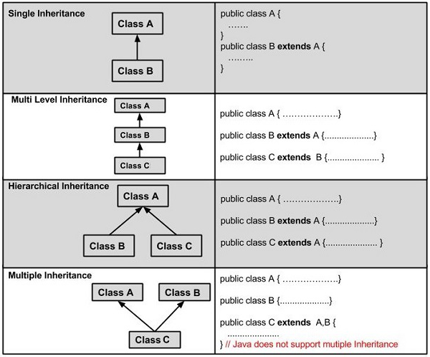
Types of Inheritance

