Slide 1



rOpengov project: a community of R package developers on open government data analytics
Aalto HELDIG DH pizza seminar 6.5.2022
Pyry Kantanen, Leo Lahti
Tämä kuva, tekijä Tuntematon tekijä, käyttöoikeus: CC BY
Tämä kuva, tekijä Tuntematon tekijä, käyttöoikeus: CC BY

Slide 2
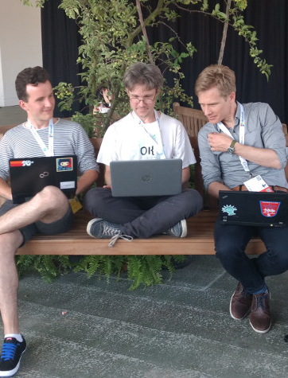

About rOpenGov
Started in 2010
Winning entry in Apps4Finland 2011 competition
Core team: Leo Lahti, Markus Kainu, Joona Lehtomäki, Juuso Parkkinen, Pyry Kantanen
Finnish collaborators: Janne Huovari (PTT), Jussi Paananen, Juho Kopra, Tuomo Nieminen (THL) among others
Joona, Leo and Markus representing rOpenGov in useR! 2017 conference in Brussels

Slide 3
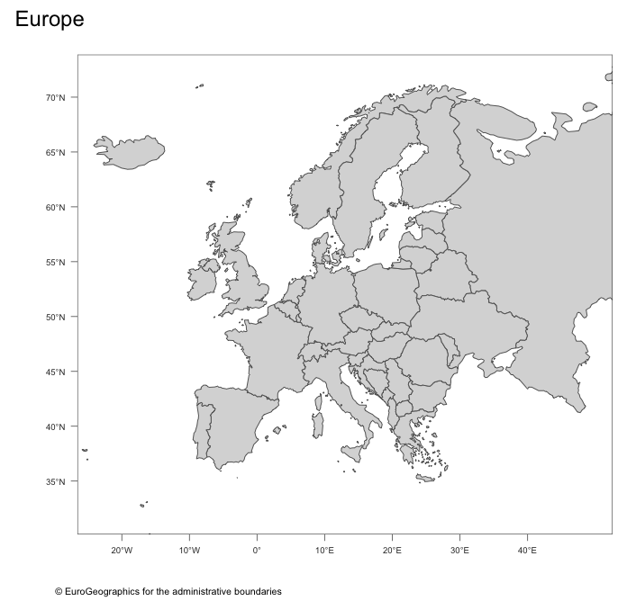
International collaborators
Måns Magnusson (SE)
sweidnumbr
pxweb
Kenneth Rose (DK)
dkstat
Przemysław Biecek (PL)
eurostat
europarl
Daniel Antal (BE)
regions
retroharmonize
iotables
Christopher Gandrud (DE)
psdata
Scott Chamberlain (US)
rsunlight
rtimes
enigma
Thomas Leeper (UK)
federalregister
mpg
Rpublica
pollstR
Diego Hernandez (ES)
giscoR
François Briatte (FR)
psdata
MM
KR
SC
TL
PB
DA
CG
FB
DH

Slide 4
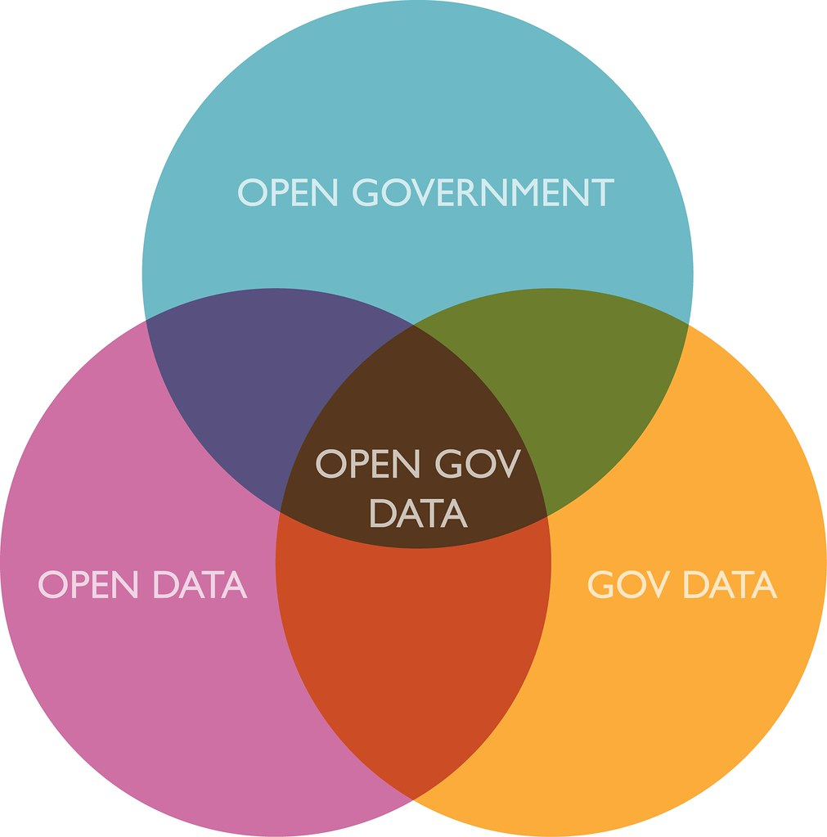

Definitions
Open data
Government Data
Open Government Data
Examples of Open Government Data
Illustration by Justin Grimes, CC BY-SA 2.0

Slide 5

Open + Government + Data
Open data
Data that can be freely used, re-used and distributed by anyone, only subject to (at the most) the requirement that users attribute the data and that they make their work available to be shared as well.”
Government Data
Any data and information produced or commissioned by public bodies.”
Source: Ubaldi, B. (2013), "Open Government Data: Towards Empirical Analysis of Open Government Data Initiatives", OECD Working Papers on Public Governance, No. 22, OECD Publishing, Paris, https://doi.org/10.1787/5k46bj4f03s7-en

Slide 6
Open Government Data
Any data and information produced or commissioned by public bodies that can be freely used, re-used and distributed by anyone.

Slide 7
Examples of Open Government Data from OECD¹
business information
Chamber of Commerce information, official business
registers, patent and trademark information, public tender databases
geographic information
address information, aerial photos, buildings, cadastral or land registry data, geodetic networks, hydrographical data, topographic information
legal information
meteorological information
climate data, climate models, weather forecasts
social data
various types of statistics on economics, employment, health, population, public administration
transport information
traffic congestion, work on roads, public transport, vehicle registration
[1] Ubaldi, B. (2013), "Open Government Data: Towards Empirical Analysis of Open Government Data Initiatives", OECD Working Papers on Public Governance, No. 22, OECD Publishing, Paris, https://doi.org/10.1787/5k46bj4f03s7-en

Slide 8
rOpenGov packages: Things already covered
Geographic information
geofi
giscoR
regions
helsinki
Meteorological information
fmi2
Social data
eurostat
pxweb
sotkanet
hetu & sweidnumbr
openthl² (with THL collaborators)
vipunen¹
Transport information
turku-package²
digitransit¹
[1] currently unmaintained
[2] unreleased, work-in-progress

Slide 9

rOpenGov packages: Things yet to be done, in Open Government Data
business information
registers, patent and trademark information, public tender databases
legal information

Slide 10
Use case: Tilastot kartalle¹
Entry to Statistic Finland’s Datamenestyjät-competition² 2021
Easily produce choropleth maps with leaflet by combining geofi, pxweb and sotkanet packages with Shiny interface
Output working R code that the user can further edit and refine
[1] ”statistics on the map”
[2] ”data achievers” -competition

Slide 11
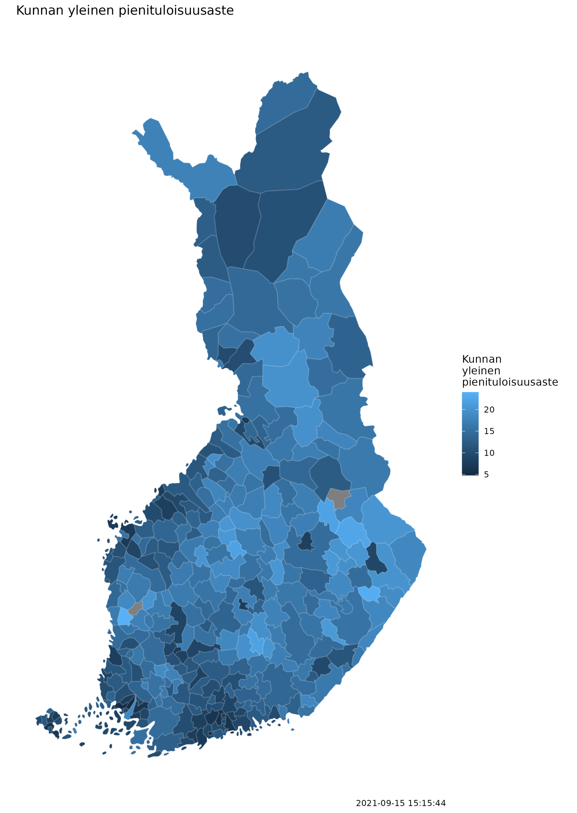

Example 1/3
Data source: Sotkanet
At-risk-of-poverty rate (% of total population)
Boundaries by municipality
Year: 2018

Slide 12
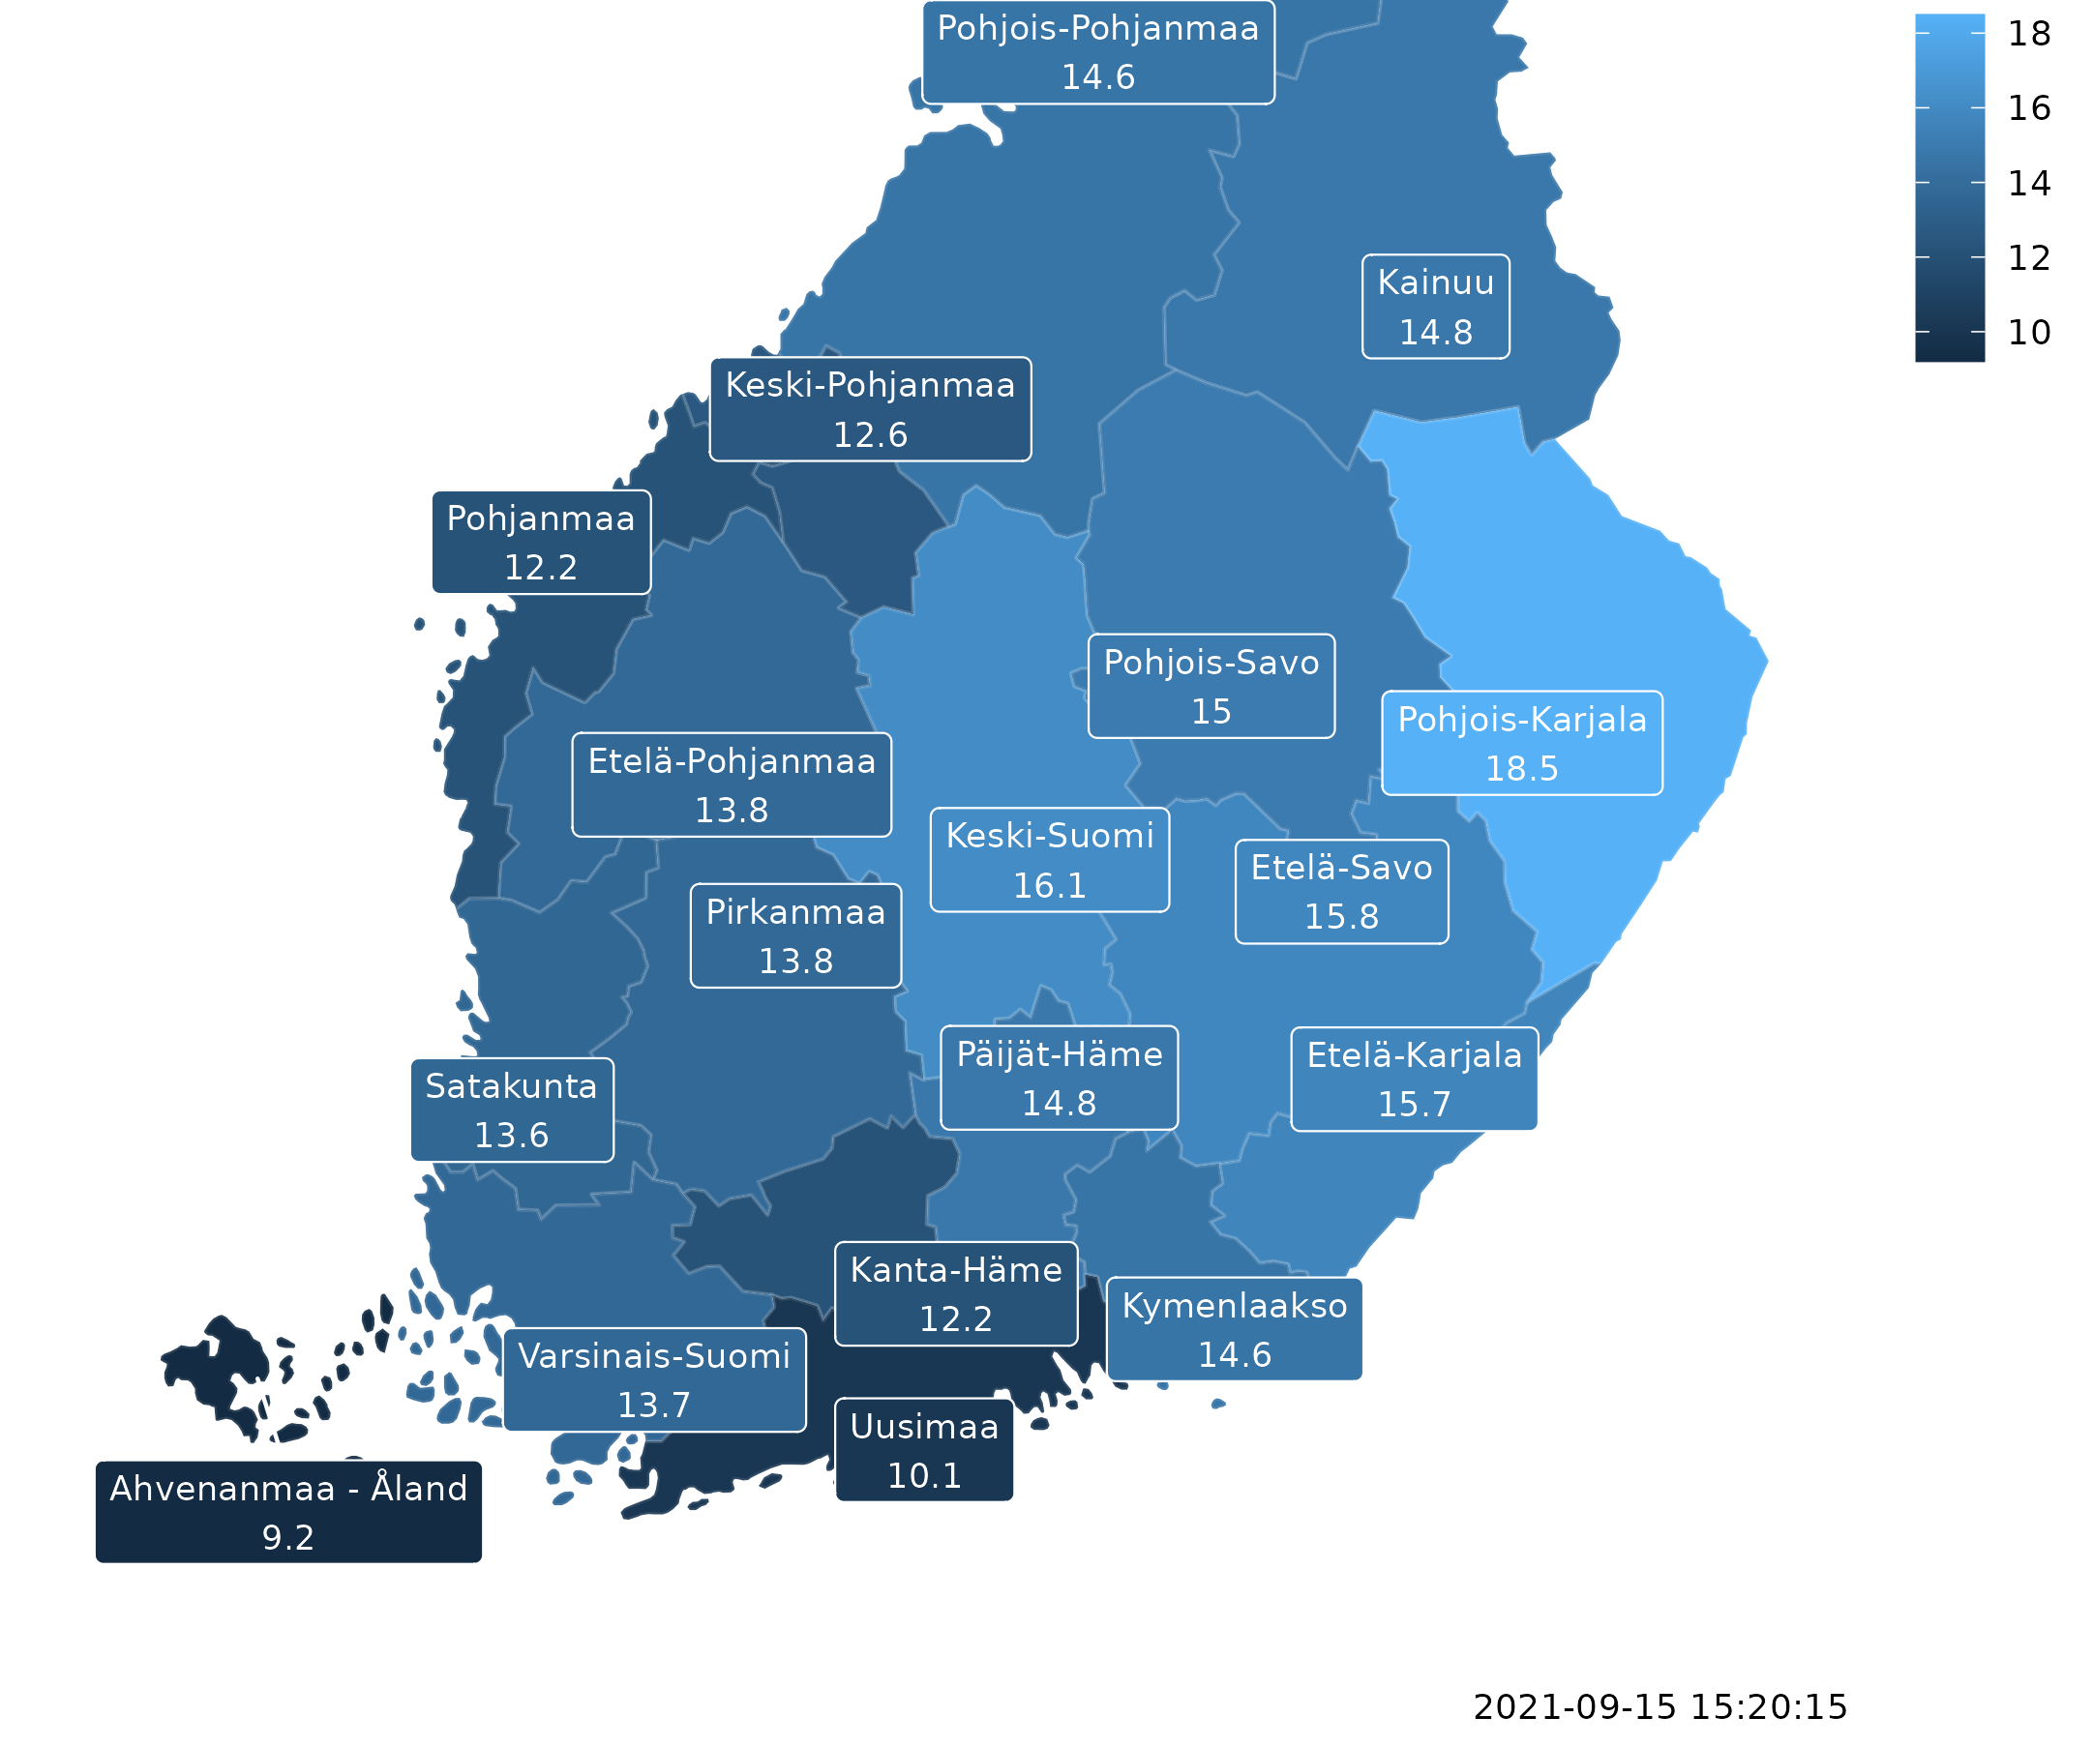
Example 2/3
Data source: Sotkanet
At-risk-of-poverty rate (% of total population)
Boundaries by region (maakunta) - a very common level of aggregation!
Year: 2018

Slide 13
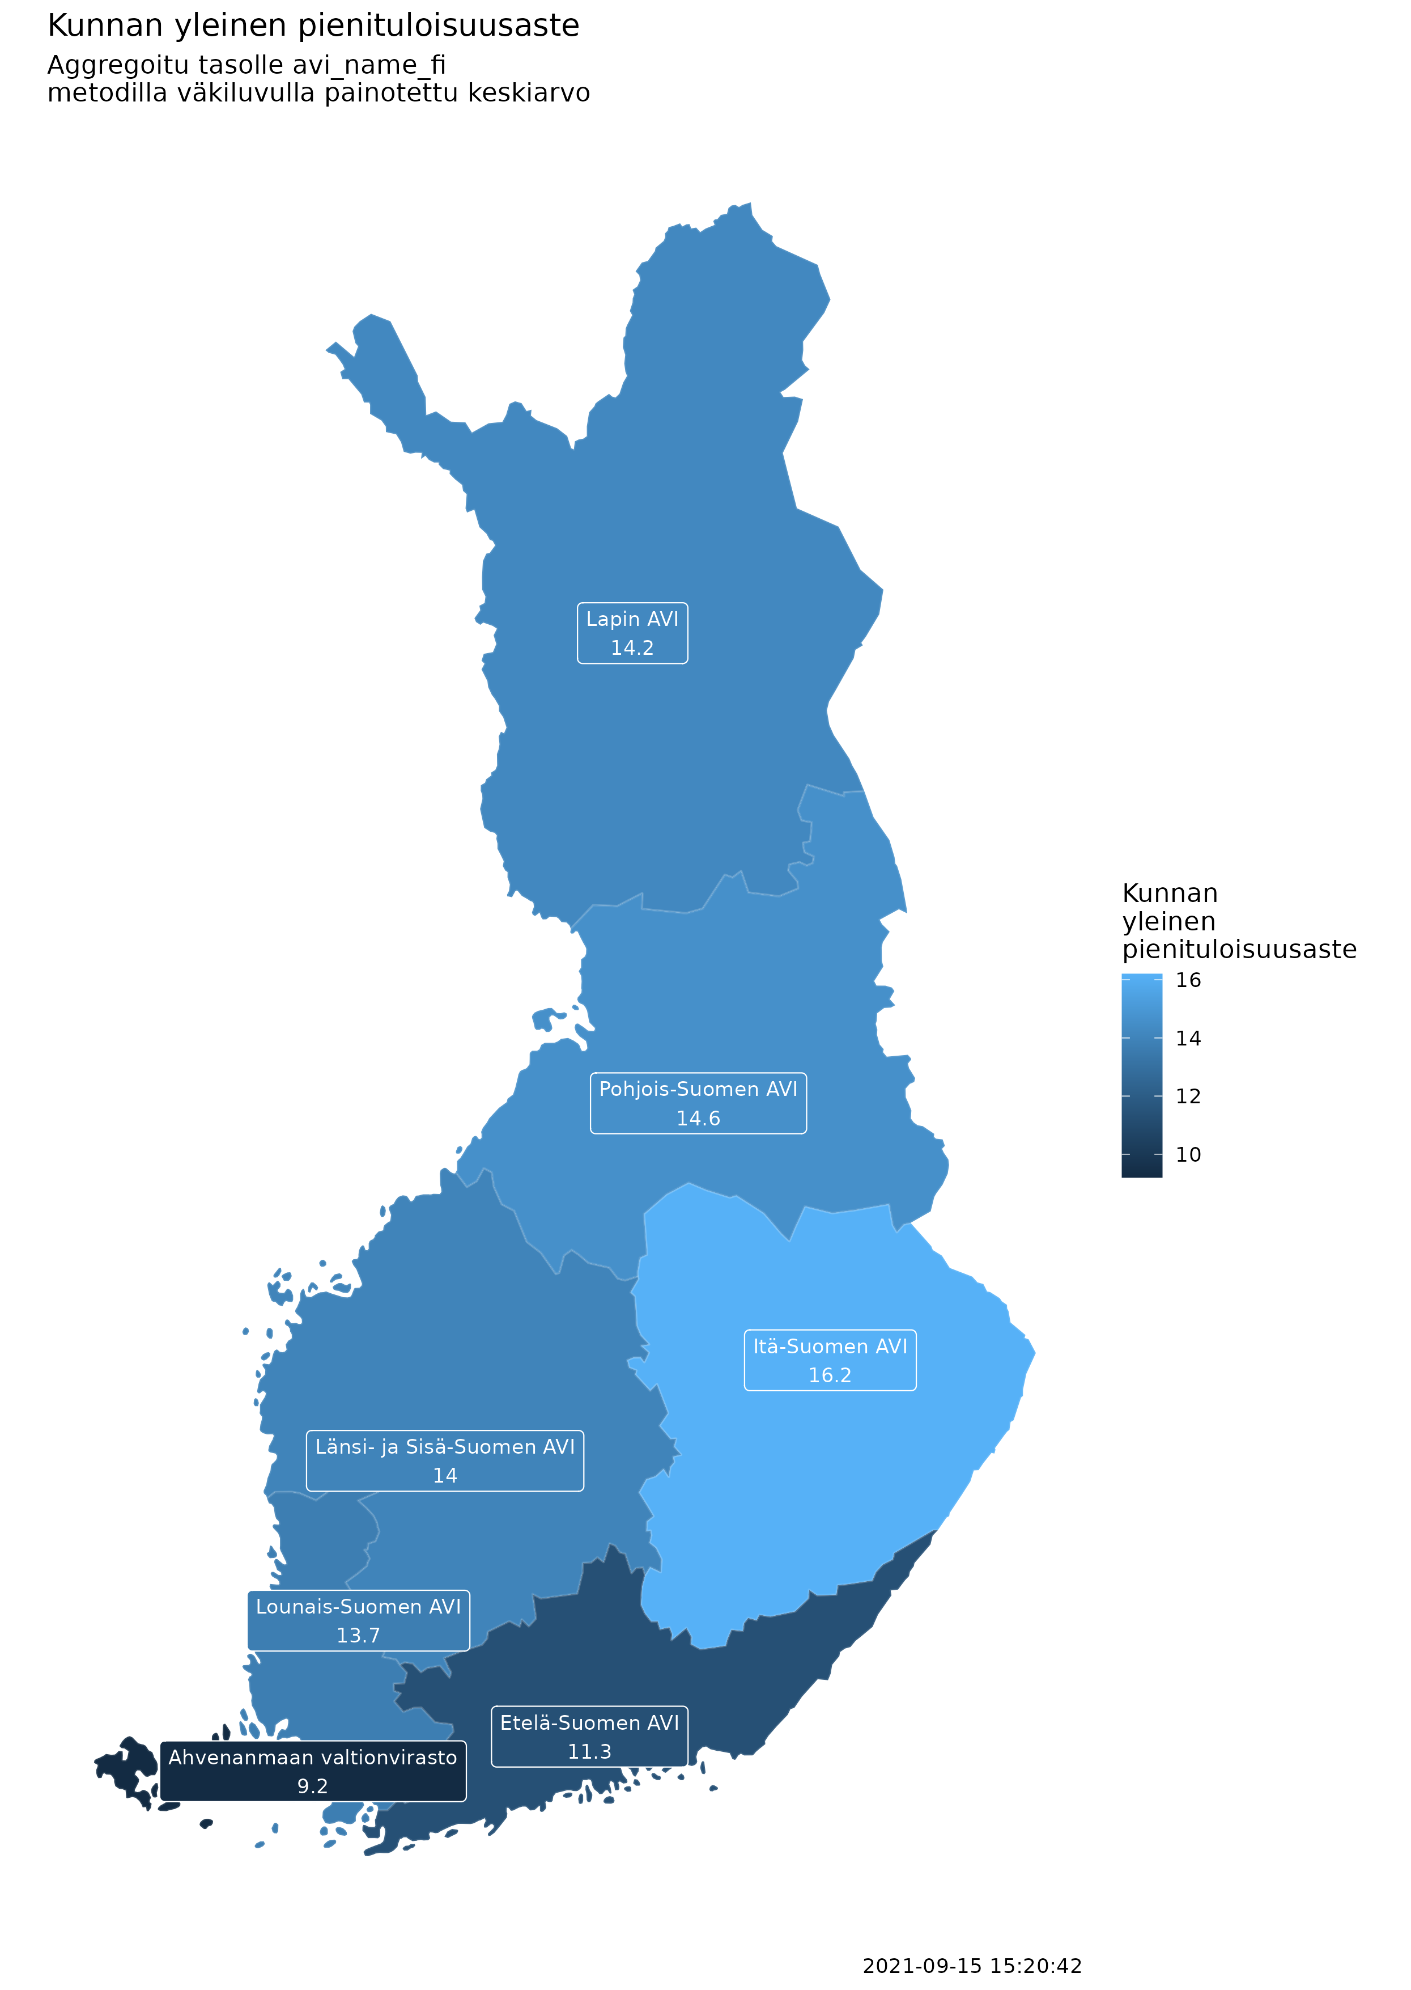
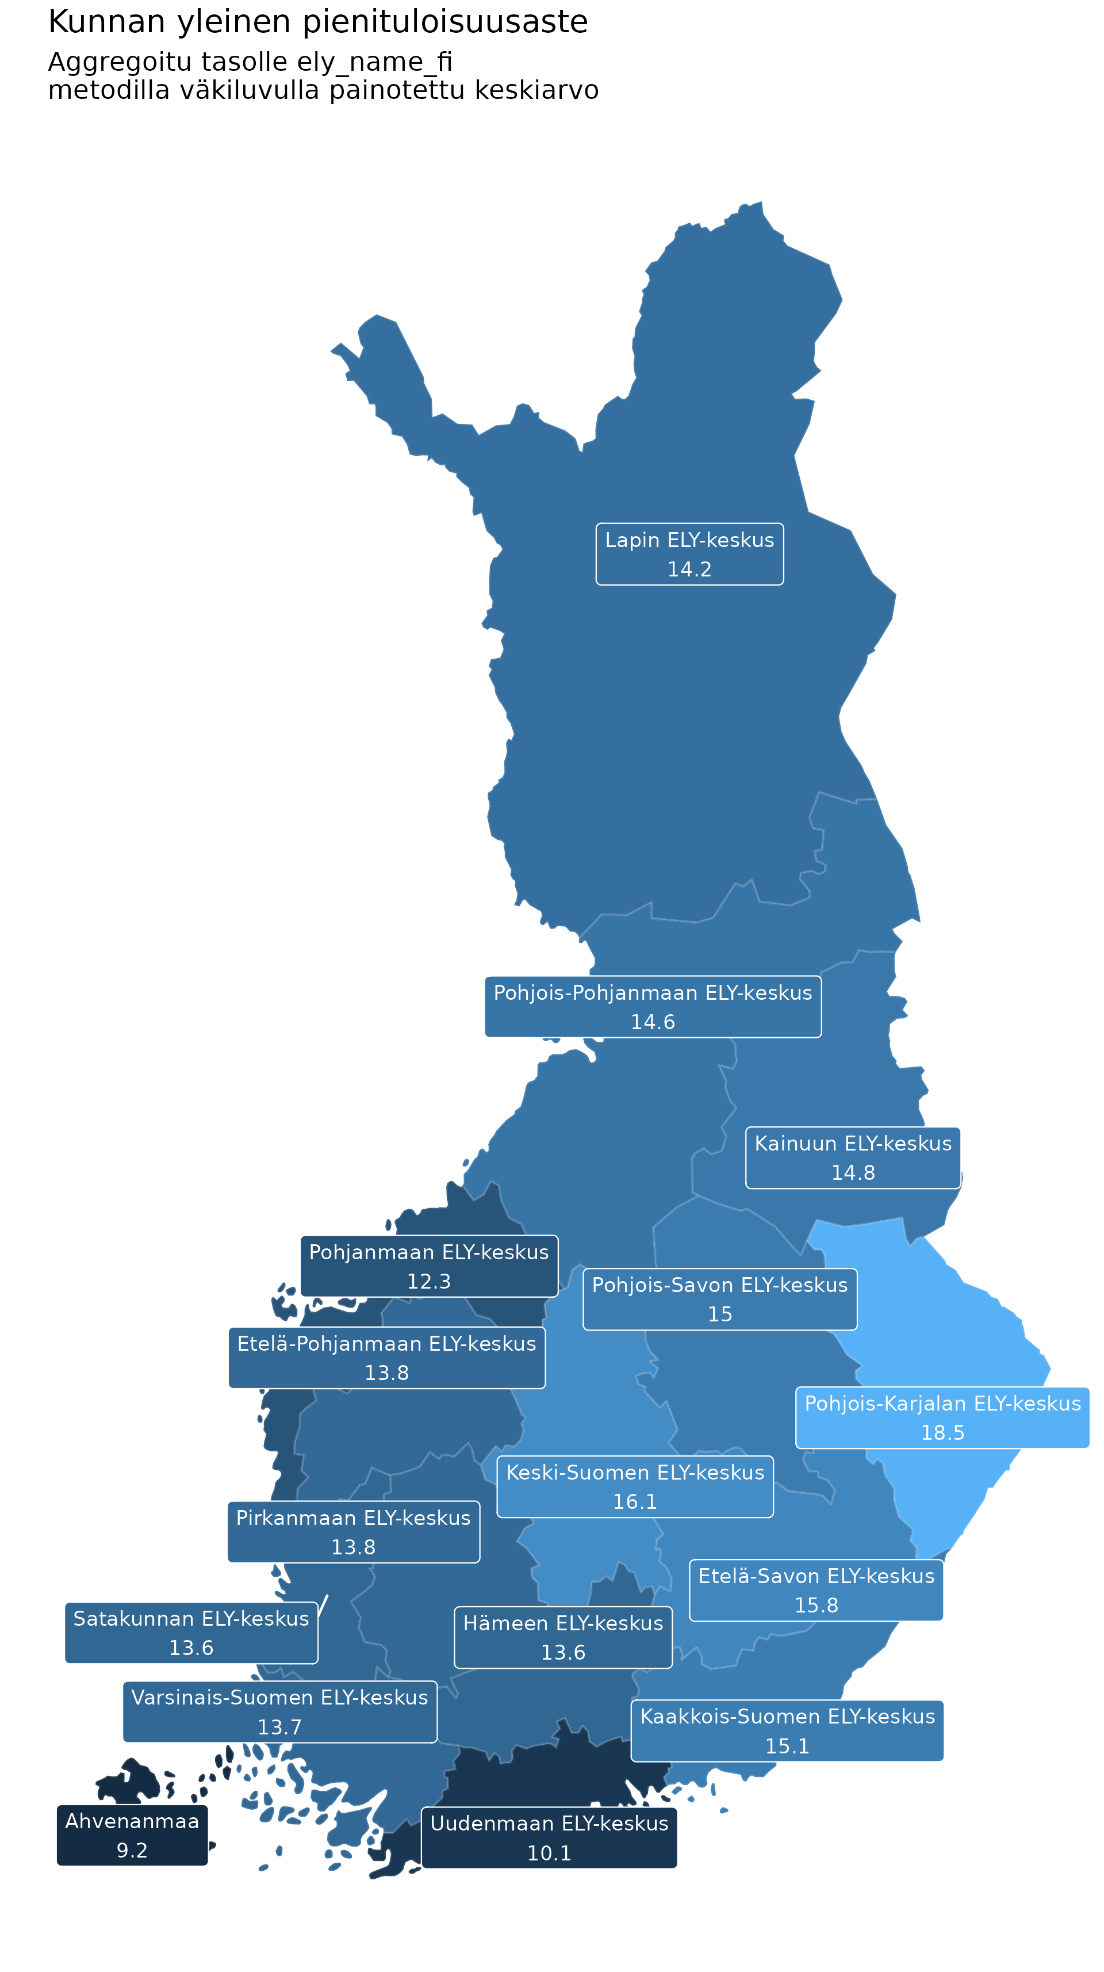
Example 3/3
Data source: Sotkanet
At-risk-of-poverty rate (% of total population)
Boundaries by
regional state administrative agency areas (avi-alue) and
centre for economic development areas (ely-alue)
Year: 2018

Slide 14
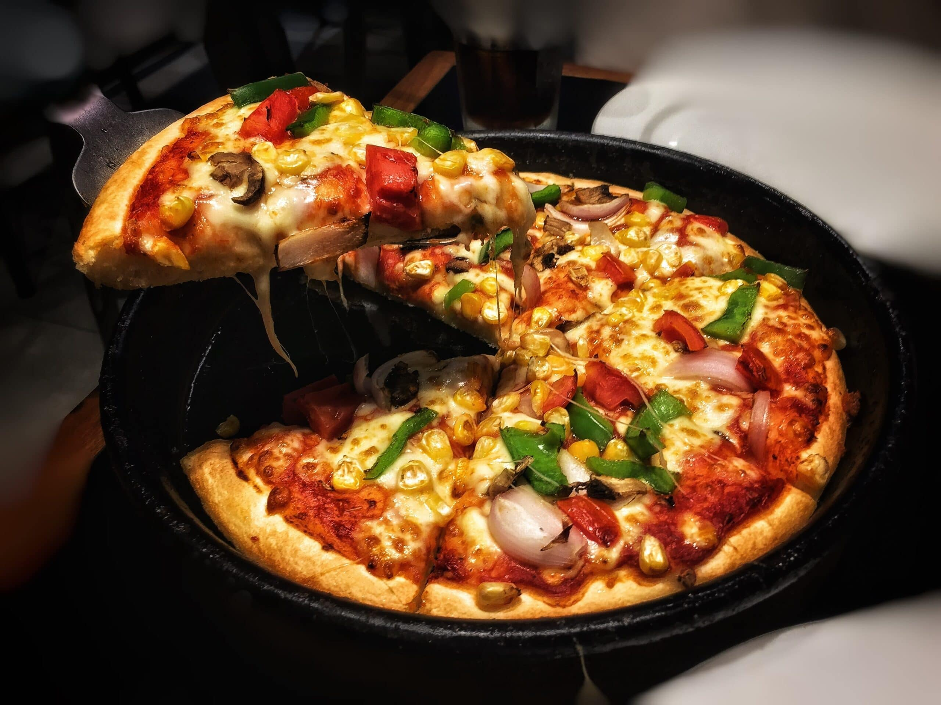
Open Government Data and Digital Humanities
Tämä kuva, tekijä Tuntematon tekijä, käyttöoikeus: CC BY

Slide 15
rOpenGov packages: Things yet to be done
business information
registers, patent and trademark information, public tender databases
legal information
What about categories not covered by OECD?

Slide 16
rOpenGov packages: Things yet to be done, in Digital Humanities 1/3
For social scientists statistical information produced by different (government) institutions for describing the structures and quantifiable qualities of people living in modern societies may be sufficient
For DH scientists studying languages, literature, history, ethics etc. abovementioned things are not sufficient for studying “how people document and process the human experience”
May be helpful as as explanatory variables

Slide 17
rOpenGov packages: Things yet to be done, in Digital Humanities 2/3
Creating an easily accessible dataset of historical administrative divisions in Finland, for example:
municipalities before municipal mergers
hundreds (kihlakunta)
fiefs (lääni)
dioceses (hiippakunta)
sockens (pitäjä)
Making historical demographic data (e.g. births, marriages, deaths from parish records (HisKi)) more easily accessible
Notes:
- This would make it possible to see how certain regions have developed in the scope of hundreds of years instead of restricting ourselves to the 20th century

Slide 18
rOpenGov packages: Things yet to be done, in Digital Humanities 3/3
Building data pipelines and reusable infrastructure on top of CSC services
Current example: bibliographic data harmonization
Currently relying heavily on GitHub tools and GitHub Actions
Solving the problem of long-term storage of statistical and geospatial data

Slide 19
What’s next for rOpenGov, as a collaborative project
We are always looking to grow our community of R developers interested in open (government) data
Special focus in fostering the use of R and in part building a sense of community between R users in Finland (not excluding international connections!)
We want to encourage researchers and data scientists to open up their R code to public and use permissive software licenses
We are also open to new joint research projects

Slide 20



Thank you!
Check out our websites:
http://ropengov.org
https://ropengov.shinyapps.io/tilastot_kartalle/
Get engaged in GitHub:
https://github.com/rOpenGov
Follow us in Twitter:
@ropengov
@antagomir (Leo Lahti)

Slide 21


