Slide 1

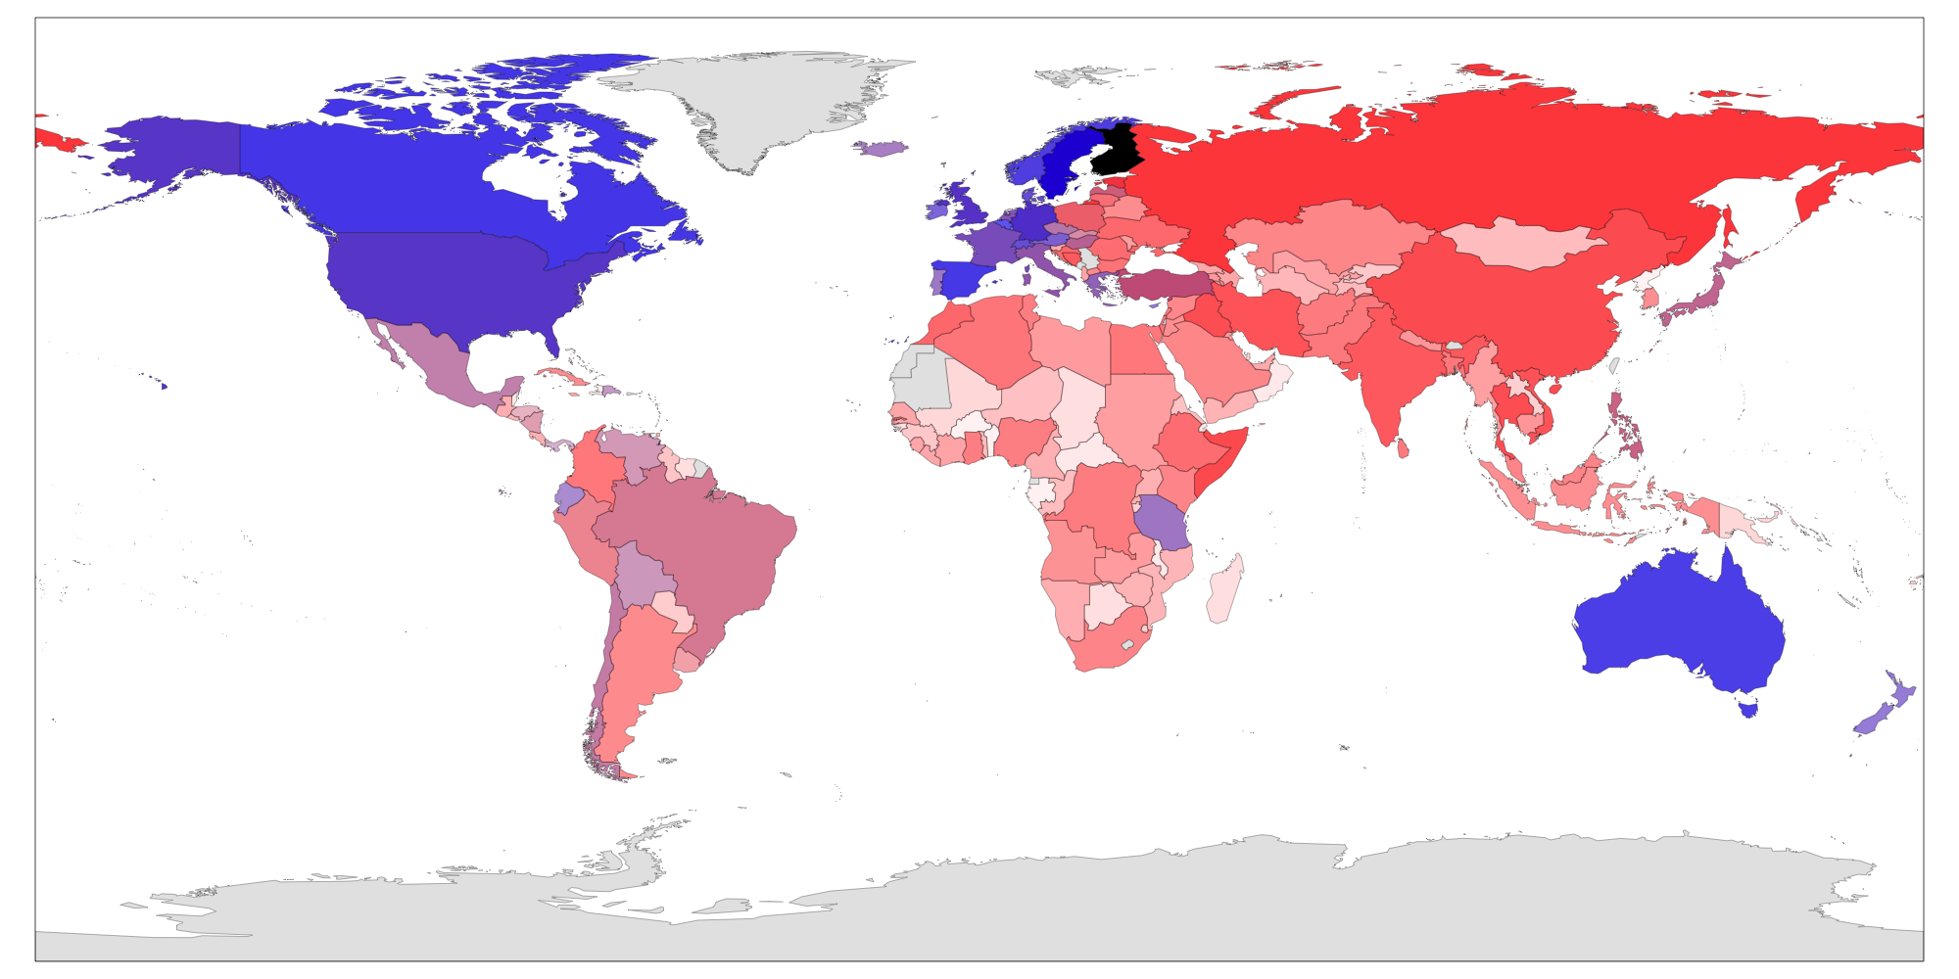
community project for open government data
Leo Lahti, University of Turku, Finland | @antagomir
UseR!2017 Jul 6, 2017 - Brussel, Belgium
<number>/8

Slide 2
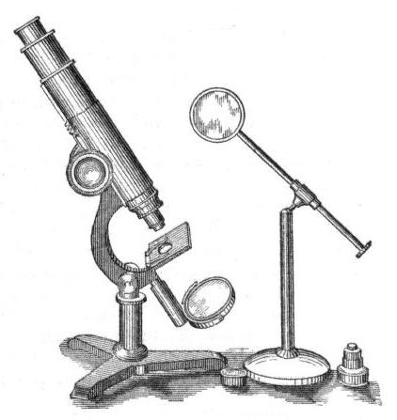

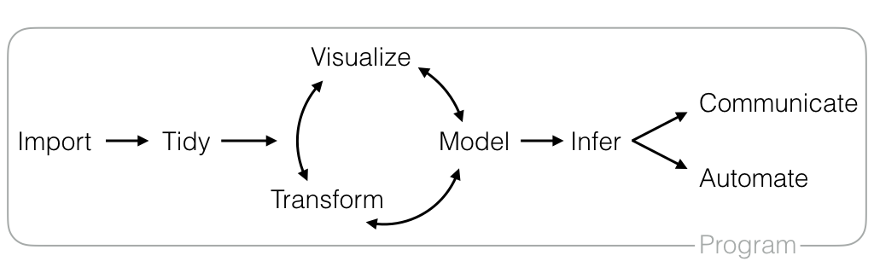
Vision: synergy - productivity - fun !
H. Wickham https://github.com/rstudio/RStartHere
<number>/8

Slide 3

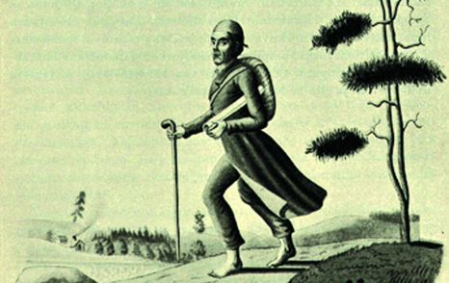


Mission?
Connect like-minded developers & users to
- foster tight community & collaboration
- feed curiosity & creativity
individual packages & users
ecosystems & communities
infrastructure projects
<number>/8

Slide 4
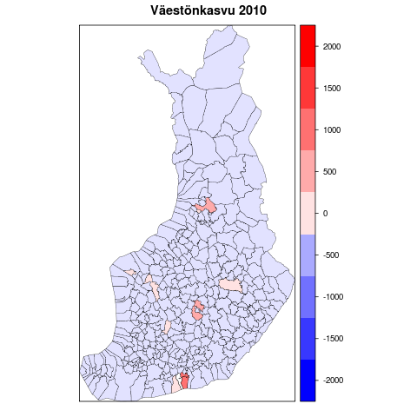
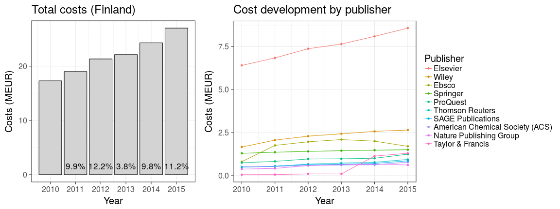
Timeline: from open data to open analytics
Finnish open data movement
International networking
Package collection grows
Visibility;
Workload;
ambiguity
Diversification & self-organization
2010
2012
2014
2016
2017
Birth
IRC chats
Apps4Finland
R packages for Finnish context
Seed funding
Datademo
Open data awards
Sitra
Data Elections Finland
Conferences & Hackathons
NIPS/MLOSS, Nevada
SHARE conference, Belgrade
Open Legislative Data conference, Paris
Helsinki OKFest
Berlin OKFest
Geneve OKFest
Activities
FOI case
Consultation
Education
Publications
Use cases
Maturing
Thousands of downloads/mo
20+ pkgs
<number>/8

Slide 5
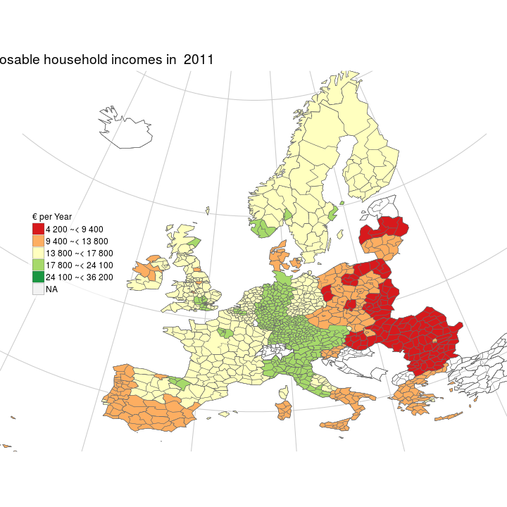
eurostat R package
http://ropengov.github.io/eurostat/
R Journal, 2017. Lahti & Kainu & Huovari & Biecek
Useful & clearly defined
Spontaneous & self-organizing
Multiple contributors; regular user feedback
R websites, cheatsheets and other resources well utilized
<number>/8
Fig: Markus Kainu
Notes:
What is “data integration”?
Technical solutions:
- Compatible software interfaces (APIs)
- Retrieval tools
- Database standardization
→ Efficient access
Computational solutions:
- Meta-analysis approaches
- Utilization of background information
- Joint modeling of multiple data sources
- Advanced computational analysis
→ Prerequisite for understanding large-scale data sets

Slide 6
Lessons learned
+ Communication channels critical for networking!
Focus or not to focus ?
data ~ methods?
statistical ~ geospatial?
national ~ international?
tools ~ applications?
academia ~ government ~ industry?
modularity ~ versatility?
packages ~ infrastructure?
outcomes ~ community?
tools ~ broader activities?
+ Compact package ecosystems & developer networks do create added value
+ Self-organization has pros & cons
+ Supporting various levels of contributions & participation
Interoperability; standards; focus areas .. ?
<number>/8

Slide 7
ropengov.github.io/contribute
Educational resources & Consultation
R packages (20+)
Open government data & analytics: eurostat, pxweb, osmar, sweidnumbr, gisfin, helsinki, rtimes, PollstR…
Networking
Online channels
Consultation & collaboration?
Feedback
Bug reports, issues, feature requests
Use cases
Guest blog posts
Research, governmental, & commercial use
Open science & data activism: FOI on journal subscription prices
@ropengov
<number>/8

Slide 8





Thank You!
http://ropengov.github.io
Joona Lehtomäki (FI)
Markus Kainu (FI)
Juuso Parkkinen (FI)
Przemyslaw Biecek (PL)
Janne Huovari (FI)
Mikko Tolonen (FI)
Scott Chamberlain (US)
Måns Magnusson (SE)
.. and many others !
@antagomir

