Slide 1
The MLCC field: seven makers, one cycle
Who wins the AI-server shortage, who rides it, and who only looks like an MLCC stock
CYCLE SCORE
BASKET VS HIGH
AI-SERVER SHARE, TOP 2
LEAD TIMES
18.5
-36%
~85%
14-20 wks
Upcycle intact
Peaked 19 Jun-1 Jul 2026
Murata + SEMCO [A]
vs 8-10 normal [A]
The big bet: the shortage runs into 2027, but most of the good news is in Murata and SEMCO prices. The cycle trade sits in the laggards; Murata is the name to buy on the next drawdown.
MLCC competitive deck v1 · 2 Oct 2026 · not investment advice
1

Slide 2
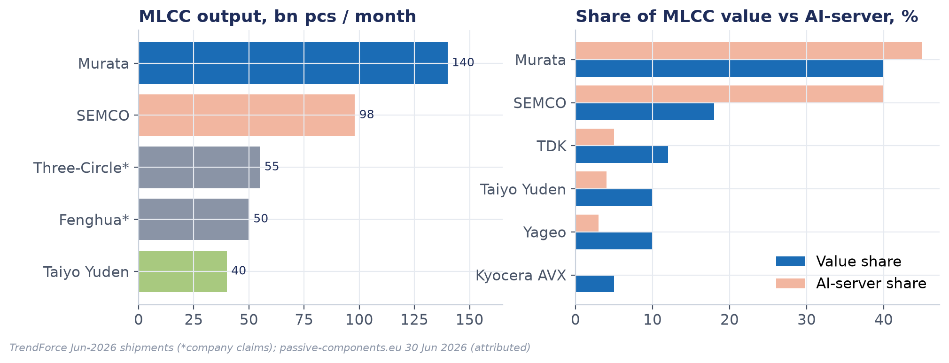
Market map: two leaders, a pack, and China
Value share and AI-server share; output at full load
Source: TrendForce Jun-2026; passive-components.eu 30 Jun 2026 [A] · MLCC competitive deck v1 · 2 Oct 2026 · not investment advice
2

Slide 3
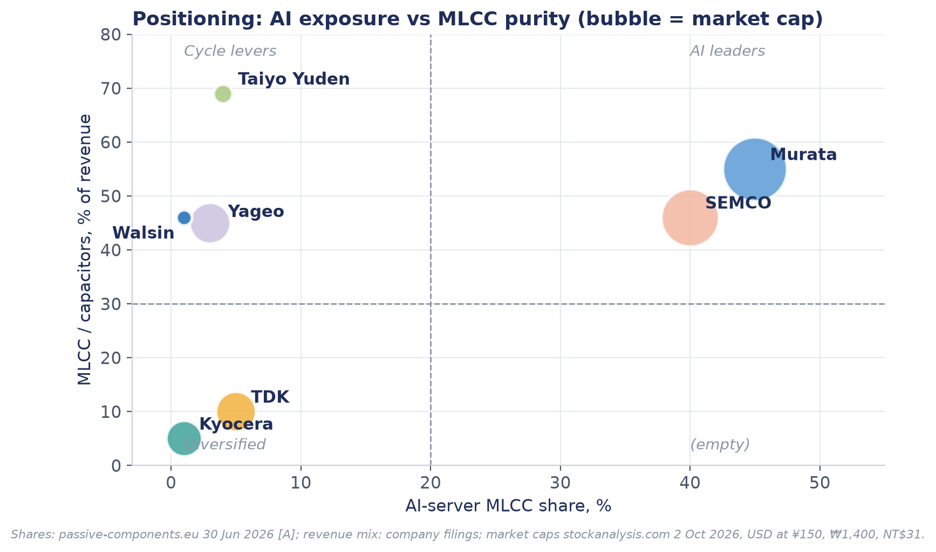
Positioning: AI exposure vs MLCC purity
Top-right = AI leaders. Top-left = cycle levers. Bottom = not really MLCC stocks
AI leaders: Murata, SEMCO. Pricing power, priced for it.
Cycle levers: Taiyo Yuden, Yageo, Walsin. Highest beta to MLCC prices.
Diversified: TDK (batteries), Kyocera (packaging, KDDI).
Source: passive-components.eu [A]; company filings; stockanalysis.com · MLCC competitive deck v1 · 2 Oct 2026 · not investment advice
3

Slide 4
Comparison matrix: who has what
Green = better for the long case; red = stretched or exposed
 | Murata | SEMCO | Taiyo Yuden | Yageo | Walsin | TDK | Kyocera
MLCC % of revenue | ~55% | ~46%* | 69% | ~45% | 46% | ~10% | <5%
AI-server share | ~45% | ~40% | <4% | ~3% | ~1% | <5% | ~1%
Book-to-bill | 1.47 | 1.31 | 1.72 | 2.2 | >1.8 | — | —
Utilization | ~95% | 91% | ~85% | 80-85% | 80-85% | — | —
2026 price action | none (−¥15bn) | +30% | +6-30% | +50% list | +5-15% | — | none
Fwd P/E | 37.8x | 47.6x | 36.4x | 24.4x | 21.7x | 22.8x | 28.9x
EV / mean EBITDA | 32x | 65x | 22x | 34x | 20x | 14x | 15x
From 2026 high | -31% | -30% | -55% | -45% | -41% | -22% | -6%
Source: Company memos [F/A]; stockanalysis.com; Yahoo; *SEMCO = Component Solutions incl. inductors · MLCC competitive deck v1 · 2 Oct 2026 · not investment advice
4

Slide 5
Capacity: who can add, and when it lands
High-end lines take 18-24 months; most 2026 decisions arrive 2H27-2028
Maker | Output / utilization | Expansion | Lands
Murata | 140bn pcs/mo; ~95% | +¥80bn equipment, >20% capacity; new Izumo building | 4Q27-2028
SEMCO | 98bn pcs/mo; 91% | Philippines plant 3; capex ₩3tn → ₩6tn | 1Q27 on
Taiyo Yuden | 40bn pcs/mo; ~85% | Malaysia pulled forward; +10-15%/yr; capex ¥42bn | 2027
Yageo | n/d; 80-85% → >90% | Kaohsiung, Vietnam, Suzhou, Mexico | ongoing
Walsin | n/d; 80-85% | +10-15% 2026, +10% 2027 | 2026-27
Fenghua / Three-Circle | 50 / 55→100bn (claims) | High-cap project RMB1.86bn | May-2027
Source: Capacity memo 02 [A] · MLCC competitive deck v1 · 2 Oct 2026 · not investment advice
5

Slide 6
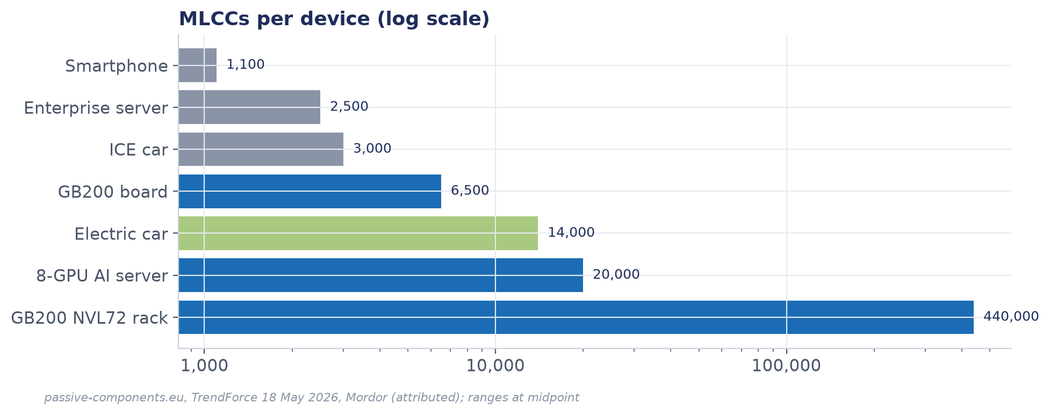
Demand: AI servers and EVs carry the increment
MLCCs per device, log scale
Source: TrendForce 18 May 2026; passive-components.eu; Mordor [A] · MLCC competitive deck v1 · 2 Oct 2026 · not investment advice
6

Slide 7
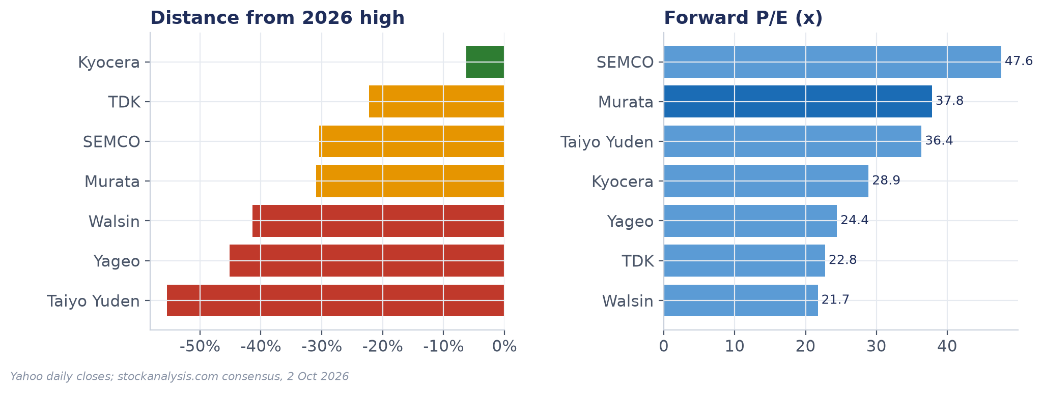
Stocks: the pure plays fell hardest
Distance from the 2026 high and forward P/E
Source: Yahoo; stockanalysis.com, 2 Oct 2026 · MLCC competitive deck v1 · 2 Oct 2026 · not investment advice
7

Slide 8
Valuation: EV over cycle-average EBITDA
Same method as the house model; 4-5 years of history for peers, so read as relative
• Murata own band: 11.6x median
• SEMCO ~65x is the outlier
• TDK / Kyocera cheap but not MLCC plays
• Walsin and Taiyo Yuden: cheapest MLCC levers
Source: Yahoo fundamentals; stockanalysis.com; house model for Murata · MLCC competitive deck v1 · 2 Oct 2026 · not investment advice
8

Slide 9
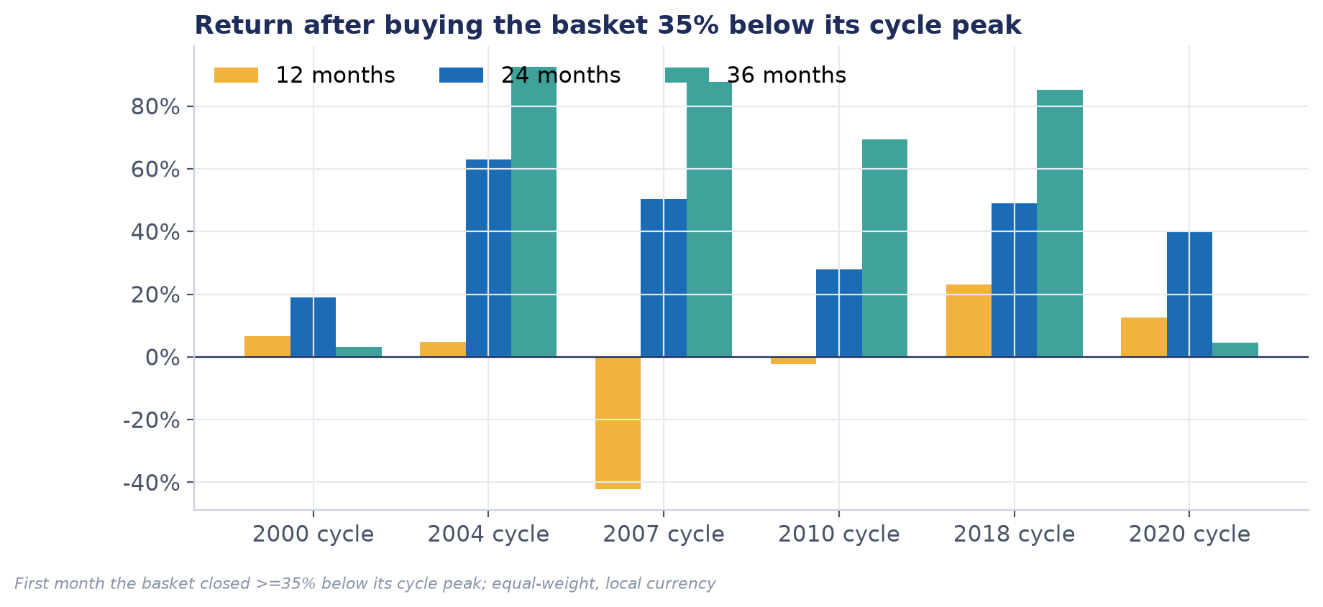
History: buying the basket 35% off the peak
Positive at 24 months in every completed cycle since 2000
Source: Equal-weight basket, local currency · MLCC competitive deck v1 · 2 Oct 2026 · not investment advice
9

Slide 10
Ranked shortlist
Verdict per name from the one-page screens
Rank | Name | Verdict | Why | Action
1 | Walsin (2492.TW) | WORTH A LOOK | Cheapest MLCC lever: 21.7x fwd, revenue +45% | Long tactical; exit on 3 MoM declines
2 | Taiyo Yuden (6976.T) | WORTH A LOOK | Book-to-bill 1.72, -55% from high | Long tactical, small size
3 | Murata (6981.T) | WATCH | Best franchise, 31x vs 12x band | Stage in ¥6,200 / ¥5,000 / ¥4,100
4 | Yageo (2327.TW) | WATCH | 2018 analog: hikes and double-order risk | Decide after 27 Oct inventory read
5 | SEMCO (009150.KS) | PASS | ~65x mean EBITDA; capex doubling | Short candidate on a turn
6 | TDK (6762.T) | PASS | Battery story, not MLCC | Out of scope
7 | Kyocera (6971.T) | PASS | Packaging/KDDI story | Out of scope
Source: Screens in targets/MLCC/peers and murata · MLCC competitive deck v1 · 2 Oct 2026 · not investment advice
10

Slide 11
The big bet and what kills it
One trade, one wait, one avoid
Trade
Wait
Avoid
• Long Walsin + Taiyo Yuden
• Into the Japanese 1Q27 price leg
• Exit: Taiwan monthly revenue down 3 months
• Murata on staged entry
• Below ¥6,200 with book-to-bill > 1.0
• Best name through the bust
• SEMCO at ~65x mean EBITDA
• Capex doubling into 2027
• Short on SC01/SC04 turning red
What kills it: distributor double-ordering (Yageo channel months, 27 Oct) or a hyperscaler 2027 capex cut.
Source: This deck · MLCC competitive deck v1 · 2 Oct 2026 · not investment advice
11

Slide 12
Sources and gaps
Tags: F = company document; A = attributed; E = estimate
• Company: Murata fact books 2022-2026 and 1Q FY3/27; Taiyo Yuden 1Q FY3/27 deck [F]
• Market: TrendForce (May-Aug 2026), passive-components.eu, cnyes, BigGo summaries [A]
• Prices: Yahoo Finance; consensus: stockanalysis.com, 2 Oct 2026
• Gaps: no primary capacity data; Paumanok/TrendForce price tables paywalled; peer history 4 years only; sell-side reports not yet included
MLCC competitive deck v1 · 2 Oct 2026 · not investment advice
12

