Slide 1
Murata: the MLCC leader, priced for a new regime
Best franchise in the cycle; the price already pays for a permanent re-rating
PRICE
HOUSE VALUE (PW, PV)
CYCLE SCORE
VERDICT
¥8,467
¥4,140
18.5 / 100
WATCH
2 Oct 2026 close
EV / 5-yr-mean EBITDA band
Upcycle intact (MLCC Cycle Watch)
Do not add; stage in below ¥6,200
Murata makes ~40% of the world's multilayer ceramic capacitors (MLCCs): the tiny parts that keep a GPU's power steady. AI servers need 8-15x more of them. The business is at a record; the stock trades at nearly 3x its own mid-cycle multiple.
Murata (6981.T) · Glilot pitch v1 · 2 Oct 2026 · not investment advice
1

Slide 2
The answer: great cycle, wrong price for Murata itself
Cycle trade belongs in the laggards; Murata is the name to own after the next drawdown
Cycle: still up
Murata: too dear
What we do
• Book-to-bill 1.47, a record
• Lead times 14-20 wks vs 8-10
• SEMCO +30%, Yageo +50% price hikes
• Supply can't answer before 2H27
• EV / 5y-mean EBITDA 31.4x vs 11.6x median
• PW value ¥4,140 vs ¥8,467
• IRR to Mar-2030: -12%
• Price needs a 21x exit to break even
• Watch, do not add
• Stage in at ¥6,200 / ¥5,000 / ¥4,100
• Only while book-to-bill > 1.0
• 20%-IRR entry ¥2,844
• Cycle exposure via Taiyo Yuden / Walsin
Source: House model; MLCC Cycle Watch · Murata (6981.T) · Glilot pitch v1 · 2 Oct 2026 · not investment advice
2

Slide 3
ELI5: an MLCC is a tiny water tower next to the chip
When a GPU suddenly draws current, nearby capacitors release charge before the power supply can react
1 Ceramic powder
2 Thin sheets
3 Print + stack
4 Fire + finish
Barium titanate, ground finer than flour. Murata makes its own.
Cast into sheets under 1 micron thick.
Nickel electrodes printed, hundreds of layers stacked.
Sintered at ~1,300°C into a chip 0.4 x 0.2 mm.
More layers, thinner layers = more charge in the same tiny box.
That is the whole game, and the thinnest layers come from the best powder.
Source: Murata, Samsung Electro-Mechanics product pages · Murata (6981.T) · Glilot pitch v1 · 2 Oct 2026 · not investment advice
3

Slide 4
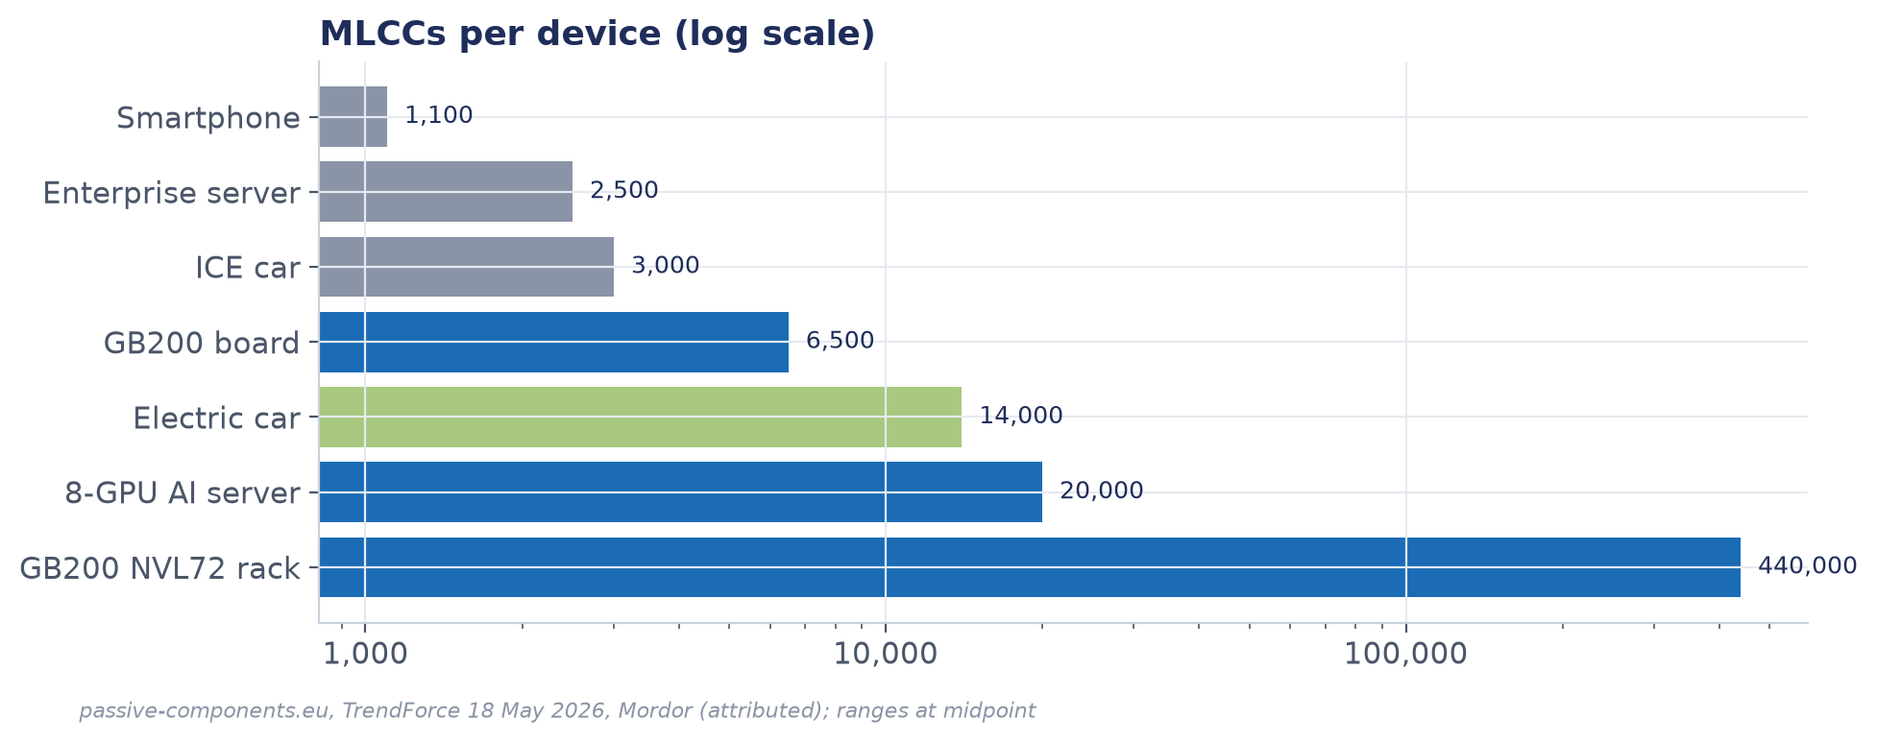
Three numbers behind the story
AI multiplies the parts count; Murata holds the share; the order book says it is still building
MLCCS PER GB200 NVL72 RACK
AI-SERVER MLCC SHARE
VISIBILITY: CAPACITOR BACKLOG
~440,000
~45%
¥402bn
vs ~1,100 in a smartphone [A]
SEMCO ~40%; rest <15% [A]
MLCC book-to-bill 1.47 [F]
Source: TrendForce 18 May 2026; passive-components.eu; Murata 1Q FY3/27 · Murata (6981.T) · Glilot pitch v1 · 2 Oct 2026 · not investment advice
4

Slide 5
The moat: own the powder, own the thinnest layers
Vertical integration from dielectric powder to firing is what competitors rent
THE CHOICE
Outcome 1: high-cap first
Outcome 2: share
Outcome 3: margin
Make the barium-titanate powder, the sheets and the equipment in-house.
Thinnest layers reach 10µF+ in small cases first: the GPU power parts.
~40% value share; ~45% AI-server; ~50% automotive [A].
Components OP margin >30% in 1Q FY3/27 [F].
How wide: wide in high-cap/auto, narrow in commodity parts. SEMCO is within 5 points in AI servers, and Chinese makers are moving up.
Source: Murata IR; passive-components.eu; company research memo · Murata (6981.T) · Glilot pitch v1 · 2 Oct 2026 · not investment advice
5

Slide 6
Value chain: powder in, power integrity out
Murata sits on the chokepoint step; distributors are where cycles break
Upstream
Murata
Downstream
• Barium titanate (in-house; Sakai ~25-28% for others)
• Nickel / copper paste
• Furnaces, printers (in-house)
• Powder → sheet → print → stack → fire → test
• Japan, Wuxi, Philippines, Thailand
• Utilization ~95%
• Distributors (~1/3 of volume)
• AI-server ODMs (Foxconn, Quanta, Wiwynn)
• Phones, auto Tier-1s
THE CHOKEPOINT: high-cap, small-case MLCCs for GPU power delivery. Murata + SEMCO supply 80-85%.
Source: Company research memo; TrendForce · Murata (6981.T) · Glilot pitch v1 · 2 Oct 2026 · not investment advice
6

Slide 7
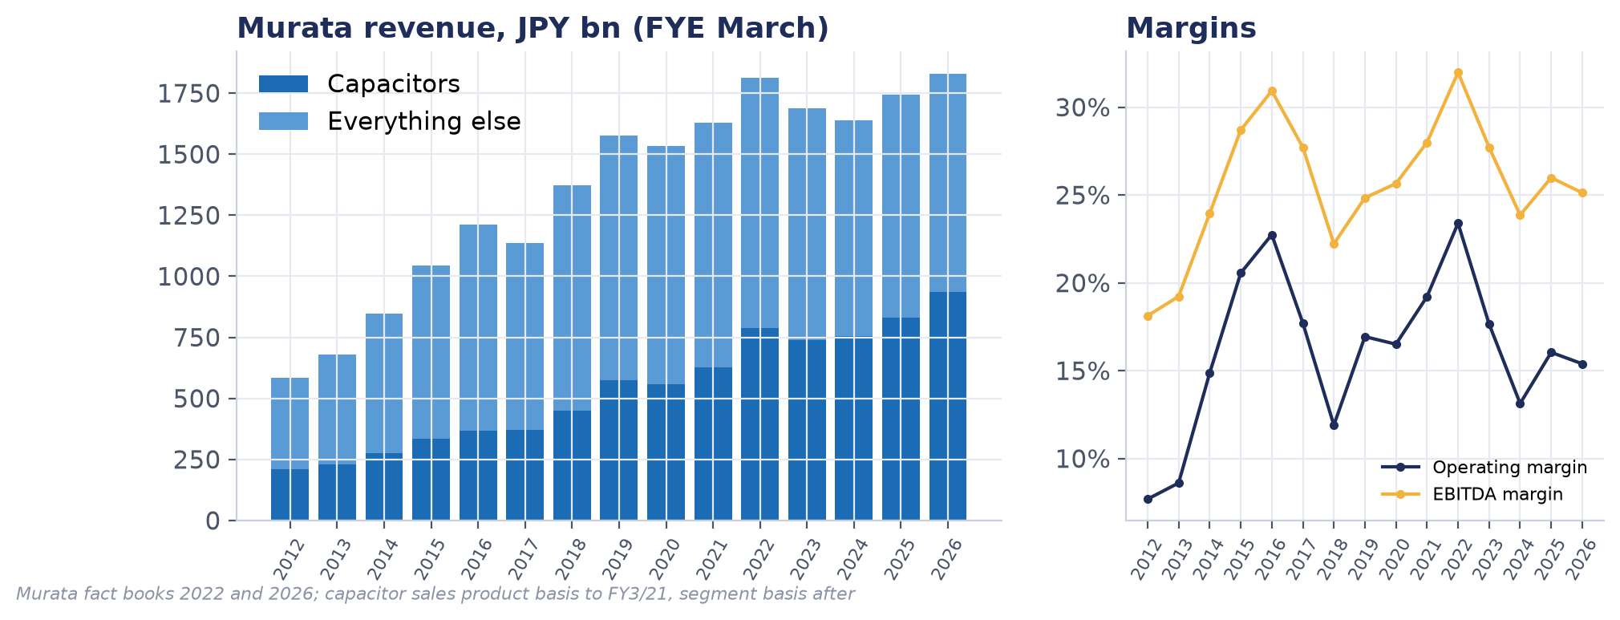
Company: ¥2.1tn revenue, half of it capacitors
FY3/27 guidance raised on 31 Jul; capacitors 55% of revenue
FY3/27 REVENUE GUIDE
FY3/27 OP GUIDE
CAPACITOR REVENUE GUIDE
NET CASH (MAR-26)
¥2.11tn
¥430bn
¥1.16tn
¥650bn
+15% YoY
20.4% margin
+24% YoY
+ ¥150bn buyback
Source: Murata fact book 2026; 1Q FY3/27 results · Murata (6981.T) · Glilot pitch v1 · 2 Oct 2026 · not investment advice
7

Slide 8
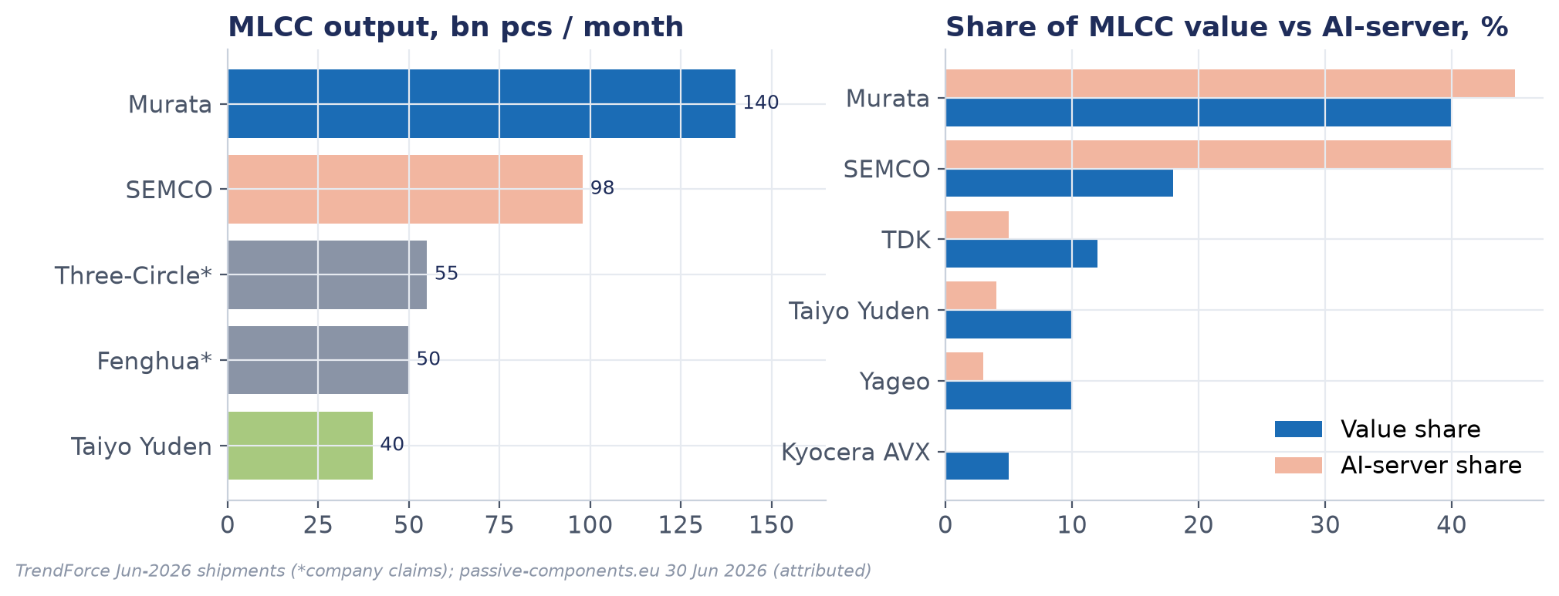
Supply: two makers own the high end
Monthly shipments at full load are the only capacity proxy anyone publishes
Murata adds >20% MLCC capacity by Mar-2028 (~¥80bn); first output from the new building 4Q27 [A].
Source: TrendForce Jun-2026; passive-components.eu 30 Jun 2026 · Murata (6981.T) · Glilot pitch v1 · 2 Oct 2026 · not investment advice
8

Slide 9
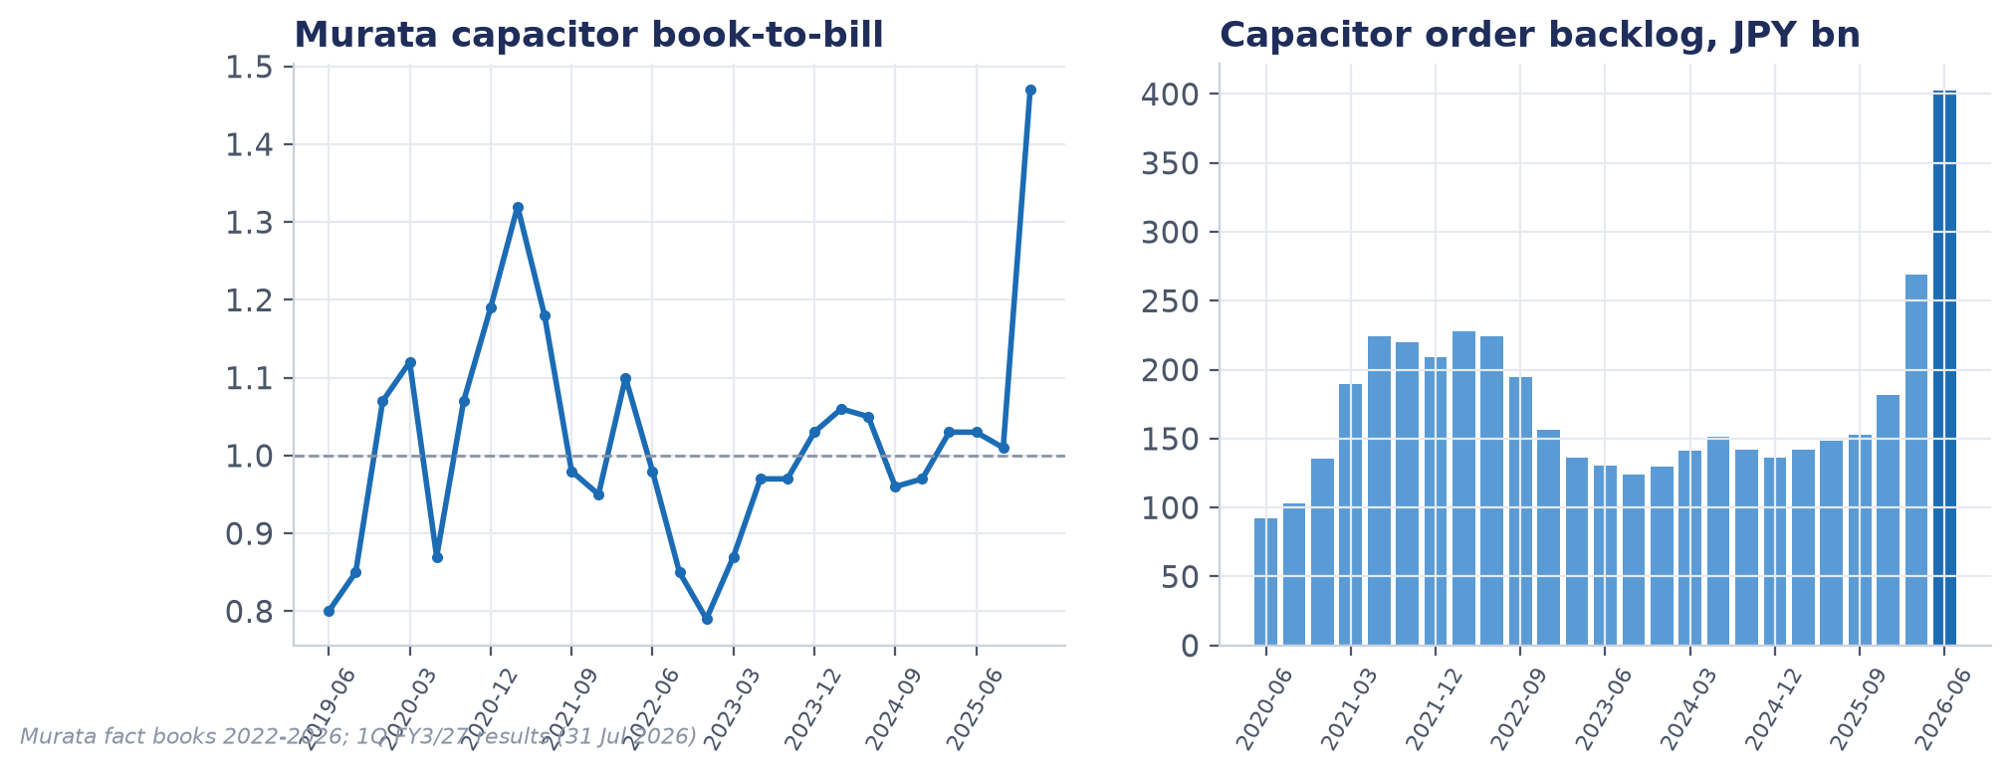
Orders: record book-to-bill, backlog 1.8x the 2021 peak
The ratio fell below 1 two quarters before each order trough (2019, 2022)
Source: Murata fact books 2022-2026; 1Q FY3/27 · Murata (6981.T) · Glilot pitch v1 · 2 Oct 2026 · not investment advice
9

Slide 10
Guidance: operating profit raised to ¥430bn
The most-guided line: up ¥50bn in July while price is still a headwind
• Volume does the work: data-center sales ¥371bn (+80%)
• Price still -¥15bn YoY: no general MLCC hike yet
• Next read: 30 Oct, a third raise needs book-to-bill > 1.3
Source: Murata fact books; 30 Apr and 31 Jul 2026 guidance · Murata (6981.T) · Glilot pitch v1 · 2 Oct 2026 · not investment advice
10

Slide 11
Cycle: score 18.5, upcycle intact
Seven of twelve signals green, five amber, none red
Signal | Weight | Status | Reading
Murata capacitor book-to-bill | 3 | GREEN | 1.47 MLCC / 1.34 total in Apr-Jun 2026, the highest in the series; cap…
Price actions and ASP direction | 3 | GREEN | SEMCO +30% (1 Aug) and a 4Q OEM hike; Yageo +50% list (1 Jul); Taiyo Y…
Channel and customer inventory | 3 | AMBER | TrendForce: mainstream channel under 30 days. Yageo: China distributio…
AI-server and hyperscaler demand | 3 | GREEN | 2026 hyperscaler capex >$700bn, raised through the year; Murata data-c…
Lead times | 2 | GREEN | Standard 14-18 weeks, high-cap/high-voltage 15-20, some SEMCO high-cap…
Utilization | 2 | GREEN | Murata ~95%, SEMCO 91%, Taiyo Yuden ~85%, Yageo 80-85% guided above 90…
Taiwan monthly revenue (Yageo, Walsin) | 2 | GREEN | Aug: Yageo NT$16.3bn +51.8% YoY (+1.2% MoM, sixth record); Walsin NT$4…
Capacity and capex response | 2 | AMBER | SEMCO capex ~₩3tn (2026) to ~₩6tn (2027) and Philippines plant 3 in 1Q…
Consumer end-demand (phones, PCs) | 2 | AMBER | Murata and TrendForce call consumer demand subdued; TrendForce warns C…
Stocks vs fundamentals | 2 | AMBER | Equal-weight basket 36% below its June high; Taiyo Yuden -55%, Yageo -…
Murata guidance slope | 2 | GREEN | FY3/27 raised on 31 Jul: revenue ¥2.11tn (from 1.96), OP ¥430bn (from …
Chinese supply and pricing | 1 | AMBER | Fenghua claims 50bn pcs/month; Three-Circle claims 55 to 100bn by end-…
Source: MLCC Cycle Watch, 2 Oct 2026 · Murata (6981.T) · Glilot pitch v1 · 2 Oct 2026 · not investment advice
11

Slide 12
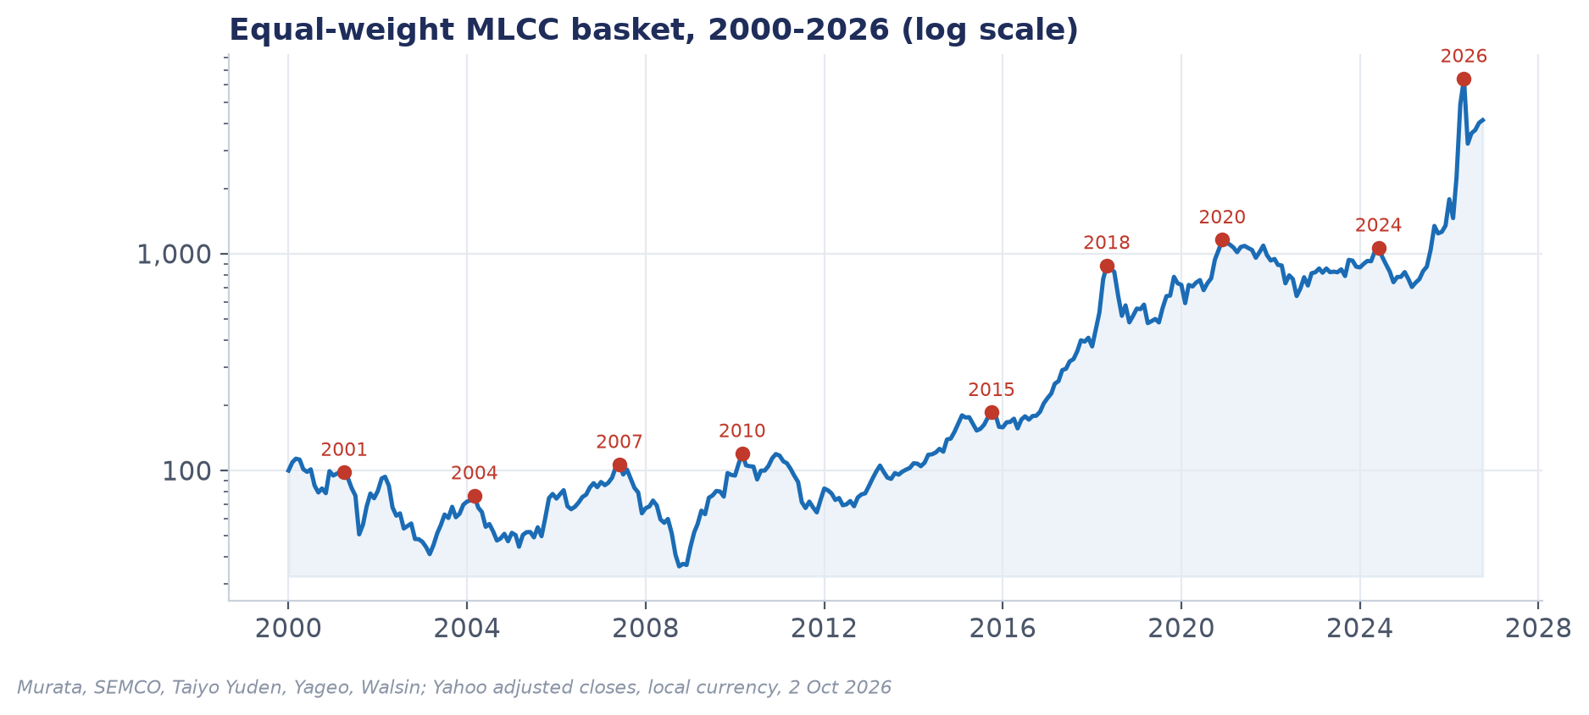
Twenty-six years of MLCC booms and busts
Stocks peaked 2-4 quarters before orders every time; shortages lasted 10-14 months
Source: Yahoo adjusted closes; basket = Murata, SEMCO, Taiyo Yuden, Yageo, Walsin · Murata (6981.T) · Glilot pitch v1 · 2 Oct 2026 · not investment advice
12

Slide 13
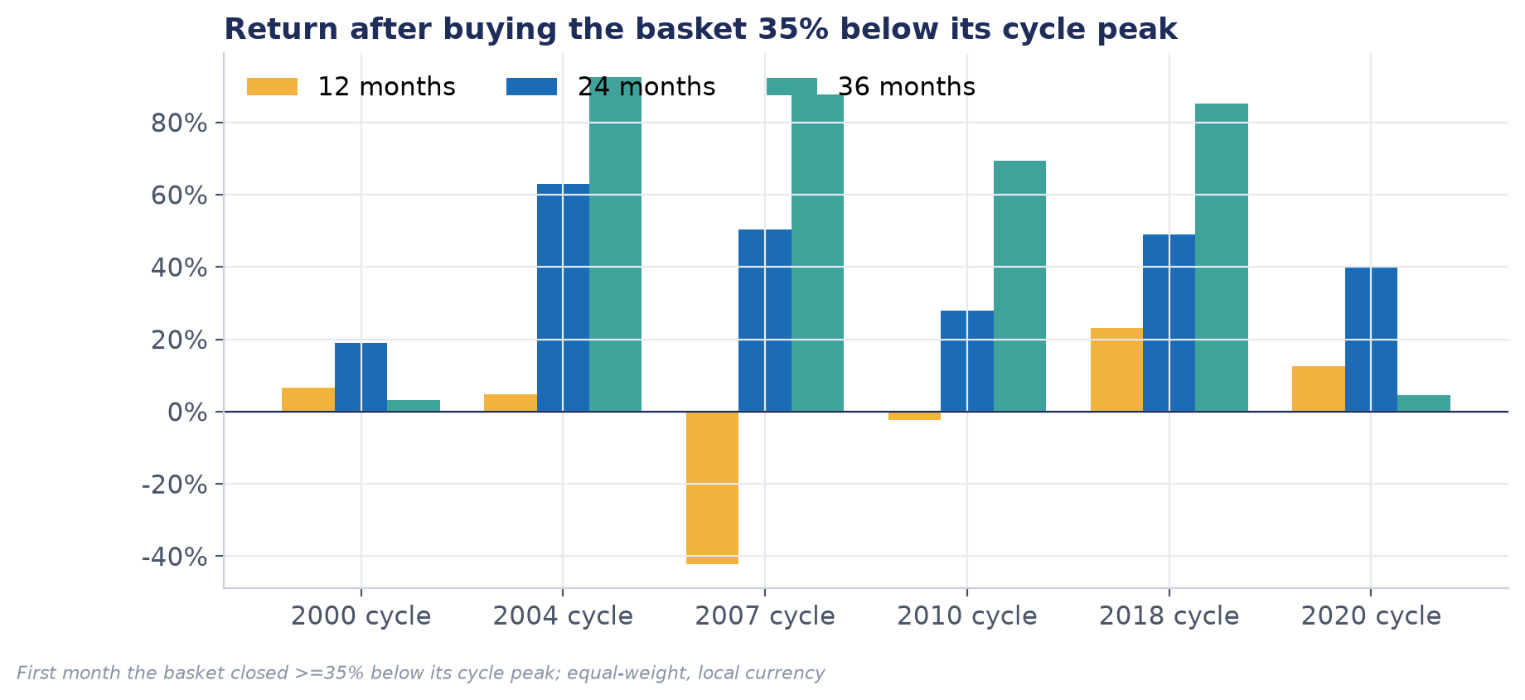
Buying 35% off the peak paid over two years
Positive at 24 months in 6 of 6 cycles; a coin toss at 12 months
• Today: basket -36%, Murata only -31%
• Worst case: 2007, -43% more first
• Murata alone works in pauses, not busts
Source: Equal-weight basket, local currency; first month >=35% below cycle peak · Murata (6981.T) · Glilot pitch v1 · 2 Oct 2026 · not investment advice
13

Slide 14
PxQ: everyone is raising prices except the Japanese
Murata's price impact is still -¥15bn YoY: the one leg the stocks have not priced
Maker | Price action 2026 | Effective | Tag
Yageo | +50% list, extended to direct customers | 1 Jul | A
SEMCO | +30% all MLCC; OEM hike in 4Q | 1 Aug | A
Taiyo Yuden | +10-30% auto, +6-13% consumer; second round | Apr / 1 Sep | A
Walsin | +5-15% consumer MLCC | Jun-Jul | A
Murata | Net price still negative (-¥15bn YoY); 15-35% on AI/auto grades reported | Apr (unconfirmed) | F / A
Kyocera | No 4Q change ("wait and see") | — | A
Sensitivity: every +5% on Murata capacitor price ≈ +¥45-50bn EBITDA (≈ +8% on FY3/27).
Source: TrendForce Aug 2026; passive-components.eu; Murata 1Q speech · Murata (6981.T) · Glilot pitch v1 · 2 Oct 2026 · not investment advice
14

Slide 15
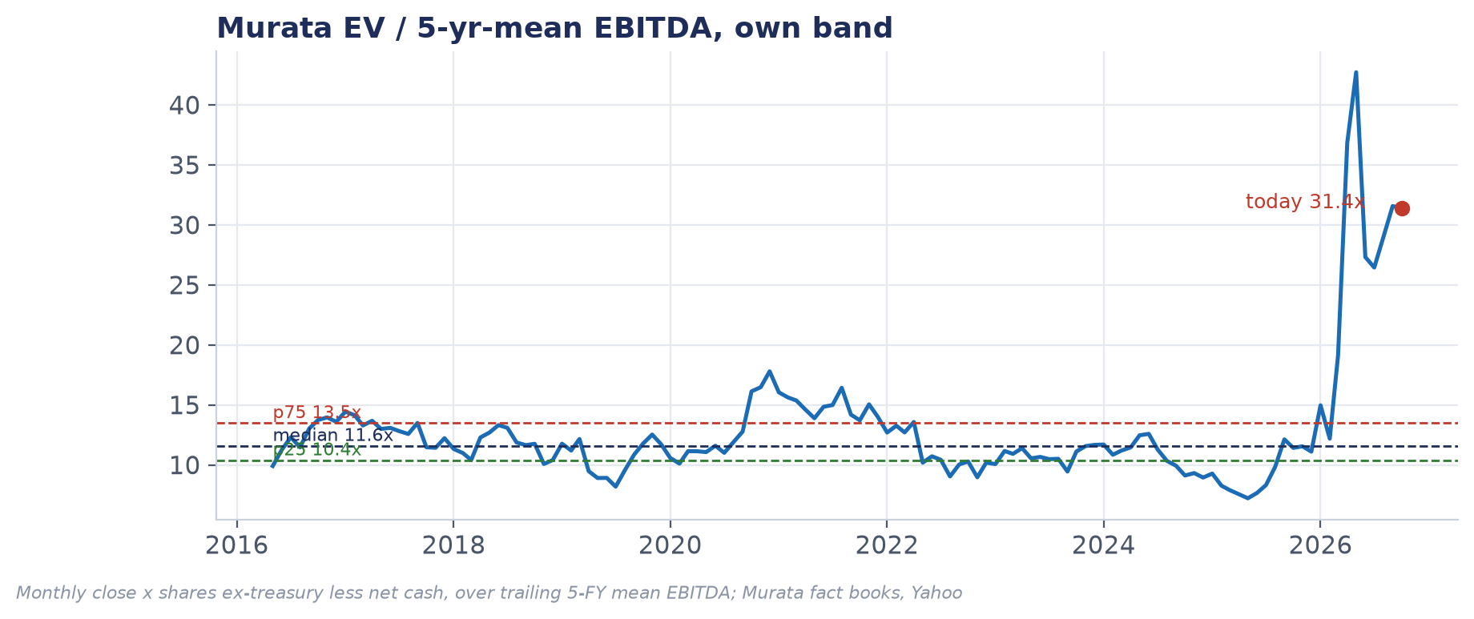
Valuation: 31x mid-cycle EBITDA vs an 11.6x history
House method: EV / 5-yr-mean EBITDA on the own band; P/B as the timing check
• Band p25 / median / p75: 10.4 / 11.6 / 13.5x
• P/B 136% above its own median
• Trailing P/E 66x vs 23x median
Source: Murata fact books; Yahoo; house model · Murata (6981.T) · Glilot pitch v1 · 2 Oct 2026 · not investment advice
15

Slide 16
Sensitivity: price and volume barely move the answer
Value per share at exit (¥). Left: annual MLCC price x volume. Right: exit multiple x mean EBITDA
vol \ price | -10% | -5% | -2% | +0% | +3% | +6% | +10%
-5% | 3,700 | 4,021 | 4,224 | 4,364 | 4,580 | 4,806 | 5,120
+0% | 3,796 | 4,157 | 4,385 | 4,543 | 4,787 | 5,041 | 5,396
+5% | 3,899 | 4,302 | 4,558 | 4,735 | 5,009 | 5,294 | 5,692
+10% | 4,007 | 4,457 | 4,742 | 4,939 | 5,246 | 5,564 | 6,010
+15% | 4,121 | 4,621 | 4,938 | 5,157 | 5,498 | 5,853 | 6,350
+20% | 4,242 | 4,794 | 5,146 | 5,389 | 5,767 | 6,161 | 6,712
x \ ¥bn | 450 | 500 | 550 | 600 | 650 | 700 | 800
8x | 2,798 | 3,017 | 3,237 | 3,457 | 3,677 | 3,896 | 4,336
10.4x | 3,391 | 3,677 | 3,962 | 4,248 | 4,534 | 4,819 | 5,391
11.6x | 3,688 | 4,006 | 4,325 | 4,644 | 4,962 | 5,281 | 5,918
13.5x | 4,157 | 4,528 | 4,899 | 5,270 | 5,641 | 6,011 | 6,753
16x | 4,775 | 5,215 | 5,654 | 6,094 | 6,533 | 6,973 | 7,852
20x | 5,764 | 6,314 | 6,863 | 7,412 | 7,962 | 8,511 | 9,610
25x | 7,000 | 7,687 | 8,374 | 9,060 | 9,747 | 10,434 | 11,807
30x | 8,236 | 9,060 | 9,884 | 10,708 | 11,533 | 12,357 | 14,005
Even +20% volume and +10% price a year for three years reach only ~¥6,712 on the own band. Today's ¥8,467 needs ~21x. The multiple is the debate, not the cycle.
Source: House model, Sensitivity sheet (live formulas) · Murata (6981.T) · Glilot pitch v1 · 2 Oct 2026 · not investment advice
16

Slide 17
Scenarios to March 2030
Exit on the own band; FY3/27 = company guidance; 25/50/25 weights
 | Bear | Base | Bull | Prob-weighted
Capacitor volume FY28/29/30 | +5 / -8 / +2% | +15 / +8 / -2% | +20 / +12 / +5%
Capacitor price FY28/29/30 | -3 / -10 / -3% | +3 / +1 / -5% | +10 / +3 / -2%
FY3/30 EBITDA (¥bn) | 451 | 710 | 985 | 714
Exit multiple | 10.4x | 11.6x | 13.5x
Value per share at exit | ¥3,498 | ¥5,013 | ¥6,768 | ¥5,073
PV per share (8% CoE) | ¥2,937 | ¥4,094 | ¥5,435 | ¥4,140
IRR from ¥8,467 | -20% | -12% | -5% | -12%
Entry for 20% IRR | ¥2,012 | ¥2,812 | ¥3,739 | ¥2,844
Source: House model, Scenarios sheet · Murata (6981.T) · Glilot pitch v1 · 2 Oct 2026 · not investment advice
17

Slide 18
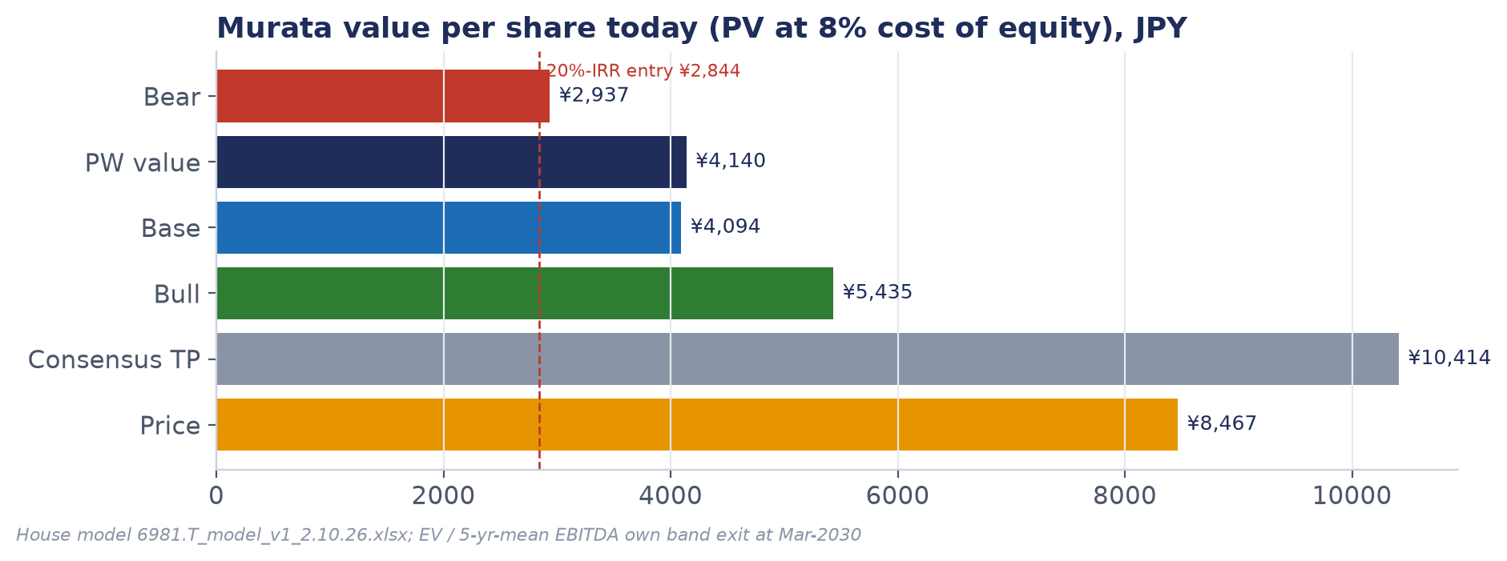
Value ladder: half the price on the house method
PW present value ¥4,140; staged entry ¥6,200 / ¥5,000 / ¥4,100
Steelman: if the trough margin has moved up for good, a 15-16x band gives ¥6,200-6,600 at exit. Still below the price.
Source: House model; stockanalysis.com consensus · Murata (6981.T) · Glilot pitch v1 · 2 Oct 2026 · not investment advice
18

Slide 19
Competition: who can take the high-end work
Ranked by threat to Murata in AI-server and automotive MLCC
High: SEMCO
Medium: China makers
Low: the rest
• ~40% AI-server share
• +30% price, ₩3.3tn LTAs
• Capex doubling in 2027
• Fwd P/E 47.6x
• Fenghua, Three-Circle
• Claims 50 and 55→100bn pcs/mo
• High-cap project May-2027
• Commodity first, then up
• Taiyo Yuden, TDK, Yageo, Kyocera
• AI-server share <5% each
• Strong in niches (Taiyo high-cap, Yageo commodity)
• TDK-Taiyo alliance is the one to watch
Source: Company memos; stockanalysis.com; Yahoo · Murata (6981.T) · Glilot pitch v1 · 2 Oct 2026 · not investment advice
19

Slide 20
Catalysts: the 30 October call decides the next leg
Dates marked est. inferred from last year
Date | Event | What to read
~8-9 Oct | Yageo / Walsin Sep revenue | Industry volume and price
27 Oct | Yageo 3Q | Distribution inventory months
~29-30 Oct | SEMCO 3Q | Capex 2027, LTA pricing
30 Oct | Murata 2Q FY3/27 | Book-to-bill, price stance, third guide raise
Nov-Dec | Japanese 1Q27 price decisions | The un-priced leg
~2-5 Feb | Murata 3Q | Distributor orders, inventory
Source: Company IR calendars; investing.com · Murata (6981.T) · Glilot pitch v1 · 2 Oct 2026 · not investment advice
20

Slide 21
What would make us wrong
And what we could not verify
Ways to be wrong
Open gaps
• Regime change: AI parts become contracted, trough margins up → 15-20x is the new band
• Japanese price leg lifts FY3/28 EBITDA toward ¥1tn
• Whole cohort re-rates as "AI picks and shovels", like memory in 2025-26
• Murata MLCC price letter unconfirmed
• No named-customer shares
• Capacitor EBITDA not disclosed (model derives ~42%)
• Sell-side reports (G: drive) not yet included
• Capacity is a shipment proxy
Source: Research memos 01-06 · Murata (6981.T) · Glilot pitch v1 · 2 Oct 2026 · not investment advice
21

Slide 22
Investment philosophy
How we own a cyclical with a great franchise
Own the cycle where it is cheap, own the franchise where the price is right.
MLCC demand has two more quarters of momentum and no supply answer before 2H27, so the trade sits in the laggards that fell 40-55%.
Murata is the name we want through the next downturn: it falls least and recovers first. We buy it in stages when the price meets the band, not when the headlines peak.
Murata (6981.T) · Glilot pitch v1 · 2 Oct 2026 · not investment advice
22

