Slide 1
When Metrics Say “Yes” But Humans Say “No”
A Case Study of Hallucination Reduction for Factual Summarization
Author: Ryan Powers
Notes:
Good afternoon everyone my name is Ryan Powers and Id like to present my 266 Final Project
‘ When Metrics say yes but humans say no
A case study of Hallucination Reduction for Factual Summarization

Slide 2
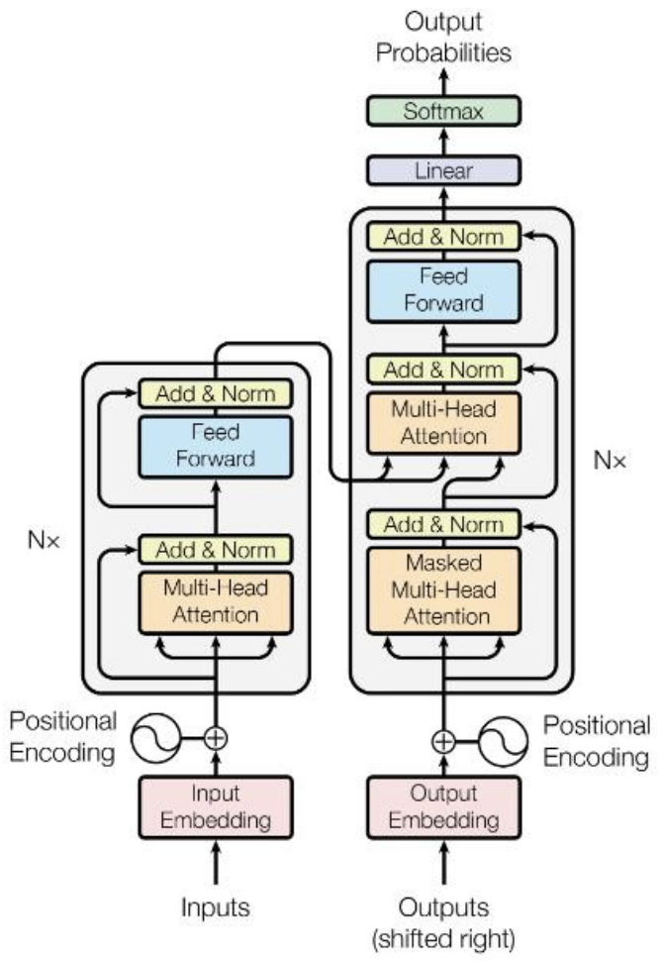




Project Characters
BART(Generator)
FactCC(Verifier)
CNN/Daily Mail (Dataset)
Single Human Annotator
Fine‑tuned summarization model
Classifier that scores article summary factual consistency.
News articles with highlight summaries
Single rater doing a 50‑example audit.
Notes:
Very quickly define each actor:
“Generator: BART‑base summarizer we fine‑tune.”
“Verifier: FactCC, a specialized factuality model.”
“World: CNN/DailyMail news dataset.”
“Judge: me as a human annotator, doing a small but careful audit.”

Slide 3
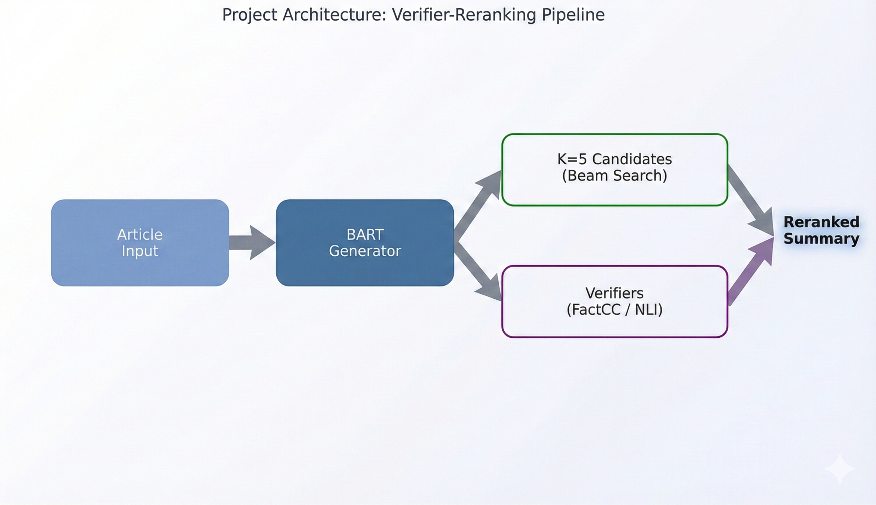
Task/Problem/Goall
Task: CNN/DailyMail abstractive summarization (BART‑base)
Problem: Summaries are fluent but sometimes factually incorrect (hallucinations)
Goal: improve factual consistency without retraining a bigger model, use reranking instead.
Challenging the assumption that improving automatic metrics improves actual quality.
Example: Article says 'Mayor announced $50M for transit' → Summary says 'Mayor cut transit funding
Success Criteria: ΔFactCC ≥ +2.0, ROUGE-L drop ≤ 1.0
Notes:
I fine‑tuned BART‑base on CNN/DailyMail and got good ROUGE, but also classic hallucinations: wrong entities, wrong numbers, unsupported claims. The question I asked is: can I fix this cheaply at inference time, by generating several summaries and letting a verifier pick the best one?”
“I fine‑tuned BART‑base on 20k CNN/DailyMail examples and evaluated on the full 11,490‑example test set. The baseline gets ROUGE‑L 28.09 and a FactCC score of 0.427, which matches what prior work reports on this dataset. So I have a solid starting point, but no explicit factuality control.”

Slide 4
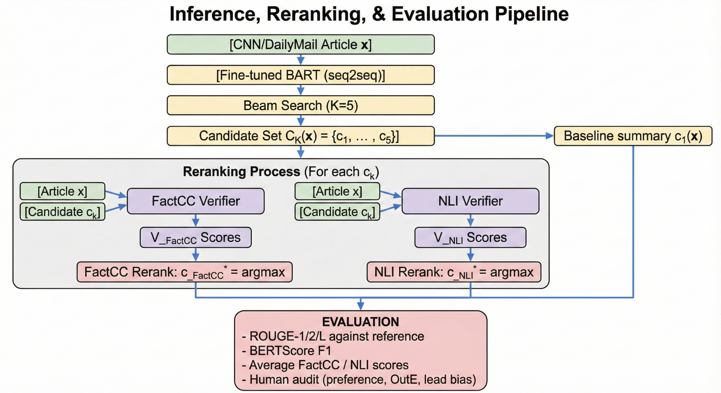
Architecture Diagram (Generate → Verify)
Generate K=5 beam candidates with the fine‑tuned BART.
Score each candidate with:
FactCC:
P(Consistent | article, candidate)
RoBERTa‑MNLI:
P(Entailment∣a,c)P(Entailment∣a,c) (for ablation).
Choose c∗=arg⁡max⁡ciscoreFactCC(a,ci)c∗=argmaxci​​scoreFactCC​(a,ci​).
Notes:
For each article, I generate K=5 summaries with beam search. Then I treat the original article as the premise and the summary as the hypothesis. FactCC gives me P(\text{Consistent} \mid a, c); RoBERTa‑MNLI gives P(\text{Entailment} \mid a, c). My reranker simply chooses the candidate with the highest FactCC score. The idea is: BART already produces a mix of better and worse candidates—so can a verifier reliably pick the better one?”
Our hypothesis was that by generating K=5 diverse candidates via beam search and selecting the one with the highest FactCC score, we could improve factuality without retraining the summarizer. This approach is motivated by the observation that BART's beam search often produces candidates with varying factual accuracy, even when they have similar likelihood scores."
Generator (BART): You Fine-tuned this on CNN/DailyMail.
Verifier (FactCC): You used the Pre-trained version (manueldeprada/FactCC) directly from Hugging Face. You did not fine-tune FactCC on your own data.
Why this matters: You tested an "Off-the-Shelf" verifier. You asked: "Can I just download this standard fact-checker and use it to fix my model's errors?" The answer turned out to be "No, not reliably."

Slide 5
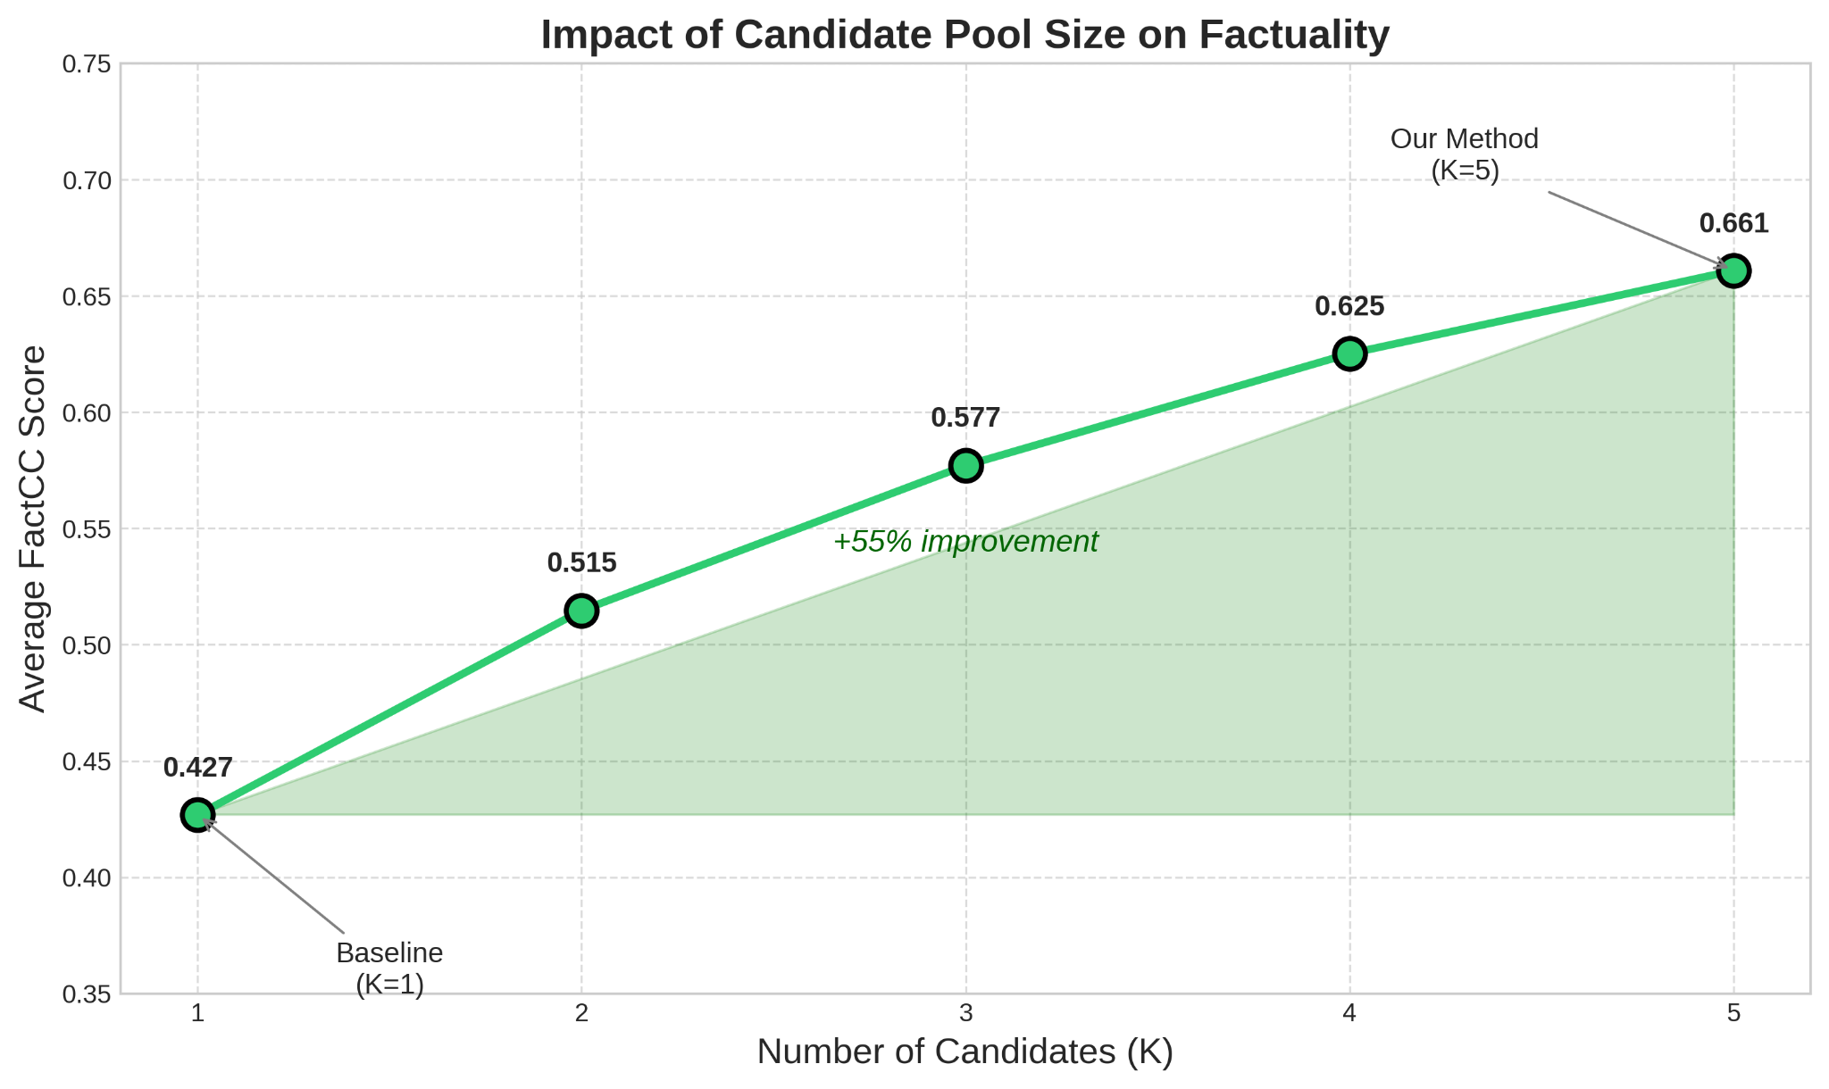
BART + FactCC / Experimental Setup
Models
Generator: facebook/bart-base (fine-tuned on 20k CNN/DM, 3 epochs, lr=5e-5) -
Verifier A: FactCC (factual consistency) -
Verifier B: RoBERTa-MNLI (ablation)
Data
Train: 20k subset (seed=42) - Val: 2k | Test: 11,490
Decoding
Beam search, K=5, max length 140
Success Criteria ✓ ΔFactCC ≥ +2.0 points ✓ ROUGE-L drop ≤ 1.0 point
After analyzing K‑ablation shows strong gains up to ~3–5, with diminishing returns.
Notes:
Implementation: The pipeline using Hugging Face Transformers (Wolf et al., 2020), Datasets (Lhoest et al., 2021), and Evaluate (von Platen et al., 2022). All experiments were run with a fixed random seed (42) for reproducibility. Code and configuration files are available in our repository.
5.3 Lead Bias and Metric–Human Disconnect
CNN/DailyMail has a strong inverted pyramid structure, where early sentences often summarize the main story. Extractive baselines like LEAD-3 achieve ROUGE-L = 24.91, only 3.18 points below my fine-tuned BART baseline (28.09). This structural bias interacts with FactCC:
FactCC tends to favor extractive candidates that closely mirror the lead sentences.
This can inflate factuality scores even when the selected summary is less informative or less well-structured than more abstractive alternatives.
In several examples, FactCC assigns higher scores to “safe but boring” candidates that copy the first sentences verbatim, while humans prefer slightly more abstractive but still faithful variants.

Slide 6
Results
┌─────────────────────────────────────────────────────────────┐
│ RESULTS: THE PARADOX │
├─────────────────────────┬───────────────────────────────────┤
│ AUTOMATIC METRICS │ HUMAN EVALUATION │
│ ✅ WIN │ ❌ LOSE │
├─────────────────────────┼───────────────────────────────────┤
│ │ │
│ FactCC: +54.8% │ Human Preference: │
│ (0.43 → 0.66) │ Baseline: 28% │
│ │ Reranked: 18% │
│ ROUGE-L: -0.17 pts │ Tie: 54% │
│ (no significant drop) │ │
│ │ Net hallucinations: │
│ Success criteria: │ Fixed: 1 │
│ ΔFactCC ≥ +2.0 ✅ │ Introduced: 3 │
│ ΔROUGE-L ≤ -1.0 ✅ │ Net: -2 (worse) │
│ │
"The metric improved. The summaries didn't."

Slide 7
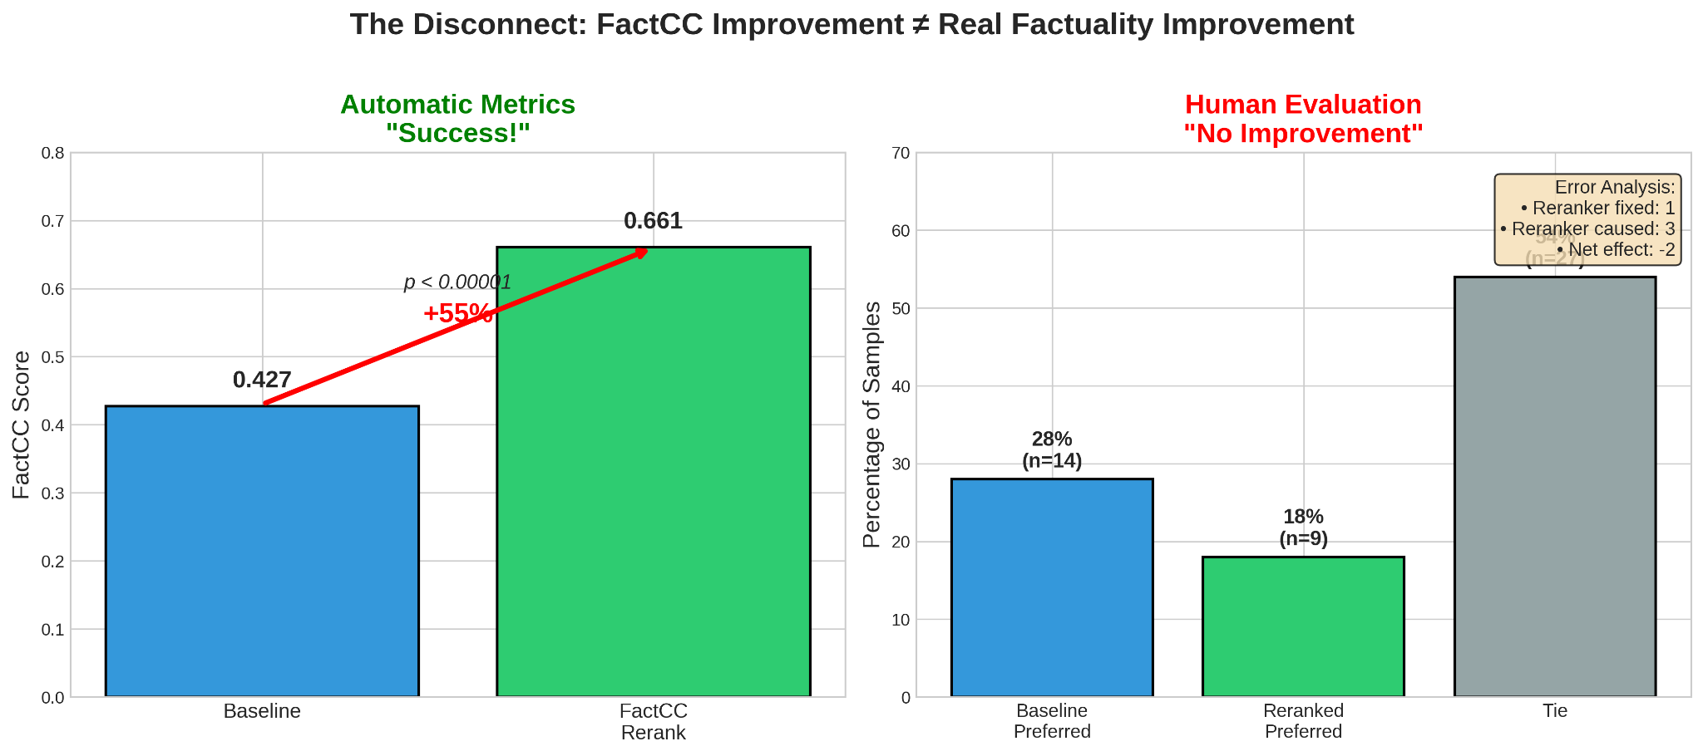
Setting
N = 50 human audit
. df[df['changed']==True].sample(30) and df[df['changed']==False].sample(20)
For this project, a hallucination is any statement in the summary that is not supported by, or contradicts, the source article, including entity, event, temporal, and out‑of‑thin‑air errors.
50 test examples:
30 where baseline vs rerank disagree
20 where they agree
Human (Single Annotator) preference:
Tie: 27 (54%)
Baseline preferred: 14 (28%)
Reranked preferred: 9 (18%)
Net hallucination effect: reranker fixes 1 error, introduces 3 → Net −2
Notes:
When I looked at what humans actually prefer, the story flipped. In 54% of cases, both summaries were basically equally good or equally bad. But when annotating 50 examples where baseline and reranked summaries differed, the baseline was preferred 28% of the time and the reranked only 18%. I also tracked hallucination errors and found that the reranker fixes 1 and introduces 3, for a net negative effect. This is the core result: FactCC says ‘+55% better’, but human auditing say ‘−10 points’.”
We didn't just pick 50 random examples, because 80% of the time the model output is identical. That would be a waste of time. Instead, we used a Stratified Sampling Strategy. We deliberately over-sampled cases where the Reranker disagreed with the Baseline (30 examples) to maximize our information gain, while keeping 20 'agreement' cases as a control group. This ensures our audit focuses on the actual impact of the intervention.

Slide 8
When Reranking Helps vs Hurts
The Success (Logic Repair)
Context: Refugees formed a human chain to stop attackers.
Baseline (The Mistake): "15 men arrested... But were prevented [from being arrested] because they huddled together..."
Status: Logical Error (Implies the chain stopped the police).
Reranked (The Fix): "...claimed the men tried to throw other Christians off... but were prevented [from doing so] because they huddled together..."
Status: Corrected (The verifier caught the causal mismatch).
The Failure (Hallucination)
Context: A father hit his toddler; store owner gave video to police.
Baseline (The Safe Bet): "Justin Whittington... was taken into custody... relationship not yet revealed..."
Status: Boring but Factual (Stuck to the text).
Reranked (The Lie): "...Police were notified... and asked the public for help identifying the man."
Status: Hallucination (The article never mentioned a public appeal).
Verifier (FactCC) isn't actually checking facts it's just checking for patterns.
Notes:
On the left, we have a clear win. The original model wrote a confusing sentence implying a 'human chain' stopped the police from arresting people. The Reranker saw this didn't make sense and picked a better draft that correctly stated the chain stopped the attackers. This is what we want.
But on the right, we see the danger. The original model wrote a boring, factual summary. The Reranker rejected it for a 'spicier' version that claimed the police 'asked the public for help.' That never happened. The model hallucinated a detail that sounded standard for a crime story, and the Reranker rewarded it. This proves the system prioritizes 'plausibility' over actual truth."
I used FactCC because it is specialized for catching summarization errors. I trained the writer (BART) using a Loss Function that rewards word prediction, which unfortunately allows for hallucinations. Attempting to fix this by generating 5 drafts and letting FactCC pick the best one. While the Metric (FactCC score) claimed success (+55%), the Ground Truth (my human audit) revealed the system was 'gaming' the metric—selecting safe, copy-paste summaries rather than genuinely better ones.

Slide 9
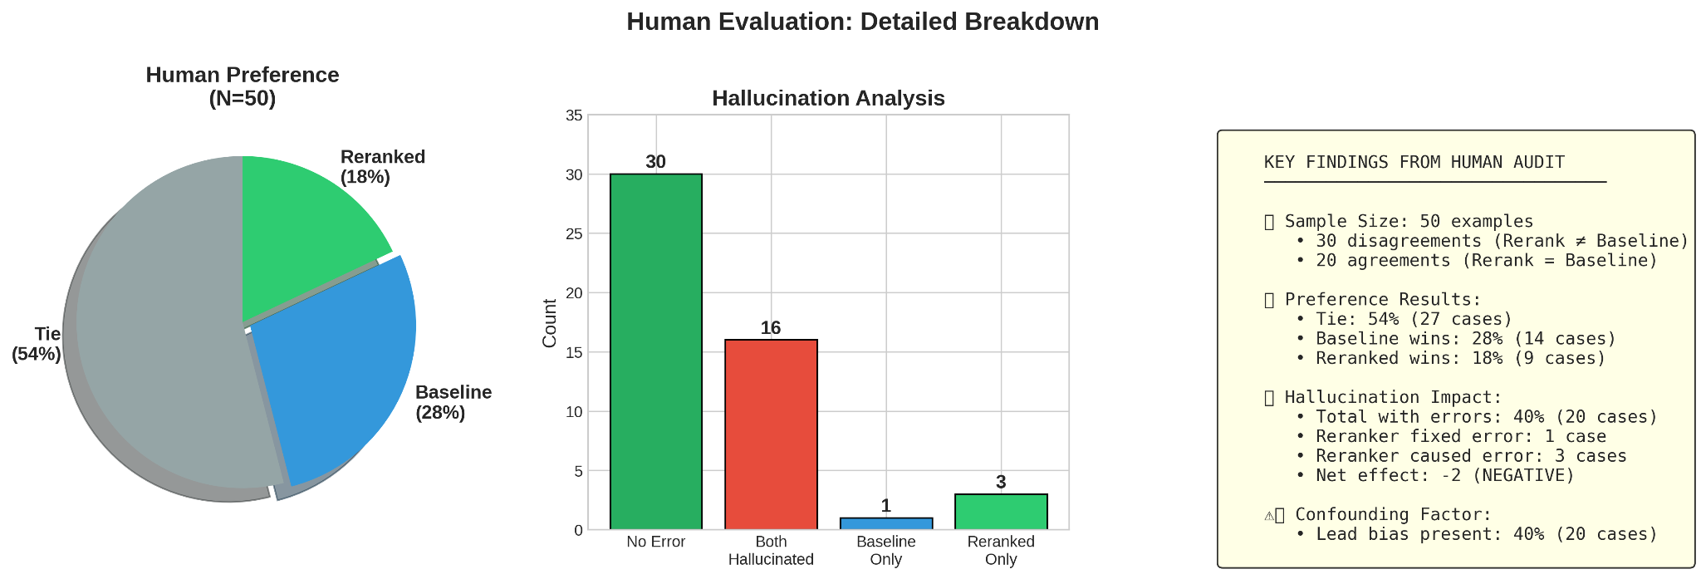
Conclusion
Lead bias: CNN/DailyMail favors early sentences; LEAD‑3 gets ROUGE‑L 24.91 (only 3.18 points below BART). Reranking often moves toward extractive “lead‑like” summaries without improving factuality.
FactCC mis-scores paraphrases: Penalizes legitimate paraphrasing, prefers extractive but slightly wrong spans.
Limited beam diversity: in ~32% of audited examples all K=5 candidates had hallucinations → reranking cannot fix generator‑level failures.
Why: Goodhart's Law. Once I made FactCC the optimization target, the system learned to game FactCC rather than be more truthful.
Notes:
Motivated by the hallucination problem in abstractive summarization, as surveyed by Ji et al. (2023). Premitively selecting FactCC for its computational efficiency and demonstrated effectiveness on summarization tasks. Other projects expand beyond supervised verifier-reranking approach with zero-shot methods like **SelfCheckGPT** (Manakul et al., 2023) and unsupervised reranking (Ravaut et al., 2023). While **QAGS** (Wang et al., 2020) and **AlignScore** (Zha et al., 2023) represent alternative factuality metrics,
The Scientific Conclusion: You proved that optimizing for FactCC does NOT equal optimizing for Truth.
Metric: FactCC went up (+55%).
Truth: Human preference went down.
Summary Statement for Your Defense
"I attempted to fix system output errors by reranking candidates using a pre-trained FactCC verifier. My goal was to improve factuality without degrading ROUGE. While I successfully improved the FactCC score by 55%, my human audit revealed this was a 'false positive' improvement. The verifier prioritized lexical overlap over semantic truth, leading it to select 'safe' summaries that sometimes contained hallucinations, rather than genuinely factual ones.

Slide 10
References & Github
Lewis et al., 2020 – BART.
Kryściński et al., 2020 – FactCC.
Wang et al., 2020 – QAGS.
Zha et al., 2023 – AlignScore.
Ji et al., 2023 – Hallucination survey.
Dror et al., 2018 – Statistical significance.
https://github.com/rPowDS/MIDS266-NLP-final-project

