Slide 1

FINAL PRESENTATION
Efficient Fine-Tuning of Code Language Models
Single-GPU QLoRA vs Dual-GPU DeepSpeed ZeRO-2 under hardware constraints
MODEL
DATASET
SPLIT
QUESTION
Qwen2.5
CodeAlpaca
900 / 100
Efficiency
0.5B-Instruct
1,000 sample subset
train / evaluation
memory, speed, loss
Talha Rashid, Bilal Fayyaz | Department of Computer Science
PDC DeepSpeed Project | QLoRA vs ZeRO-2
01

Slide 2

BASIC INTRODUCTION
The Problem
Fine-tuning code LLMs is valuable, but the hardware bill arrives before the model improves.
Memory
Can the model fit?
Full-parameter training stresses GPU memory and runtime.
Single cloud notebook GPUs often cannot support full fine-tuning comfortably.
Distributed training improves throughput, but adds setup and synchronization complexity.
The project compares two practical efficiency paths on the same task.
Speed
How fast does it train?
Quality
What loss is achieved?
PDC DeepSpeed Project | QLoRA vs ZeRO-2
02

Slide 3
BASE PAPER HIGHLIGHTED
Literature Review
Base Paper
LoRA / QLoRA
DeepSpeed ZeRO
The provided IEEE paper compares Single-GPU QLoRA and Dual-GPU DeepSpeed ZeRO-2 for Qwen2.5-0.5B-Instruct on CodeAlpaca.
LoRA trains low-rank adapters. QLoRA loads the base model in 4-bit form and backpropagates into adapters.
ZeRO partitions optimizer states and gradients across workers; ZeRO-2 enables practical distributed full fine-tuning.
CodeAlpaca
Hugging Face Stack
Research Gap
Prompt-completion code instruction examples are reformatted into question, reasoning, and answer blocks.
Transformers, Trainer, PEFT-style workflows, tokenizer handling, and metric capture support reproducibility.
A practical comparison helps choose between accessible adapter tuning and faster distributed full-model updates.
PDC DeepSpeed Project | QLoRA vs ZeRO-2
03

Slide 4
WHAT THE STUDY MEASURES
Research Objectives
Implement QLoRA
Implement ZeRO-2
Fine-tune Qwen2.5-0.5B-Instruct on a single Tesla T4 using 4-bit quantization and LoRA adapters.
Run full-parameter fine-tuning with DeepSpeed across two RTX A4000 GPUs.
Measure Trade-offs
Recommend Usage
Compare trainable parameters, runtime, throughput, loss, memory, FLOPs, and GPU utilization.
Explain which method is better under constrained single-GPU versus multi-GPU conditions.
PDC DeepSpeed Project | QLoRA vs ZeRO-2
04

Slide 5
METHODOLOGY DIAGRAM
Proposed Solution Workflow
Shared preparation
Load
Sample
Format
Tokenize
CodeAlpaca 20K
1,000 examples
Q + R + A
max length 512
Compare
Track A: QLoRA Baseline
Track B: DeepSpeed ZeRO-2
loss, runtime, throughput, memory, utilization
4-bit loading, LoRA adapters, FP16, gradient accumulation, single Tesla T4.
FP16 full fine-tuning, optimizer and gradient partitioning, two RTX A4000 GPUs.
PDC DeepSpeed Project | QLoRA vs ZeRO-2
05

Slide 6
SAME TASK, DIFFERENT OPTIMIZATION STRATEGY
Methodology
Component | Single-GPU QLoRA | Dual-GPU DeepSpeed ZeRO-2
Platform | Google Colab | RunPod
GPU | 1 x Tesla T4 | 2 x RTX A4000
Training type | 4-bit LoRA adapter tuning | Full-parameter fine-tuning
Precision | 4-bit + FP16 | FP16
Dataset split | 900 train / 100 eval | 900 train / 100 eval
Max sequence length | 512 | 512
Epochs | 5 | 1
Global steps | 565 | 57
Source: paper Table I and methodology section.
PDC DeepSpeed Project | QLoRA vs ZeRO-2
06

Slide 7
ALIGNED TO THE PROVIDED PAPER
Fact-Checked Experimental Setup
DATASET
SAMPLES
MODEL
SEQUENCE
CodeAlpaca 20K
1,000
Qwen2.5-0.5B
512
HuggingFaceH4 subset
900 train, 100 eval
Instruct checkpoint
maximum tokens
QLoRA configuration
ZeRO-2 configuration
LoRA rank 16, alpha 32, dropout 0.05; target modules include q_proj, k_proj, v_proj, o_proj, gate_proj, up_proj, and down_proj.
FP16 training with gradient accumulation, reduce-scatter, all-gather partitioning, and contiguous gradients.
The earlier deck's core values were checked against the paper. This version keeps the paper's final reported QLoRA runtime of 2,829.545 s and losses of 0.448 / 0.823.
PDC DeepSpeed Project | QLoRA vs ZeRO-2
07

Slide 8
WHAT MADE THE PROJECT NON-TRIVIAL
Implementation Challenges
Single-GPU limitation
Distributed launch complexity
Colab's Tesla T4 could not comfortably support full fine-tuning, so QLoRA was used for the constrained track.
DeepSpeed required multi-GPU verification, config tuning, launcher commands, and synchronized metric collection.
Comparison fairness
Telemetry interpretation
Hardware and epoch counts differ, so runtime and loss are interpreted as practical outcomes rather than a controlled benchmark.
nvidia-smi snapshots and PyTorch peak memory report different views of memory behavior.
Dataset structure
CodeAlpaca provides prompt-completion pairs, so a consistent reasoning template was inserted for the desired response format.
PDC DeepSpeed Project | QLoRA vs ZeRO-2
08

Slide 9
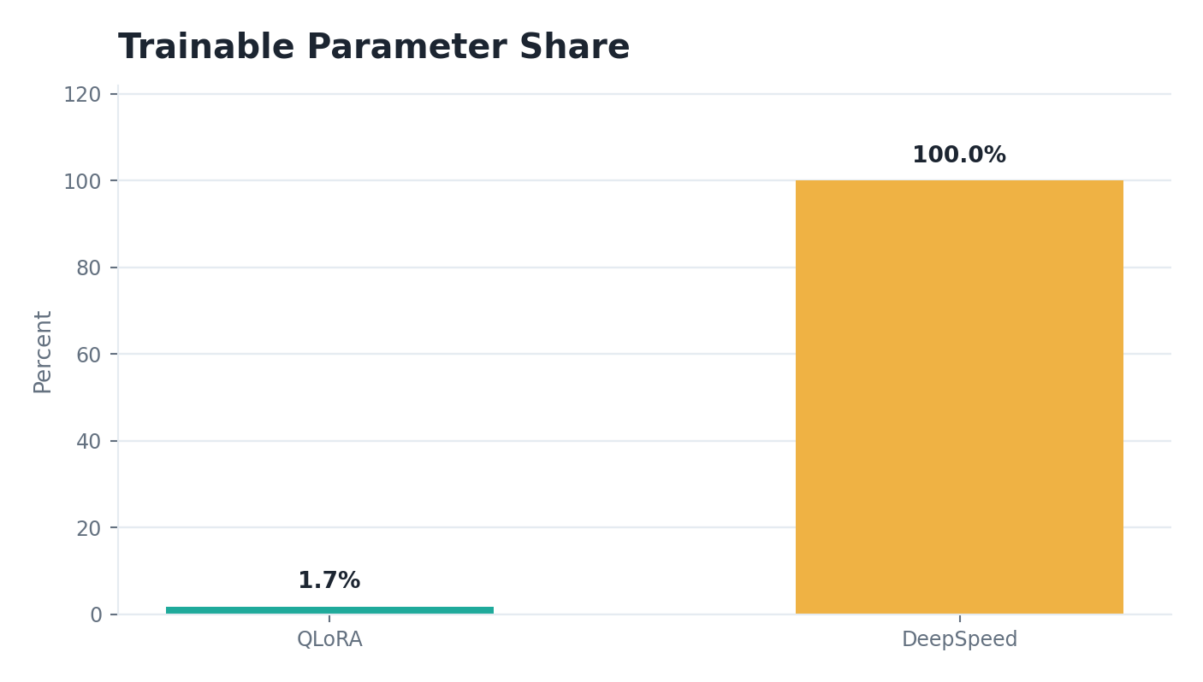
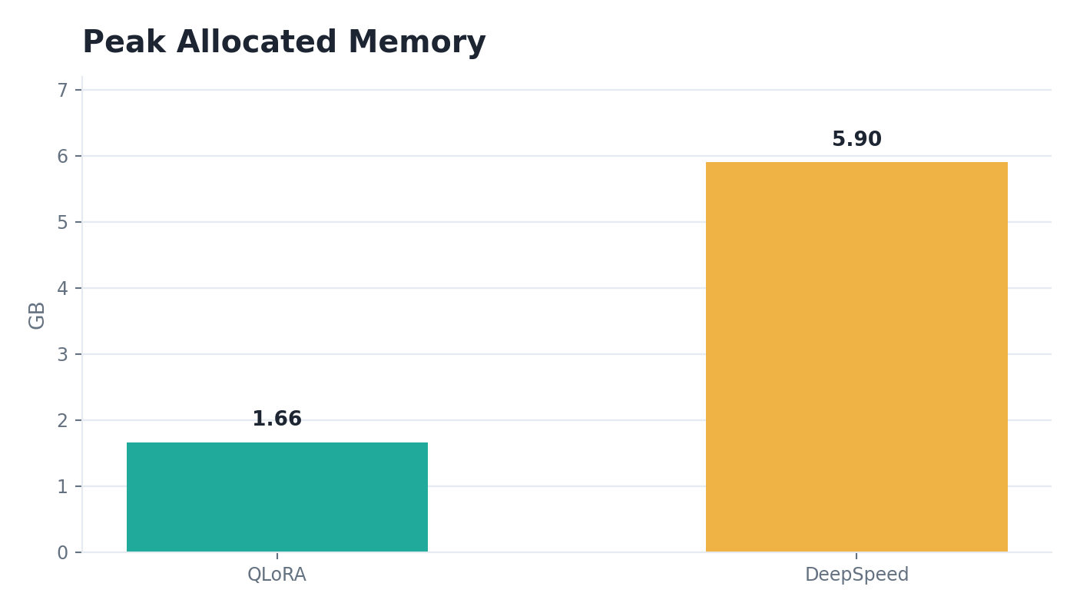
QLORA BASELINE VERSUS PROPOSED DISTRIBUTED FULL FINE-TUNING
Baseline Comparison
Metric | QLoRA Baseline | DeepSpeed ZeRO-2
Trainable parameters | 8,798,208 | 494,032,768
Trainable percentage | 1.7497% | 100.0000%
Training runtime | 2,829.545 s | 247.091 s
Training throughput | 1.590 samples/s | 3.642 samples/s
Training loss | 0.448 | 0.792
Evaluation loss | 0.823 | 0.616
Peak allocated memory | 1.66 GB | 5.9008 GB per rank
PDC DeepSpeed Project | QLoRA vs ZeRO-2
09

Slide 10
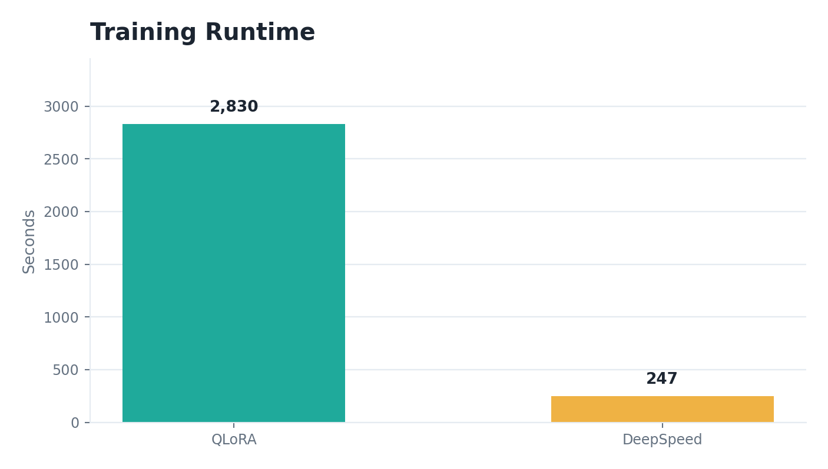
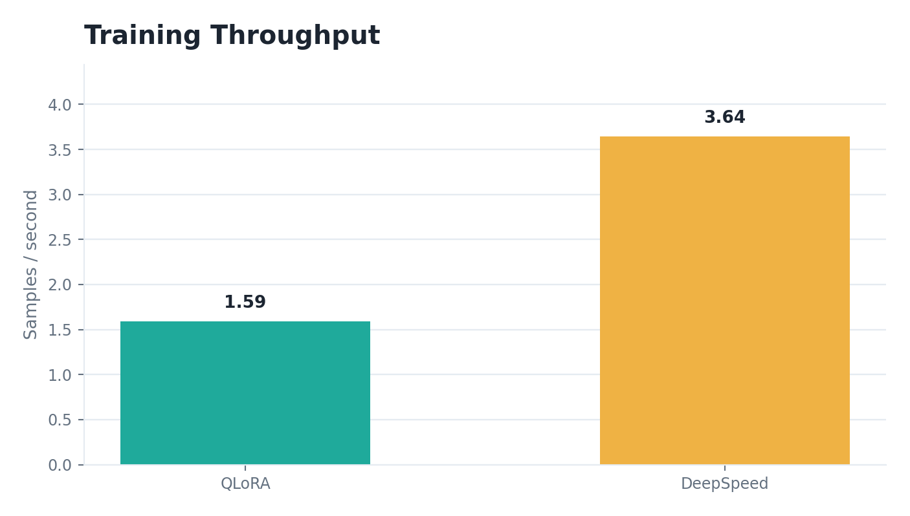
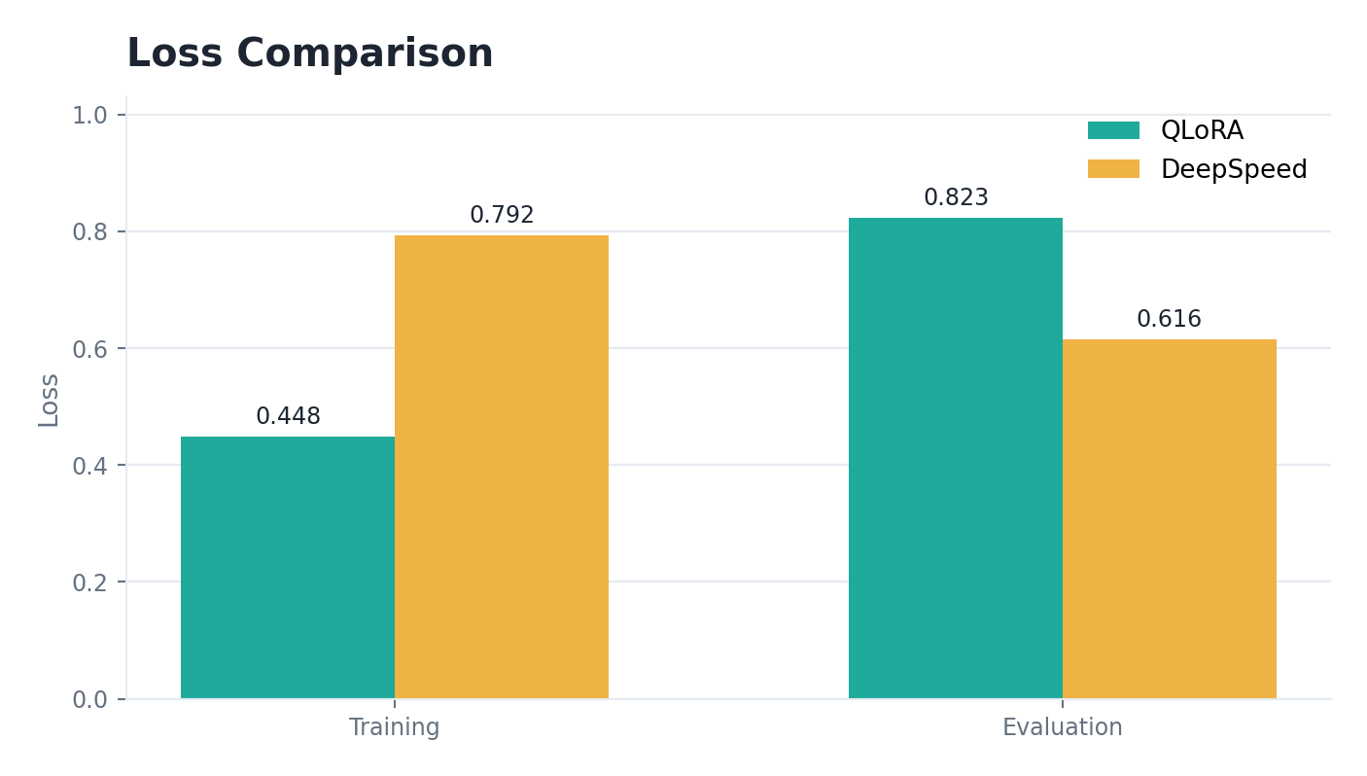
SPEED AND LOSS AT A GLANCE
Graphical Results
Runtime
Throughput
Loss
DeepSpeed finished the one-epoch run in 247.091 s versus 2,829.545 s for the five-epoch QLoRA run.
DeepSpeed reached 3.642 samples/s compared with 1.590 samples/s for QLoRA.
QLoRA had lower training loss; DeepSpeed had lower evaluation loss after full-parameter tuning.
PDC DeepSpeed Project | QLoRA vs ZeRO-2
10

Slide 11
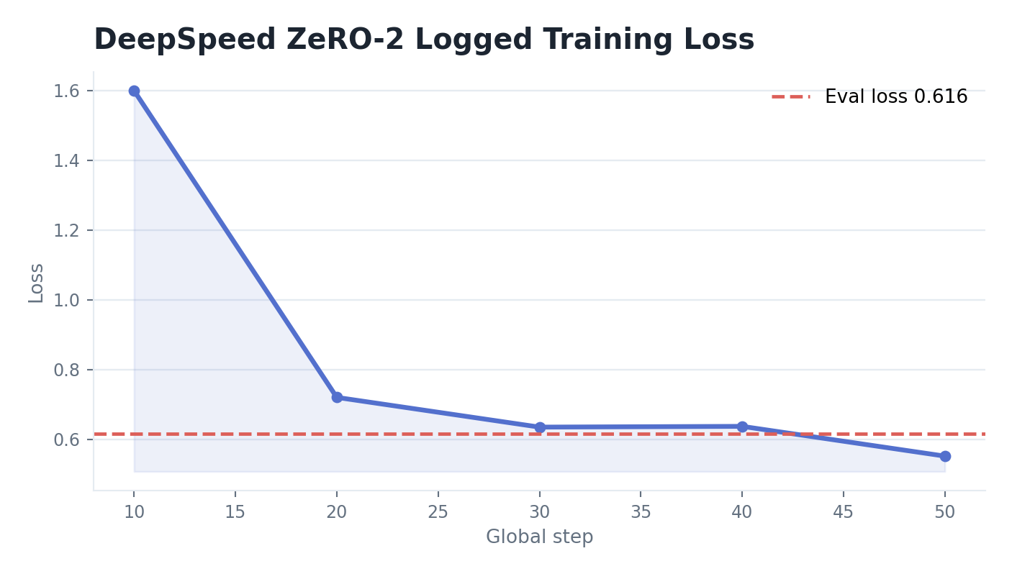
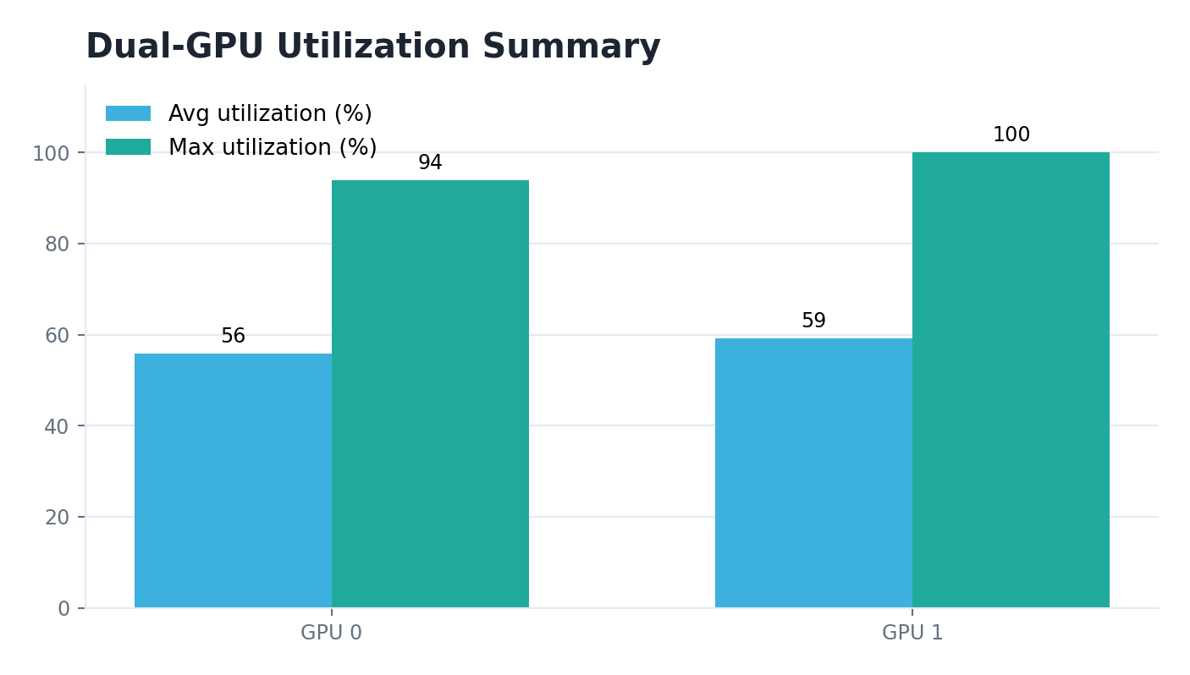
LOSS TREND AND GPU UTILIZATION
DeepSpeed Telemetry
GLOBAL STEPS
EVAL SPEED
MAX UTIL
AVG POWER
57
35.1/s
100%
~67 W
one epoch
samples per second
GPU 1 peak
per GPU
PDC DeepSpeed Project | QLoRA vs ZeRO-2
11

Slide 12
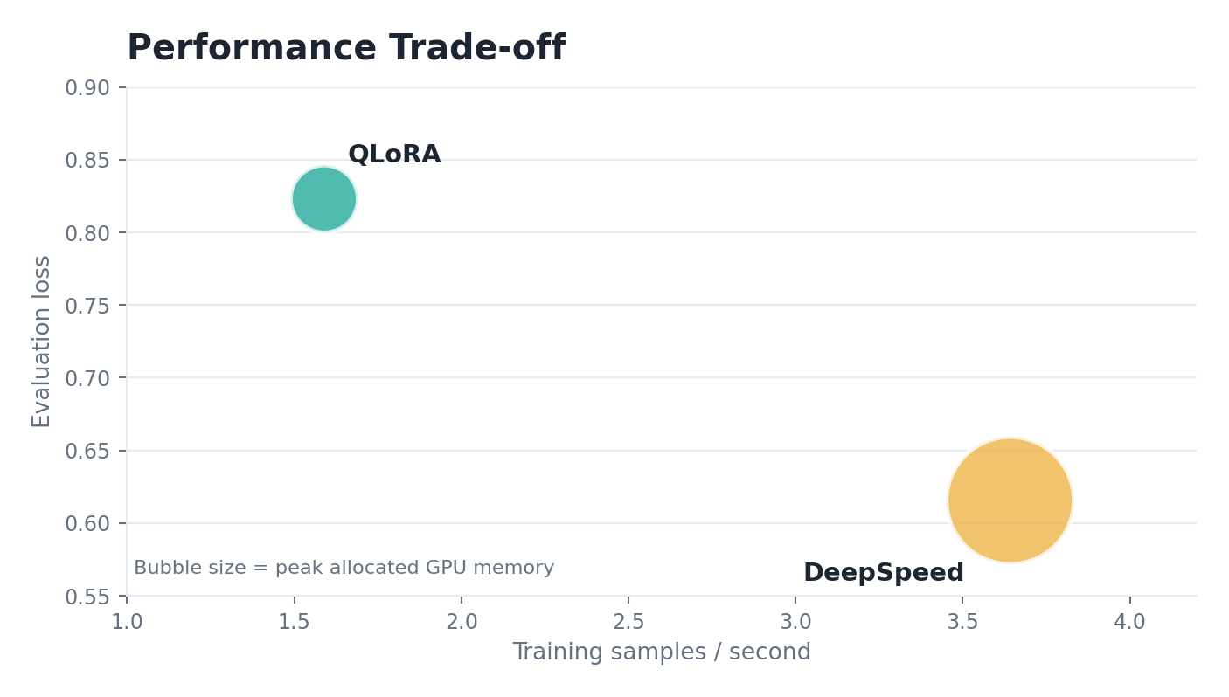
THE BETTER APPROACH DEPENDS ON THE CONSTRAINT
Performance Trade-off
QLoRA optimizes accessibility
It updates only 1.7497% of parameters and stays within a low memory footprint on a single Tesla T4.
DeepSpeed optimizes full adaptation
It updates 100.0000% of parameters and reaches stronger throughput and lower evaluation loss with two GPUs.
Interpret carefully
The runs are practical comparisons, not perfectly controlled hardware-neutral benchmarks.
PDC DeepSpeed Project | QLoRA vs ZeRO-2
12

Slide 13
HOW TO MAKE THE COMPARISON STRONGER
Limitations and Future Work
Different hardware: Tesla T4 versus two RTX A4000 GPUs.
Different epoch counts: QLoRA used five epochs, DeepSpeed used one.
Reasoning text was synthetically inserted because CodeAlpaca contains prompt-completion pairs.
Evaluation used loss and limited qualitative testing, not HumanEval or MBPP.
Next experiment
Run matched epoch counts on equalized hardware budgets.
Scale data
Repeat with 5,000 or 10,000 CodeAlpaca examples.
Add benchmarks
Evaluate generated code using HumanEval, MBPP, or similar suites.
PDC DeepSpeed Project | QLoRA vs ZeRO-2
13

Slide 14
FINAL TAKEAWAY
Conclusion
QLORA
DEEPSPEED
THROUGHPUT
EVAL LOSS
1.75%
247.1 s
3.642/s
0.616
trainable parameters
training runtime
DeepSpeed samples
DeepSpeed result
QLoRA is the stronger choice for constrained single-GPU environments; DeepSpeed ZeRO-2 is better when multi-GPU resources make full-model adaptation practical.
The project demonstrates a reproducible, metric-backed comparison of memory efficiency, throughput, loss, and implementation complexity.
PDC DeepSpeed Project | QLoRA vs ZeRO-2
14

