Slide 1

FINAL PRESENTATION
Efficient Fine-Tuning of Large Language Models
Cluster 1 – NLP Comparative Research
Single-GPU QLoRA vs Dual-GPU DeepSpeed ZeRO-2 under hardware constraints
MODEL
DATASET
SPLIT
QUESTION
Qwen2.5
CodeAlpaca
900 / 100
Efficiency
0.5B-Instruct
1,000 sample subset
train / evaluation
memory, speed, loss
Talha Rashid, Bilal Fayyaz | Department of Computer Science
PDC DeepSpeed Project | QLoRA vs ZeRO-2
01
Notes:
Our presentation is based on Cluster 1 NLP, and it is a comparative research paper focused on efficient fine-tuning of large language models.
In this work, we compare single-GPU QLoRA with dual-GPU DeepSpeed ZeRO-2
using the Qwen2.5-0.5B-Instruct model and a 1,000-sample subset of the CodeAlpaca dataset.
The purpose of this study is to evaluate which approach is more practical under hardware constraints, particularly in terms of memory usage, runtime, and training efficiency.

Slide 2

BASIC INTRODUCTION
The Problem
Fine-tuning LLMs is valuable, but the hardware bill arrives before the model improves.
Memory
Can the model fit?
Full-parameter training
Single cloud notebook GPUs
Distributed training
Speed
How fast does it train?
Quality
What loss is achieved?
PDC DeepSpeed Project | QLoRA vs ZeRO-2
02
Notes:
Fine-tuning LLMs is valuable, but the hardware bill often arrives before the model improves.
Full-parameter training puts a heavy load on GPU memory and runtime.
Single cloud notebook GPUs often cannot support full fine-tuning comfortably.
Distributed training can improve throughput, but it also adds setup and synchronization complexity.
So, this project compares two practical efficiency paths on the same task.

Slide 3
WHAT THE STUDY MEASURES
Research Objectives
Implement QLoRA
Implement ZeRO-2
Fine-tune Qwen2.5-0.5B-Instruct on a single Tesla T4 using 4-bit quantization and LoRA adapters.
Run full-parameter fine-tuning with DeepSpeed across two RTX A4000 GPUs.
Measure Trade-offs
Recommend Usage
Compare trainable parameters, runtime, throughput, loss, memory, FLOPs, and GPU utilization.
Explain which method is better under constrained single-GPU versus multi-GPU conditions.
PDC DeepSpeed Project | QLoRA vs ZeRO-2
04
Notes:
The first objective of this study is to implement QLoRA on a single Tesla T4 GPU using 4-bit quantization and LoRA adapters.
The second objective is to implement DeepSpeed ZeRO-2 for full-parameter fine-tuning across two RTX A4000 GPUs.
After that, the project measures the trade-offs in terms of trainable parameters, runtime, throughput, loss, memory, FLOPs, and GPU utilization.
Finally, the goal is to recommend which approach is better under single-GPU and multi-GPU conditions.

Slide 4
METHODOLOGY DIAGRAM
Workflow
Shared preparation
Load
Sample
Format
Tokenize
CodeAlpaca 20K
5,000 examples
Q + R + A
max length 512
Track A: QLoRA Baseline
Track B: DeepSpeed ZeRO-2
4-bit loading, LoRA adapters, FP16, gradient accumulation, single Tesla T4.
FP16 full fine-tuning, optimizer and gradient partitioning, two RTX A4000 GPUs.
Compare
loss, runtime, throughput, memory, utilization
PDC DeepSpeed Project | QLoRA vs ZeRO-2
05
Notes:
The workflow starts with similar preparation, where the CodeAlpaca dataset is loaded, a sample is selected, and the data is formatted into a question, reasoning, and answer structure.
After that, the text is tokenized with a maximum length of 512 tokens so both methods use the same input format.
From there, the process splits into two tracks: QLoRA on a single Tesla T4, and DeepSpeed ZeRO-2 on two RTX A4000 GPUs.
Finally, both tracks are compared using loss, runtime, throughput, memory usage, and GPU utilization.

Slide 5
SAME TASK, DIFFERENT OPTIMIZATION STRATEGY
Methodology
Component | Single-GPU QLoRA | Dual-GPU DeepSpeed ZeRO-2
Platform | Google Colab | RunPod
GPU | 1 x Tesla T4 | 2 x RTX A4000
Training type | 4-bit LoRA adapter tuning | Full-parameter fine-tuning
Precision | 4-bit + FP16 | FP16
Dataset split | 900 train / 100 eval | 900 train / 100 eval
Max sequence length | 512 | 512
Epochs | 5 | 5
Global steps | 565 | 285
Source: paper Table I and methodology section.
PDC DeepSpeed Project | QLoRA vs ZeRO-2
06
Notes:
This table shows that both methods solve the same task, but they use different optimization strategies.
QLoRA runs on Google Colab with one Tesla T4, using 4-bit LoRA adapter tuning and 4-bit plus FP16 precision.
DeepSpeed ZeRO-2 runs on RunPod with two RTX A4000 GPUs, using full-parameter fine-tuning in FP16.
Both use the same dataset split and sequence length, but QLoRA is trained for 5 epochs while DeepSpeed is trained for 1 epoch, which is reflected in the global steps.

Slide 6
WHAT MADE THE PROJECT NON-TRIVIAL
Implementation Challenges
Single-GPU limitation
Distributed launch complexity
Colab's Tesla T4 could not comfortably support full 20,000 parameters, so lower samples were picked for comparison.
DeepSpeed required multi-GPU verification, config tuning, launcher commands, and synchronized metric collection.
Comparison fairness
Telemetry interpretation
Hardware are different
nvidia-smi snapshots and PyTorch peak memory report different views of memory behavior.
PDC DeepSpeed Project | QLoRA vs ZeRO-2
08
Notes:
One challenge was the single-GPU limitation, because Colab’s Tesla T4 could not comfortably support full fine-tuning.
Another challenge was distributed launch complexity, since DeepSpeed required multi-GPU setup, configuration tuning, and synchronized metric collection.
The comparison also needs to be read carefully, because the hardware are different, so the results reflect practical outcomes rather than a perfectly controlled benchmark.
Finally, telemetry had to be interpreted with care, since nvidia-smi and PyTorch peak memory report different views of memory behavior.

Slide 7
BASE PAPER HIGHLIGHTED
Literature Review
Base Paper
LoRA / QLoRA
DeepSpeed ZeRO
ZeRO-2 & DeepSpeed: Shattering barriers of deep learning speed & scale
Published May 19, 2020
QLoRA: Efficient Finetuning of Quantized LLMs
Published May 23, 2023
ZeRO partitions optimizer states and gradients across workers; ZeRO-2 enables practical distributed full fine-tuning.
CodeAlpaca
Hugging Face Stack
Research Gap
Prompt-completion code instruction examples are reformatted into question, reasoning, and answer blocks.
Transformers, Trainer, PEFT-style workflows, tokenizer handling, and metric capture support reproducibility.
A practical comparison helps choose between accessible adapter tuning and faster distributed full-model updates.
PDC DeepSpeed Project | QLoRA vs ZeRO-2
03
Notes:
The literature review is based on three areas. First, LoRA and QLoRA reduce the memory cost of fine-tuning by training adapters instead of all parameters. Second, DeepSpeed ZeRO reduces memory redundancy during distributed training. Third, CodeAlpaca provides code instruction data. Our research gap is practical: under hardware constraints, should a student or researcher use QLoRA on one GPU or DeepSpeed ZeRO-2 on multiple GPUs

Slide 8
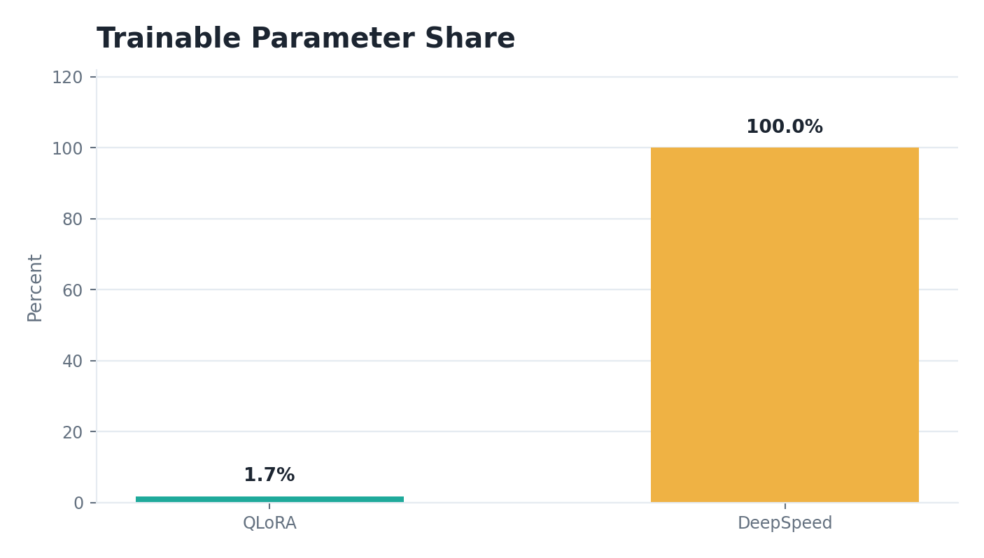
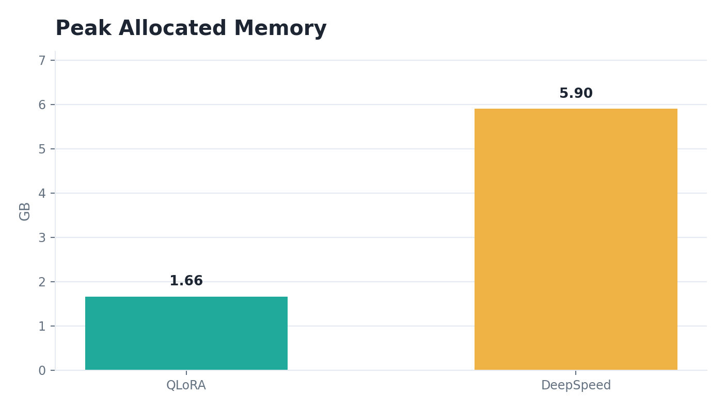
QLORA BASELINE VERSUS PROPOSED DISTRIBUTED FULL FINE-TUNING
Baseline Comparison
Metric | QLoRA Baseline | DeepSpeed ZeRO-2
Trainable parameters | 8,798,208 | 494,032,768
Trainable percentage | 1.7497% | 100.0000%
Training runtime | 2,829.545 s | 247.091 s
Training throughput | 1.590 samples/s | 3.642 samples/s
Training loss | 0.448 | 0.792
Evaluation loss | 0.823 | 0.616
Peak allocated memory | 1.66 GB | 5.9008 GB per rank
PDC DeepSpeed Project | QLoRA vs ZeRO-2
09
Notes:
We did not claim a new fine-tuning algorithm. Our contribution is a practical comparison and implementation analysis

Slide 9
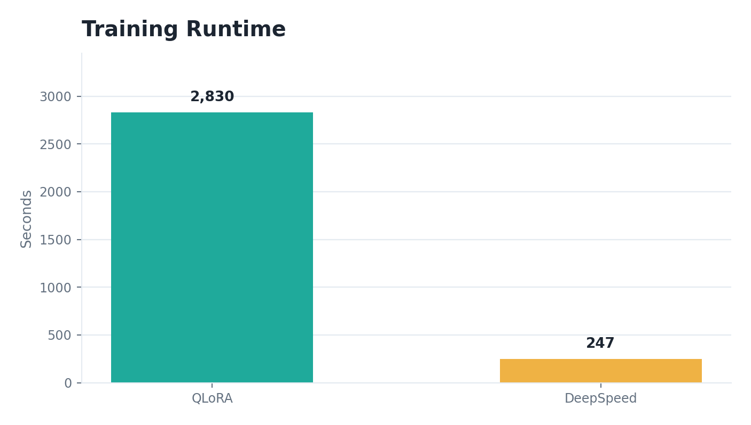
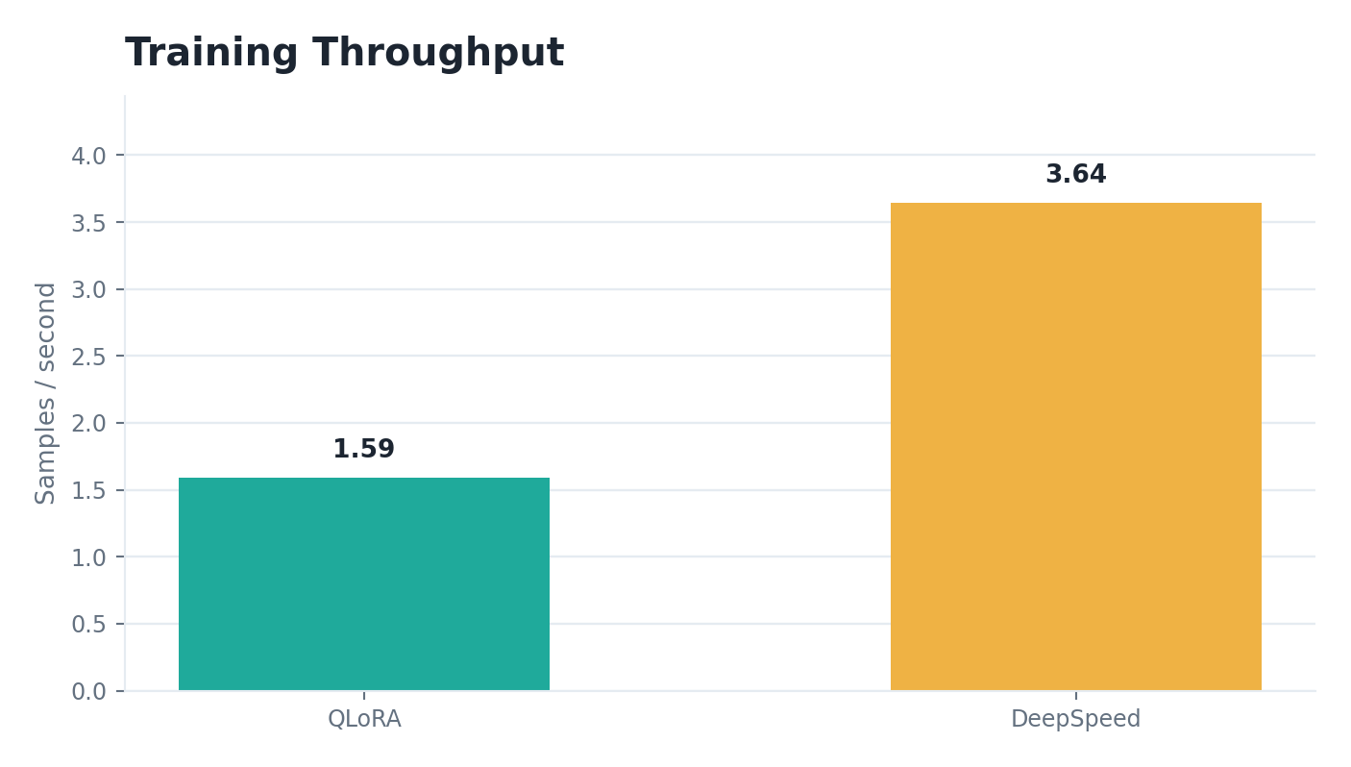
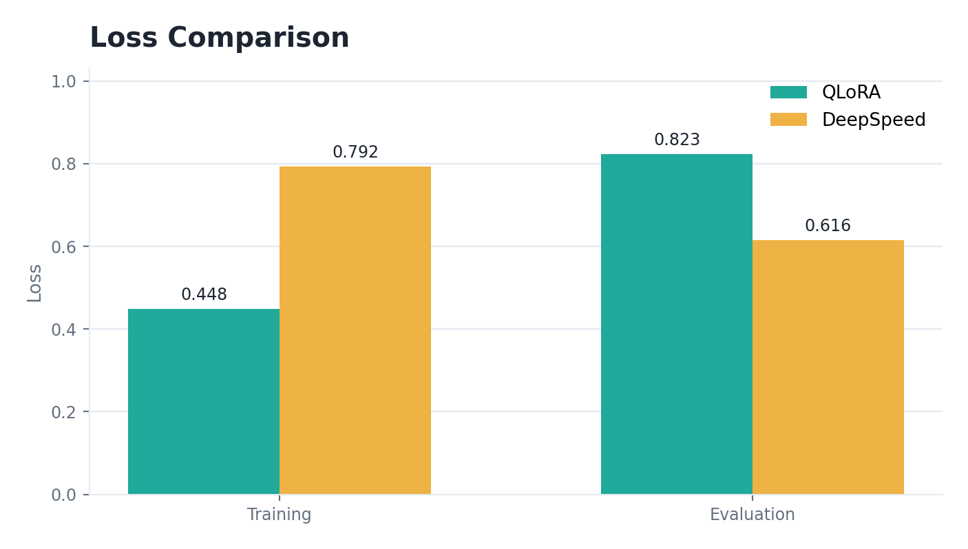
SPEED AND LOSS AT A GLANCE
Graphical Results
Runtime
Throughput
Loss
DeepSpeed finished the one-epoch run in 247.091 s versus 2,829.545 s for the five-epoch QLoRA run.
DeepSpeed reached 3.642 samples/s compared with 1.590 samples/s for QLoRA.
QLoRA had lower training loss; DeepSpeed had lower evaluation loss after full-parameter tuning.
PDC DeepSpeed Project | QLoRA vs ZeRO-2
10
Notes:
QLoRA: lower training loss.DeepSpeed: lower evaluation loss.DeepSpeed is not automatically better in every situation. It is better when multi-GPU hardware is available. QLoRA is better when memory and accessibility are the main constraints

Slide 10
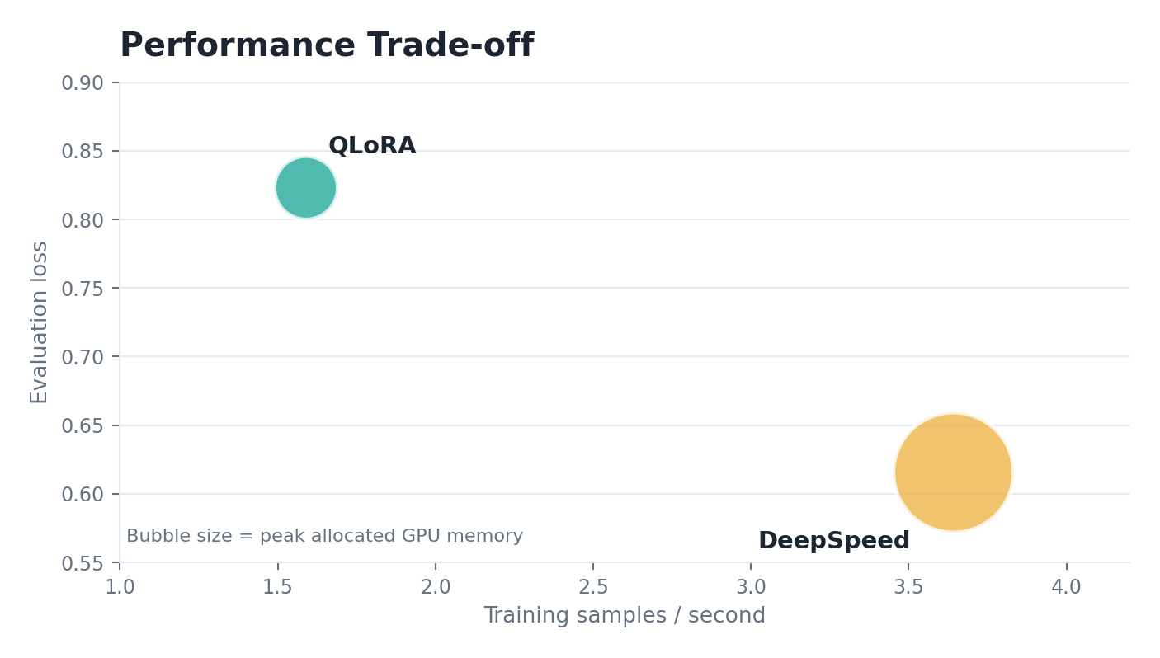
THE BETTER APPROACH DEPENDS ON THE CONSTRAINT
Performance Trade-off
QLoRA optimizes accessibility
It updates only 1.7497% of parameters and stays within a low memory footprint on a single Tesla T4.
DeepSpeed optimizes full adaptation
It updates 100.0000% of parameters and reaches stronger throughput and lower evaluation loss with two GPUs.
Interpret carefully
The runs are practical comparisons, not perfectly controlled hardware-neutral benchmarks.
PDC DeepSpeed Project | QLoRA vs ZeRO-2
12
Notes:
The better approach depends on the constraint. QLoRA is better when we only have one limited GPU because it is memory-efficient and trains only adapters. DeepSpeed ZeRO-2 is better when we have multiple GPUs because it can train all parameters and achieve higher throughput. So our conclusion is constraint-dependent.

Slide 11
HOW TO MAKE THE COMPARISON STRONGER
Limitations and Future Work
Different hardware: Tesla T4 versus two RTX A4000 GPUs.
Different epoch counts: QLoRA used five epochs, DeepSpeed used one.
Reasoning text was synthetically inserted because CodeAlpaca contains prompt-completion pairs.
Evaluation used loss and limited qualitative testing, not HumanEval or MBPP.
Next experiment
Run matched epoch counts on equalized hardware budgets.
Scale data
Repeat with 15,000 or 20,000 CodeAlpaca examples.
Add benchmarks
Evaluate generated code using HumanEval, MBPP, or similar suites.
PDC DeepSpeed Project | QLoRA vs ZeRO-2
13
Notes:
In future work, we would use matched epochs, equalized hardware, larger data, and benchmarks like HumanEval or MBPP

Slide 12
FINAL TAKEAWAY
Conclusion
QLORA
DEEPSPEED
THROUGHPUT
EVAL LOSS
1.75%
247.1 s
3.642/s
0.616
trainable parameters
training runtime
DeepSpeed samples
DeepSpeed result
QLoRA is the stronger choice for constrained single-GPU environments; DeepSpeed ZeRO-2 is better when multi-GPU resources make full-model adaptation practical.
The project demonstrates a reproducible, metric-backed comparison of memory efficiency, throughput, loss, and implementation complexity.
PDC DeepSpeed Project | QLoRA vs ZeRO-2
14
Notes:
The final takeaway is that neither method is universally better. QLoRA is the stronger option when memory is limited and only a single GPU is available. DeepSpeed ZeRO-2 is stronger when multi-GPU hardware is available and full-model adaptation is needed. Our project shows this using concrete metrics: trainable parameters, runtime, throughput, memory, and loss

Slide 13
