Slide 1
ITP 348

Slide 2

Rob Parke
Email: parke@usc.edu
Office Hours: OHE 412 (hours on Piazza)
Senior Lecturer
Connected Devices and Making Minor
Sound Editor / Web Developer (previous)
USC Alum!

Slide 3
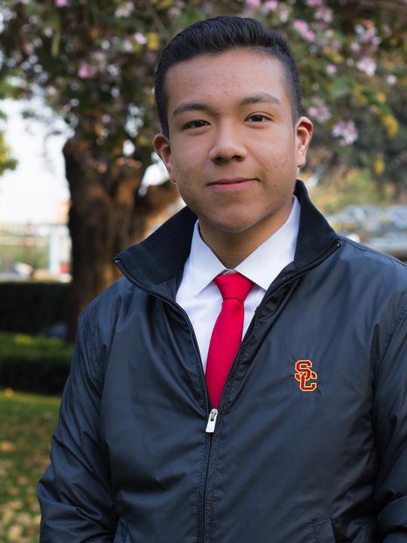
Teaching Assistants / Graders
Neftali | Hernadez | neftalih@usc.edu
Office hours for will be posted on Blackboard
For grading issues, contact the TA first
For general questions, you can visit either of us

Slide 4

New Class!
…is a little bit like the Wild West

Slide 5
New Class!
Your feedback is really important throughout the semester
I want to know what works, what doesn't, any way to improve the class

Slide 6
Textbook
Instead of a textbook, there is a kit that must be purchased from the bookstore
Readings will be available online
Notes:
zyBooks
Mention that the textbook is interactive and student feedback is very positive
Part of the grade will be based on completion of zybooks exercises so it required to purchase

Slide 7
Grading Scale
Participation | 10%
Assignments | 40%
In-Class Labs and Quizzes | 20%
Final Project | 30%

Slide 8
Exams
None!
Notes:
zyBooks
Mention that the textbook is interactive and student feedback is very positive
Part of the grade will be based on completion of zybooks exercises so it required to purchase

Slide 9
Assignments
Assigned weekly and due Monday at 11:59pm
Submissions will be on Blackboard and typically include code files as well as video files
We can not accept assignments via email
Must be well commented and documented
We will discuss comments
You will lose points for this

Slide 10
Assignment Extra Credit
Up to 10% extra credit on each assignment for features beyond the scope of the course.
May or may not be stated on assignment description
Points will be earned based on
Rigor (how difficult was the feature to implement)
Functionality (does the feature work properly)
Applicability (does the feature make sense given the larger assignment)
Important: You must describe the included extra features in their Blackboard submission

Slide 11
Labs
Some of our in-class activities will be turned in for credit
Graded on a 0-2 point scale
0 No attempted / minimal effort
1 Significant effort
2 Complete / mostly complete

Slide 12
Quizzes
There will be a few quizzes during the semester
These will be short (a few questions) and will be announced a week ahead of time
There will NOT be any unannounced quizzes

Slide 13
Late Assignment Policy
You have 3 “late days” which may be used for extra time without penalty
May be used for one assignment or distributed across several assignments
Instructor-granted extensions are only considered after all grace days are used and only given in rare, exceptional situations
Late work will not be accepted after all the grace days have been used
Important: You must state that you are using a grace day in their Blackboard submission

Slide 14
Late Lab Policy
Labs
Since labs are completed in class, they can not be accepted late or made up

Slide 15
Final Project
Final Project
No final exam
Final device project
Due on Friday during Finals Week

Slide 16
Adding the Course after Week 1
You may add the course until the end of week 3
However, you should plan on attending from the beginning of the semester
If you add after week 1, email the instructor immediately to make a plan to for completing work and learning missed materials
All missed work is must completed and submitted according to the syllabus

Slide 17
Collaboration and Cheating
Programming courses are different than other courses
Collaboration and sharing of code are considering cheating
This also includes looking at someone's solution
Department policy to assign grade of F
Last semester
14 of 150 students were reported to SJACS

Slide 18
Academic Integrity
No sharing of code
Sending another student your code is breaking the academic integrity
There is no reason to be working together to solve a problem
You must be the sole author of your code
No one can physically type your code except for you
You cannot physically type code for someone else
You cannot take code from the internet
Any plagiarism in your code is easily detectable
Giving code and receiving code are the same—same punishment
Have questions? Office hours!
Notes:
Please don’t be an idiot and ask the internet. More often than not, we know ALL of the forums that students post questions to.
Yahoo! Answers is not a viable place to ask questions.

Slide 19
Piazza
Piazza for class discussions on homework
Everyone should have been invited (link posted on Blackboard)
Forum monitored by all instructors, graders, TAs
No posting of code large sections of code

Slide 20
Useful Resources
USC Kortschak Center for Learning and Creativity
Academic coaching, time management, study room
https://kortschakcenter.usc.edu/
Tips / handouts on self-care, goal setting, test taking, note taking, and more
https://kortschakcenter.usc.edu/tools-resources/

Slide 21
Useful Resources
Almost half of all college students will experience severe depression or symptoms of mental illness in college
Student Counseling Center
Free confidential counseling
(213) 740-7711
https://engemannshc.usc.edu/counseling/
Trojans Care for Trojans
Anonymously let staff know you are concerned about a fellow student experiencing personal difficulties
https://studentaffairs.usc.edu/trojans-care-for-trojans-tc4t/

Slide 22
Useful Resources
Relationship and Sexual Violence Prevention and Services (RSVP)
Immediate therapy services—confidential
(213) 740-4900
https://engemannshc.usc.edu/rsvp/
Office of Equity and Diversity
Report issues related to harassment, discrimination, sexual harassment, or Title IX
(213) 740-5086
https://equity.usc.edu/

Slide 23
Useful Resources
Trojan Alert
Sign up to receive alerts during emergencies
https://trojansalert.usc.edu/register.php

Slide 25
Speed Friending
Get in two rows facing each other
1 minute timer
Introduce yourself
Answer a question I pose
When timer ends, students closest to back wall rotate one seat to left
When we were are all done, share one interesting thing you learned about classmates
Notes:
Question list: https://docs.google.com/document/d/1B39r8Sj7hAQ5mfk1cUYdS2BbdeLpn6e9Jyeo1yz8vZQ/edit

