Slide 1
Issue & bug tracking
tools to keep your projects on track

Slide 2

NEMFL Systems
  RT
  Redmine
  Assembla
  Track
  Bugzilla
  Jira
  Pivotal Tracker

Slide 3
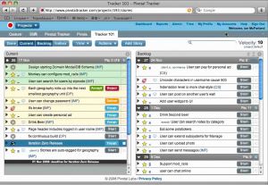
Pivotal Tracker
  Story-based iterative planning
  Agile project management tool
  @see pivotaltracker.com
  @ask Aarmel

Slide 4
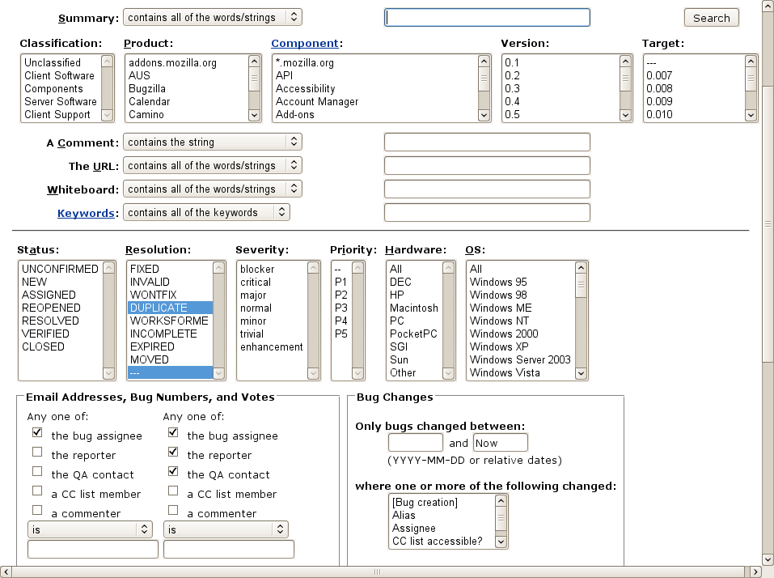
Bugzilla
  Was popular for bug tracking
  PERL based
  @see Bugzilla.org

Slide 5
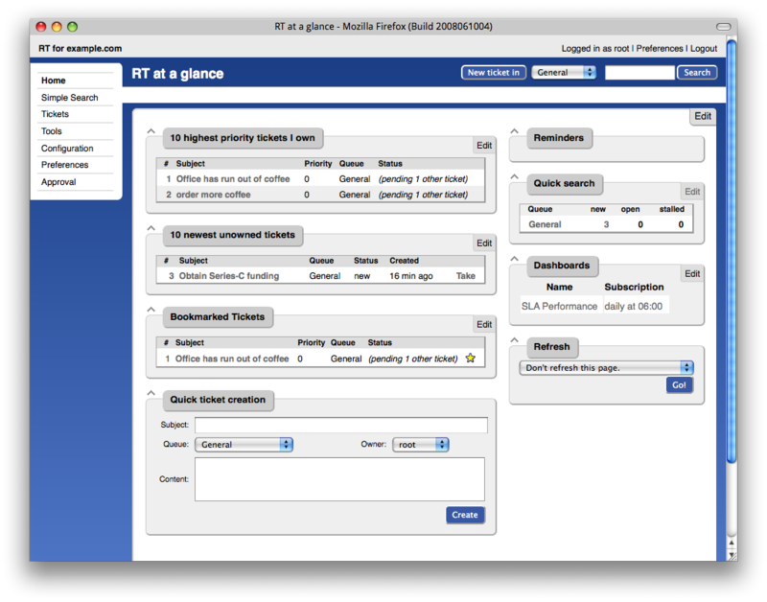
RT, Request Tracker by Best Practical
  One of the first of its kind
  PERL
  Enterprise Grade
  RT is used by Fortune 100 companies, government agencies, educational institutions, and development organizations worldwide
  @see bestpractical.com/rt

Slide 6
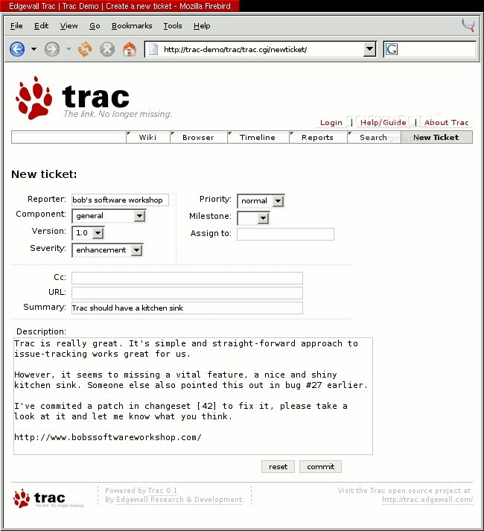
Trac by Edgewall
  Python
  SVN integration
  @see trac.edgewall.org

Slide 7
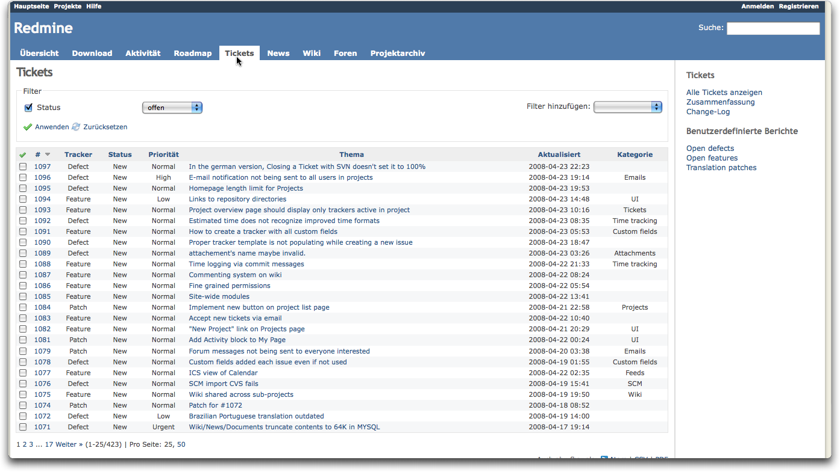
Redmine
  Ruby on Rails
  @see redmine.org

Slide 8
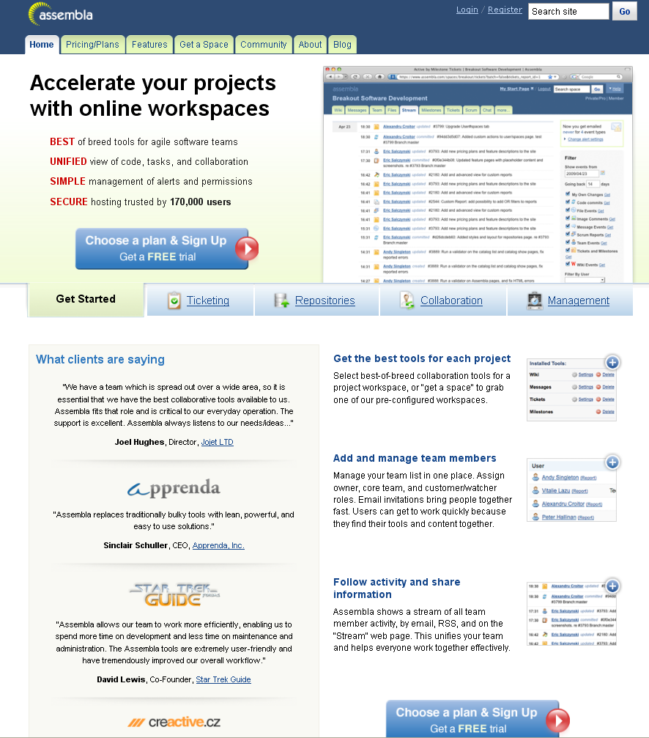
Assembla
  Hosted solution
  @see assembla.com

Slide 9
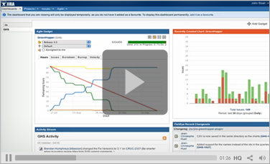
Jira by Atlassian
  Java
  @see www.atlassian.com/software/jira

Slide 10
The End

