Slide 1
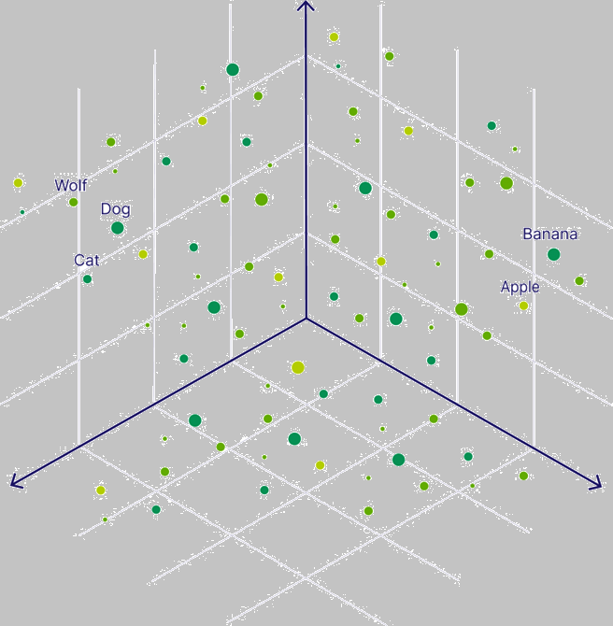
Powering Semantic Search using
Vector Database

Slide 2


Raihan Alam
Senior Software Engineer

Slide 3
Session Breakdown
Understanding Search
Fundamentals of Vector Database
Hands-on Session
Q&A

Slide 4
Disclaimer
The session includes solely my opinion, doesn’t represent my employer’s position on any technology.
In the interest of time, we shall sometimes simplify some terms/concepts.

Slide 5
Understanding Search

Slide 6
Lexical Search
Semantic Search
    Looks for exact matches
    Focus on spelling
    Example – searching for name of people/places
    Looks at the meaning of words
    Intent over spelling
    Example – searching for events.
VS

Slide 7
Lexical Search
Semantic Search
    Searching for “bag”
    won’t return “egg”
    Searching for “breakfast” will return “egg”
VS

Slide 8
Fundamentals of Vector Database

Slide 9
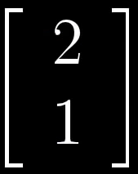
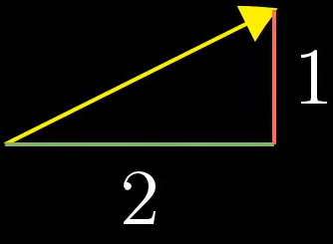

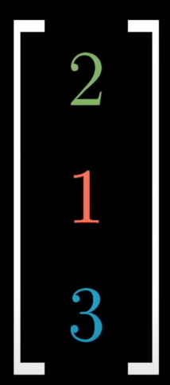
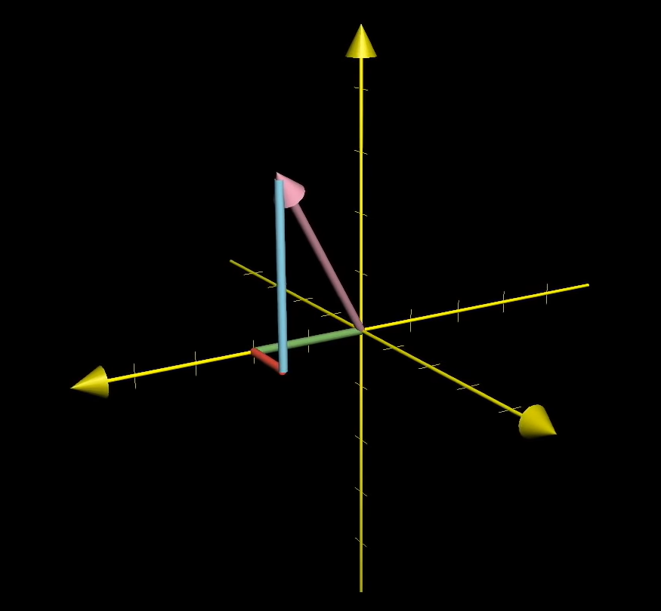
Vector
A vector is a list of numbers.
If a matrix has only one row or only one column it is called a vector.
2 dimensional
3 dimensional
Great link - Vectors | Chapter 1, Essence of linear algebra

Slide 10
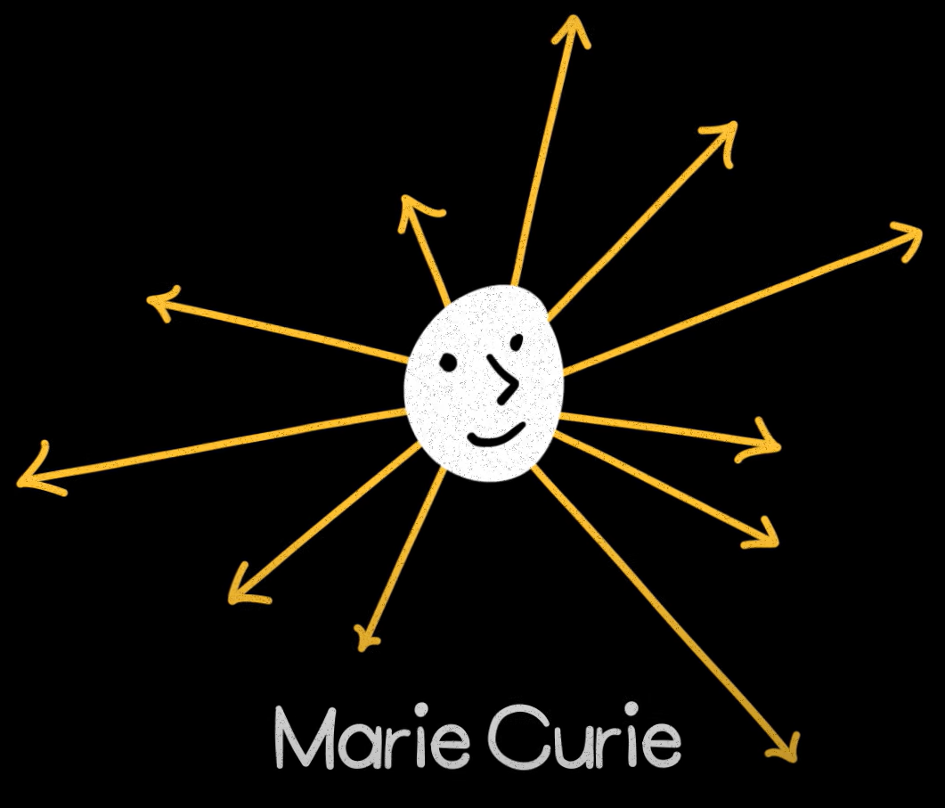
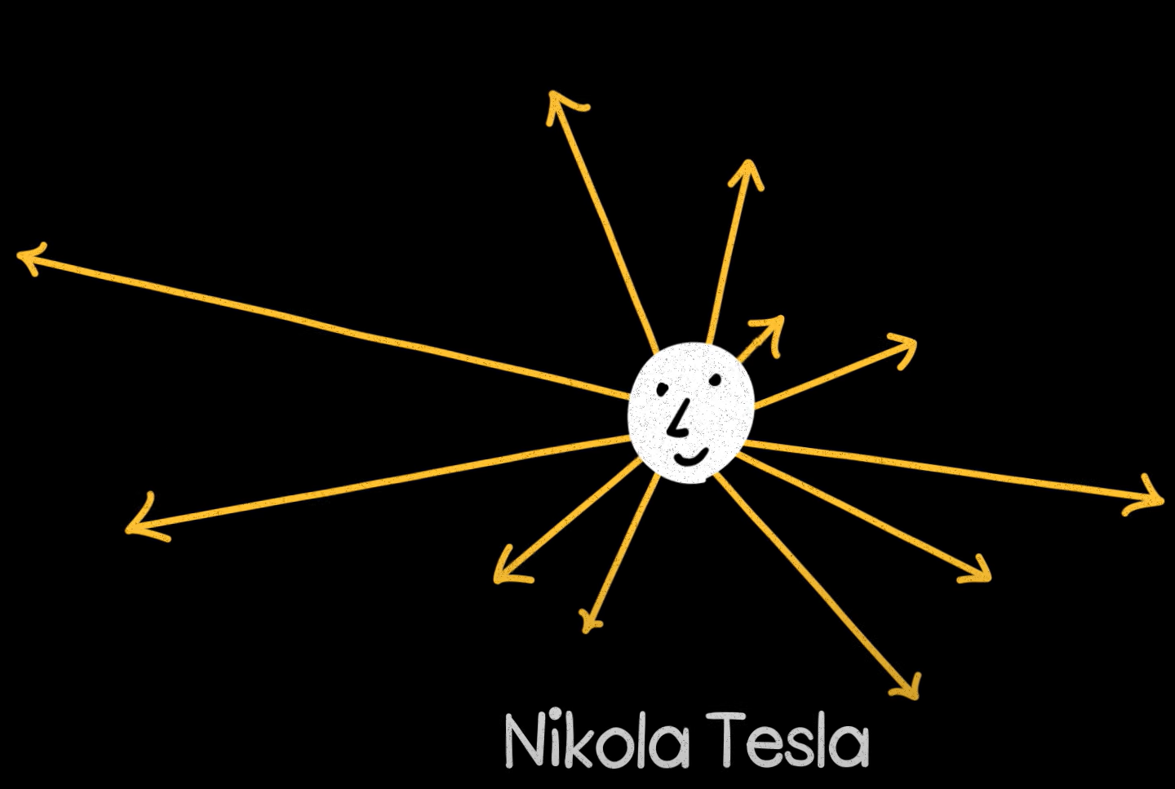
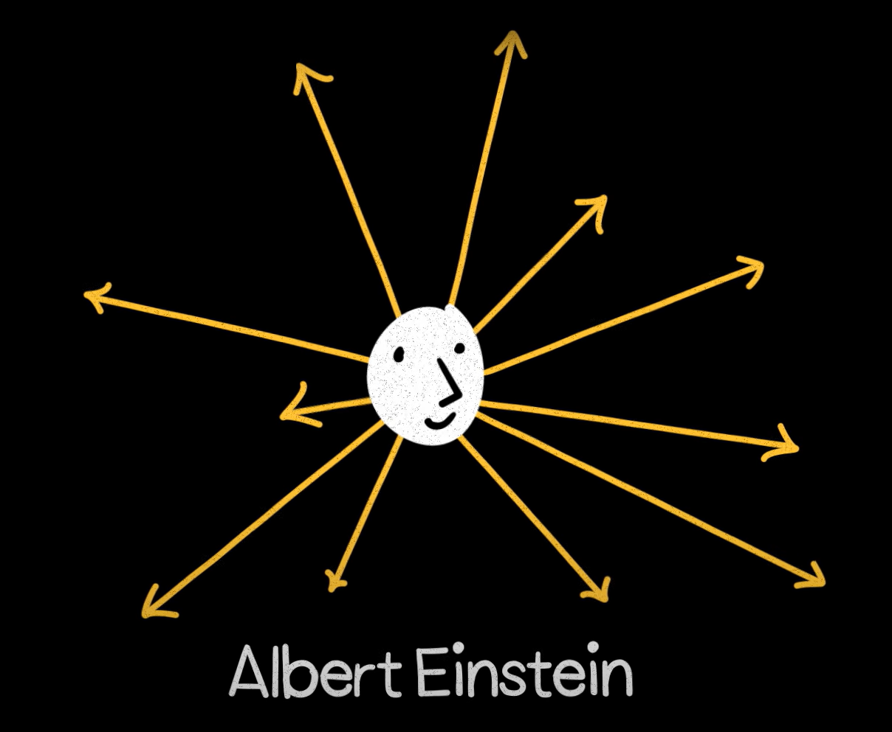
Country
High dimensional vector space
Research area
Geometrically counter-intuitive spaces.
Real world, an object has many possible dimensions.
Birthplace

Slide 11
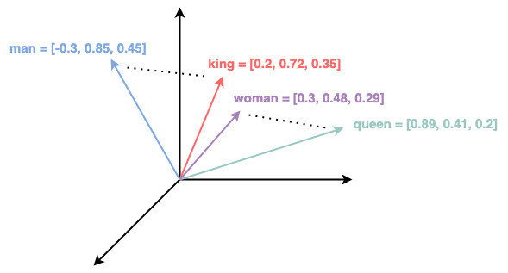
Dimensionality
Higher dimensionality => higher storage and computational resource.
Higher accuracy model (e.g., translation) requires higher dimension compared to models like entity recognition.
Experiment to find the optimal dimension.
Simple 3-dimensional word vectors
Details - Understanding Multi-Dimensionality in Vector Space Modelling

Slide 12
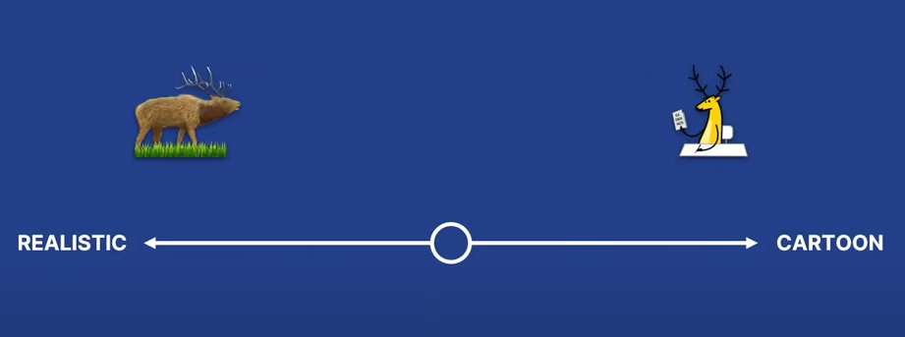
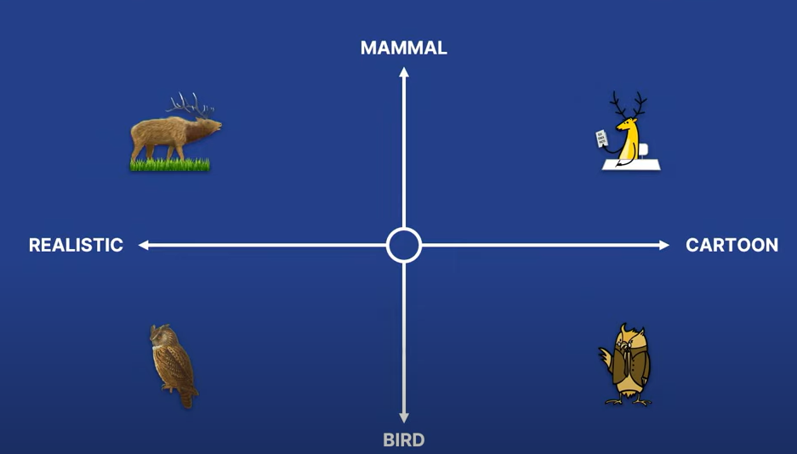
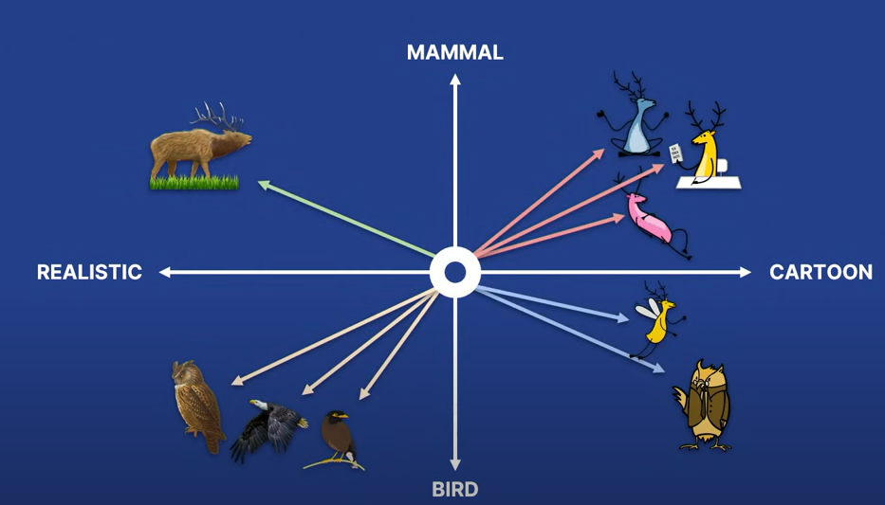
Goal
show me your friends, and I’ll tell who you are.
Similar data is in the similar dimensional space.
Try it - Visualization of high-dimensional data

Slide 13
How Search Works
Data
Generate Embeddings
Indexing
Vector Database
Calculate Similar Vectors
Search Result
Vectors
Search
Search Term
Generate Embeddings
Search Term Vector

Slide 14
Calculating Similar Vectors
Similarity metrics
Similarity Metrics convey how similar or dissimilar two vector embeddings are.
Indexing
indexing organizes the vectors for fast retrieval based on similarity or distance measures.

Slide 15
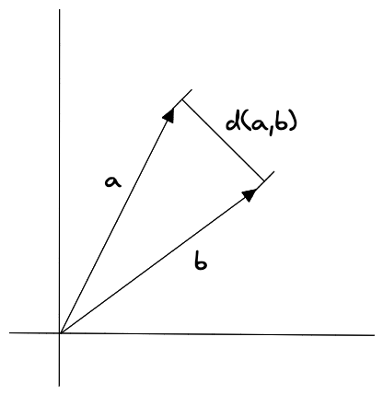
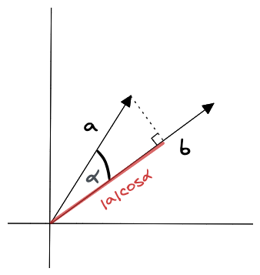
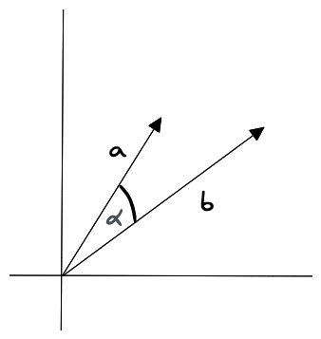
Similarity metrics
Similarity Metrics convey how similar or dissimilar two vector embeddings are.
Similarity Metric | Vector properties considered
Euclidean distance | Magnitudes and direction
Cosine similarity | Only direction
Dot product similarity | Magnitudes and direction
Euclidean distance
Dot product similarity
Cosine similarity

Slide 16
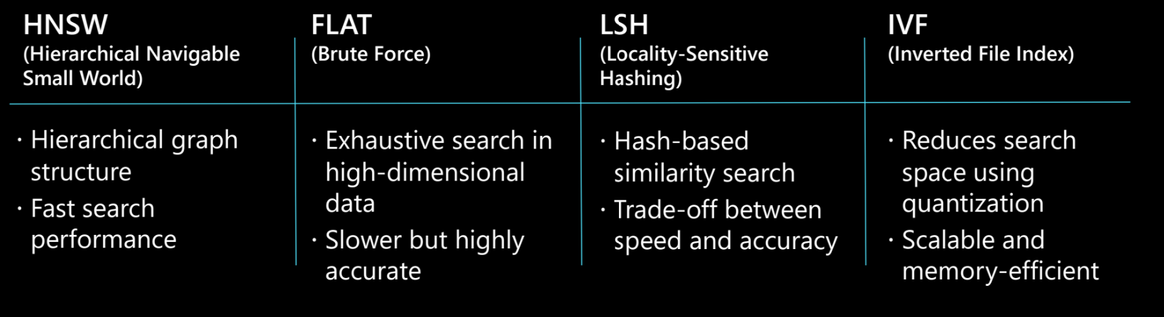
Indexing
KNN
works by calculating the distance between the query vector and all the vectors in the dataset.
ANN
sacrifices accuracy in exchange for executing efficiently in high dimensional spaces

Slide 17
Micorhack
Hands-on session – things may break

Slide 18
Steps
Generate Embeddings
Create Index
Ingest Vectors
Query

Slide 19
Q&A

