Slide 1


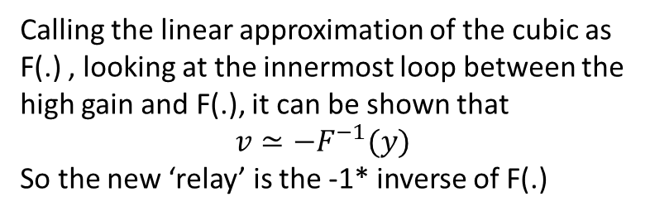
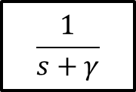




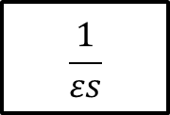











$$w$$
$$v$$
$$v$$
$$ε_{1}$$
Inverse
-1
$$ε_{2}$$
$$ε_{2}$$
$$ε_{1}$$
$$ε_{2}$$
$$ε_{1}$$
$$v$$
$$w$$
$$w$$
$$+$$
$$y$$
$$+$$
$$\frac{1}{εs}$$
$$I_{app}$$
$$−$$
$$+$$
Calling the linear approximation of the cubic as F(.) , looking at the innermost loop between the high gain and F(.), it can be shown that $$v≃−F^{−1}(y)$$
So the new ‘relay’ is the -1* inverse of F(.)
$$v$$
$$w$$
$$\frac{1}{s+γ}$$

Slide 2
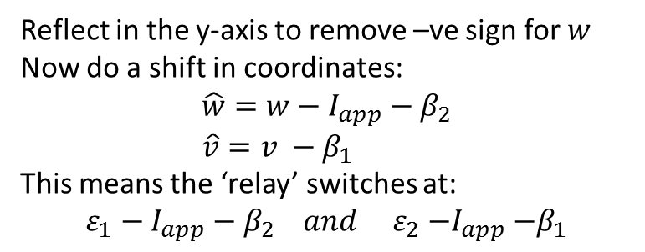









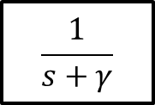

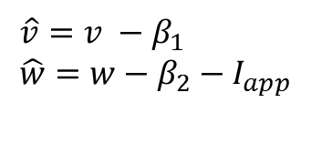








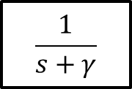


$$\hat{v}$$
$$v$$
$$v$$
$$v$$
$$\hat{v}=v −β_{1} \\ \hat{w}=w−β_{2}−I_{app}$$
Reflect
Shift
$$ε_{2}$$
$$ε_{1}$$
$${−ε}_{1}−I_{app}−β_{2}$$
$$\hat{w}$$
$$\hat{w}$$
$$w$$
$${−ε}_{1}$$
$${−ε}_{2}$$
$$\hat{w}$$
$$\hat{w}$$
$${−ε}_{2}−I_{app}−β_{2}$$
$$+$$
Reflect in the y-axis to remove –ve sign for $w$
Now do a shift in coordinates: $$\hat{w}=w−I_{app}−β_{2} \\ \hat{v}=v −β_{1}$$
This means the ‘relay’ switches at:
$$ε_{1}−I_{app}−β_{2} and ε_{2}{−I}_{app}−β_{1}$$
$$I_{app}$$
$$−$$
$$v$$
$$w$$
$$\frac{1}{s+γ}$$
$$\hat{w}$$
$$\hat{v}$$
$$\frac{1}{s+γ}$$

Slide 3




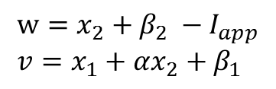


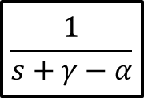




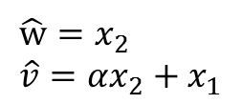




$$\hat{v}$$
$$\hat{v}$$
$$x_{1}$$
$$T=\left[\begin{matrix}1 & 0 \\ α & 1\end{matrix}\right]$$
$$x_{1}$$
Change basis
$${−ε}_{1}+I_{app}$$
$${−ε}_{2}+I_{app}$$
$$\hat{w_{1}}$$
$$\hat{w_{1}}$$
$$x_{2}$$
$$x_{2}$$
$$\left[\begin{matrix}\hat{w} \\ \hat{v} \end{matrix}\right]=T\left[\begin{matrix}x_{2} \\ x_{1}\end{matrix}\right]$$
$$x_{2}$$
$$x_{1}$$
$$\hat{w}=x_{2} \\ \hat{v}=αx_{2}+x_{1}$$
$$\frac{1}{s+γ−α}$$
$$w=x_{2}+β_{2} −I_{app} \\ v=x_{1}+αx_{2}+β_{1}$$

Slide 5

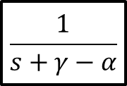

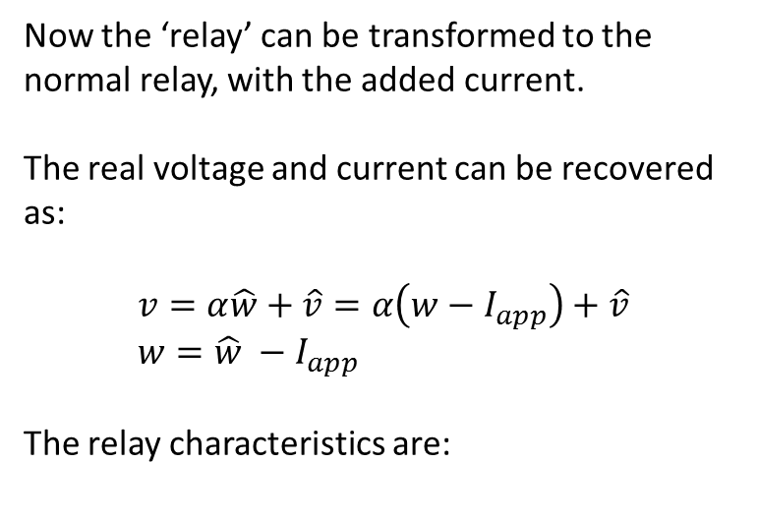




Now the ‘relay’ can be transformed to the normal relay, with the added current.
The real voltage and current can be recovered as:
$$v=α\hat{w}+\hat{v}=α\left(w−I_{app}\right)+\hat{v} \\ w=\hat{w} −I_{app}$$
The relay characteristics are:
$$\hat{w}$$
$$\hat{v}$$
$$\frac{1}{s+γ−α}$$
$$\hat{v}$$
$${−ε}_{1}+I_{app}$$
$${−ε}_{2}+I_{app}$$
$$\hat{w}$$

Slide 6







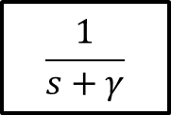


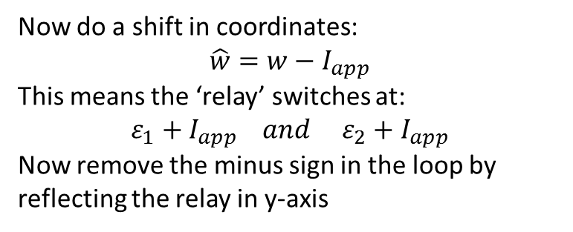




$$v$$
$$v$$
$$v$$
Shift
-1
$$ε_{2}$$
$$ε_{1}$$
$$ε_{2}−I_{app}$$
$$ε_{1}−I_{app}$$
$$w$$
$$\hat{w}$$
$${−ε}_{1}+I_{app}$$
$${−ε}_{2}+I_{app}$$
$$\hat{w}$$
Now do a shift in coordinates: $$\hat{w}=w−I_{app}$$
This means the ‘relay’ switches at:
$$ε_{1}+I_{app} and ε_{2}+I_{app}$$
Now remove the minus sign in the loop by reflecting the relay in y-axis
$$I_{app}$$
$$+$$
$$−$$
$$v$$
$$w$$
$$\frac{1}{s+γ}$$
$$\hat{w}$$
$$v$$
$$\frac{1}{s+γ}$$

