Slide 1
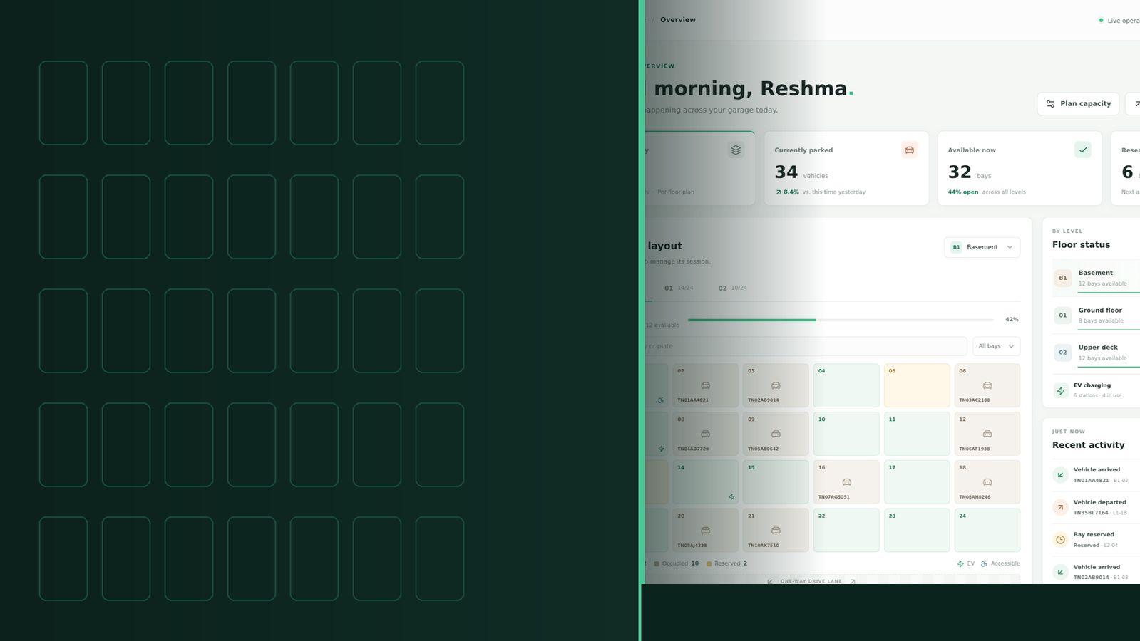
parkline.
PROJECT REVIEW
ACADEMIC PROJECT · 2026
Multi-Level Parking
Operations & Capacity
Planning
Parkline · Functional UI / domain-logic MVP
A codebase-grounded review of requirements, architecture,
implementation, live screens, verification and roadmap.
Presented by [Student Name] · [Register Number]
Guided by [Project Guide Name] · November 2026
Version 0.1.0 · 4 seeded sites · 72 bays/site · browser-local persistence
Actual built UI · captured from build
Notes:
Opening slide. Replace the student, register number and guide placeholders before submission. State clearly that Parkline is a browser-local MVP, not an installed parking-control system. The right-hand image is a genuine capture of the built application, not a mockup.

Slide 2
PARKLINE / PROJECT REVIEW
01 / CONTEXT
Review at a glance
What the MVP proves, what the checks show, and where the review boundary sits
A functional browser-local MVP with coherent, testable state rules — suitable for academic review and demonstration, not for production deployment.
REVIEW POSITION
4 × 72
3 × 3
13 / 13
2
seeded bays
status × kind
unit + static
open findings
Riverside + 3 Chennai mall sites; 3 floors × 24 bays each
available / occupied / reserved; standard / EV / accessible
9 Vitest cases; lint, typecheck and production build pass
Reload persistence + 390 px mobile overflow
What is strong
What is bounded
What needs hardening
Totals, floor map and active sessions derive from one bay collection
One browser and origin; no shared database or login
Added-location reload selection failed in one E2E scenario
Pure helpers own validation and immutable transitions
Reserved samples are displayed, not managed end-to-end
390 px viewport measured 457 px document width
Occupied/reserved bays survive capacity reduction
Static LIVE/trend/EV labels are not telemetry
Dialog focus, schema validation and concurrency are open
Parkline · Project Review | Source-grounded MVP
02 / 30
Notes:
Use this slide to frame the review: the local domain model works, static and unit checks are green, but browser persistence and narrow-screen quality remain open. Avoid calling it production-ready.

Slide 3
PARKLINE / PROJECT REVIEW
01 / CONTEXT
Review map
Six sections move from project context to evidence, decisions and reproducible artifacts
01
Context & goals
02
Requirements
03
Design & build
Slides 04–07
Slides 08–09
Slides 10–17
Identity, problem, objectives, literature, scope
Actor journey, use cases, FR/NFR map
Architecture, model, workflows, code, stack, UI
04
Product demo
05
Verification
06
Outlook
Slides 18–22
Slides 23–27
Slides 28–30
Real captures: overview, map, sessions, planning, mobile
Checks, traceability, defects, achievements, privacy
Roadmap, review decisions, evidence gallery
Parkline · Project Review | Source-grounded MVP
03 / 30
Notes:
If time is short, spend most time on slides 10–17 and 23–29. Slides 18–22 are the visual demo; slide 30 is an evidence appendix.

Slide 4
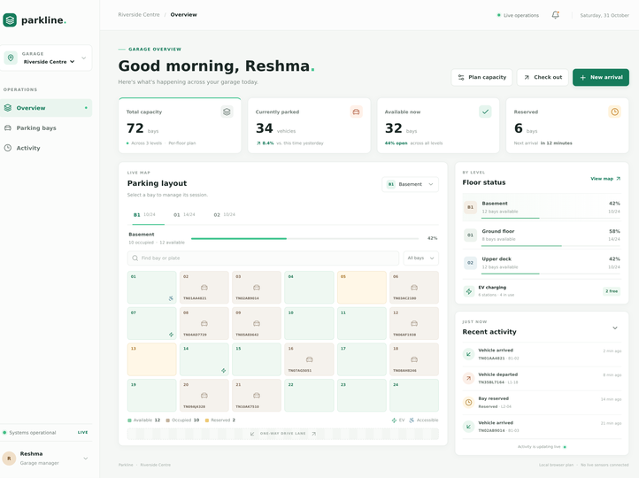
PARKLINE / PROJECT REVIEW
01 / CONTEXT
Project identity & product snapshot
Parkline turns a multi-level garage into a location-scoped, floor-aware operator dashboard
PARKLINE / MULTI-LEVEL PARKING
One selected garage.
Three scopes that must agree.
Location scope selects the inventory. Level scope selects the map and departure list. Bay scope decides whether an arrival or departure is valid.
Package / version
multi-level-parking · 0.1.0
Primary route
Next.js App Router / → ParkingDashboard
Seed sites
Riverside, Marina Velachery, VR Anna Nagar, Phoenix OMR
Seed floors
B1 Basement · L1 Ground floor · L2 Upper deck
Persistence
localStorage key parkline-garage-planning
Reviewed application source matches the recorded SHA-256 evidence set.
Actual dashboard capture · Riverside Centre, B1
Parkline · Project Review | Source-grounded MVP
04 / 30
Notes:
Emphasize that named sites and registrations are fixtures. The dashboard is a cohesive model of inventory and sessions, not a live feed from those places.

Slide 5
PARKLINE / PROJECT REVIEW
01 / CONTEXT
Problem statement & measurable objectives
The engineering question is local consistency, not claimed deployment impact
SEVEN COORDINATION PROBLEMS
TEN OBJECTIVES → FOUR OUTCOME GROUPS
Fragmented floor visibility
Reserved ≠ available ≠ occupied
Visibility
O1–O2
Location/floor occupancy; visual map, search and filters
Unnormalized registration input
Double allocation of a bay
O3–O5
Session integrity
Duplicate active vehicle
Unsafe capacity reduction
TN plate normalization; guarded arrivals; departure release
Cross-location state leakage
Safe planning
O6–O8
Protected resize; configurable locations; isolated operations
CORE QUESTION
Evidence
Can a browser app keep totals, map and active sessions consistent after each supported local action?
O9–O10
Browser-local retention; tests and documented limitations
Desired outcome: an operator-centred MVP with testable invariants and transparent boundaries — not traffic, revenue or customer-satisfaction claims.
ACCEPTANCE INVARIANTS
Check-in: T and R unchanged, O +1, A −1. Capacity: inventory count changes while every occupied/reserved bay ID survives.
Parkline · Project Review | Source-grounded MVP
05 / 30
Notes:
A successful check-in is not just a confirmation message. Ask reviewers to watch the invariant: capacity and reserved stay fixed, occupied rises by one, available falls by one.

Slide 6
PARKLINE / PROJECT REVIEW
01 / CONTEXT
Design influences, gaps & feasibility
A technical review of approaches — not a survey of commercial parking installations
Criterion
Manual / spreadsheet
Parkline MVP
Proposed shared system
FOUR RESEARCH GAPS
Visibility
Operator-maintained
Derived floor totals + bay map
Shared authoritative inventory
01 Shared correctness across operators
Rules
Human discipline / formulas
Pure TypeScript guards
Server guards + constraints
02 Durable visit history after checkout
Persistence
Files / documents
One browser-local JSON value
Durable DB + backups
03 Trusted identity and authorized edits
Concurrency
Manual reconciliation
No safe coordination
Transactions + conflict handling
04 Broader recovery, accessibility and reload evidence
Identity
External process
Static profile only
Auth + role-based access
FEASIBILITY
Verification
Manual review
Unit + browser checks
Integration, recovery, security
Technical
Passed install, lint, typecheck, build; Node 20.9+ required
Economic
Open-source demo stack; no ROI claimed without deployment data
Operational
Supervised demo and requirements discovery; not sole real record
Parkline · Project Review | Source-grounded MVP
06 / 30
Notes:
The literature review supports a typed local model and layered tests, while making clear that shared correctness, durable history and trust require a server authority.

Slide 7
PARKLINE / PROJECT REVIEW
01 / CONTEXT
Scope & explicit boundaries
“Implemented” means an identifiable code path — not a production guarantee
INCLUDED IN THE MVP
OUTSIDE IMPLEMENTED SCOPE
Implemented capability
Explicit exclusion
Switch four seeded sites; add a named location
Login, roles, audit attribution or data retention policy
Inspect 1–10 floors and 1–99 bays per floor
API, shared database, backup or multi-tab coordination
Search current floor by bay ID or plate; filter by status
Reservation creation, expiry, cancellation or fulfilment
Check in/out with TN registration validation
Payments, tariffs, billing, receipts or visit history
Resize capacity while protecting non-available bays
Gate control, ANPR, sensors, telemetry or charging status
Display reserved, EV and accessible sample records
Historical analytics, forecasting or measured utilization
Save plan and session changes in this browser
Edit/delete location, geometric floor plans or eligibility rules
INTERPRETATION RULE
Decorative values — manager name, displayed date, yesterday comparison, next arrival, EV charging summary and LIVE badges — are presentation content. Derived counts come from bay records; static labels are not measured results.
Parkline · Project Review | Source-grounded MVP
07 / 30
Notes:
This is one of the most important review slides. The polished UI must not be read as evidence of authentication, payments, sensors or a shared database.

Slide 8
PARKLINE / PROJECT REVIEW
02 / REQUIREMENTS
Operator journey & use cases
One browser operator; the “Garage manager” profile is presentation, not an enforced role
1
Select site
→
2
Choose floor
→
3
Inspect / find
→
4
Start / end
→
5
Plan capacity
→
6
Review output
Location scope
Level scope
Current-floor map
Bay + session
Inventory change
Counts + activity
SIX IMPLEMENTED USE CASES
UC-01
Observe occupancy
UC-02
Search / filter
UC-03
Check in
Location cards, floor tabs, occupancy strips and legends
Case-insensitive current-floor ID or plate; status predicate
Normalize TN plate, guard bay + duplicate, commit session
UC-04
Check out
UC-05
Plan capacity
UC-06
Manage selection
Select active session on current level, release its bay
Change 1–99 per floor, preserve occupied/reserved IDs
Create new location or switch independent inventories
BOUNDARY
No use case creates a reservation, authenticates an administrator or reads a sensor.
Parkline · Project Review | Source-grounded MVP
08 / 30
Notes:
Walk through the journey left to right. Note that search/filter affect only the current floor, while the arrival bay selector lists available bays across the selected location.

Slide 9
PARKLINE / PROJECT REVIEW
02 / REQUIREMENTS
Requirements map & quality expectations
18 functional requirements and 10 non-functional expectations, grouped for review
Group
IDs
Acceptance focus
Principal source
NON-FUNCTIONAL EXPECTATIONS
Operations
FR-01–05
Location/floor scope; reconciled counts; search/filter
Dashboard + occupancyForLevel
Maintainability
NFR-01/02
Pure helpers + shared types; dashboard remains large
Sessions
FR-06–10
TN normalization; guards; departure; activity/feedback
checkIn / checkOut
Usability
NFR-03/04
Breakpoints and labels exist; overflow and focus gaps remain
Capacity
FR-11–13
Expand/shrink safely; preserve protected bay IDs
resizeLevelBays
Reliability
NFR-05/08/09
Locations
FR-14–15
1–10 floors, 1–99 bays; blank/duplicate name rejected
createManagedLocation
Save/restore effects, reproducible scripts, bounded inputs
Persistence
FR-16–18
Local save/restore; reset view state on site switch
storage effects / changeLocation
Honesty & privacy
NFR-06/07
Document provenance; fictional demo data recommended
Shared safety
NFR-10
TRACEABILITY
Concurrent physical allocation not satisfied locally
FR-02/06–09 → unit tests; FR-11–14 → resize/creation tests; FR-01/18 → location-switch browser test; FR-14/16/17 → failed reload scenario.
EVIDENCE RULE
No response-time, WCAG or security certification is claimed.
Parkline · Project Review | Source-grounded MVP
09 / 30
Notes:
Use the IDs to connect requirements to source files and tests. Stress that a passing implementation feature and a fully accepted quality outcome are different claims.

Slide 10
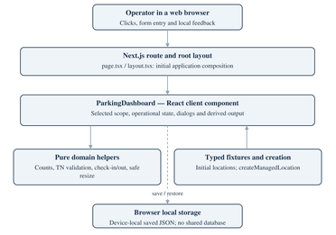
PARKLINE / PROJECT REVIEW
03 / DESIGN & BUILD
Implemented architecture
A browser-centred Next.js shell with pure domain rules and one local persistence boundary
EXECUTION AREAS · ACTUAL SOURCE BOUNDARY
DESIGN PRINCIPLES
Separation of concerns
Operator in a web browser
Explicit state ownership
Clicks, form entry, status feedback and derived dashboard output
Conservation of inventory
↓
Immutable transformations
Transparent boundaries
Next.js App Router shell
src/app/page.tsx · layout.tsx · globals.css · prerendered / route
↓
ParkingDashboard — React client component
Selected location/level · operationsByLocation · dialogs · derived cards and bay map
↙
↘
Pure domain helpers
Typed fixtures & creation
occupancy · TN validation · check-in/out · safe resize
seed locations · createManagedLocation · shared interfaces
Full architecture diagram retained in the project report.
save / restore
Parkline · Project Review | Source-grounded MVP
10 / 30
Notes:
Point out the dashed local-storage connection: it is a browser effect, not a network service. There are no parking API route handlers, server actions or database repositories.

Slide 11
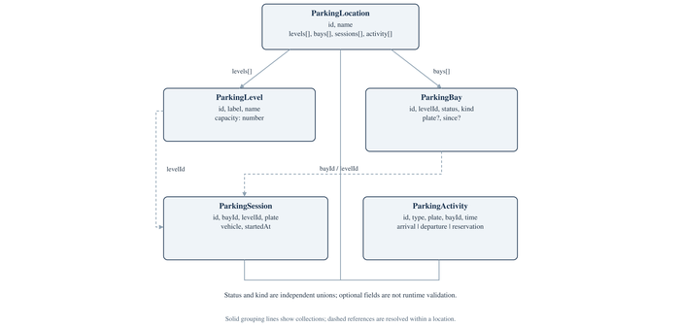
PARKLINE / PROJECT REVIEW
03 / DESIGN & BUILD
Domain model & data dictionary
Five TypeScript interfaces and two union vocabularies; array lookup replaces database keys
ParkingLocation
ParkingLevel
ParkingBay
ParkingSession
ParkingActivity
id · name
levels · bays
sessions · activity
→
id · label · name
capacity: 1–99
→
id · levelId
status · kind
plate? · since?
→
id · bayId · levelId
plate · vehicle
startedAt
→
id · type · plate
bayId · time
VOCABULARIES
BayStatus
BayKind
available
occupied
reserved
standard
ev
accessible
CONCEPTUAL ER, NOT SQL
No relational database exists. A location has many levels/bays; a bay is intended to have zero or one active session. Composite keys would be required in a shared schema.
Source-grounded domain diagram · interfaces, not class instances
Parkline · Project Review | Source-grounded MVP
11 / 30
Notes:
Bay kind is independent of status: an EV bay can be available or occupied. Reserved is unavailable inventory, not a parked vehicle. IDs are location-scoped, not global.

Slide 12

PARKLINE / PROJECT REVIEW
03 / DESIGN & BUILD
Bay state machine & conservation rules
Only two operational transitions are implemented; reserved is a protected display state
DERIVED VALUES
T
Total bay records on the level
AVAILABLE
→
OCCUPIED
→
BACK TO
AVAILABLE
O
Bays with status occupied
Can be selected
for ordinary arrival
One active session
and plate record
Bay kind
is retained
checkIn
checkOut
R
Bays with status reserved
A
T − O − R
RESERVED — DISPLAY / FIXTURE ONLY
Unavailable for arrival, excluded from available count, protected during resize; no create/cancel/expire path.
%
round(100 × O / T); 0 when T = 0
LOCAL INVARIANTS
Each active session points to one occupied bay in its location. A normalized plate occurs at most once in that location’s active sessions. Helpers do not repair corrupted saved data or coordinate simultaneous clients.
Parkline · Project Review | Source-grounded MVP
12 / 30
Notes:
Do not draw reserve/cancel arrows — no reservation lifecycle exists. The invariant is local to one selected location and one input snapshot, not a global database constraint.

Slide 13
PARKLINE / PROJECT REVIEW
03 / DESIGN & BUILD
Core workflows & validation gates
Presentation controls and reusable domain helpers enforce different layers of the same rules
ARRIVAL
normalizeTamilNaduPlate → bay exists + available → no duplicate normalized plate → create session → bay occupied → prepend activity
VALIDATION RULE SET
Layered rejection
Plate: ^TN\d{2}[A-Z]{2}\d{4}$; spaces/hyphens removed, letters uppercased
DEPARTURE
find active session → map its bay to available → clear plate/since → remove session → prepend departure activity
Arrival bay must exist and be available
Normalized plate must not already be active in this location
CAPACITY
integer 1–99 → protected count = occupied + reserved → reject lower capacity → remove available IDs from highest suffix / add unused suffixes
Departure session must exist in supplied active list
Capacity: integer 1–99 and ≥ occupied + reserved
NEW LOCATION
trim name → 1–10 floors → 1–99 bays/floor → generate all-standard available bays → empty sessions/activity → insert by location ID
Location name: trimmed, non-empty, case-insensitively unique in UI
Floors: integer 1–10; maximum new inventory 990 bays
startedAt is not validated; restored JSON has shallow checks; EV/accessible eligibility is not enforced.
KNOWN GAP
Parkline · Project Review | Source-grounded MVP
13 / 30
Notes:
Native HTML controls communicate bounds; pure helpers enforce business rules even when called outside the form. A thrown error prevents the successful-state commit.

Slide 14
PARKLINE / PROJECT REVIEW
03 / DESIGN & BUILD
Implementation: the reusable domain core
Ordinary TypeScript functions receive collections and return new collections or throw
src/lib/parking.ts
src/lib/parking.ts
src/lib/parking.ts
export function normalizeTamilNaduPlate(value: string) {
const plate = value.replace(/[\s-]/g, "").toUpperCase();
if (!/^TN\d{2}[A-Z]{2}\d{4}$/.test(plate)) {
throw new Error("Use TN + 2 digits + 2 letters + 4 digits");
}
return plate;
}
if (!bay || bay.status !== "available") {
throw new Error("Choose an available parking bay.");
}
if (sessions.some(s => s.plate === normalizedPlate)) {
throw new Error("This vehicle already has an active session.");
}
// immutable map + append only after all guards pass
const protectedCount = levelBays
.filter(bay => bay.status !== "available").length;
if (capacity < protectedCount) {
throw new Error("Capacity cannot be below the number
of occupied or reserved bays.");
}
// reduce: remove highest available suffixes only
WHAT THE HELPERS DO — AND DO NOT DO
Implemented
Not implemented in helpers
occupancyForLevel counts actual bay records, not declared capacity
HTTP, React setters, localStorage or database calls
checkIn / checkOut return paired bay and session updates
Runtime schema validation or malformed timestamp checks
resizeLevelBays protects all non-available records
Transactions, locks or cross-client conflict resolution
No mutation of input arrays; failed operations throw before commit
Special-kind minimums, pricing or completed-session history
Parkline · Project Review | Source-grounded MVP
14 / 30
Notes:
This is the strongest engineering contribution: the same rules can be unit-tested without React and later reused as a behavioral specification for a server transaction.

Slide 15
PARKLINE / PROJECT REVIEW
03 / DESIGN & BUILD
Codebase map & technology stack
A small source tree makes the path from screen → helper → test traceable
Path
Responsibility
DEPENDENCY BASELINE
src/app/page.tsx
Home route renders ParkingDashboard
Next.js 16.4.3
App Router, build and prerendered / route
src/app/layout.tsx
Metadata, global CSS, root document
React 19.0.0
Client state, derived values, effects
src/app/globals.css
Design tokens, component styles, breakpoints
src/components/parking-dashboard.tsx
State, derived view, handlers, dialogs, output
TypeScript 5.7.2
Interfaces, unions and --noEmit checks
src/types/parking.ts
Five interfaces + status/kind unions
Tailwind 3.4 / CSS
Utility directives + named component classes
src/lib/parking.ts
Occupancy, resize, plate, arrival, departure
Lucide React
SVG icons; not service integrations
src/lib/parking-data.ts
Seed inventory + managed-location creation
src/lib/parking.test.ts
Nine existing domain/fixture cases
Vitest 5 / Playwright
Domain tests and browser workflows
e2e/parking-workflows.spec.ts
Three existing operator browser scenarios
ESLint 9 / npm
Static checks and reproducible scripts
Parkline · Project Review | Source-grounded MVP
15 / 30
Notes:
The route contains no parking business logic. The dashboard is the only major client component; helpers and fixtures are deliberately separate and testable.

Slide 16
PARKLINE / PROJECT REVIEW
03 / DESIGN & BUILD
Persistence lifecycle & browser boundary
One origin-scoped JSON snapshot; no authoritative service arbitrates competing clients
WHAT IS SAVED
LOCAL STORAGE · parkline-garage-planning
Included
Initial state
→
Read effect
→
storageReady
Locations and nested collections
Seed locations +
operationsByLocation
Parse JSON; shallow
shape checks
Enable write
after load
Working operations by location ID
↓
Selected location ID
Write effect serializes locations, operationsByLocation and locationId
Catch path logs a warning; no rollback, save-failure banner or conflict protocol
WHAT IS NOT SAVED / NOT GUARANTEED
Open concerns
Saved JSON shape (schematic)
Selected floor, search text or status filter
{
"locations": [ /* ParkingLocation records */ ],
"operationsByLocation": { "riverside": { "bays": [], "sessions": [], "activity": [] } },
"locationId": "riverside"
}
Versioned schema or referential integrity
Multi-tab coordination, backup or attributed audit
Durable cross-device state or server authority
Parkline · Project Review | Source-grounded MVP
16 / 30
Notes:
Explain the two effects: read after mount, then write once storageReady is enabled. The observed reload failure shows that effect presence is not proof of reliable restoration.

Slide 17
PARKLINE / PROJECT REVIEW
03 / DESIGN & BUILD
UI design system & accessibility foundations
A neutral canvas, green primary actions and amber reservation accents; status is not colour-only
Interaction
Implemented support
Remaining limitation
IMPLEMENTED VISUAL TOKENS
Bay inspection
Accessible ID/status/plate name
Contrast / SR experience not audited
Main ink
Canvas
Primary green
#172823
#F5F7F5
#157B5B
Forms
Labels, required, native controls
Error association could be stronger
Bright green
Amber
Paper
Dialogs
Dialog role, modal flag, autofocus
No focus trap, Escape, focus return
#46C692
#C58229
#FFFFFF
Floor tabs
Tablist + selected semantics
No full arrow-key / roving tabindex
Layout: 238 px desktop sidebar · 6-column bay grid → 4 columns narrow · breakpoints at 1150 / 900 / 620 px · reduced-motion query.
Feedback
Status notices + alert errors
Save failure only console warning
Narrow layout
Panels stack; sidebar collapses
390 px overflow; selector hidden
DESIGN HONESTY
The bay grid is a visual inventory, not an architectural floor plan. The one-way lane is a cue, not validated circulation. Notification, account and activity-options buttons are intentionally limited controls.
PRIORITY UI FIXES
Wrap narrow heading actions, keep location selection reachable, complete modal keyboard behaviour and label sample values clearly.
Parkline · Project Review | Source-grounded MVP
17 / 30
Notes:
The design has good foundations but no formal WCAG audit. Mention the missing focus trap, Escape close, focus return and complete arrow-key tab pattern.

Slide 18
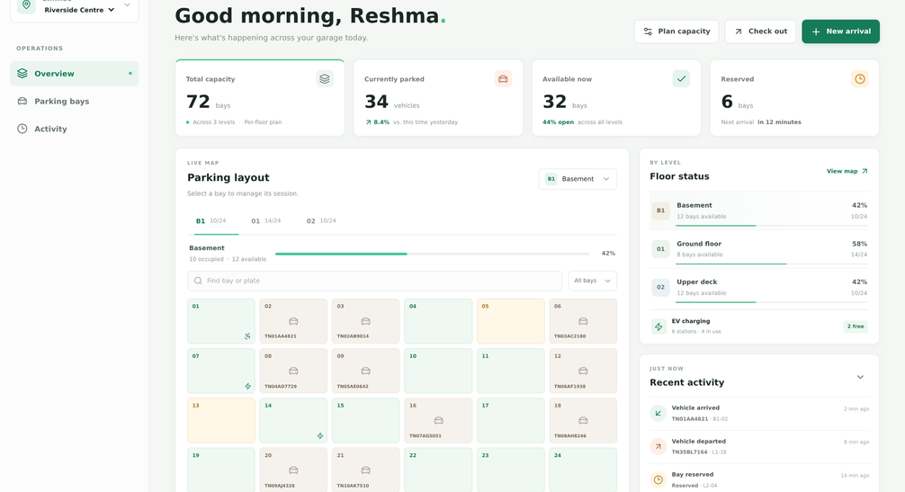
PARKLINE / PROJECT REVIEW
04 / PRODUCT DEMO
Demo 1 · Garage overview
Derived metric cards, floor status, live-map panel, activity and planning actions
READ THE SCREEN
72 / 34 / 32 / 6
Total, occupied, available, reserved across 3 levels
B1 · 10/24
Floor tab and 42% occupancy strip use the same bay records
Bay B1-01
Available + accessible; click routes to the arrival dialog
Recent activity
Latest five events; human-readable relative times
Trend, next-arrival, date and EV summary include static labels.
REMEMBER
Built application · Riverside Centre overview, B1 selected
Parkline · Project Review | Source-grounded MVP
18 / 30
Notes:
Use the Riverside seed as the demo baseline: 72 total, 34 occupied, 32 available, 6 reserved. Point out the footer that says no live sensors are connected.

Slide 19
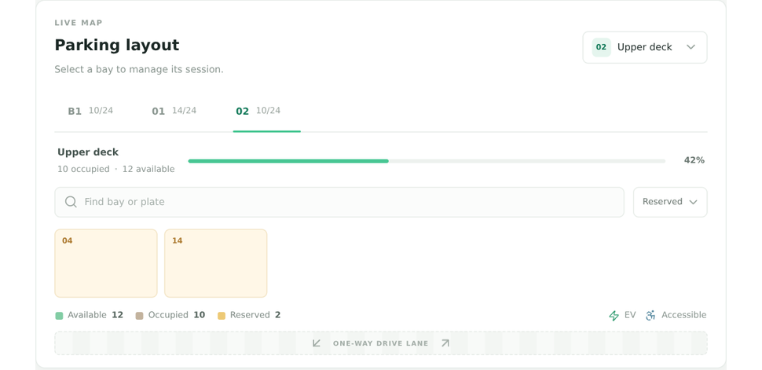
PARKLINE / PROJECT REVIEW
04 / PRODUCT DEMO
Demo 2 · Floor map, search & status filter
Search and filtering change only the visible current-floor bays, never the underlying statistics
INTERACTION RULES
Current-floor scope
Search trims/lowercases and matches bay ID or plate substring
Status filter: all / available / occupied / reserved
Counts and occupancy strip remain derived from all floor bays
EV and accessible icons are physical kinds, not statuses
WHY IT MATTERS
The observable map is a filtered view. A successful session or capacity change must still reconcile the full selected-location inventory.
Upper deck filtered to Reserved · two bays shown
EMPTY / RESERVED FEEDBACK
No bays match this search · B1-05 is reserved.
Parkline · Project Review | Source-grounded MVP
19 / 30
Notes:
The captured Upper deck / Reserved filter returns two bays. An unknown search shows an explicit empty-map message; a reserved bay click reports its state instead of opening arrival.

Slide 20
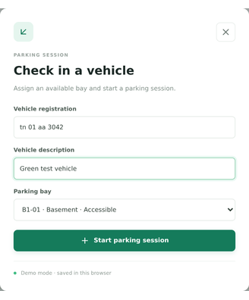
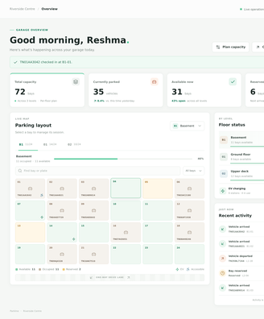
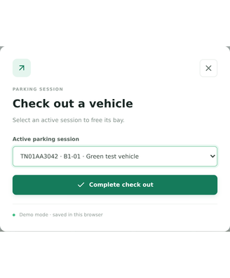
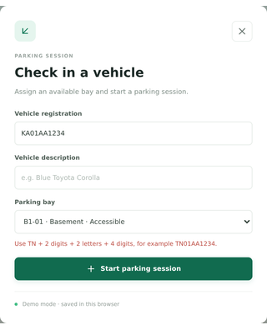
PARKLINE / PROJECT REVIEW
04 / PRODUCT DEMO
Demo 3 · Arrival, departure & validation
Real captures of the form, success notice and rejection paths
Arrival form · formatted TN input
Success notice + occupied B1-01
Departure session selector
Invalid registration error
SUCCESS POSTCONDITION
FAILURE POSTCONDITION
DEPARTURE
One new active session; occupied +1, available −1; capacity and reserved unchanged.
Domain exception shown; dialog can stay open; successful-state commit is skipped.
Bay becomes available; plate/since cleared; session removed. No tariff, receipt or history.
Parkline · Project Review | Source-grounded MVP
20 / 30
Notes:
Demonstrate the formatted plate 'tn 01 aa 3042' becoming TN01AA3042, then duplicate and non-TN rejection. Checkout releases B1-01 and restores the counts.

Slide 21
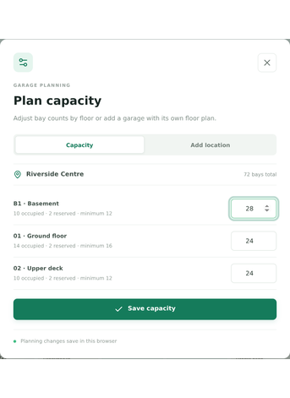
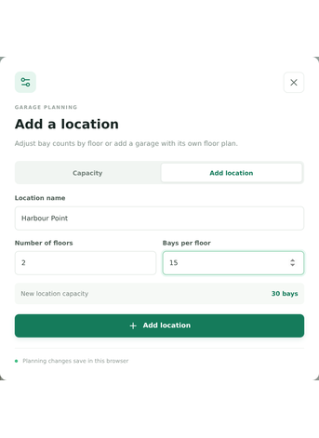
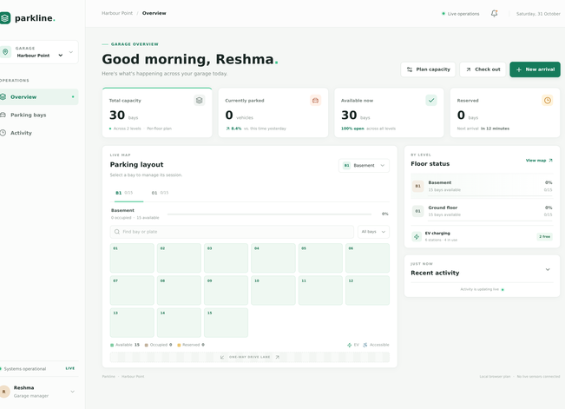
PARKLINE / PROJECT REVIEW
04 / PRODUCT DEMO
Demo 4 · Capacity planning & new locations
Planning changes inventory size while preserving every occupied and reserved bay identity
Capacity dialog · protected minimums
New location · floors and bays per floor
Independent empty inventory after creation
BOUNDS
Existing floor capacity 1–99 · new location 1–10 floors × 1–99 bays = max 990 bays.
DUPLICATE NAMES
Blank names and case-insensitive duplicates are rejected in the dashboard UI.
Parkline · Project Review | Source-grounded MVP
21 / 30
Notes:
The basement input advertises minimum 12 (10 occupied + 2 reserved). New locations start with all-standard available bays and empty sessions/activity.

Slide 22
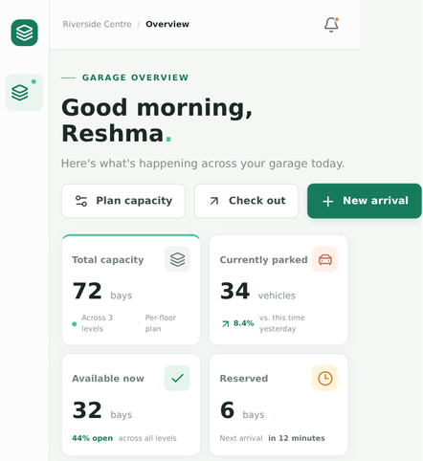
PARKLINE / PROJECT REVIEW
04 / PRODUCT DEMO
Mobile presentation & observed layout defect
A 390 px viewport produced a 457 px document width in the recorded browser run
390 px
457 px
DELTA
+67 px horizontal overflow; New arrival button reaches the right edge.
viewport
document
innerWidth recorded in Chromium
scrollWidth measured
WHAT THE STYLESHEET DOES / DOES NOT DO
Area
Implemented
Observed / remaining
Breakpoints
1150 / 900 / 620 px; panels stack
Media queries do not guarantee child wrapping
Bay grid
Six columns → four at narrow width
Heading action row still overflows
Garage selector
Sidebar collapses
Location selector hidden below breakpoint
Dialog keyboard
Modal roles and autofocus
No focus trap / Escape / focus return
Upper 500 CSS px of the full mobile capture; full image is retained in the report assets.
Verification
Supplemental geometry assertion
B15 failed; no cross-browser audit
Parkline · Project Review | Source-grounded MVP
22 / 30
Notes:
This is measured evidence, not a general claim about all viewports. The diagnostic identified a primary action button in the heading row as the overflowing element.

Slide 23
PARKLINE / PROJECT REVIEW
05 / VERIFICATION
Verification scoreboard
Executed checks are reported separately; a green unit suite does not override browser failures
9/9 Existing Vitest suite
9 passed / 0 failed · selected domain + fixture cases
BASELINE
Reviewed 31 October 2026 · commit aa4b730 in report evidence · application source hashes match current files · Node 22.22.3 / npm 10.9.8 documentation run.
1/1 ESLint
Configured static checks passed
1/1 TypeScript --noEmit
Compile-time source consistency passed
UNCAUGHT ERRORS
None observed in the supplemental browser sequence. This is not a universal runtime-error guarantee.
1/1 Next.js production build
Compilation + route generation passed
2/3 Existing Playwright scenarios
E2E-02 failed: added location not retained after reload
NOT CLAIMED
No test coverage %, security score, endpoint latency, availability figure, field trial or formal acceptance study was collected.
15/16 Supplemental browser assertions
B15 failed: 390 px viewport → 457 px document
Parkline · Project Review | Source-grounded MVP
23 / 30
Notes:
Review the evidence boundary: Chromium 153 in an isolated local production-build context. No field trial, stakeholder UAT, latency benchmark, security audit or WCAG certification was performed.

Slide 24
PARKLINE / PROJECT REVIEW
05 / VERIFICATION
Test coverage & acceptance traceability
Nine unit cases, three original browser scenarios and sixteen supplemental assertions
EXISTING VITEST · 9 PASS
PLAYWRIGHT · 2 PASS / 1 FAIL
SUPPLEMENTAL · 15 PASS / 1 FAIL
Domain + fixture cases
E2E-01 PASS
B01–B16 evidence
UT-01 occupancy excludes reservations
Switch Marina, VR and Phoenix locations
B01 seed counts 72/34/32/6
UT-02 check-in normalizes TN plate
B02–B04 floor filter, reserved click, empty search
E2E-02 FAIL
UT-03 duplicate / unavailable bay rejected
Add 2×15 Harbour Point, resize to 18, reload → selector returns riverside
B05–B08 arrival, reload, duplicate, checkout
UT-04 non-TN formats rejected
B09–B12 capacity, new site, independent switch
UT-05 checkout releases bay
E2E-03 PASS
B13–B14 format + duplicate-name errors
Check TN01AA3042 into B1-01 and back out
B15 FAIL 390 px geometry; B16 no uncaught errors
UT-06 safe expand / reduce capacity
UT-07 protection + 100-bay rejection
NEXT TESTS
TRACE
UT-08 four consistent seed locations
FR-02/06–09 → unit tests. FR-01/18 → E2E-01. FR-14/16/17 → E2E-02 open. FR-04/05/10/15 → supplemental checks.
Repeated reloads, malformed storage, integer boundaries, timestamps, keyboard dialogs and narrow-width action reachability.
UT-09 requested floor / bay creation
Parkline · Project Review | Source-grounded MVP
24 / 30
Notes:
The supplemental capture script intentionally continues after failures; its process exit is not an all-tests-passed signal. Keep original tests and documentation checks distinct.

Slide 25
PARKLINE / PROJECT REVIEW
05 / VERIFICATION
Open defects & risk register
Observed failures are separated from source-level quality gaps and architectural limits
ID
Class
Finding
Suggested closure evidence
D-01
Observed browser failure
Added/expanded location not retained as selected after reload
Repeated E2E-02 passes with verified stored content
D-02
Observed layout failure
390 px viewport produced 457 px document width
Width assertions + reachable actions across narrow widths
D-03
Source quality gap
Dialog focus lifecycle incomplete
Keyboard and assistive-technology tests
D-04
Integrity gap
Saved JSON lacks complete runtime validation
Versioned schema + corruption/recovery tests
D-05
Architectural limit
Browser snapshots cannot coordinate operators
Transactional server + stale-write conflict tests
D-06
Presentation limit
Static values / LIVE labels can imply telemetry
Every operational claim has an explicit data source
RISK PRIORITIES FROM SOURCE REVIEW
HIGH
Reload + mobile geometry
HIGH
Multi-tab overwrite / no shared authority
MEDIUM
Saved JSON shape and registration privacy
MEDIUM
Dialog keyboard behaviour and static labels
Parkline · Project Review | Source-grounded MVP
25 / 30
Notes:
D-01 and D-02 are concrete browser findings. D-05 is not a bug to patch in the UI: it is the reason a future authoritative service is needed.

Slide 26
PARKLINE / PROJECT REVIEW
05 / VERIFICATION
Achievements against objectives & current limitations
A source-backed feature is not automatically a fully accepted quality outcome
O1–O10 · OUTCOME ASSESSMENT
PRINCIPAL LIMITATIONS
O1–O2
Implemented + demonstrated
Where conclusions stop
Counts are local records; search is current-floor only
Authority: browser state is not a shared, durable operational record
O3–O5
Implemented + tested
TN syntax only; no concurrent-client guarantee
Persistence: one reload scenario failed; root cause unconfirmed
Implemented + demonstrated
History: checkout deletes the active session; no completed visit ledger
O6–O8
Protection is by status, not special-kind minimum
Interface: narrow-width overflow, hidden selector, incomplete modal focus
O9
Save/restore exists
Scope: no login, reservations, tariffs, payments, sensors or ANPR
Reload reliability finding remains open
Evaluation: no stakeholder interviews, field trial or ROI measurement
O10
Tests + failures recorded
No field deployment or formal acceptance study
REVIEW LANGUAGE
Functional educational MVP — not a production parking system. The limitations define the roadmap rather than negate the prototype’s value.
STRONGEST CONTRIBUTION
Typed records + explicit guards + immutable updates + derived outputs.
Parkline · Project Review | Source-grounded MVP
26 / 30
Notes:
The reusable domain core and transparent documentation are the strongest achievements. The largest limitation is authority: browser state can be cleared, edited or overwritten.

Slide 27
PARKLINE / PROJECT REVIEW
05 / VERIFICATION
Security & privacy review
Source-level observations, not a penetration test or certification
Concern
Current observation
Recommended production control
Operator identity
No sign-in or role checks; static manager profile
Authenticate users and authorize every operation
Registration data
Plain JSON in browser storage
Minimize, restrict access, define retention/deletion
Data integrity
Client can edit collections and storage
Server-side validation + transactional constraints
Concurrent allocation
No shared authority
Atomic bay/session updates + conflict responses
Auditability
Activity lacks actor and structured event time
Append-only, attributed audit events
Storage corruption
Shallow restoration checks
Versioned runtime schema + recovery path
Credentials / payments
Not collected or integrated
Compliant providers; never store secrets locally
Connected devices
No device protocol or identity
Device auth, stale-data handling, manual override
The TN regex checks syntax, not ownership, existence or accessible-space eligibility.
Use fictional registrations, especially on shared computers; clearing site data is not governed deletion.
VALIDATION ≠ IDENTITY
DEMO PRACTICE
Parkline · Project Review | Source-grounded MVP
27 / 30
Notes:
A login screen alone would not repair client-side trust or concurrency. Start with a threat model and data policy, then add server authority and access controls.

Slide 28
PARKLINE / PROJECT REVIEW
06 / OUTLOOK
Staged enhancement roadmap
Reliability and clarity come first; shared authority, commercial rules and hardware follow
1
MVP HARDENING
1
INTERFACE QUALITY
1
HONEST PRESENTATION
Fix restoration/write coordination
Wrap narrow action controls
Mark or remove static trends
Canonical versioned saved schema
Keep mobile location selection reachable
Clarify LIVE, next-arrival and EV labels
Runtime validation + repeated reload tests
Complete modal focus / Escape / return
Separate fixture data from derived counts
GATE Repeated reload + corrupt-storage tests pass
GATE Geometry, keyboard and accessibility review
GATE Every operational claim has a data source
2
SHARED AUTHORITY
3
DOMAIN RULES
4
PHYSICAL INTEGRATION
Server API + durable database
Reservation create/cancel/expire/consume
Device identity and stale sensor policy
Atomic bay/session operations
Tariffs, grace periods, compliant payments
Manual overrides and monitoring
Auth, authorization, attribution, retention
Completed sessions + structured events
GATE Concurrency, access-control and recovery tests
GATE Conflict, expiry, idempotent settlement tests
GATE Hardware failure + safe fallback exercises
Parkline · Project Review | Source-grounded MVP
28 / 30
Notes:
None of these production capabilities is implemented. Each stage has an acceptance gate so the project does not expand the domain before the local foundation is trustworthy.

Slide 29
PARKLINE / PROJECT REVIEW
06 / OUTLOOK
Review decisions & discussion
Four decisions turn the mixed verification outcome into an actionable next iteration
01
Accept the academic MVP
DISCUSSION PROMPTS
Recognize the typed local model, real screens and honest evidence; do not label it production-ready.
Which operational rules require stakeholder sign-off?
02
Prioritize Stage 1
Fix reload/persistence coordination and narrow-width layout before expanding scope.
What is the retention policy for registration data?
Keep scope claims explicit
When should a shared backend replace browser storage?
03
No authentication, shared DB, reservation lifecycle, payments or sensors are implied by the UI.
Which accessibility tests define “done” for Stage 1?
04
Approve evidence-led roadmap
Should reservations, pricing and sensors stay out of v1?
Add runtime schema, accessibility tests, then server authority and transactional operations.
Q&A
DEMO TIP
Use slides 18–22 for the live walkthrough; skip slide 30 if time is short.
Parkline · Project Review | Source-grounded MVP
29 / 30
Notes:
Close by asking reviewers to accept the MVP within its stated boundary and prioritize Stage 1 before any production feature discussion.

Slide 30
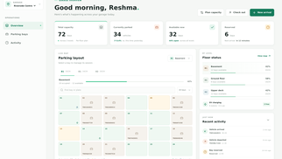
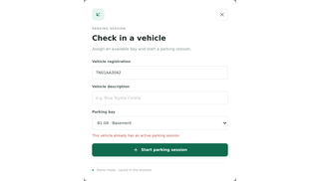
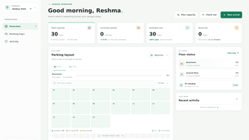
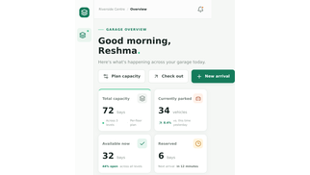
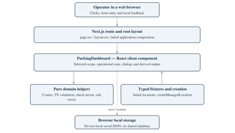
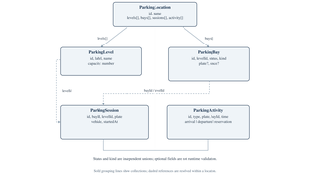
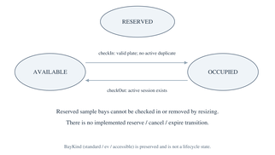
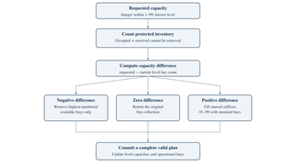
PARKLINE / PROJECT REVIEW
06 / OUTLOOK
Appendix · evidence gallery & reproduction
Editable PPTX, full report, diagrams, genuine captures and machine-readable results
Overview
Duplicate rejection
New location
Mobile finding
Architecture
Domain model
State machine
Capacity workflow
REPRODUCE
npm ci · npm test · npm run lint · npm run typecheck · npm run build · npm run dev | Full report: docs/project-report/ · Evidence JSON: source/
Assets: 11 source-grounded diagrams, 12 Chromium captures, editable DOCX + 111-page PDF, speaker notes in this PPTX.
Parkline · Project Review | Source-grounded MVP
30 / 30
Notes:
This appendix is for reviewers who want provenance. The PPTX does not replace the 111-page report; it summarizes it for presentation and keeps source claims traceable.

