Slide 1

Web of Data
Master 2 - Data Science
Joe Raad joe.raad@universite-paris-saclay.fr

Slide 2
Plan for this session
Introduce the GeoSPARQL standard
Create a simple RDF graph of French cities
Have fun with GeoSPARQL ☺

Slide 3
GeoSPARQL
Standard by the Open Geospatial Consortium (OGC) since 2012
Goal: representing and querying geospatial data in the Web of Data
GeoSPARQL are aligned to other Geo standards (outside RDF)
Contributions
Vocabulary for representing geospatial data in RDF
A set of SPARQL extension functions for spatial computations
A set of RIF rules for spatial reasoning (not covered today)

Slide 4
GeoSPARQL Vocabulary
geo: <http://www.opengis.net/ont/geosparql#>
geo:SpatialObject
geo:SpatialObject: This class represents everything that can have a spatial representation

Slide 5
GeoSPARQL Vocabulary
geo: <http://www.opengis.net/ont/geosparql#>
geo:SpatialObject
rdfs:subClassOf
geo:Feature
geo:Feature: This class represents the top-level feature type

Slide 6
GeoSPARQL Vocabulary
geo: <http://www.opengis.net/ont/geosparql#>
geo:SpatialObject
rdfs:subClassOf
rdfs:subClassOf
geo:Feature
geo:Geometry
geo:Geometry: This class represents the top-level geometry type

Slide 7
GeoSPARQL Vocabulary
geo: <http://www.opengis.net/ont/geosparql#>
geo:SpatialObject
rdfs:subClassOf
rdfs:subClassOf
geo:Feature
geo:Geometry
geo:hasGeometry
geo:hasGeometry: A spatial representation for a given feature

Slide 8
GeoSPARQL Vocabulary
geo: <http://www.opengis.net/ont/geosparql#>
geo:SpatialObject
rdfs:subClassOf
rdfs:subClassOf
geo:Feature
geo:Geometry
geo:defaultGeometry
geo:defaultGeometry: The default geometry to be used in spatial calculations. It is Usually the most detailed geometry.

Slide 9
GeoSPARQL Vocabulary
geo: <http://www.opengis.net/ont/geosparql#>
geo:SpatialObject
rdfs:subClassOf
rdfs:subClassOf
geo:Feature
geo:Geometry
geo:dimension
xsd:integer
geo:dimension: The topological dimension of this geometric object, which must be less than or equal to the coordinate dimension.

Slide 10
GeoSPARQL Vocabulary
geo: <http://www.opengis.net/ont/geosparql#>
geo:SpatialObject
rdfs:subClassOf
rdfs:subClassOf
geo:Feature
geo:Geometry
geo:asGML
geo:asWKT
geo:gmlLiteral
geo:wktLiteral

Slide 11
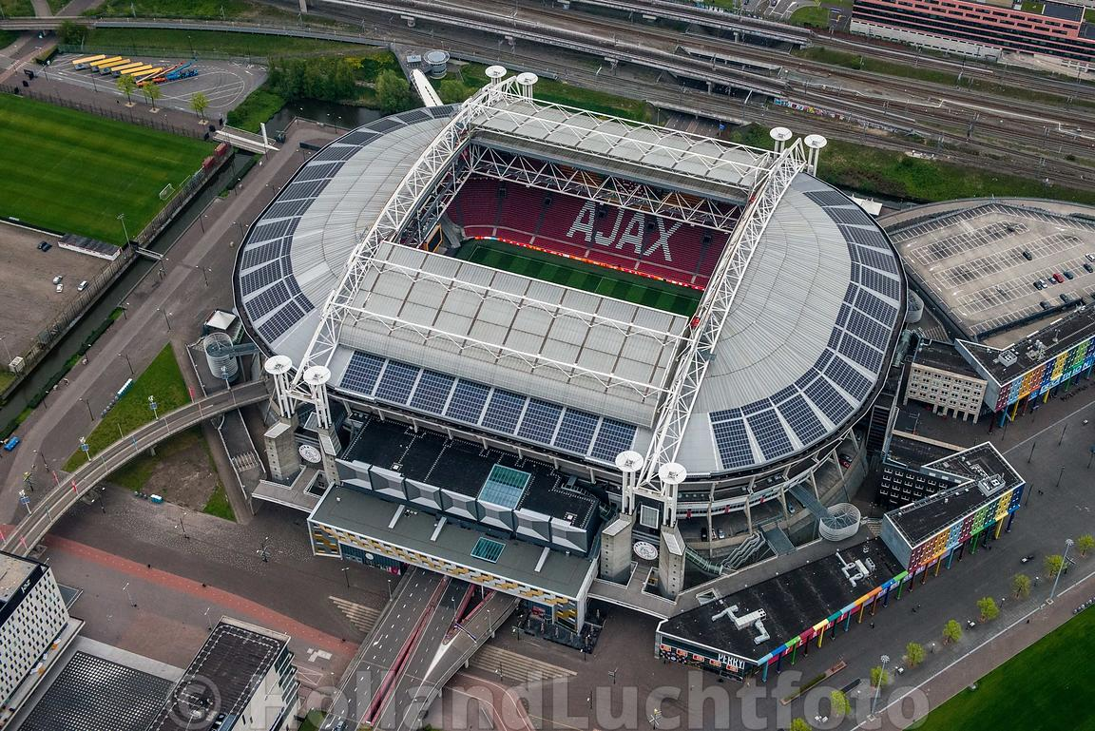
Example
Johan Cruijff Arena ArenA Boulevard 1, 1101AX Amsterdam, Netherlands
https://data.labs.kadaster.nl/kadaster/-/stories/bag-20

Slide 12
GeoSPARQL
Standard by the Open Geospatial Consortium (OGC) since 2012
Goal: representing and querying geospatial data in the Web of Data
GeoSPARQL are aligned to other Geo standards (outside RDF)
Contributions
Vocabulary for representing geospatial data in RDF
A set of SPARQL extension functions for spatial computations
A set of RIF rules for spatial reasoning (not covered today)

Slide 13
GeoSPARQL Functions
geof: <http://www.opengis.net/def/function/geosparql#>
geof:contains A query function that returns true if the first geometry argument spatially contains the second geometry argument
geof:distance A query function that returns the distance between the two closest points of the input geometries
geof:intersection A query function that returns a geometry consisting of all points that are part of both input geometries.
…

Slide 14
Plan for this session
Introduce the GeoSPARQL standard
Create a simple RDF graph of French cities
Have fun with GeoSPARQL ☺

Slide 15
Exercice 1
Tool: https://yasgui.triply.cc
SPARQL endpoint: https://api.druid.datalegend.net/datasets/nlgis/gemeentegeschiedenis/services/gemeentegeschiedenis/sparql
Query:
prefix geo: http://www.opengis.net/ont/geosparql#
select ?feature ?shape {
?feature geo:hasGeometry ?geometry.
?geometry geo:asWKT ?shape.
}
limit 1

Slide 16

Exercice 2
Tool:
Task:
Create a Knowledge Graph that allows us (using GeoSPARQL) to:
Get the number of cities per region and per department
Return for a given city its nearest 10 neighbors
Data: https://github.com/raadjoe/WoD-UPsaclay/tree/main/GeoSPARQL Downloaded and Cleaned from: https://www.data.gouv.fr/fr/datasets/communes-de-france-base-des-codes-postaux/

