Slide 1
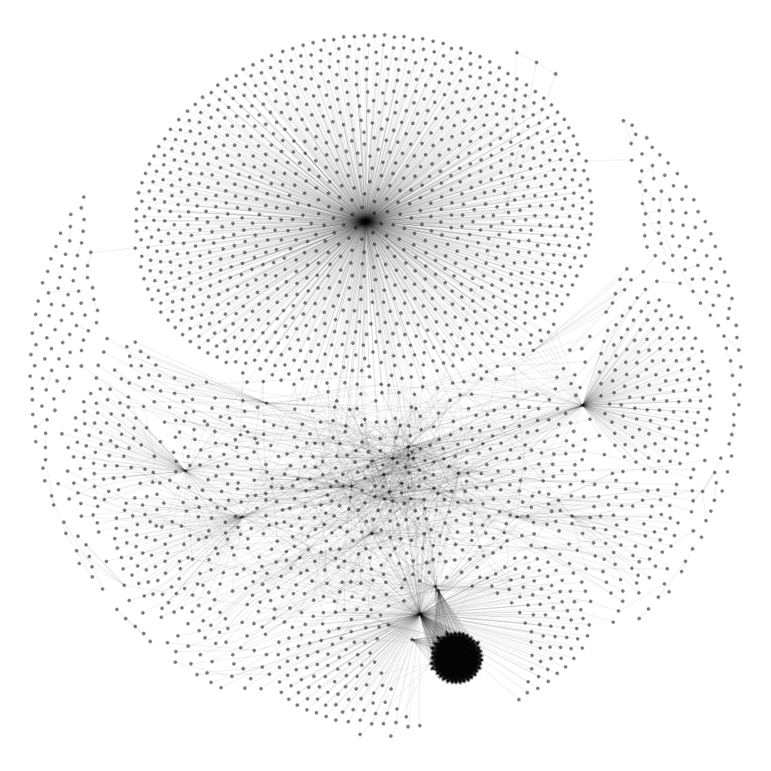
bibsonomy.org
freebase.com
multilingual variants
of dbpedia.org
dbpedia.org

Slide 2
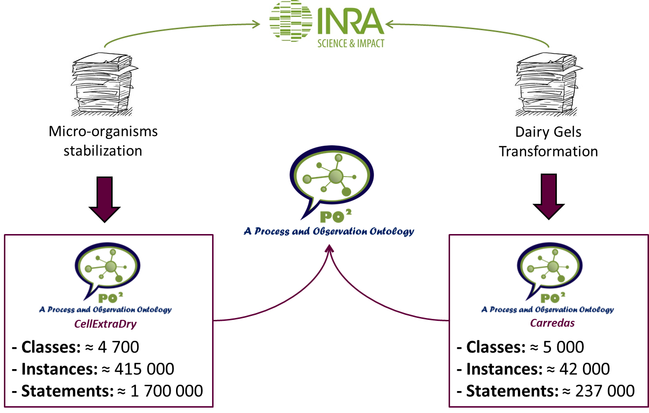

Slide 3



BioMiP team
(CellExtraDry project)
FFOPP team
(Caredas project)
Micro-organisms stabilisation
Dairy Gel Consumption

Slide 4

BioMiP team
(CellExtraDry project)
FFOPP team
(Caredas project)
1K Excel files
1.8K Excel files
Micro-organisms stabilisation
Dairy Gel Consumption
2.7M triples
21 named graphs (projects)
453 transformation processes

Slide 5
Target Class
Mixture / Step
Unwanted Properties
properties related
to observations
Required
2.7M triples
Required
Optional
DECIDE
DEtection of Contextual IDEntity

Slide 6
Domain experts have evaluated the plausibility of the 20 best rules
(in terms of error rate and support combined)
1
0
6
4
9
plausibility
Strongly Disagree
Disagree
Not sure
Agree
Strongly
Agree
The error rate of a rule decreases by 22% in CellExtraDry and by 33.5% in Carredas when a global context is replaced by a more specific global context

Slide 7
Target
Class
Unwanted
Properties
Necessary
Properties
Knowledge
Graph
Required
Optional
Co-occurring
Properties
DECIDE
DEtection of Contextual IDEntity
Unwanted Properties
Necessary Properties
Co-occurring Properties
p has unstructured values (free text); insignificant variations
p should exist in every context in order to consider it as relevant
p1 does not have a meaning without p2 (e.g. measure and unit)
up = (c_{i} , p, *)
np = (c_{i} , p, *)
cp = { (c_{i} , p1, *), (c_{i} , p2, *)}

Slide 8
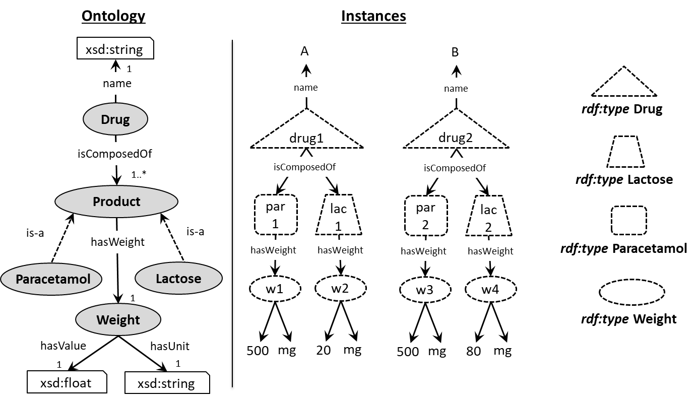
DECIDE
DEtection of Contextual IDEntity
Step 1: Choosing the Level of Abstraction by selecting the set of Classes
DepC = { Drug, Paracetamol, Lactose, Weight }

Slide 9
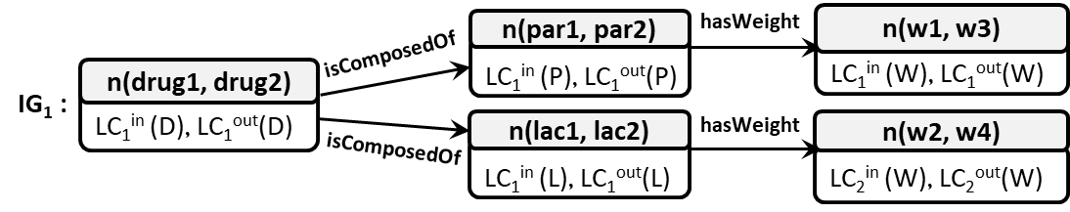
DECIDE
DEtection of Contextual IDEntity
Step 2: For each pair of the target class, construct the identity graph(s)
Depth First Construction
Several Similarity Graphs in case of multi valued properties (different pair mappings)
Each node contains two local contexts
(outgoing and incoming local context)

Slide 10
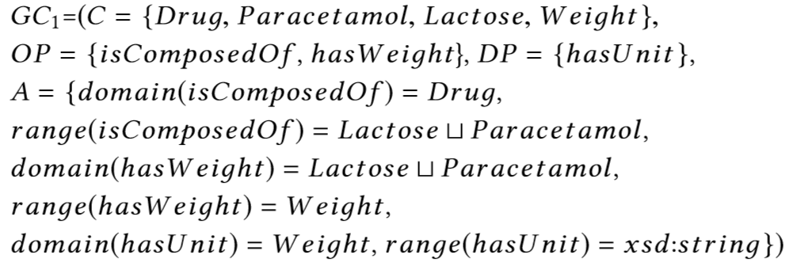
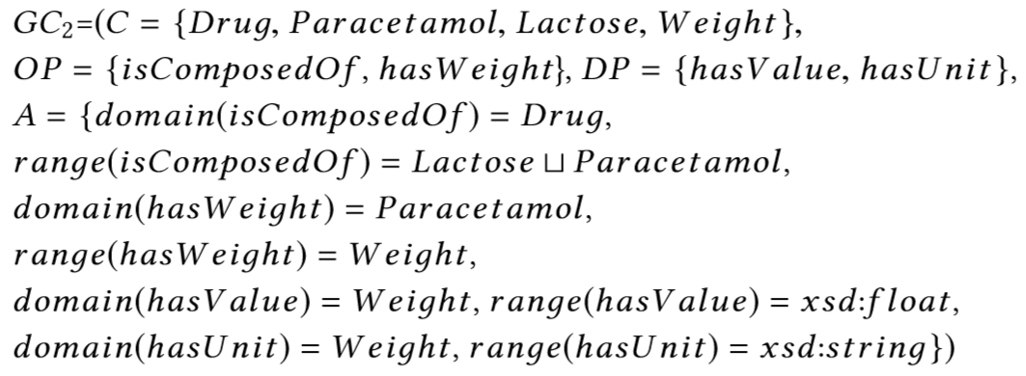
DECIDE
DEtection of Contextual IDEntity
Step 3: For each constructed identity graph, generate the most specific GC
In a context where we discard the property “name” and “hasValue”
In a context where we don’t consider the property “name” and the Weight of the Lactose

