Slide 1
Car Dealership System
Group No. 02
Contributors:
•
•
•
Md. Mahbubur Rahman Raad – 19101069 : Activity Diagram, DFD, SMD, WND
Sayem Kader Chowdhury – 19101076 : Intro, Sequence Diagram, Class Diagram
Md. Mehtabul Islam Shafin – 19101088 : Requirement Analysis, Use Case Diagram

Slide 2
Project Explanation
Behind-the-scene story of this project
We wanted to build a system which would be an online platform where Car companies, brand new car importers and reconditioned car importers can list their cars for sale, with adequate information, and prices, for the buyers. Buyers can sign up to the platform, view items up for sale, request additional information, and contact with the shop for further clarification.
Planning
Accessible to the customer
Streamline communication between shops and customers
Analysis
This system will be compatible with all web browsers
Fully responsive application
Available in both Android and iOS platform.

Slide 3
Project Explanation
Design
Customer
Browse through cars collection
Book for cars
Express their opinion, share rating
Seller
Enlist car collection
Reply to customer queries
Respond to booking request

Slide 4
Project Explanation
Analysis of current system:
Lack of item interaction
Lack of feedback
Analysis of Proposed System:
Watch the item before buying
Request for booking
Take out for a test drive
Review opinions of others
Look at rating

Slide 5
Requirement Analysis
Functional Requirements:
User Authentication.
Contact.
Payment Gateway Integration.
Delivery Integration.

Slide 6
Requirement Analysis
Non-Functional Requirements:
Operational.
Performance.
Security.
Cultural and Politics.

Slide 7
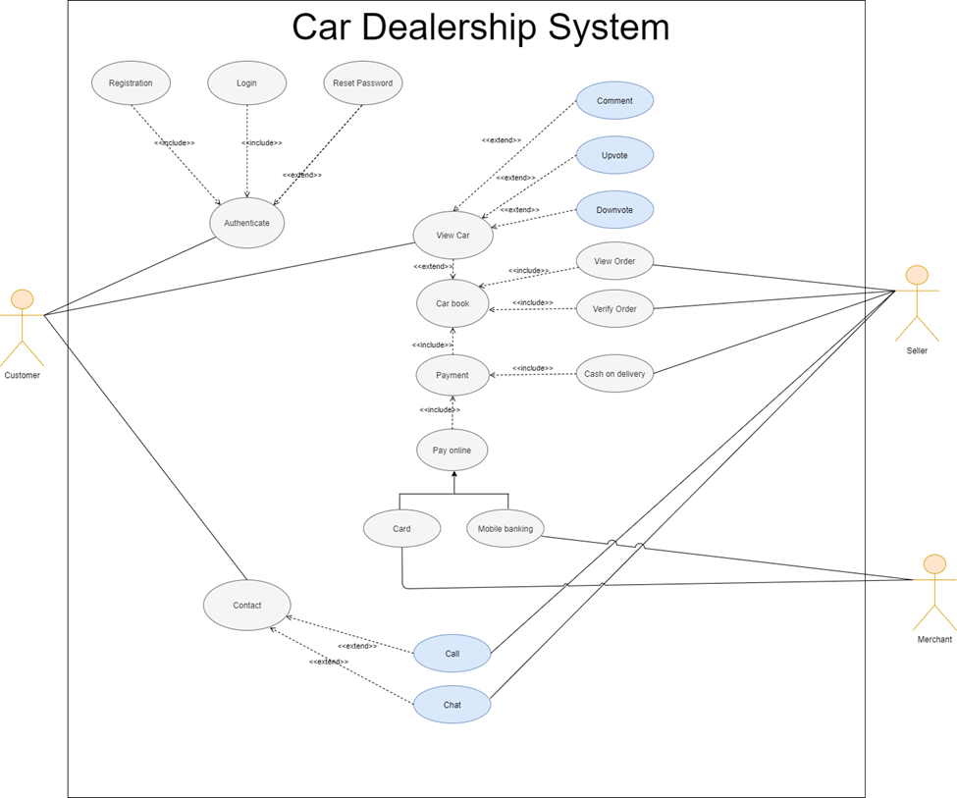
USE Case Diagram

Slide 8
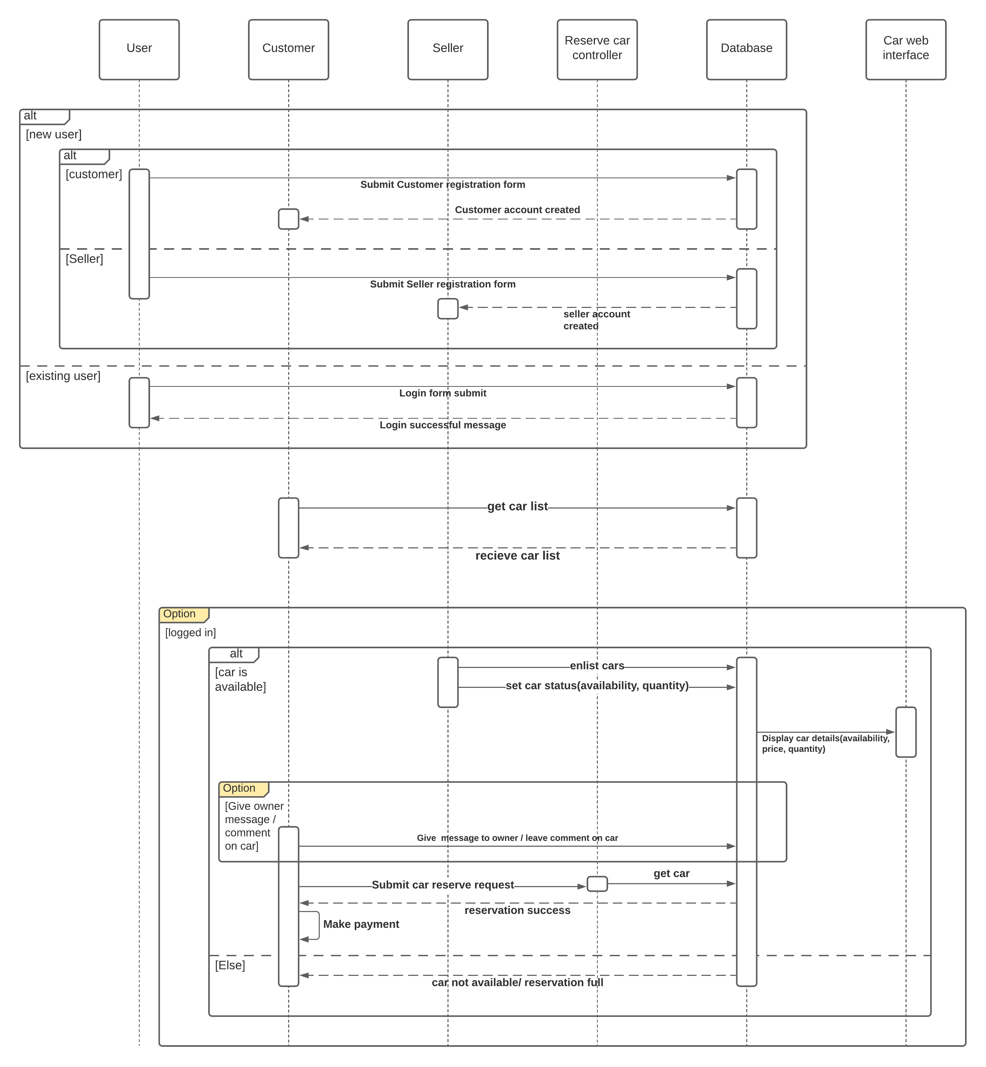
Sequence Diagram

Slide 9
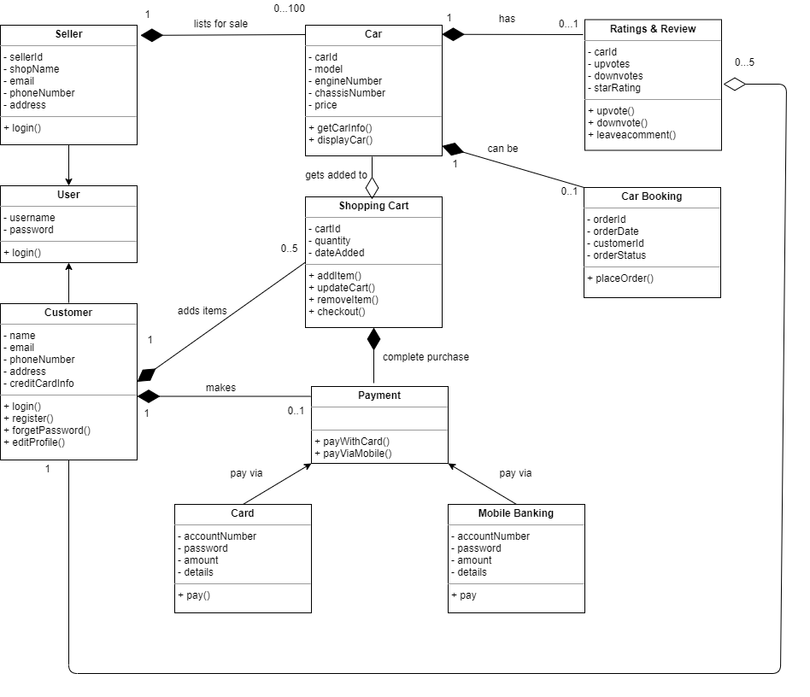
Class Diagram

Slide 10
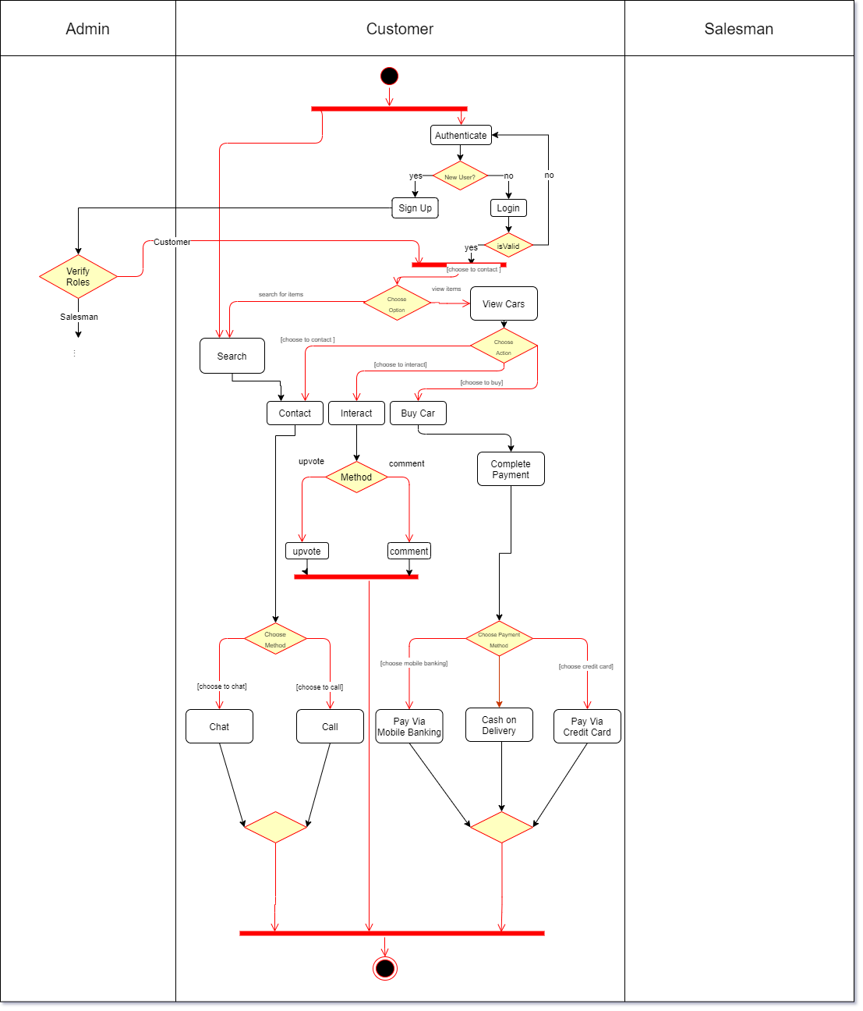
Activity Diagram
Customer

Slide 11
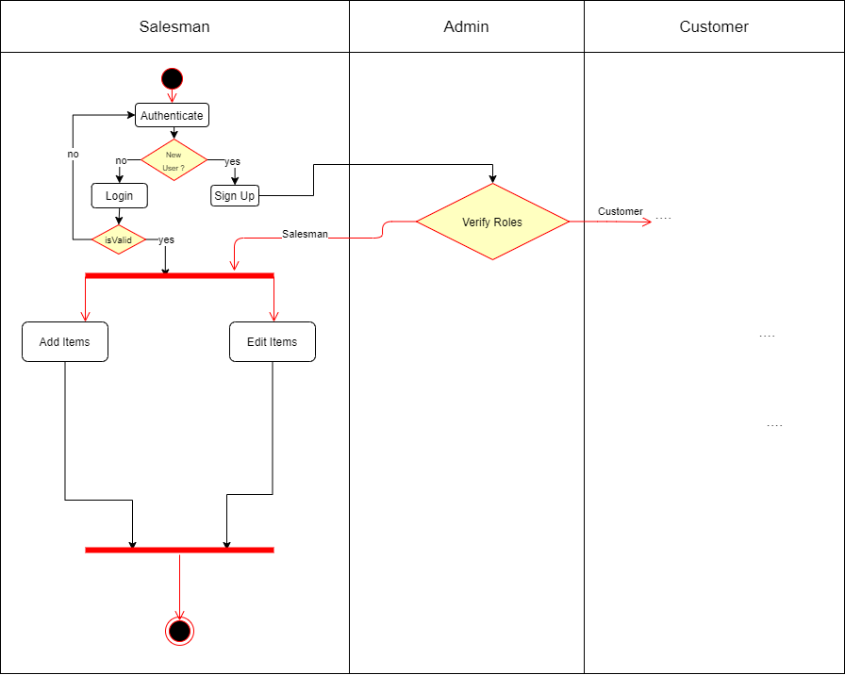
Activity Diagram
Salesman

Slide 12
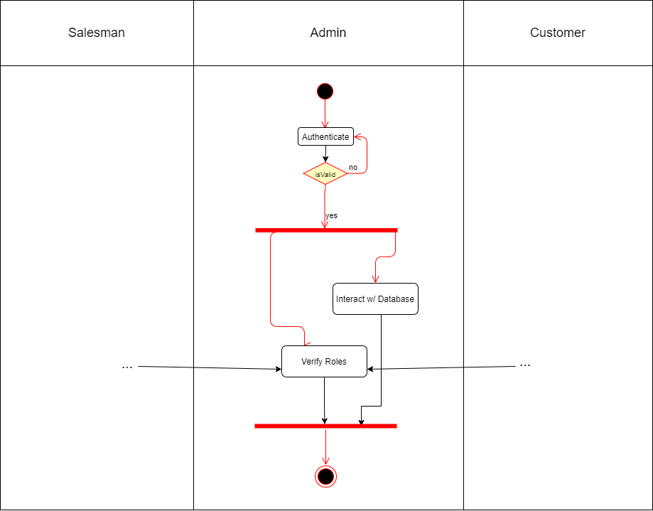
Activity Diagram
Admin

Slide 13
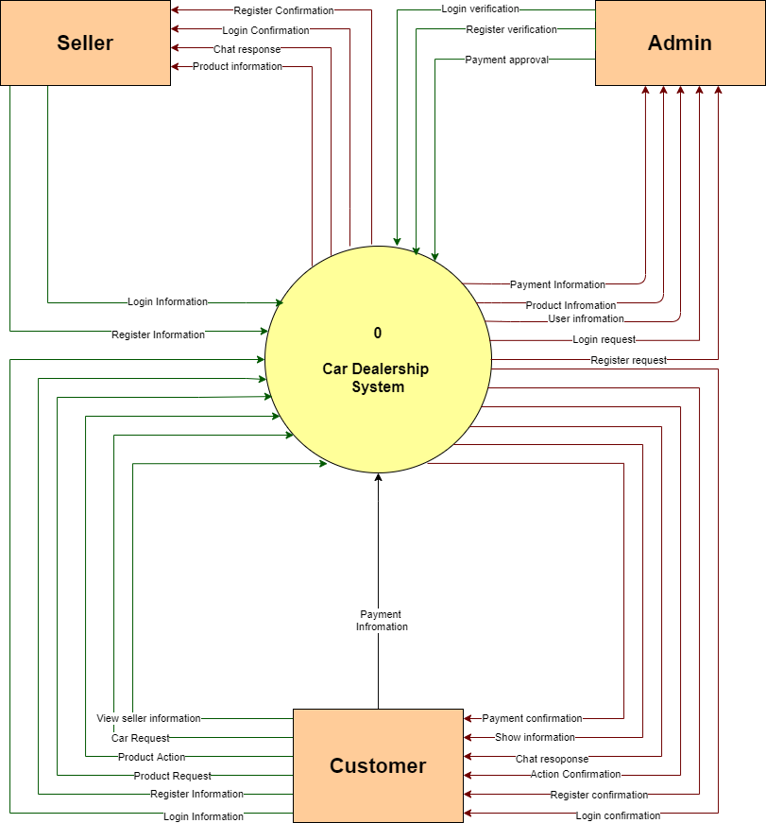
Data Flow
Diagram (DFD)
Level – 0 Diagram
Shows the main process which comprises our system.

Slide 14
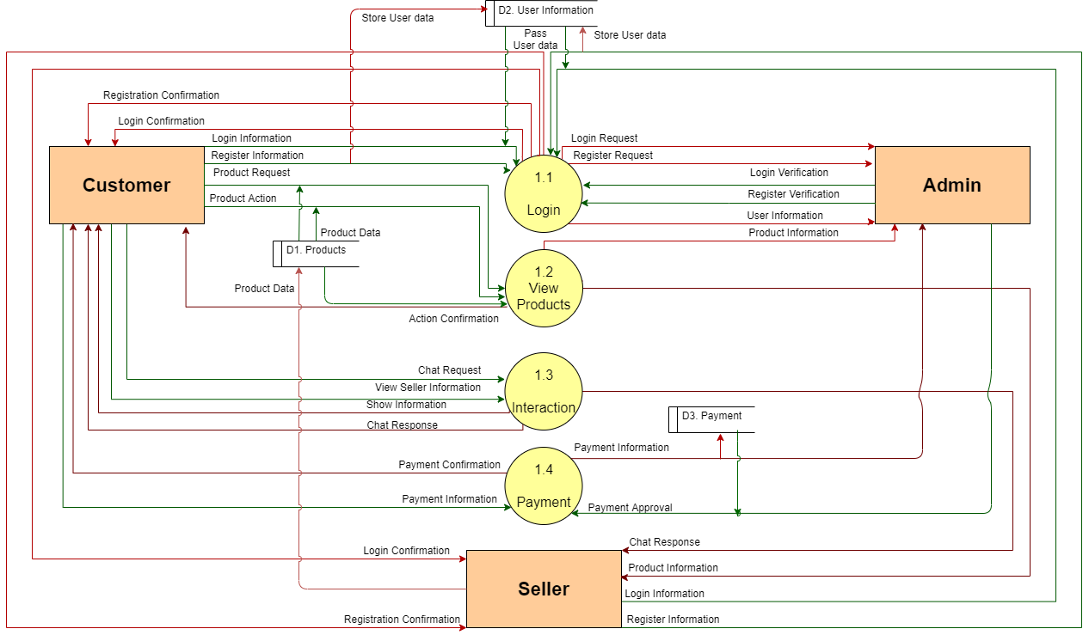
Data Flow
Diagram (DFD)
Level – 1 Diagram
Shows all processes which comprise a single process.

Slide 15
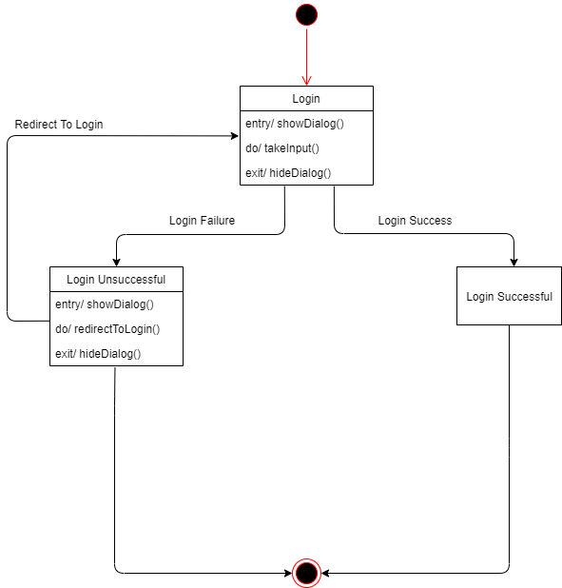
State-Machine
Diagram
Login State

Slide 16
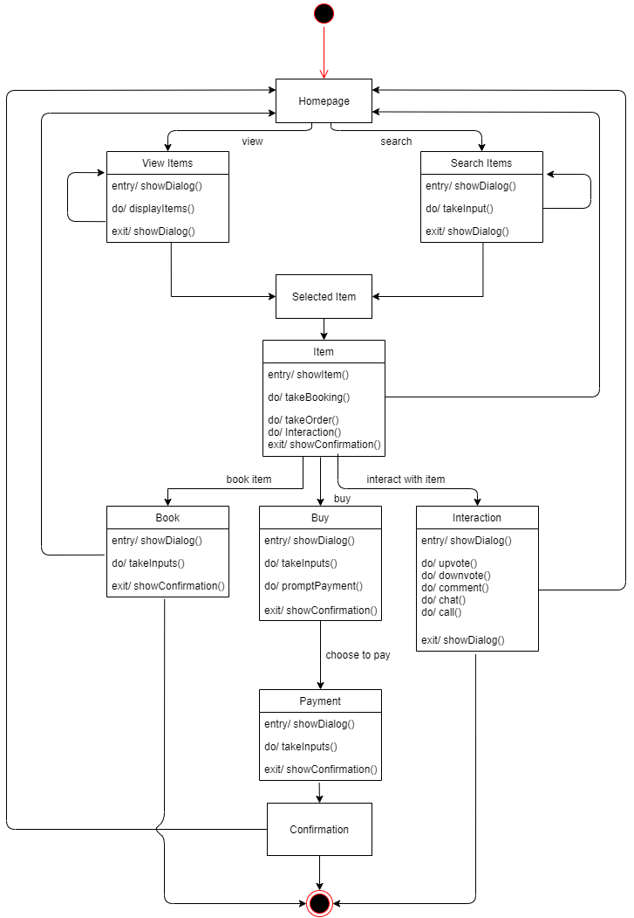
State-Machine
Diagram
Buy State

Slide 17
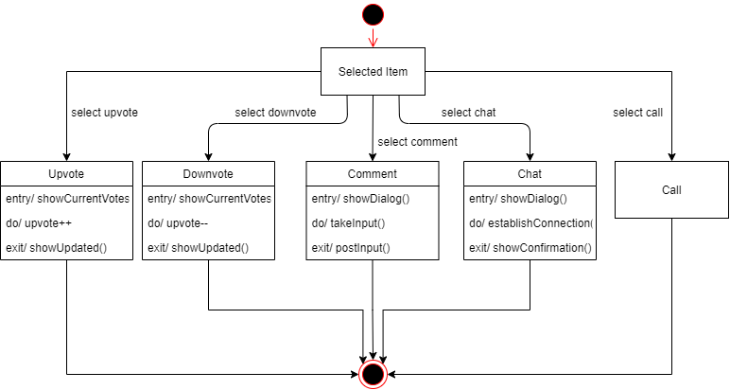
State-Machine
Diagram
Interaction State

Slide 18
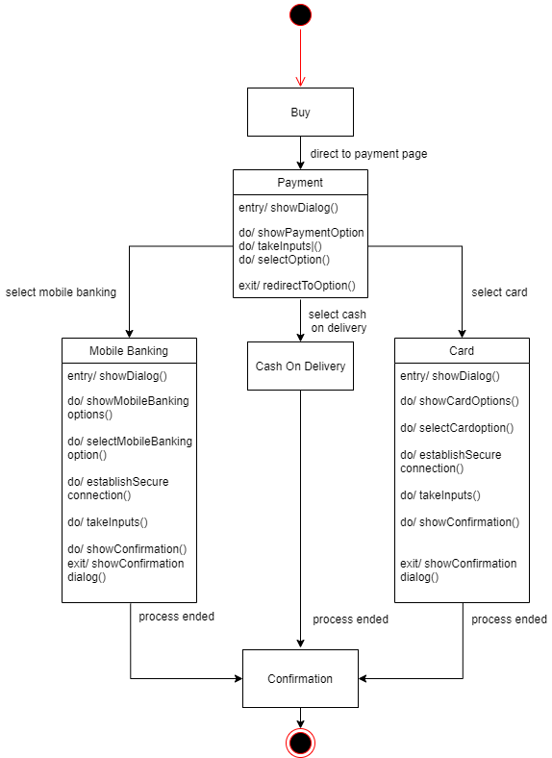
State-Machine
Diagram
Payment State

Slide 19
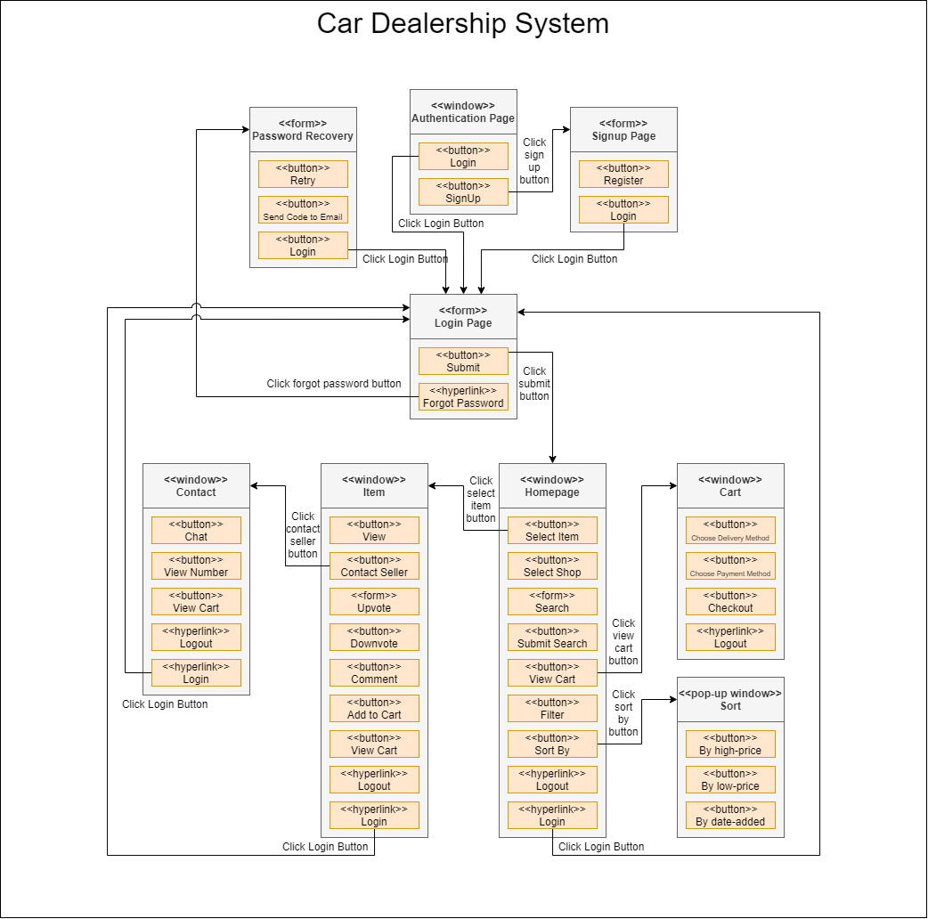
Windows Navigation
Diagram

Slide 20
Summary
Increasing Accessibility
Streamlining Communication
Ensuring Security
Prioritizing the Customer

Slide 21
Thank You!

