Slide 1
Most popular components - SYNCFUSION RAAGAVAN S

Slide 2
MOST POPULAR COMPONENT
Data Grid
Charts
Listview
Scheduler
Diagram
Pdf viewer
Excel library

Slide 3
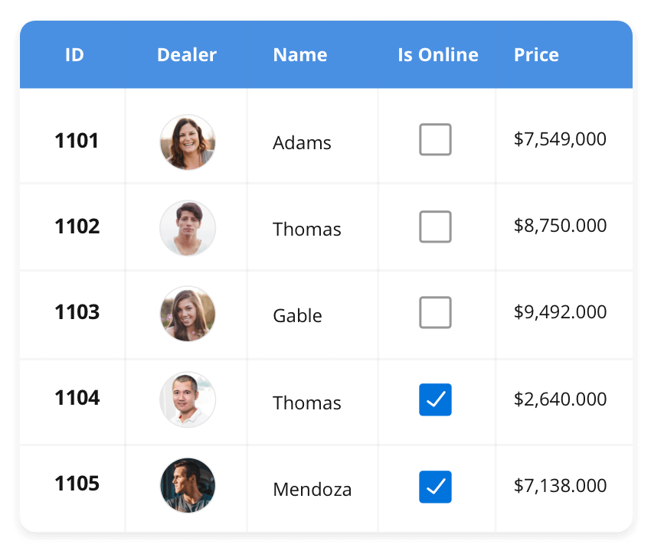



DataGrid​
The DataGrid control is a high-performance grid component that helps display and manipulate large amounts of data in a tabular format.
Its rich feature set includes functionalities like data binding, sorting, grouping, editing, filtering, swiping, dragging, resizing, loading more items, pull-to-refresh, and exporting to Excel and PDF file formats.
SUPPORTED PLATFORMS
| javascript angular react Vue blazer
| winform wpf winui
| xaramin flutter uwp

Slide 4
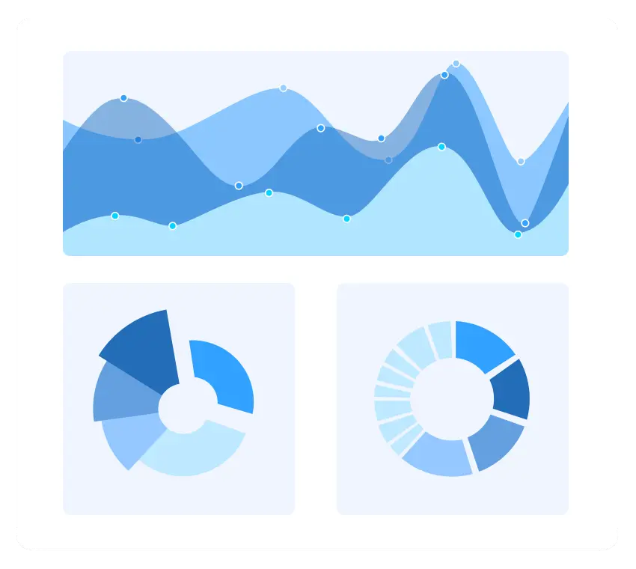
charts​
The Charts control can plot a wide range of chart types, ranging from line charts to specialized financial charts. Its rich feature set includes functionalities like data binding, multiple axes, legends, animation, data labels, annotations, trackballs, tooltips, and zooming.
SUPPORTED PLATFORMS
| javascript angular react Vue blazer
| winform wpf winui
| xaramin flutter uwp

Slide 5
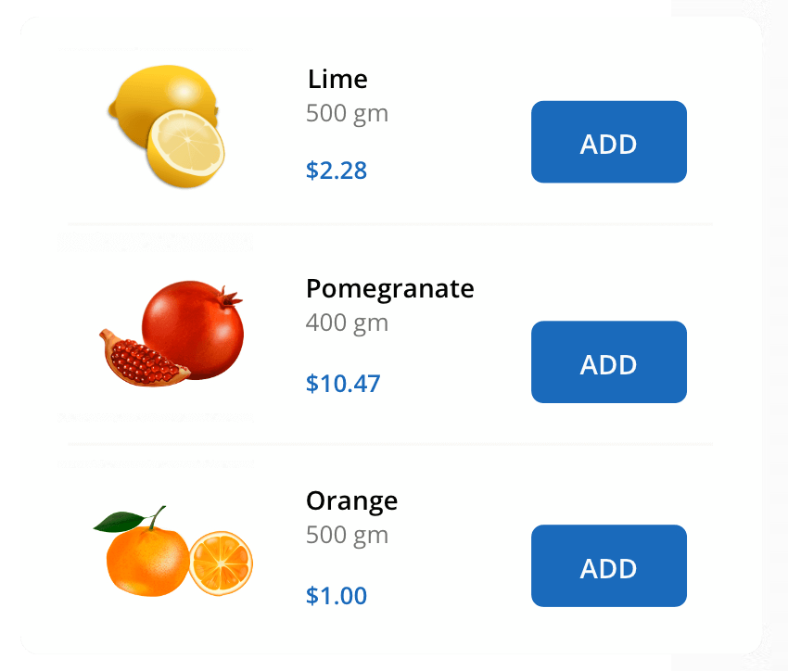
ListView
The Listview renders a set of data items with UI views or custom templates. It has many features like grouping, sorting, filtering, paging, swiping, multiple selection, drag and drop, and different layout types. The ListView control has been optimized to work with large amounts of data.
SUPPORTED PLATFORMS
| javascript angular react Vue blazer
| winform wpf winui
| xaramin flutter uwp

Slide 6
THANK YOU

