Slide 1
Learn Data Science For Free

Slide 2
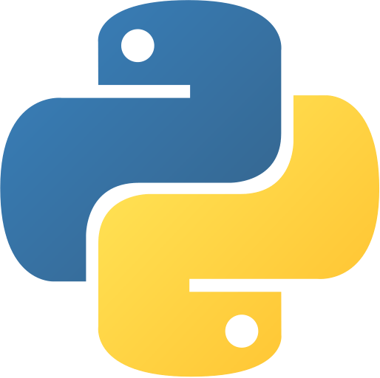
Variables, numbers
Strings, lists, dictionaries
For loop, if condition
Functions
Read/write file
Basics understanding of modules
Programming Language

Slide 3

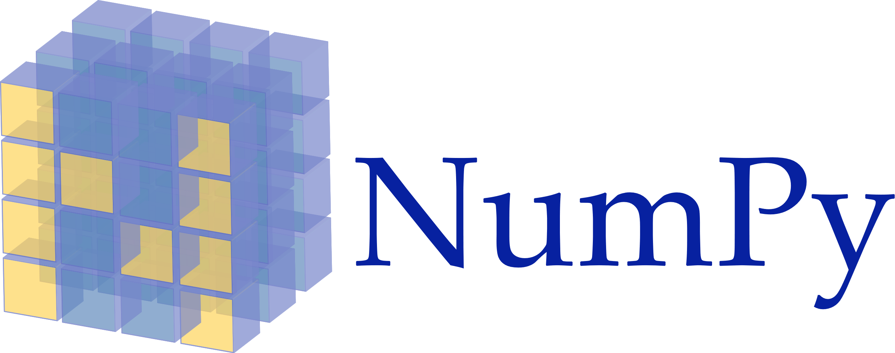
Data Cleaning and Exploration
Series and dataframe basics
Create dataframe from csv/excel/json
Handle missing data, fillna, dropna
groupby
merge, concat dataframes

Slide 4



IDE: Integrated Development Environment

Slide 5

Data Visualization
Line chart, bar chart, pie chart
Histograms
Axes labels, legend, grid
Scatter plot

Slide 6
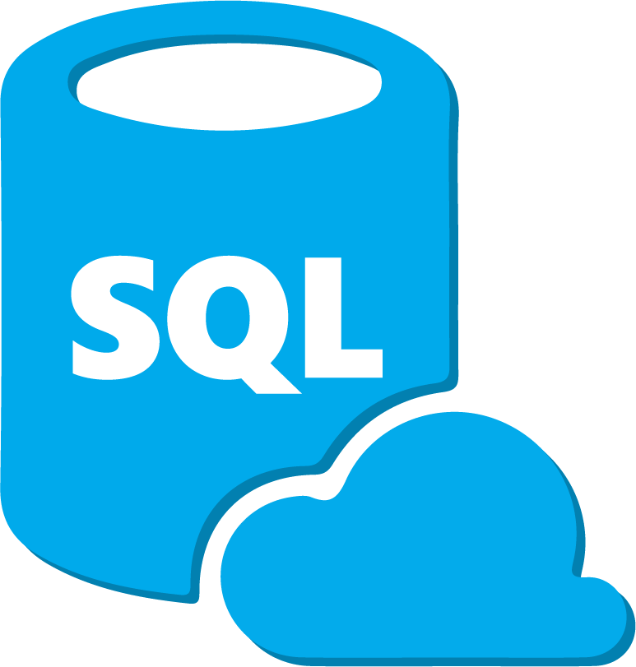
Basics of relational database and structured query language (SQL)
Query and update data: select, where, insert, update clause
Groupby, orderby, joins, views

Slide 7
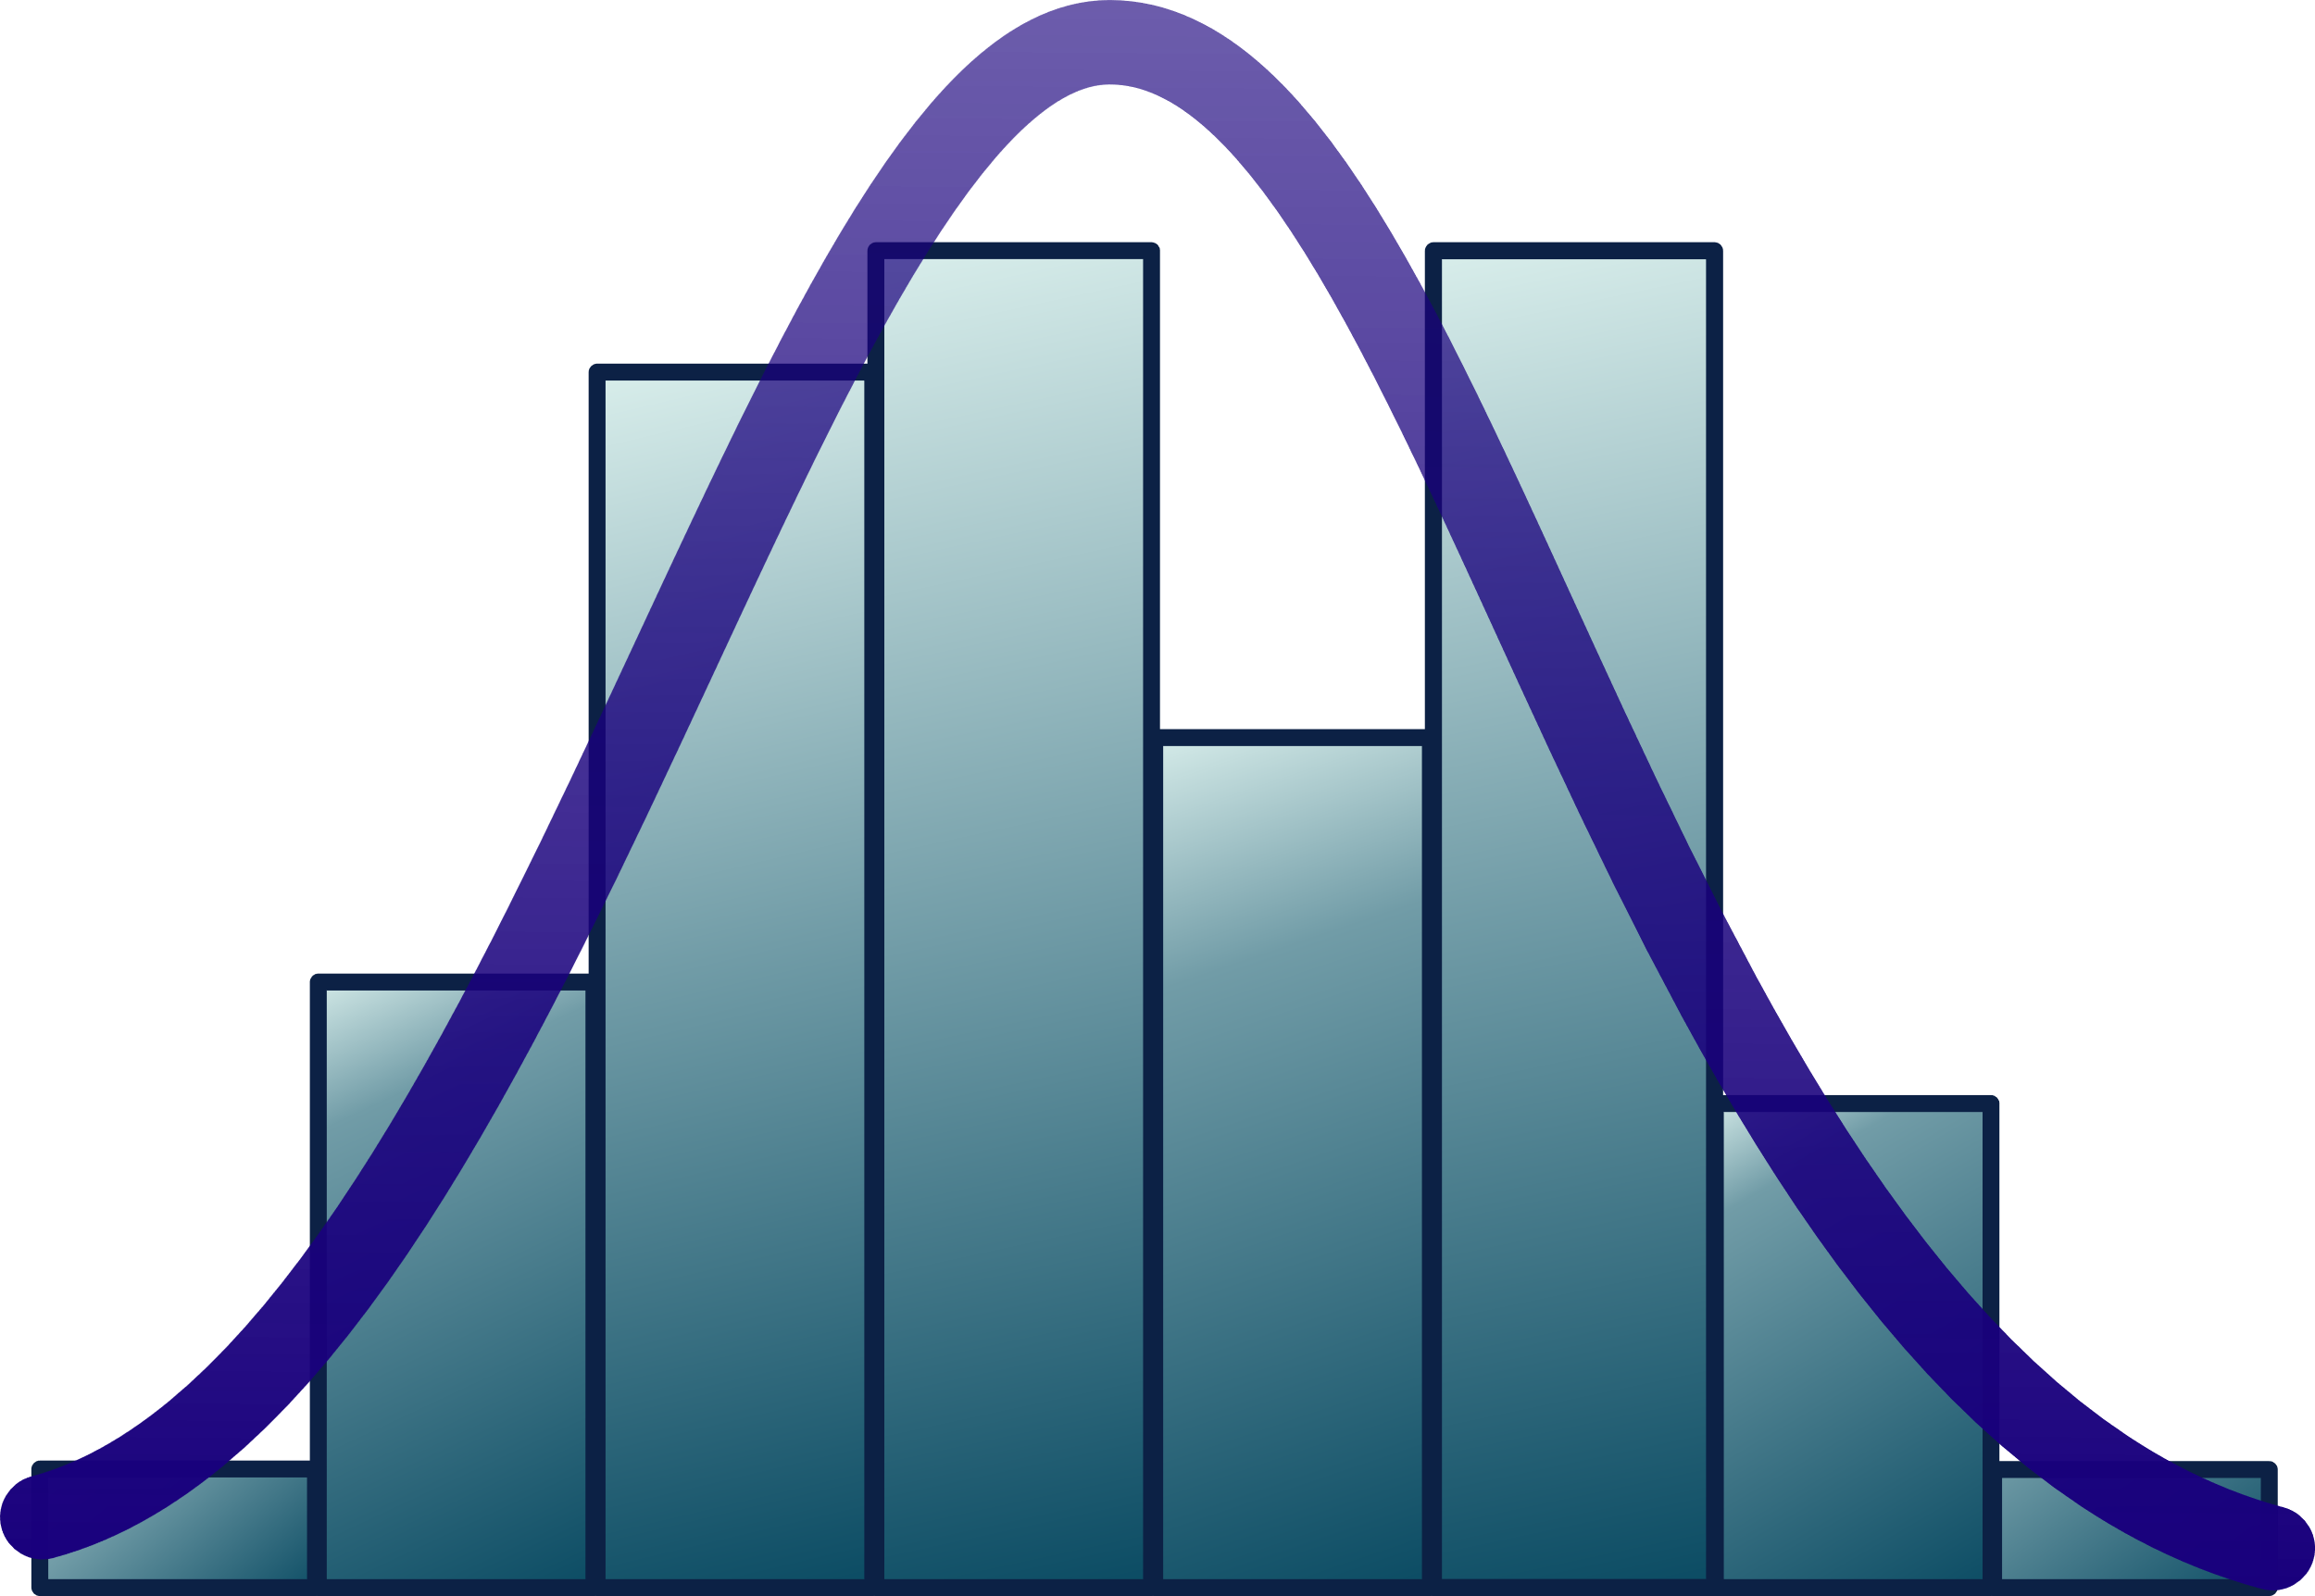
Math & Statistics
Linear algebra
Mean, median, normal distribution, standard deviation, mode, variance, range, IQR, correlation
Probability, conditional probability, priors, posteriors, maximum likelihood
Descriptive statistics, inferential statistics, regression, hypothesis testing, A/B testing

Slide 8
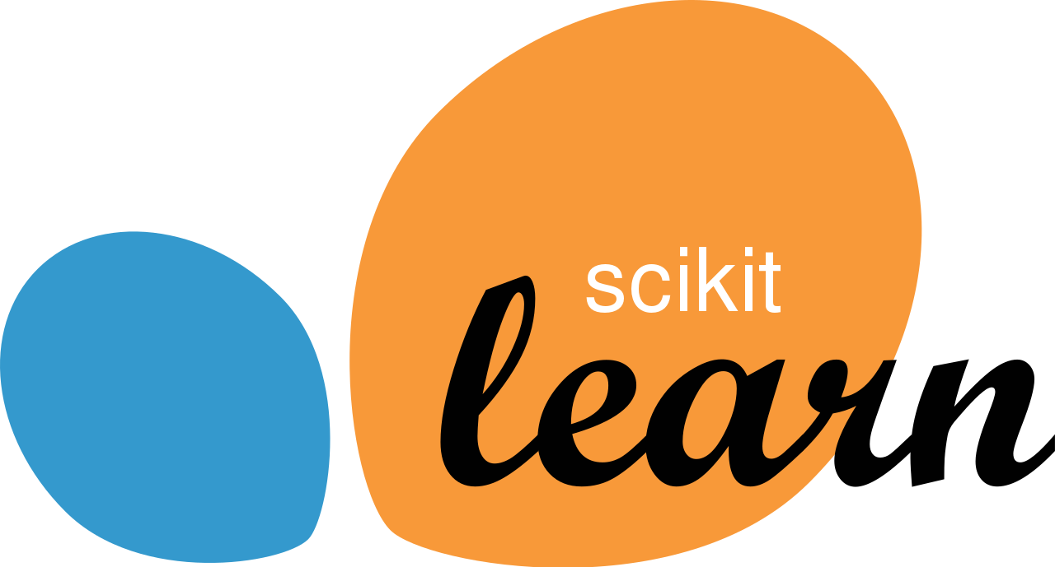
Machine Learning
Regression: Linear regression
Classification: svm, decision tree, random forest, logistic regression, naïve bayes
Unsupervised learning: k means
Label and one hot encoding
train_test_split
K fold cross validation
GridSearchCV

Slide 9


Deep Learning
Neural network basics
Input, hidden, output layers
Activation function
Convolutional neural networks – CNN
Recurrent neural networks - RNN

Slide 10
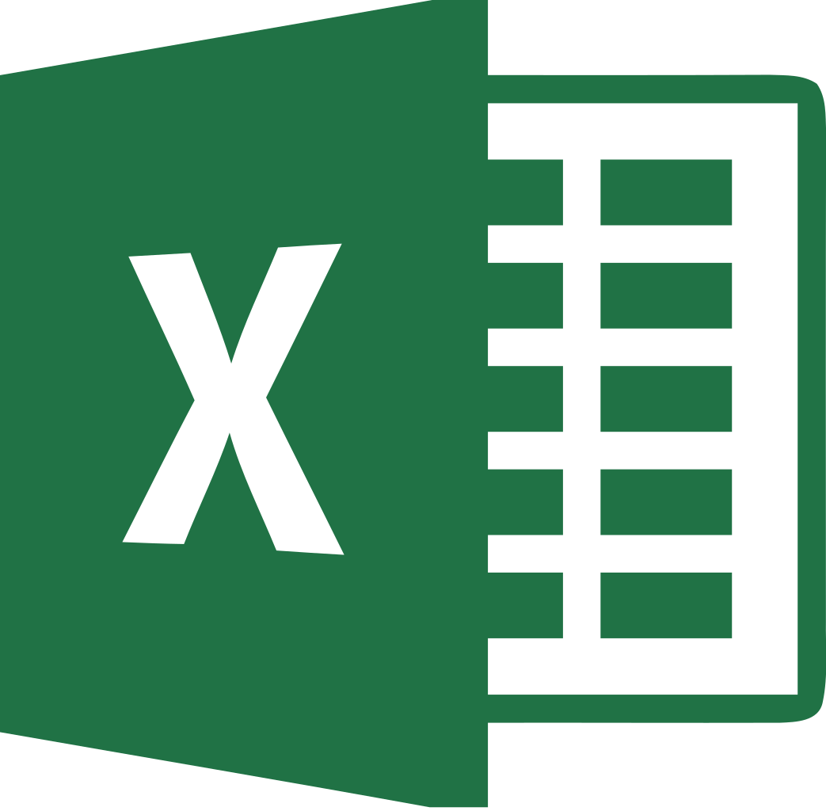
Data Analysis Tool
Data filters, functions
Formulas
Charts and plots
Pivot table, transpose
Vlookup
Allows you to do quick data analysis without having to write code

Slide 11



numpy

Slide 12
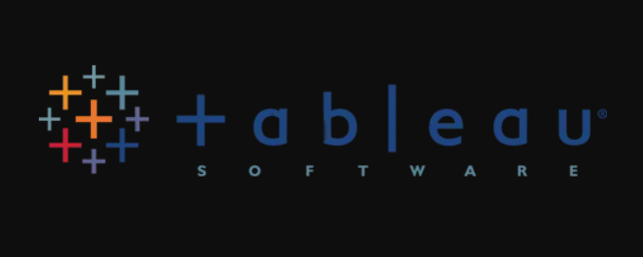


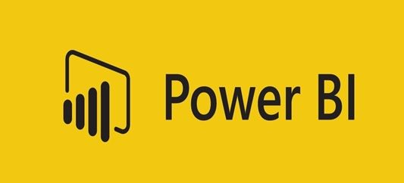



Slide 13
Books
Statistics - Think stats http://greenteapress.com/thinkstats2/thinkstats2.pdf
Python – Automate Boring Stuff
https://automatetheboringstuff.com/
Python – Data cleaning, exploration, visualization and machine learning
https://jakevdp.github.io/PythonDataScienceHandbook/

Slide 14
Online free courses
https://www.edx.org/course/python-for-data-science-2
https://www.edx.org/course/data-science-essentials
https://www.coursera.org/specializations/deep-learning
https://cognitiveclass.ai/learn/data-science
http://work.caltech.edu/telecourse

