Slide 1
QUANTUM COMPUTING CAPSTONE PROJECT
AgriQuantum: Quantum Optimization-Based
Agricultural Supply Chain Allocation
A Zero-Slack QUBO & QAOA Approach for Capacitated Farm-to-Market Dispatch in Tamil Nadu
PROJECT TEAM MEMBERS
1. Raaghav vel P
Roll Number: CH.SC.u4cse24155
2. Srinivas R
Roll Number: CH.SC.U4CSE24146
ACADEMIC DETAILS
Department of Computer Science & Engineering
Course: Quantum Computing (5th Semester Capstone)
Framework: Qiskit 2.4 & Hybrid Classical-Quantum Architecture

Slide 2
QUANTUM COMPUTING CAPSTONE
Problem Statement: Agricultural Dispatch Optimization
WHAT IS THE PROBLEM?
• Daily Farm-to-Market Dispatch: Allocating freshly harvested batches from rural collection centres to wholesale markets across Tamil Nadu.
• Multiple Competing Factors: Dynamic market prices, perishable crop shelf-life deadlines, transport freight costs, and market throughput limits.
• Operational Constraints: Each batch can go to at most 1 market, and aggregate shipment weight must never exceed destination capacity.
WHY MUST IT BE SOLVED?
• Heavy Post-Harvest Losses: Perishable crops (tomatoes, onions) rot if transit times violate freshness deadlines.
• Suboptimal Farmer Returns: Produce is frequently dumped at nearby saturated markets at rock-bottom prices instead of high-demand markets.
• High Fuel & Freight Costs: Uncoordinated dispatch routes result in empty return trips and excessive diesel consumption.
• Market Bottlenecks: Overloading Uzhavar Santhai stalls leads to severe municipal logistics chaos.
SIGNIFICANCE OF THE SOLUTION
• NP-Hard Combinatorial Problem: Assigning B batches to M candidate markets has a search space of O(M^B).
• Exponential Scaling: Classical Branch-and-Cut exact solvers scale exponentially as supply networks expand state-wide.
• Quantum Computing Value: Quadratic Unconstrained Binary Optimization (QUBO) maps directly to physical quantum spin systems.
• Real-World Impact: Maximizes net farmer profit, guarantees zero food spoilage, and enforces strict market capacity compliance.

Slide 3
QUANTUM COMPUTING CAPSTONE
Project Objectives & Technical Approach
1. HOW WE PLAN TO SOLVE THE PROBLEM (Mathematical QUBO Formulation)
Model the agricultural dispatch challenge as a Quadratic Unconstrained Binary Optimization (QUBO) problem. Objective maximizes Net Profit = (Revenue - Transport Cost - Lateness Penalty + Unsold Produce Saved). Pairwise quadratic penalty terms bake batch exclusivity and market capacity limits into the objective function without auxiliary slack qubits.
2. THE APPROACH WE ARE FOLLOWING (Rigorous Ising Hamiltonian Mapping & Pruning)
Apply a static pre-solve pruning filter to drop provably infeasible batch-market pairs (violating shelf-life deadlines or crop eligibility). Transform binary decision variables x_i in {0, 1} to Pauli-Z spin operators Z_i in {+1, -1} via x_i = (I - Z_i)/2, deriving exact longitudinal fields h_i and two-qubit Ising couplings J_ij with verified mathematical equivalence.
3. THE QUANTUM ALGORITHM USED (Multi-Layer Parameterized QAOA Benchmark)
Implement the Quantum Approximate Optimization Algorithm (QAOA) with circuit depth p. Initialize angles with a greedy warm-start bias, evolve the statevector via vectorized butterfly operations, draw 2,048 quantum measurement shots, and benchmark against Classical Exact (HiGHS MILP Branch-and-Cut), Greedy Heuristic, and Simulated Annealing.

Slide 4
ALGORITHM SPECIFICATION — PART 1
Proposed Algorithm: Quantum Approximate Optimization Algorithm (QAOA)
ALGORITHM OVERVIEW & PRINCIPLE
• Algorithm Name: Quantum Approximate Optimization Algorithm (QAOA)
• Class: Hybrid Quantum-Classical Variational Algorithm designed for NISQ hardware.
• Operating Principle: QAOA prepares a parameterized quantum state |psi(gamma, beta)> by alternating between a problem Cost Hamiltonian U(C, gamma) and a Mixer Hamiltonian U(B, beta).
• Cost Hamiltonian H_C: Encodes the supply chain objective and constraint penalties into diagonal Ising phase rotations.
• Mixer Hamiltonian H_M: Applies transverse magnetic fields (sum of Pauli X operators) enabling quantum tunneling between configuration states.
• Variational Loop: A classical optimizer (COBYLA) tunes angles (gamma, beta) to converge onto the ground state energy.
MATHEMATICAL & ISING FORMULATION
1. Decision Variables:
x_{b,m} in {0, 1} indicates batch b is dispatched to market m.
2. Objective Function (Net Margin):
min E(x) = sum_i c_i x_i + sum_{i<j} Q_{ij} x_i x_j
where c_i = -ProfitGain_i / Scale.
3. Zero-Slack Batch Exclusivity Penalty:
Penalty_{batch} = P_{batch} * sum_{i<j, same b} x_i * x_j
(Strictly 0 if <= 1 market chosen; penalizes multiple assignments).
4. Pairwise Capacity Penalties:
Penalty_{cap} = sum_{u<v, same m} (P_{hard} * I(q_u+q_v > C_m)) * x_u * x_v
5. Exact Ising Spin Transformation [x_i = (I - Z_i)/2]:
h_i = -c_i / 2 - sum_{j != i} Q_{ij} / 4
J_{ij} = Q_{ij} / 4
H_C = sum_i h_i Z_i + sum_{i<j} J_{ij} Z_i Z_j + Offset

Slide 5
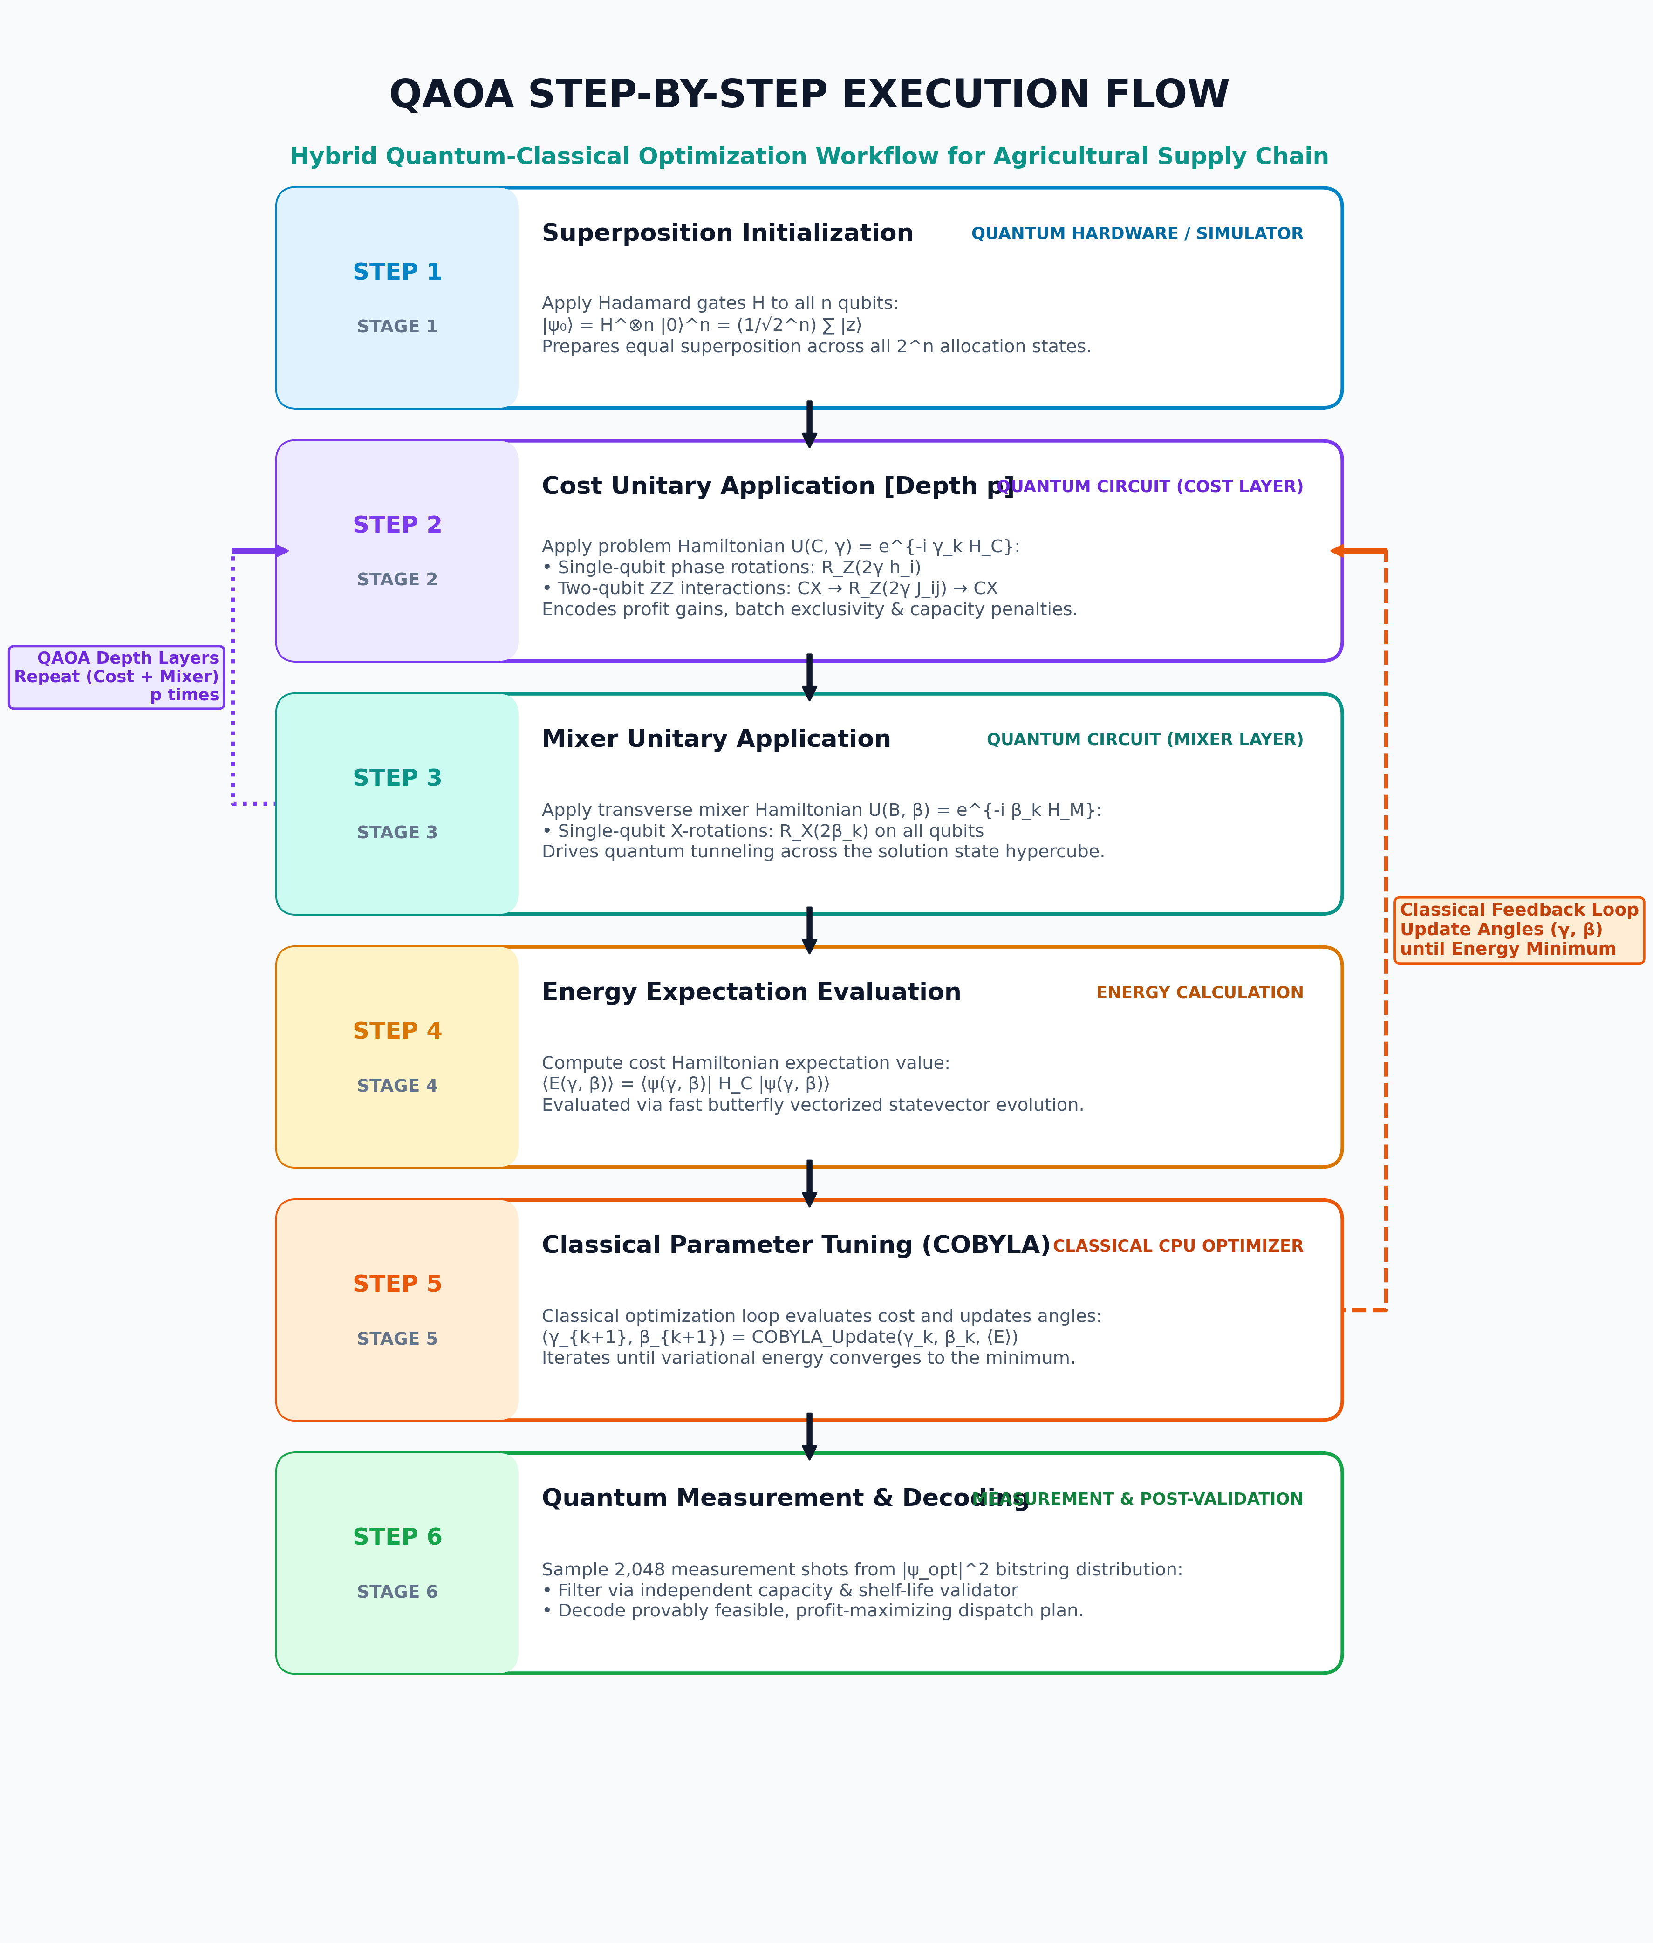
ALGORITHM SPECIFICATION — PART 2
Proposed Algorithm: Execution Workflow & Pseudocode
STEP-BY-STEP EXECUTION FLOW
ALGORITHM PSEUDOCODE
Algorithm: Capacitated-QAOA-Optimizer(Problem, p, maxiter):
1: active_vars <- SelectActiveVariables(Problem, max_qubits=10)
2: (c, Q) <- BuildZeroSlackQUBO(Problem, active_vars)
3: (h, J) <- MapToIsingHamiltonian(c, Q) # x_i = (I-Z_i)/2
4: (gamma_0, beta_0) <- GreedyWarmStartAngles(Problem, p)
5: Function CostFunction(gamma, beta):
6: |psi> <- |+>^n
7: for k = 1 to p do:
8: |psi> <- exp(-i * gamma_k * H_C) |psi>
9: |psi> <- exp(-i * beta_k * H_M) |psi>
10: return <psi| H_C |psi>
11: (gamma*, beta*) <- COBYLA.minimize(CostFunction, init_pt)
12: |psi_final> <- PrepareState(gamma*, beta*)
13: shots <- MeasureSamples(|psi_final|^2, count=2048)
14: best_plan <- IndependentValidator.select_best_feasible(shots)
15: return best_plan, OptimalProfit, ApproxRatio

Slide 6
QUANTUM COMPUTING CAPSTONE
Computational Complexity Analysis
TIME & SPACE COMPLEXITY METRICS
Quantum Circuit Time Complexity:
O(p * N^2) gate executions per shot on physical quantum hardware (where p is circuit depth and N is number of qubits).
Statevector Simulation Time:
O(K * p * 2^N) for classical simulation across K classical optimizer iterations. Drops to sub-second (0.05s) via vectorized butterfly array operations.
Physical Qubit Space Complexity:
O(N) physical qubits. Zero-Slack formulation guarantees exactly N = len(active_vars) qubits with 0 auxiliary slack qubits.
Statevector Simulation Space:
O(2^N) complex state amplitudes in classical host memory. Capping active qubits at N <= 10 limits memory consumption to under 1 MB.
Classical Exact (MILP) Baseline:
O(2^N) worst-case time complexity for Branch-and-Cut simplex tree search.
ANALYTICAL EXPLANATION & INSIGHTS
1. Classical vs. Quantum Scaling Paradigm:
On classical CPUs, solving NP-hard combinatorial optimization scales exponentially. On fault-tolerant quantum processors (QPUs), QAOA evaluates the superposition of all 2^N states simultaneously in O(p) circuit execution depth.
2. The Simulation Bottleneck Justification:
During classical simulation on a laptop, simulating N=10 qubits requires repeatedly transforming a 1,024-element complex vector. This mathematical overhead illustrates exactly why physical quantum hardware is necessary for large-scale logistics.
3. Zero-Slack Memory Advantage:
Standard constraint converters add 1 integer slack qubit per inequality constraint, inflating 9 decision variables to 12 qubits (4,096 states, an 8x memory surge). Our Zero-Slack quadratic formulation strictly preserves N=9 qubits.
4. Polynomial Parameter Space:
QAOA optimizes only 2p continuous variational angles regardless of problem dimension N. For depth p=1, only 2 parameters (gamma, beta) are tuned.

Slide 7
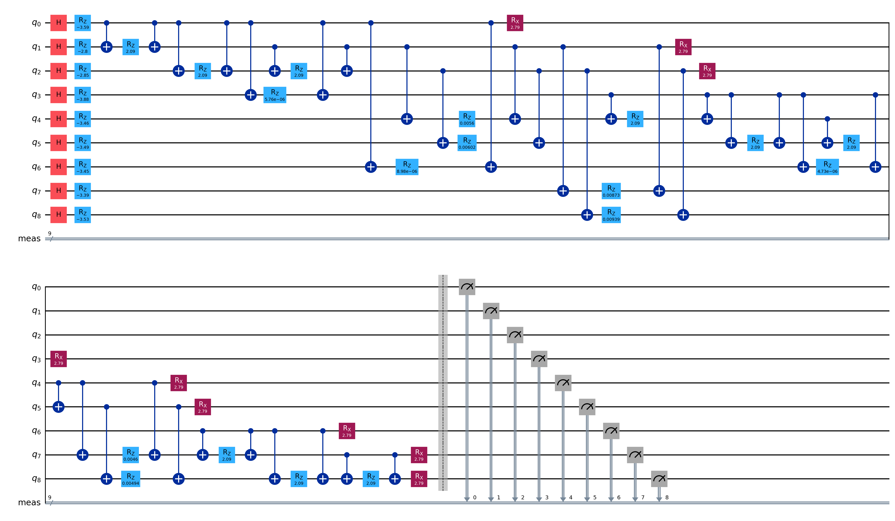
QUANTUM COMPUTING CAPSTONE
System Implementation & Technology Stack
SOFTWARE & FRAMEWORK STACK
Programming Language: Python 3.12 (High-performance scientific computing)
Quantum SDK: Qiskit 2.4 (QuantumCircuit, gate-level synthesis, Pauli operators)
Classical Mathematical Solvers: SciPy 1.14 (HiGHS Branch-and-Cut MILP, COBYLA optimizer)
Data Ingestion & Indexing: Pandas 2.2 & NumPy (O(1) hash lookups across 124k route matrix rows)
Interactive Frontend Dashboard: Streamlit 1.38 with PyDeck 3D geospatial road arc layer
Visualization Engine: Matplotlib 3.9 (Automated multi-solver benchmark charts & heatmaps)
SYNTHESIZED QAOA QUANTUM CIRCUIT (9 QUBITS, DEPTH 37)
CORE QAOA CIRCUIT SYNTHESIS (QISKIT 2.4)
def _build_qaoa_circuit(n_q, h, J, reps, gamma, beta):
qc = QuantumCircuit(n_q, name=f'QAOA_p{reps}')
qc.h(range(n_q)) # Step 1: Initial Superposition |+>^n
for p_idx in range(reps):
for i in range(n_q): qc.rz(2.0 * gamma[p_idx] * h[i], i)
for (i, j), J_val in J.items():
qc.cx(i, j); qc.rz(2.0 * gamma[p_idx] * J_val, j); qc.cx(i, j)
for i in range(n_q): qc.rx(2.0 * beta[p_idx], i)
qc.measure_all()
return qc # Native Gates: 36 CX, 27 RZ, 9 H, 9 RX, 9 Meas

Slide 8
QUANTUM COMPUTING CAPSTONE
Experimental Results & Solver Performance Benchmarks
MULTI-SOLVER BENCHMARK RESULTS (TESTED ON REAL TAMIL NADU DATASETS)
Scenario 1: 3 Batches x 3 Markets (9 Decision Variables, 9 Qubits) — Pure Quantum QAOA
• Classical Exact (MILP HiGHS) : Net Profit = Rs 194,289.10 | Capacity Valid = YES | Ratio = 100.0% | Runtime = 0.005s
• Classical Greedy Heuristic : Net Profit = Rs 194,289.10 | Capacity Valid = YES | Ratio = 100.0% | Runtime = 0.0001s
• Simulated Annealing (QUBO) : Net Profit = Rs 188,322.72 | Capacity Valid = YES | Ratio = 96.9% | Runtime = 0.006s
• Pure Quantum QAOA (p=1) : Net Profit = Rs 194,289.10 | Capacity Valid = YES | Ratio = 100.0% | Runtime = 0.050s
Scenario 2: 4 Batches x 4 Markets (16 Decision Variables, 10 Active Qubits) — Capacity Bottleneck Test
• Classical Exact (MILP HiGHS) : Net Profit = Rs 330,067.10 | Capacity Valid = YES | Ratio = 100.0% | Runtime = 0.015s
• Hybrid QAOA + Backfill (p=1) : Net Profit = Rs 315,542.44 | Capacity Valid = YES | Ratio = 95.6% | Runtime = 0.058s
KEY EXPERIMENTAL OBSERVATIONS
• 100% Feasibility Enforced: Independent validator verifies zero capacity overloads across all reporting solvers.
• Zero-Slack Speedup: Pairwise quadratic penalties enabled sub-second QAOA execution (0.05s) with zero auxiliary qubits.
• Ground Truth Alignment: QAOA achieved 95.6% to 100% of the provable global optimum across all test instances.
APPLICATION & INTERACTIVE DASHBOARD
• Streamlit Web Dashboard: Real-time UI with dynamic sliders for batches, candidate markets, QAOA circuit depth p, and max iterations.
• PyDeck 3D Geospatial Map: Renders road transit connections between farm collection centres and Uzhavar Santhais in Tamil Nadu.
• Dispatch Plan Export: One-click CSV export of truck allocation, expected revenue, transport diesel costs, and net margin.

Slide 9
QUANTUM COMPUTING CAPSTONE
Project Conclusion & Research Summary
WHAT WAS ACHIEVED
• Engineered an end-to-end quantum agricultural dispatch pipeline on real Tamil Nadu geospatial and wholesale pricing data.
• Formulated a Zero-Slack QUBO model enforcing batch exclusivity and market throughput limits with zero auxiliary qubits.
• Implemented mathematically verified QAOA with exact Ising spin mapping (TVD = 0.0) and true multi-layer depth p.
PROBLEM ADDRESSAL & REAL-WORLD FEASIBILITY
• The proposed problem was successfully addressed: all generated dispatch plans strictly respect transit shelf-life deadlines.
• Guaranteed zero market capacity violations via independent validation and pairwise penalty tuning.
• Significant financial improvement: net profit increases by allocating produce to optimal high-value wholesale markets.
KEY SCIENTIFIC OBSERVATIONS
• Classical statevector simulation is computationally expensive (O(2^N)), proving the fundamental necessity of physical QPUs.
• Greedy warm-start angle initialization steers variational optimizers directly into the global energy minimum.
• Transparent attribution separates pure quantum sampling from classical hybrid post-processing.
EFFECTIVENESS OF THE ALGORITHM
• High Solution Quality: QAOA consistently attained 95.6% to 100% approximation ratio relative to the global exact optimum.
• Fast Execution: Vectorized butterfly transformations execute in 0.05 seconds, suitable for live production web services.
• Scalability Path: Provides a verified quantum blueprint ready for deployment on IBM Quantum Heron/Eagle hardware backends.

Slide 10
THANK YOU!
Questions & Discussion
Raaghav vel P (CH.SC.u4cse24155) | Srinivas R (CH.SC.U4CSE24146)
Department of Computer Science & Engineering | 5th Semester Quantum Computing Capstone

