Slide 1
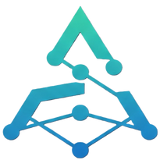





Spectrum’25
ARXIVE
SMART CONTRACT LIFECYCLE MANAGEMENT SUITE
TEAM: GENESIS

Slide 2


PROBLEM STATEMENT
Aptos
WHY THIS
IMPORTANT?
No Efficient Archival – Unused smart contracts remain on-chain, consuming storage.
Lack of Lifecycle Management – No built-in tools for modifying, tracking, or archiving contracts.
Cumbersome Deployment – Requires multiple terminal commands, making the process inefficient.
Storage Constraints on Aptos – Move’s resource-oriented model makes contract deletion difficult.
Immutability vs. Scalability – Removing/modifying contracts conflicts with blockchain finality & verifiability.
No Unified Developer Tooling – Developers lack a single platform to manage smart contracts seamlessly.
Reduces blockchain bloat by optimizing storage usage.
Improves developer experience with easy contract deployment & management.
Enhances security & verifiability while maintaining Aptos’s core principles.
Ensures long-term scalability for dApps by enabling structured contract management.
**Aptos lacks a comprehensive smart contract management system

Slide 3

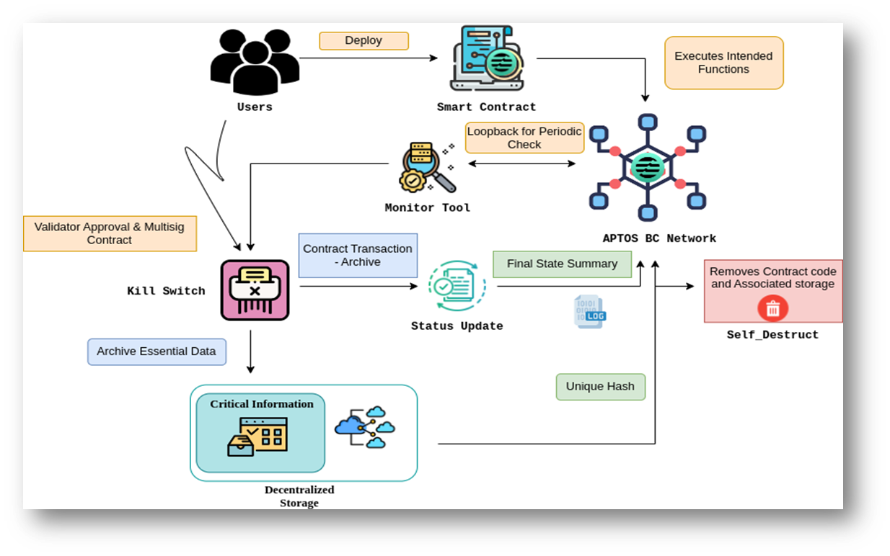
OUR SOLUTION
Arxive
Smart Contract Lifecycle Management
Deployment and Retrieval Workflow
Off-chain Storage
Verifiable Archival
A decentralized platform tailored for Aptos that enables developers to archive, manage, and retrieve smart contracts efficiently—streamlining the entire contract lifecycle.
Offers a one-click deployment system for Aptos Move contracts and enables selective contract validation and retrieval, eliminating manual complexities and enhancing developer productivity.
Balances on-chain and off-chain storage by moving archived contracts to IPFS, while storing only the proofs on Aptos, reducing gas fees and storage overhead.
Incorporates zk-SNARKs to cryptographically compress and seal unused contracts, ensuring verifiability without compromising immutability—a critical advancement in decentralized archival integrity.

Slide 4




MARKET OPPORTUNITY
Value Propositions
Revenue Streams: Aptos Move, Aptos SDK, zk-SNARKs (Groth16/Plonk), IPFS
Arxives business model centers around providing a comprehensive smart contract archival and verification platform on Aptos, leveraging zk-SNARKs for proof generation and offering a built-in Move code editor.
They target blockchain developers, enterprises, and Web3 startups, fostering relationships through developer support and community engagement.
Backend & Storage: NodeJS, Aptos REST API, MongoDB, IPFS-based archival
Frontend & UI: React, Next.js, Tailwind CSS
Revenue Streams
Security & Validation: Zero-Knowledge Proofs (ZKPs), State Commitments, Cryptographic Hashing
Freemium API model (basic archival free)
Premium enterprise services (custom archiving, zk-proof verification)
SaaS subscription model (advanced analytics, team collaboration)
Enterprise API licensing for Web3 platforms
TECH STACK

Slide 5

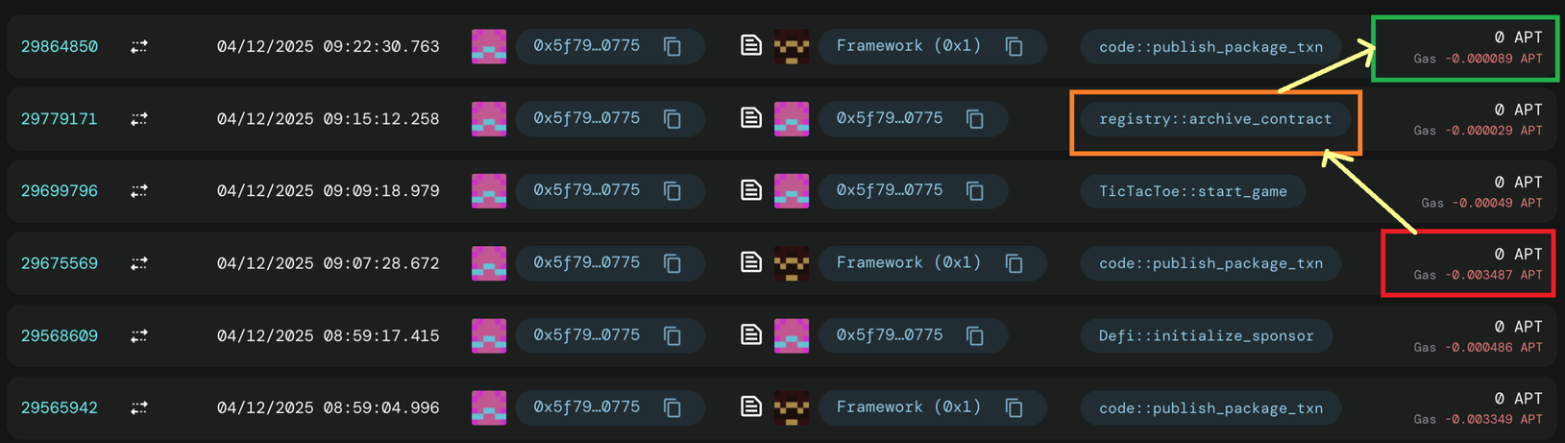

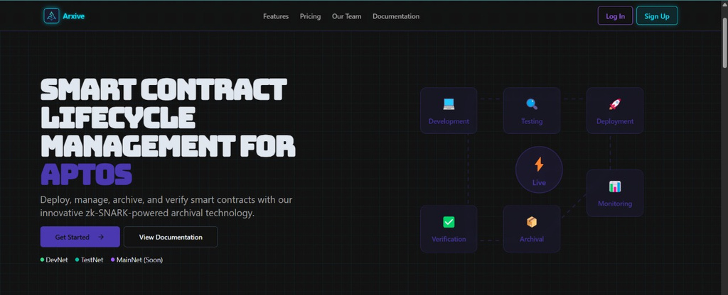
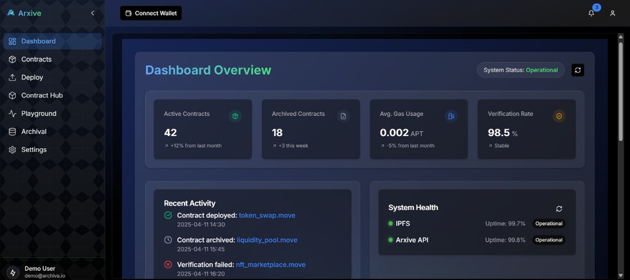

DELIVERABLE

Slide 6





Spectrum’25
THANK YOU

