Slide 1


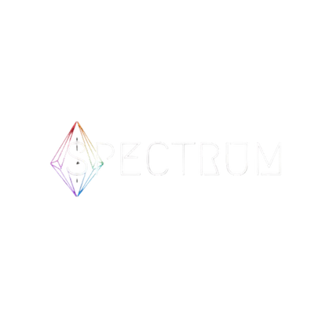




OPEN SOURCE PROGRAMMING CLUB
Archiva
TEAM NAME: Genesis
DOMAIN: Blockchain & Decentralized Solution

Slide 2












OPEN SOURCE PROGRAMMING CLUB
PROBLEM STATEMENT:
Smart Contract Lifecycle Management on Aptos
No Efficient Archival – Unused smart contracts remain on-chain, consuming storage.
Lack of Lifecycle Management – No built-in tools for modifying, tracking, or archiving contracts.
Cumbersome Deployment – Requires multiple terminal commands, making the process inefficient.
Storage Constraints on Aptos – Move’s resource-oriented model makes contract deletion difficult.
Immutability vs. Scalability – Removing/modifying contracts conflicts with blockchain finality & verifiability.
No Unified Developer Tooling – Developers lack a single platform to manage smart contracts seamlessly.
Why this important?
Reduces blockchain bloat by optimizing storage usage.
Improves developer experience with easy contract deployment & management.
Enhances security & verifiability while maintaining Aptos’s core principles.
Ensures long-term scalability for dApps by enabling structured contract management.
**Aptos lacks a comprehensive smart contract management system—Archiva fills this gap!

Slide 3


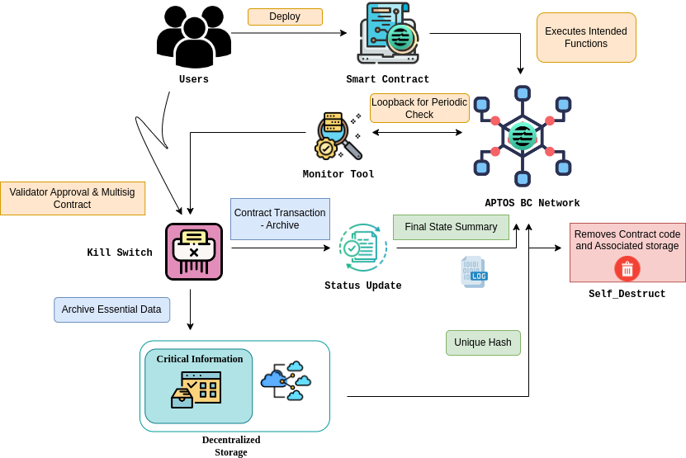
OPEN SOURCE PROGRAMMING CLUB
Solution
Archiva: Revolutionizing Smart Contract Management
A decentralized smart contract lifecycle management platform built on Aptos.
Enables developers to archive, manage, and retrieve smart contracts seamlessly.
Uses zero-knowledge proofs (zk-SNARKs) to ensure verifiable archival without breaking immutability.
Balances on-chain and off-chain storage, reducing storage overhead and gas costs.
Optimized for Aptos, Polygon zkEVM, and Ethereum ecosystems.
How it works?
Smart Contract Archival – Uses zk-SNARKs to cryptographically seal and compress unused contracts.
Efficient Storage Management – Moves archived contracts off-chain while retaining proof on Aptos.
Selective Pruning & Retrieval – Allows contract validation without full on-chain storage.
One-Click Deployment – Deploy Aptos Move contracts without running multiple terminal commands.
Interoperability – Supports Aptos SDK, MetaMask-like wallets, and Aptos Move for seamless contract management.

Slide 4


OPEN SOURCE PROGRAMMING CLUB
INNOVATION & USP
First-of-its-kind Smart Contract Archival on Aptos → No existing tool enables contract storage optimization while preserving immutability.
zk-SNARK-powered Contract Verification → Allows contract retrieval & validation without keeping full data on-chain.
Decentralized & Permissionless Management → No central authority—users control their own contract lifecycle.
One-Click Smart Contract Deployment → Eliminates complex terminal commands for Aptos Move developers.
Built-in Move Code Editor → First-ever browser-based editor for Aptos smart contracts, improving developer productivity.
Seamless Aptos Integration → Works natively with Aptos wallets (Martian, Petra) for smooth interactions.
Interoperability Across Chains → Supports Aptos Move & future compatibility with Polygon zkEVM, Ethereum L2s.
Storage Optimization & Blockchain Efficiency → Archived contracts remain verifiable via Merkle Proofs on IPFS/Arweave, reducing blockchain bloat.

Slide 5











BUSINESS MODEL
OPEN SOURCE PROGRAMMING CLUB
Key Partners
Key Activities
Value Propositions
Channels
Aptos
Polygon zkEVM
IPFS/Arweave
Devfolio
ETHIndia
Smart contract archival & verification
zk-SNARK-powered proof generation
Move code editor & one-click deployment
API development & maintenance
Developer community engagement
Reduces blockchain storage costs
Ensures contract immutability & verifiability
First all-in-one smart contract archival & lifecycle management tool
Integrated zk-SNARK verification for contract integrity
Built-in Move code editor for seamless development
ETHIndia, Polygon Devs
Aptos ecosystem, Devfolio
Web3 developer communities
Hackathons & online workshops
Customer Relationships
Customer Segments
Key Resources
Cost Structure
Developer support forums
Web3 hackathons & grants
Onboarding assistance for enterprises
Community-driven feature requests
Blockchain developers & dApp creators
Enterprises managing high-volume smart contracts
DeFi & NFT projects
Web3 startups adopting Aptos
Aptos Move, zk-SNARKs
IPFS, Arweave
ReactJS, FastAPI
Developer grants & community funding
API maintenance & infrastructure
zk-SNARK validation costs
Smart contract indexing & archival expenses
Developer grants & incentives
Freemium API model (basic archival free)
Premium enterprise services (custom archiving, zk-proof verification)
SaaS subscription model (advanced analytics, team collaboration)
Enterprise API licensing for Web3 platforms
Revenue Streams

Slide 6

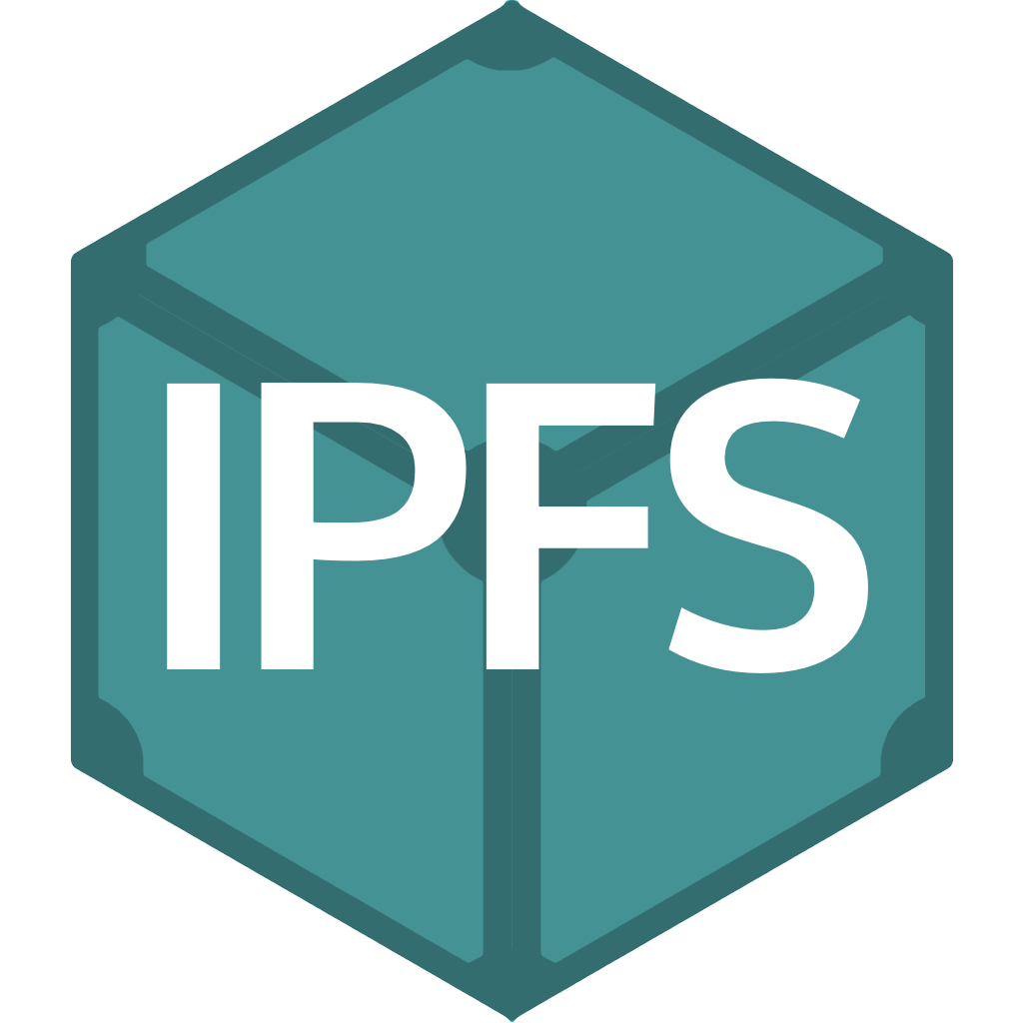






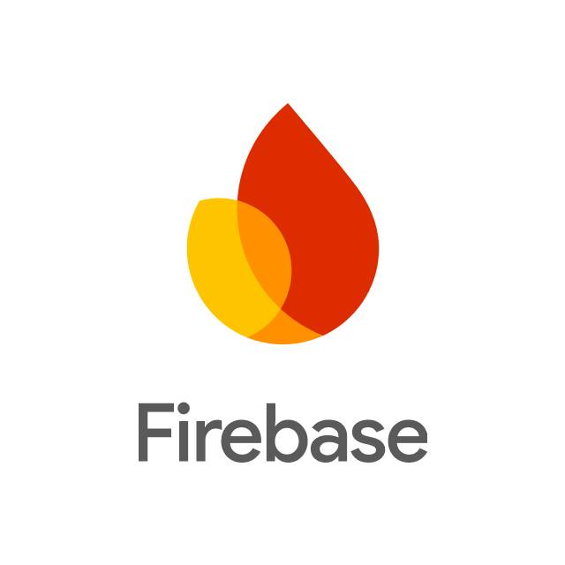



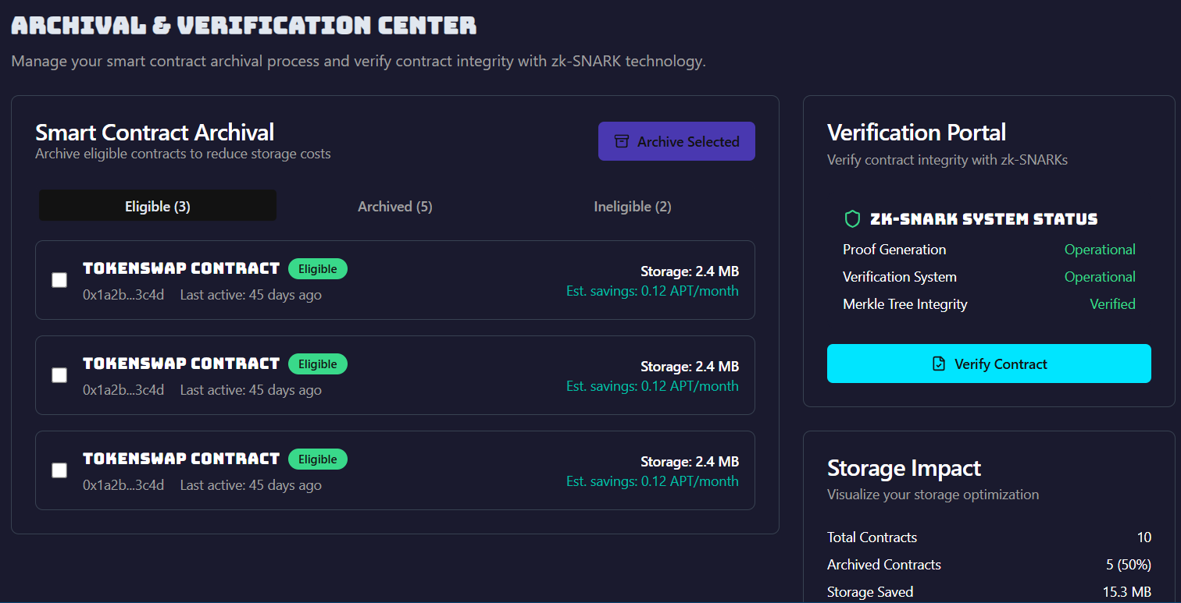
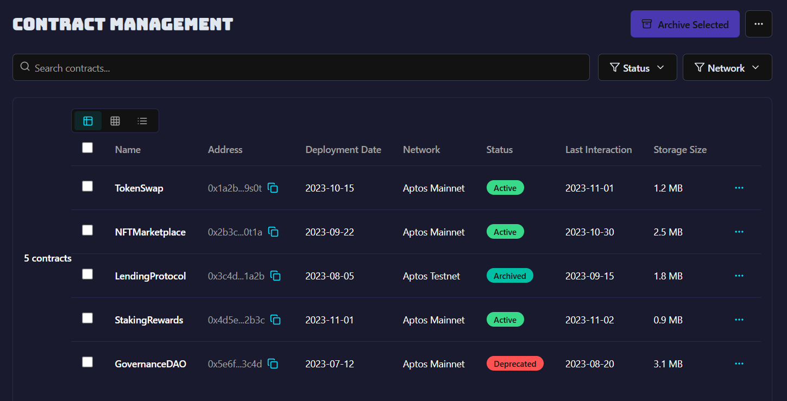

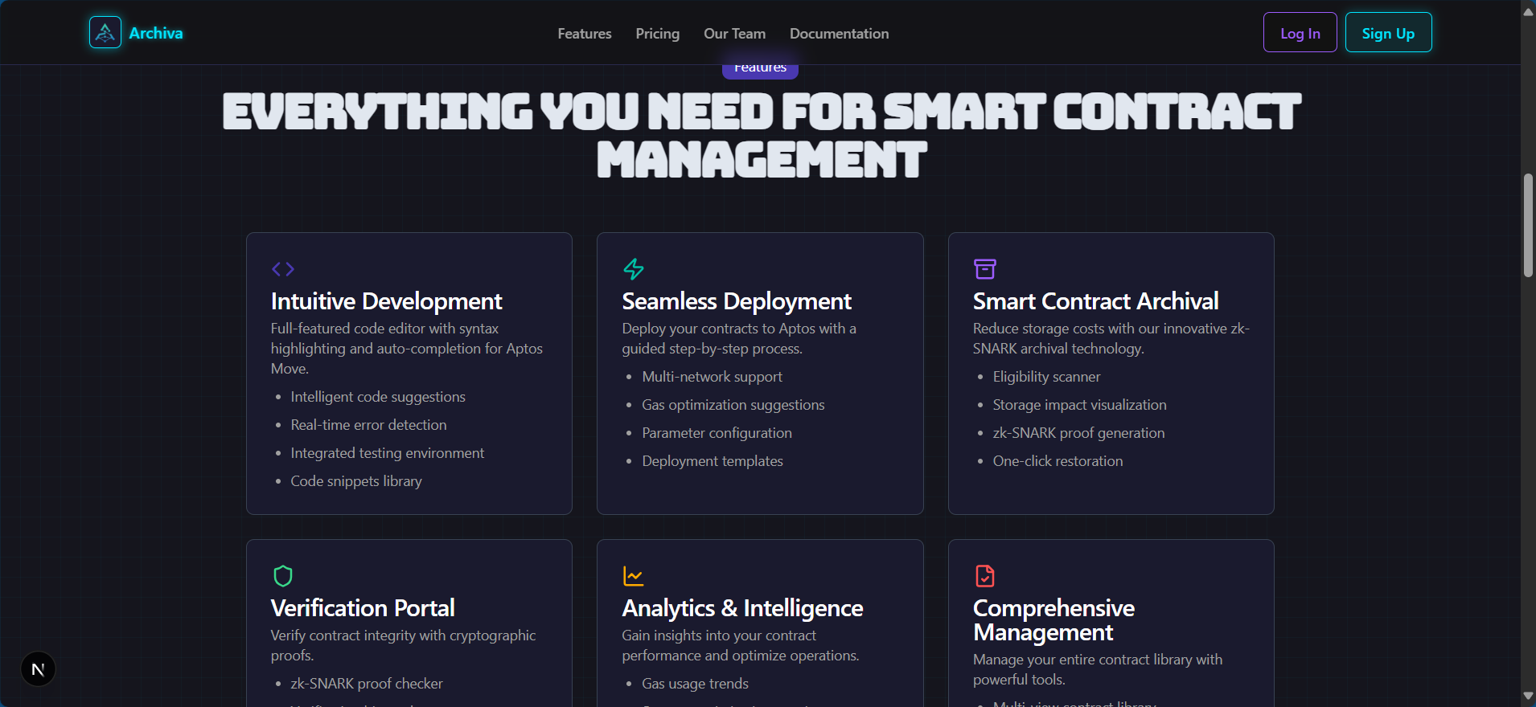
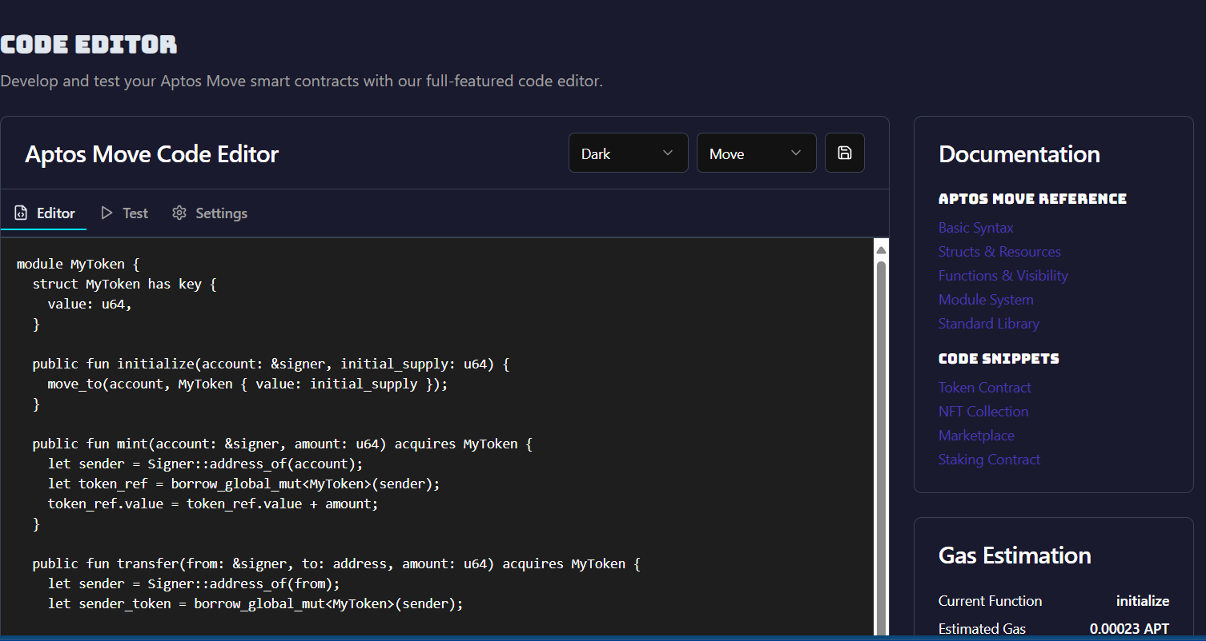
TECH STACK
OPEN SOURCE PROGRAMMING CLUB
Blockchain & Smart Contracts
Frontend & UI
Backend & Storage
React, Next.js, Tailwind CSS, MetaMask-like Extension (Aptos-SDK-based)
Aptos Move, Aptos SDK, zk-SNARKs (Groth16/Plonk), IPFS/Arweave
FastAPI, Python, Aptos REST API, Firestore, IPFS-based archival
Archival & Verification Page
Contract Management
Security & Validation
Zero-Knowledge Proofs (ZKPs), State Commitments, Cryptographic Hashing
Landing
Page
Code Editor
(AI powered)
WIREFRAME

Slide 7

OPEN SOURCE PROGRAMMING CLUB
TEAM MEMBERS
TEAM NAME: Genesis
Team Lead: Jayashre K
College Name: Shiv Nadar University Chennai
Email: jaya2004kra@gmail.com
Phone: 6382230940
Team Member 1: Adithya A
College Name: Shiv Nadar University Chennai
Email: itsmeadithyaa@gmail.com
Phone: 82476 67696
Team Member 3: Raahul R
College Name: Shiv Nadar University Chennai
Email: raahulramesh11@gmail.com
Phone: 73581 01875
Team Member 2: Nidhi Gummaraju
College Name: Shiv Nadar University Chennai
Email: nidhigumm05@gmail.com
Phone: 9790896639
Team Member 4: Roahith R
College Name: Shiv Nadar University Chennai
Email: roahith11@gmail.com
Phone: 9585788585
TEAM MEMBERS

