Slide 1

MANGAIND
Guided by: Prof. Bhavisha Suthar
Submitted BY : Honey Soni
Rahul Tanna

Slide 2
TABLE OF CONTENT
Introduction
Scope
Literature Survey
Technical Perspective
Functional and Non-functional requirements
UML Diagrams & DFD
Conclusion and Future works
References

Slide 3
INTRODUCTION
The purpose of the MangaIND is to provide Manga to every Manga fans. Nowadays increasing usage of the internet goes on and on. Now everything is available on the internet. But howsoever, the manga are not available easily online.
Even many people don’t have the idea or knowledge where to find them or how to read them without encountering malicious sits with non-stop pop ups or advertisements.
MangaIND significant objective is to provide a wide range of genres options in manga like action, comedy, teenage, sci-fi et cetera. Also, the manga will be available in different languages too. So, the user can easily access his/her favorite manga and read it without any issues.
Also, it draws me to my next point. It is very tough for people to contribute time specially to go Amazon or Flipkart and order manga. It is time consuming as well as money exhausting. MangaIND will come in the light and make a user work efficient and convenient.

Slide 4
SCOPE
The purpose of the MangaIND App Service is to help both users and creator. The user is saved by efficient search methods and easy readability options other wasting their precious time. The creator get help by a greater number of customers than they usually get while publishing if offline with a fee.
The potential of this application is broad in today time. In future, it can do many more things rather than these existing one which we will talk later in the SRS.
So, this way the user can find their desired manga’s. Besides, A user can publish its own manga if he/she had made one.

Slide 5
LITERATURE SURVEY
In current system, in order to find a manga. One has to search online and find the manga. If the manga is found there is a chance that it will be expensive. Apart from it, if you ignore online and try to find the manga offline then good luck with it because you will waste your resources like time and money while roaming in the city to find it.
Our system can provide easy search and good reading experience for users.
Our system provides use the features like bookmarks, download, and continuation from where they left off on that manga.
This way the user can find manga and can also publish there on manga.
Currently there are few websites who let you read manga, but most of them are paid. We are providing free manga at one place with out any malicious bugs or viruses.

Slide 6
Technical
perspective SURVEY

Slide 7


Android Studio
Front-end & BACK-end

Slide 8
FUNCTIONAL REQUIREMENTS
&
Non- Functional requirements
SURVEY

Slide 9
FUNCTIONAL REQUIREMENTS
Login
Google Verification
Main Screen
Browse Screen
Download Screen

Slide 10
Non- FUNCTIONAL REQUIREMENTS
Reliability
Usability
Security
Maintainability

Slide 11
UML Diagrams
&
Data flow diagrams

Slide 12
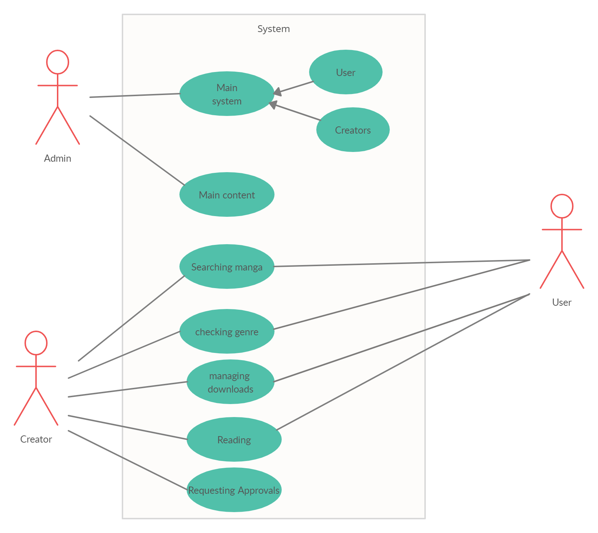
Use case diagram

Slide 13
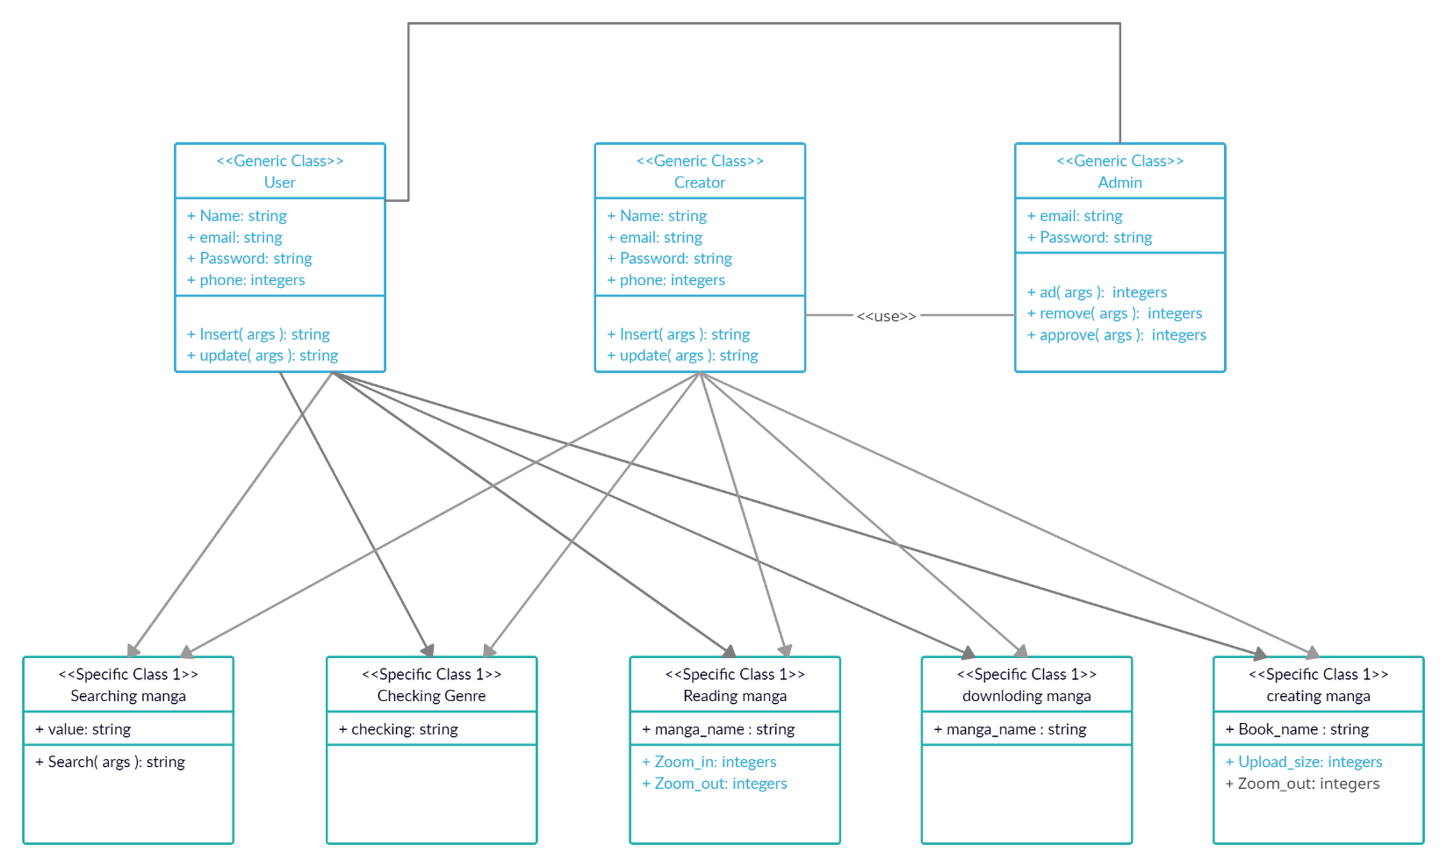
Class diagram

Slide 14
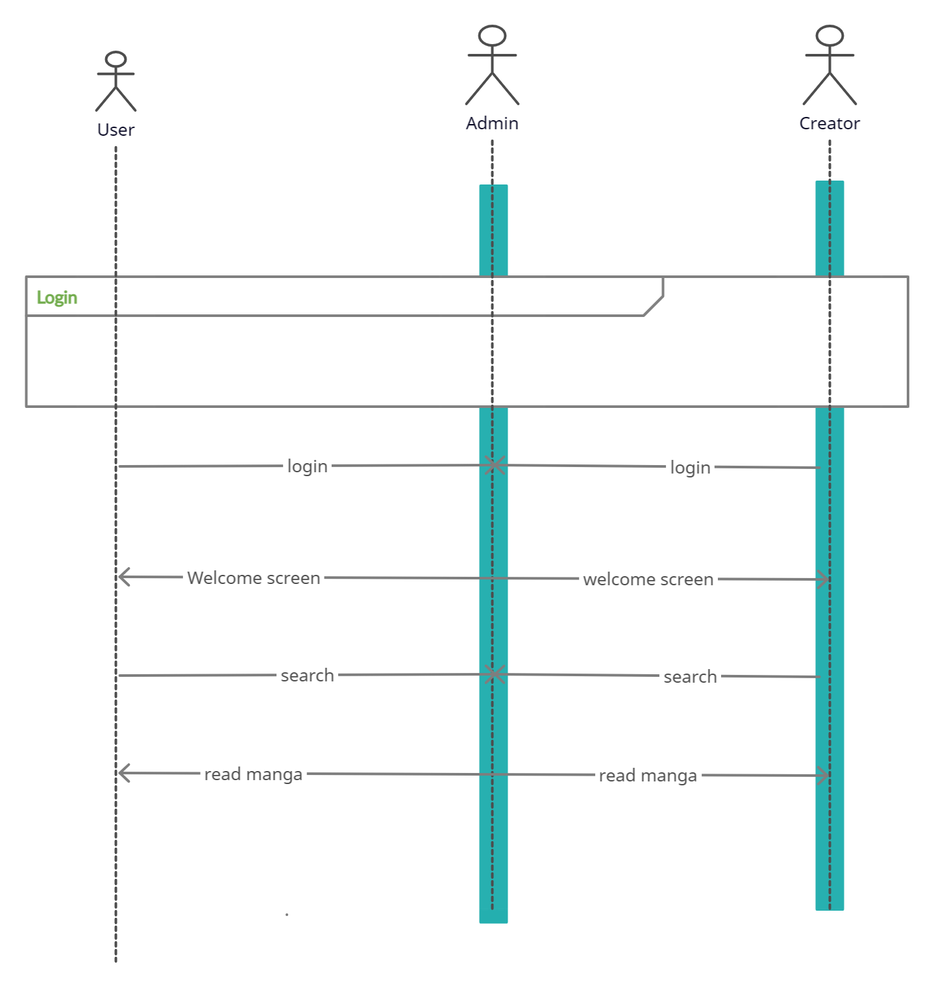
Sequence diagram

Slide 15
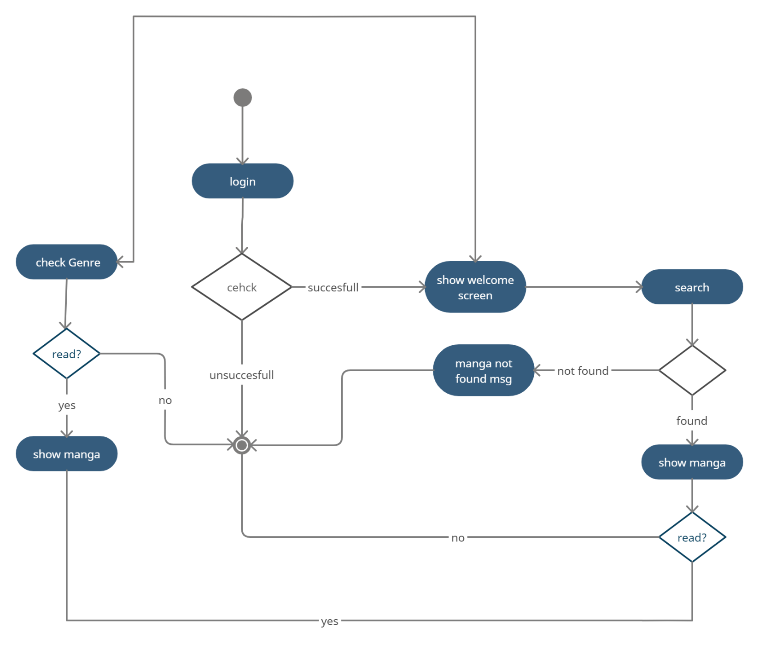
Activity diagram

Slide 16

Data Flow Diagram
Level-0
Level-1
Level-2

Slide 17
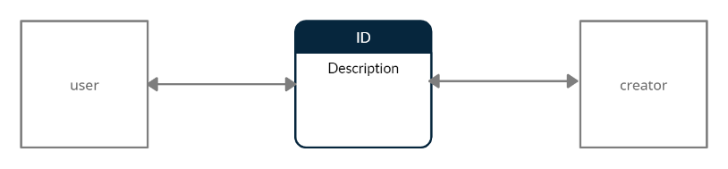
Level-0

Slide 18
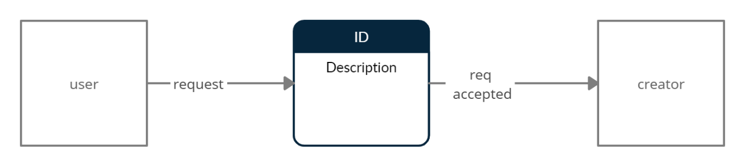
Level-1

Slide 19
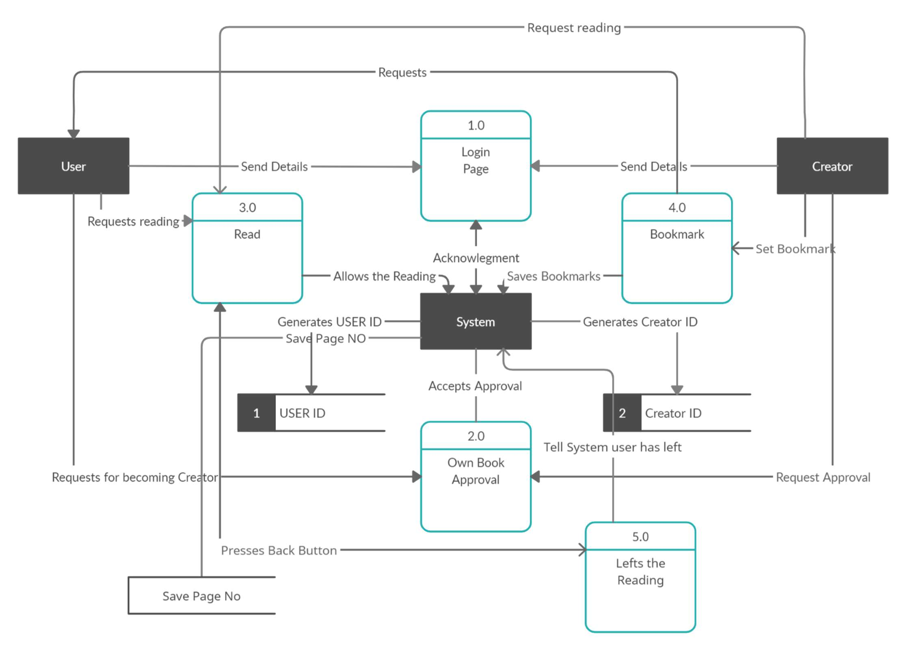
Level-2

Slide 20
Conclusion & future works
The whole system is designed into the multiple modules like login portal, registration portal, creator portals et cetera. Each one has their specific roles and functionalities. For implementing the system various feature Android studio have been used
There are various features and module which will make it effective and flexible to use.
Below is some point which shows the future points to be considered:
Each module of the system will provide a different user experience and the UI will be updated in future so it provides the best experiences at the regular interval of time.
As the system consist the creator functionality so there will be best interface for the user to showcase their art using the application
It was due to this project; we came to know how professional software is designed and now we can make software/application with this project experience and eventually make this software/application more robust.

Slide 21
references
1. Mangakakalot
Mangakakalot - Read Manga Online
2. Mangaowl.net
Welcome to MangaOwl - Read manga free online
3. Android Studio Tutorial
Android Studio Tutorial - Firebase Comic Reader App

Slide 22

Thank You

