Slide 1
Grammars

Slide 2


Grammar (or Unrestricted Grammar)

Slide 3
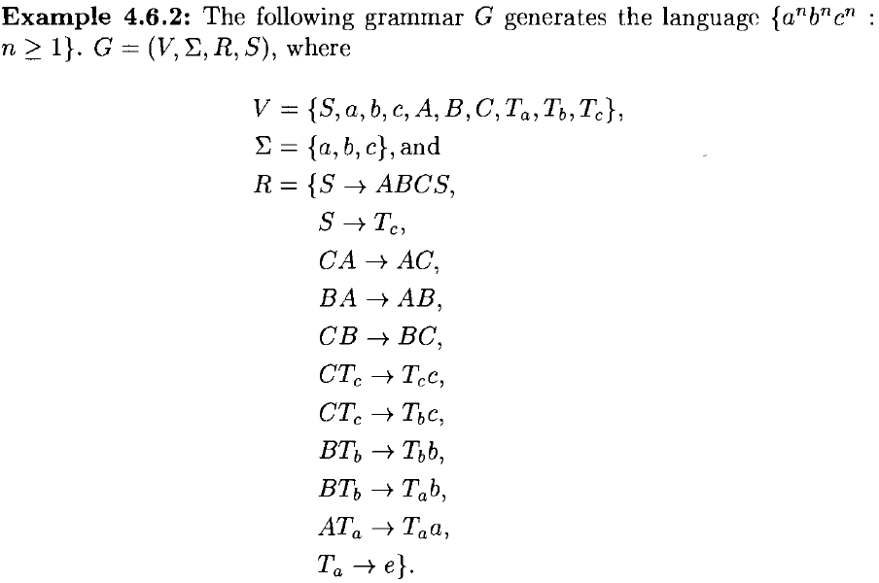

Slide 4

Grammars

