Slide 1
Sets, Relations, and Languages

Slide 2
Sets
Set, elements
Subset, proper subset
Set operations
Union
Intersection
Difference

Slide 3
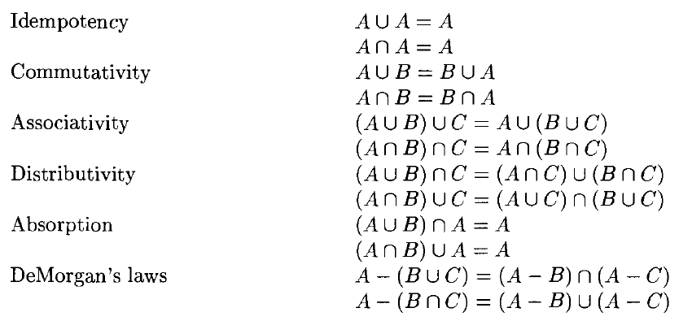
Properties of Set Operations

Slide 4
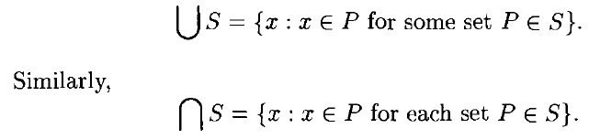




Slide 5
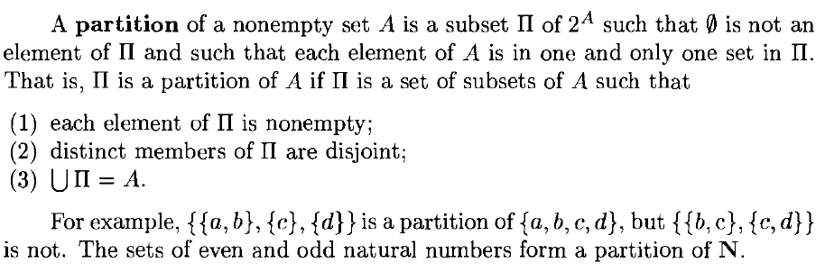
Partition

Slide 6
Relations and Functions
Ordered Pairs
Cartesian Product
Binary relation, n-ary relation
Function
Domain, image, range
One-to-one function
Onto function
Bijection
Inverse of a binary relation
Composition of functions

Slide 7
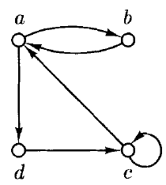
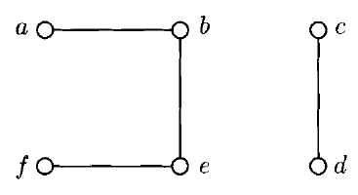
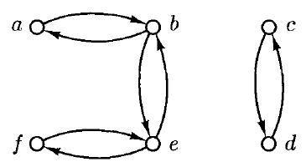
Special Types of Binary Relations
Directed graph
Undirected graph

Slide 8
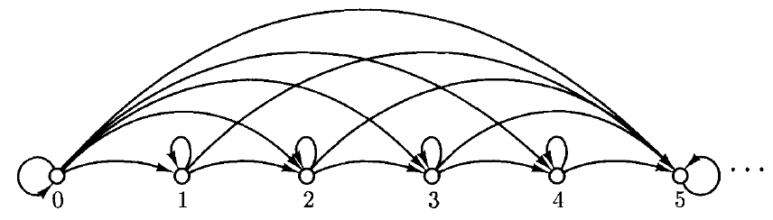
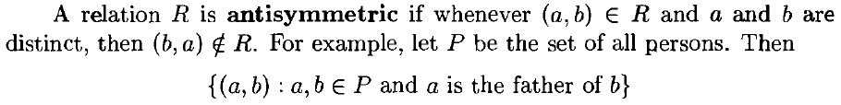
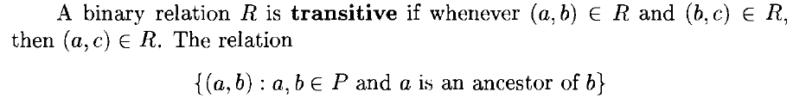
Special Types of Binary Relations

Slide 9
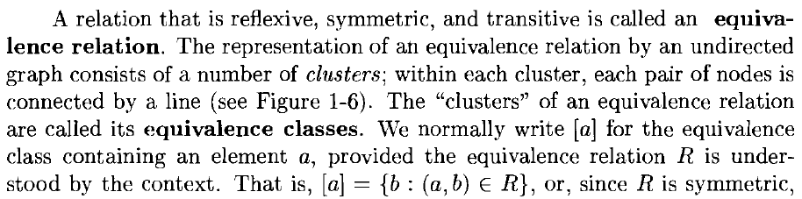
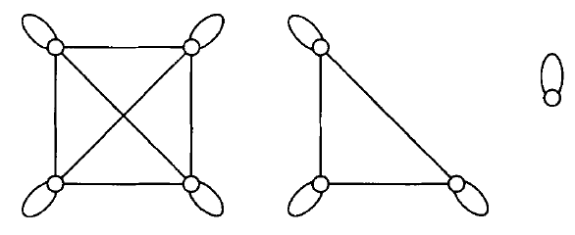

Equivalence Relation

Slide 10
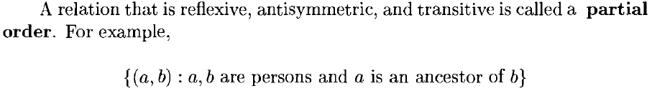
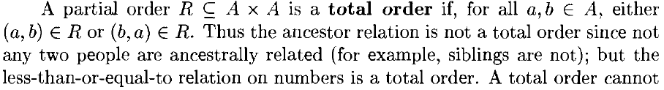
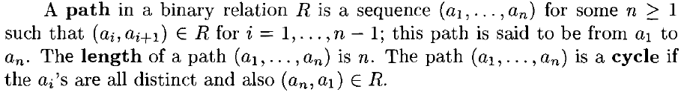
Partial and Total Order

Slide 11
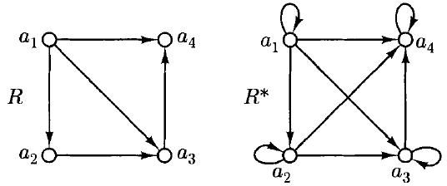
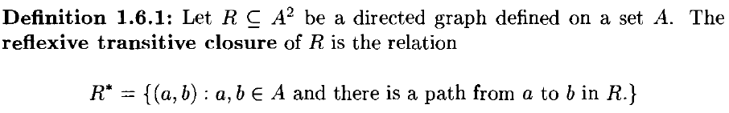
Closures
R* is the smallest possible directed graph that contains R, is reflexive, and is transitive
R* is called the reflexive transitive closure of R

Slide 12
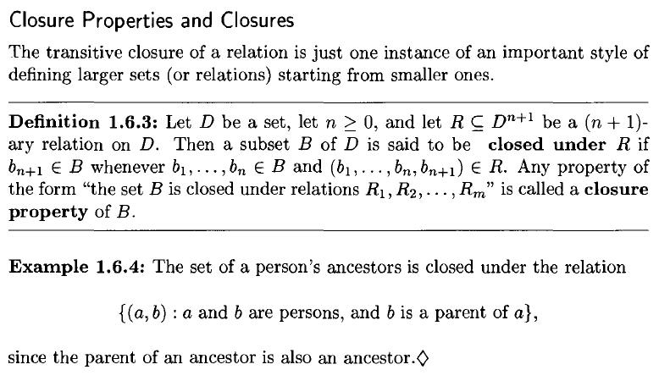

Slide 13
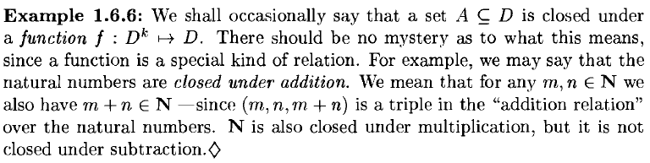
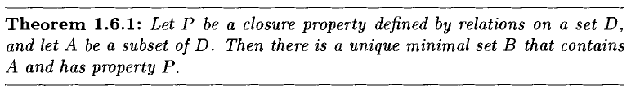
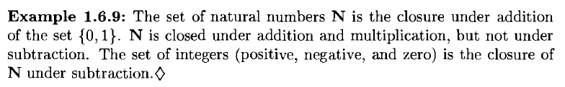

Slide 14
Finite and Infinite Sets
We call two sets A and B equinumerous if there is a bijection f: A → B.
In general, we call a set finite if, intuitively, it is equinumerous with {I, 2, ... , n} for some natural number n. The cardinality of a finite set is the number of elements in it - the cardinality of A (in symbols, IAI) is n.
A set is infinite if it is not finite.

Slide 15
Countable and Uncountable Sets
A set is said to be countably infinite if it is equinumerous with N, and countable if it is finite or countably infinite.
A set that is not countable is uncountable.
To show that a set A is count ably infinite we must exhibit a bijection f between A and N
We need to find a way in which A can be enumerated as A = {a₀, a₁, a₂, …..}

Slide 16
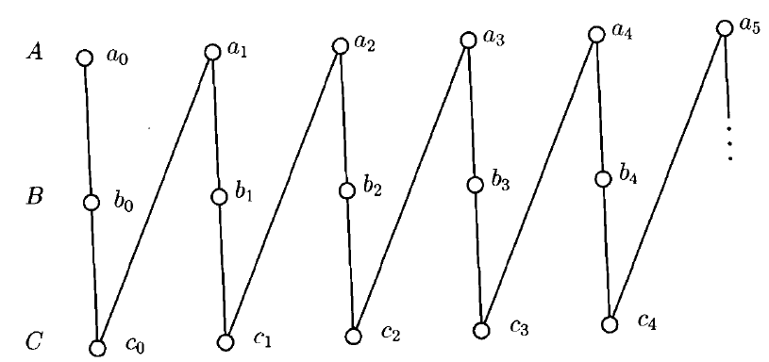
Countably Infinite Set
Example: the union of any finite number of countably infinite sets is countably infinite
Let A = {a₀, a₁,..}, B = {b₀, b₁,..}, C = {c₀, c₁,.. }
The technique of interweaving the enumeration of several sets is called "dovetailing"

Slide 17
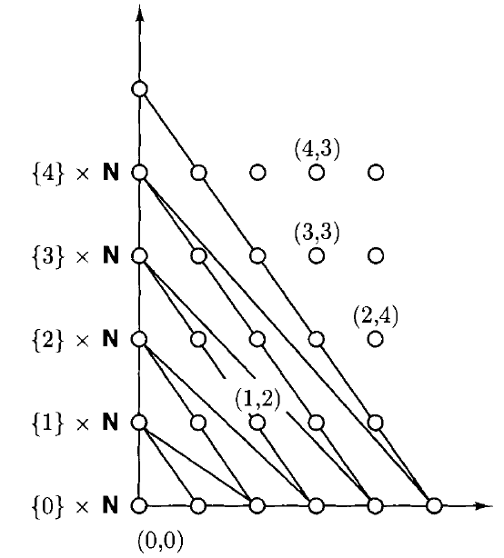
Countably Infinite Set
N X N

Slide 18
Three Fundamental Proof Techniques
Mathematical induction
Pigeonhole principle
Diagonalization

Slide 19
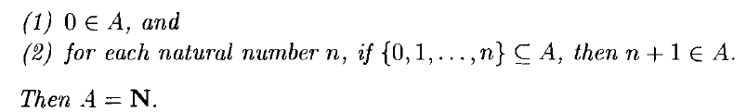
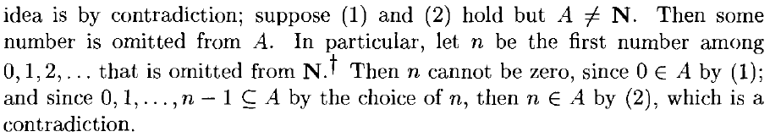
Principle of Mathematical Induction
Let A be a set of natural numbers such that
Proof by Contradiction:

Slide 20
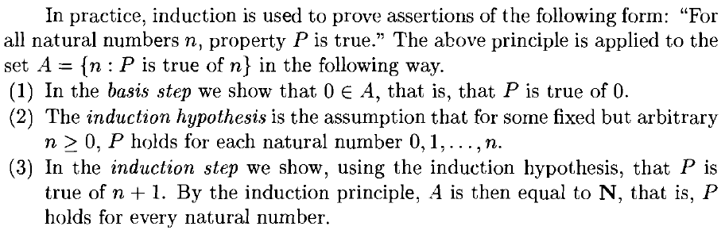
Using Mathematical Induction

Slide 21
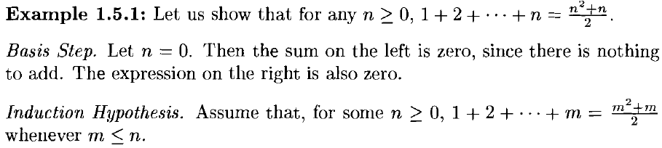
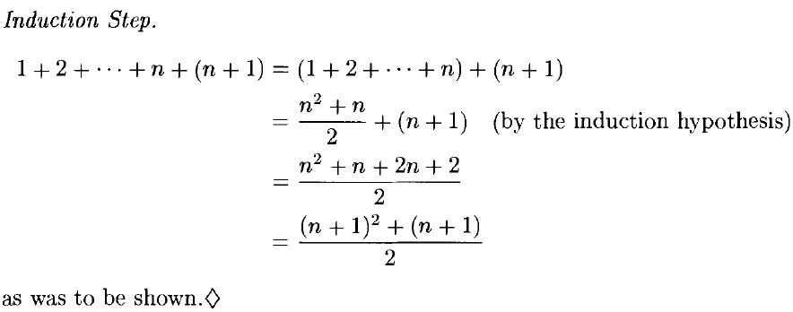
Example: Induction

Slide 22
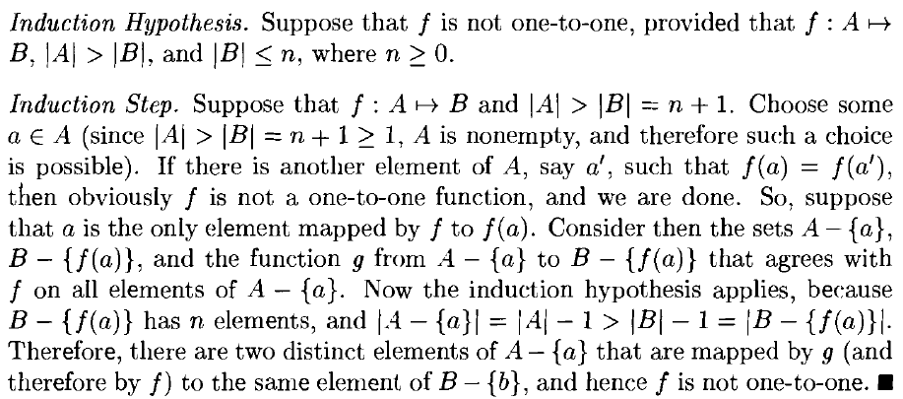
The Pigeonhole Principle
If A and B are finite sets and IAI > IBI, then there is no one-to-one function from A to B

Slide 23
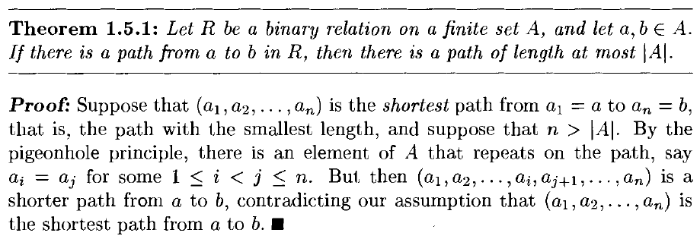
Using the Pigeonhole Principle

Slide 24
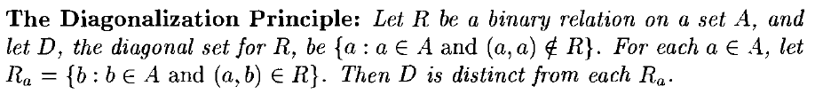
Diagonalization Principle

Slide 25
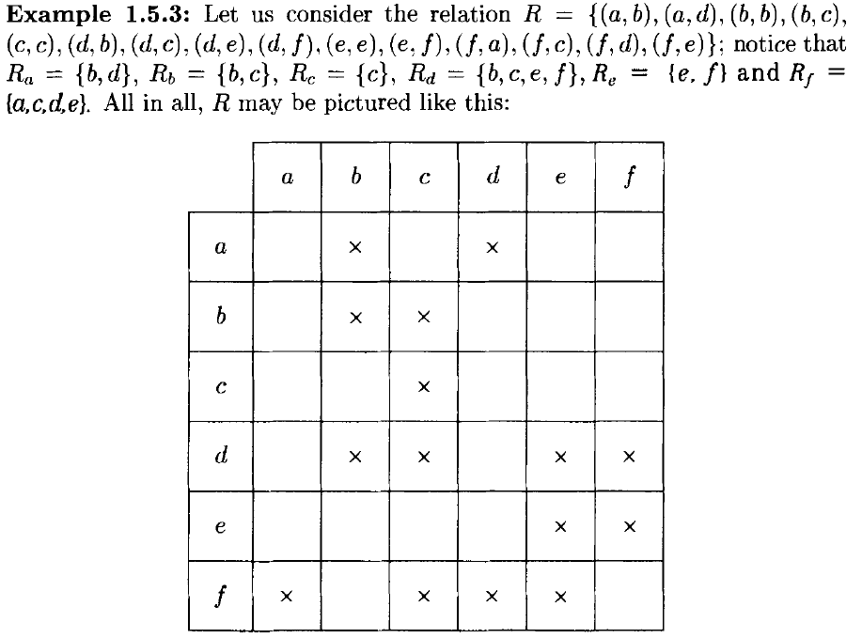

Slide 26
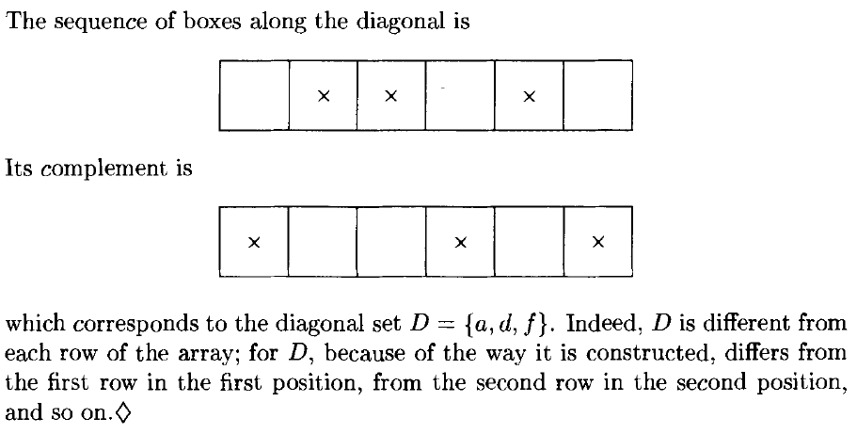
Diagonalization Example

Slide 27
Using Diagonalization
Prove

