Slide 1

Undecidability

Slide 2
Undecidability
What can be computed? What cannot be computed?
Natural upper limit of a computation device, or an algorithm is the Turing Machine
But not all Turing machines deserve to be called “algorithms”
Turing machines that semi-decide languages, and thus reject by never halting, are not useful computational devices, whereas Turing machines that decide languages and compute functions (and therefore halt at all inputs) are.

Slide 3
The Church-Turing Thesis
We therefore propose to adopt the Turing machine that halts on all inputs as the precise formal notion corresponding to the intuitive notion of an “algorithm”.
Nothing will be considered an algorithm if it cannot be rendered as a Turing machine that is guaranteed to halt on all inputs, and all such machines will be rightfully called algorithms.
This principle is known as the Church-Turing Thesis

Slide 4
The Church-Turing Thesis
It is a thesis, not a theorem, because it is not a mathematical result
It simply asserts that a certain informal concept (algorithm) corresponds to a certain mathematical object (Turing machine)
According to the Church-Turing thesis, computational tasks that cannot be performed by Turing machines are impossible, hopeless, undecidable
Certain computational problems cannot be solved by any algorithm

Slide 5
Universal Turing Machines
A Turing machine is an “unprogrammable” piece of hardware, specialized at solving one particular problem, with instructions that are “hard-wired at the factory”
Universal Turing Machine
A “generic” Turing machine that can be programmed to solve any problem that can be solved by Turing machines
The “program” that makes this generic machine behave like a specific machine M will have to be a description of M.
Turing machines as a programming language
interpreted by a Universal Turing machine

Slide 6
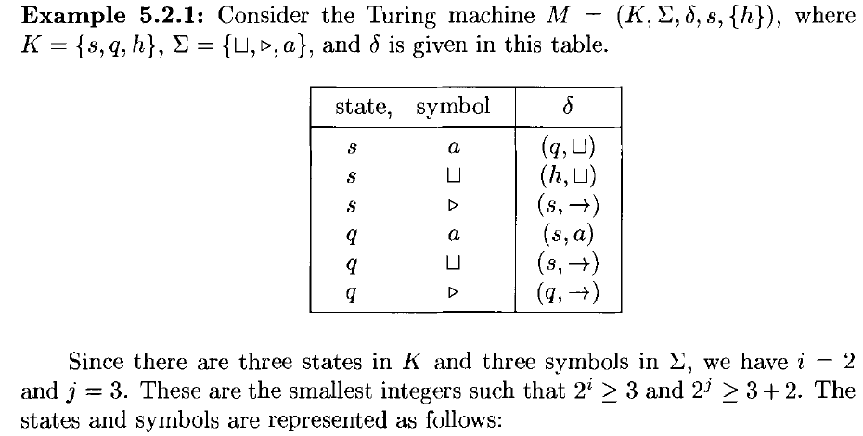
Representing a Turing Machine as a String

Slide 7
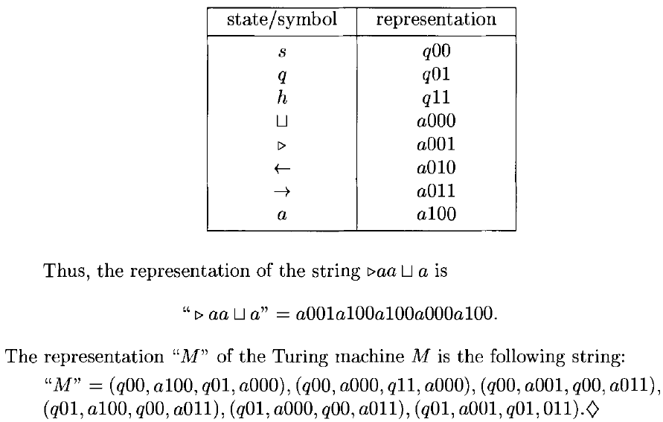

Slide 8

Universal Turing Machine U
U takes two arguments, a description of a machine M, “M”, and a description of an input string w, “w”.
We want U to have the following property
U halts on input “M” “w” if and only if M halts on input w.

Slide 9
The Halting Problem
Assume there is a program halts(P, X)
where
P is some program
X is an input to the program
Such that halts(P, X) correctly determines whether P would halt on input X (it returns “yes” if it does), or whether it would run forever (it returns “no”)

Slide 10
The Halting Problem
You can use halts(P, X) to write another program, with the name diagonal(X)
diagonal(X)
a: if halts(X, X) then goto a else halt
If the halts program decides that program X would halt if presented with itself as input, then diagonal(X) loops forever; otherwise it halts.
Does diagonal(diagonal) halt?

Slide 11
The Halting Problem
It halts if and only if the call halts( diagonal, diagonal) returns “no”
That is, It halts if and only if it does not halt !!
This is a contradiction
We must conclude that the only hypothesis that started us on this path is false, that program halts(P, X) does not exist.
There can be no algorithm for solving the problem halts would solve: to tell whether arbitrary programs would halt or loop forever.

Slide 12
The Halting Problem
Let

Slide 13
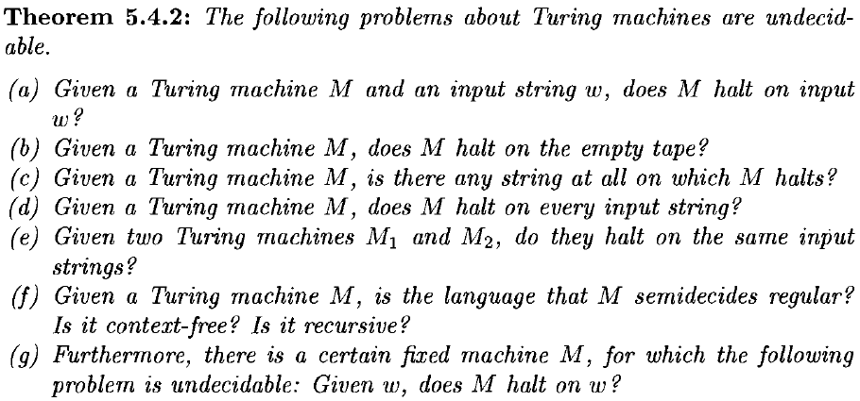
Undecidable Problems about Turing Machines

Slide 14
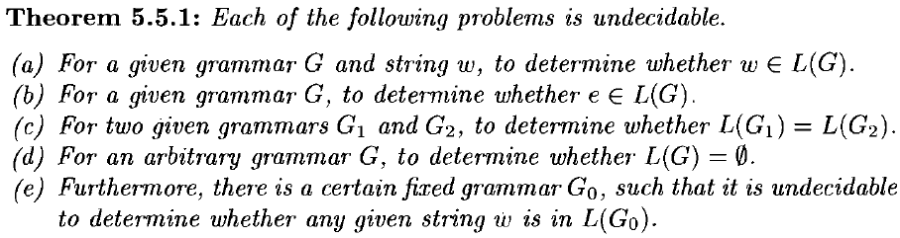
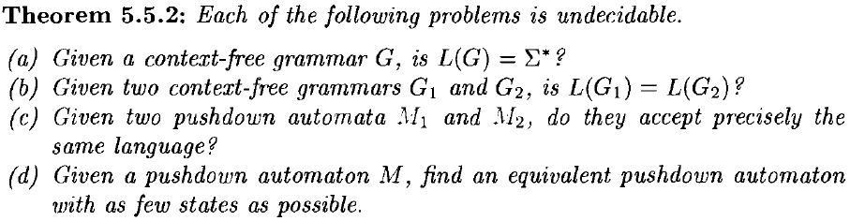
Unsolvable Problems about Grammars

Slide 15

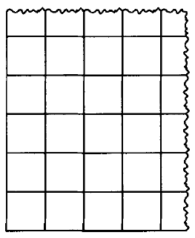
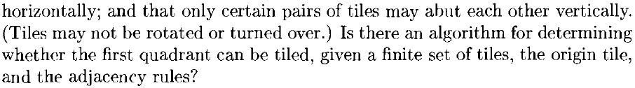
An Unsolvable Tiling Problem

Slide 16
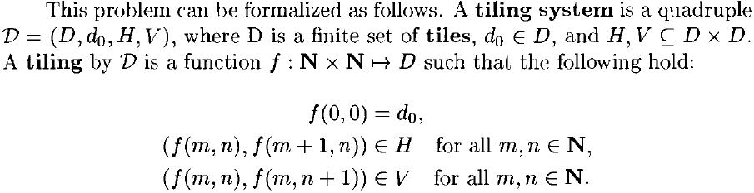
An Unsolvable Tiling Problem

Slide 17
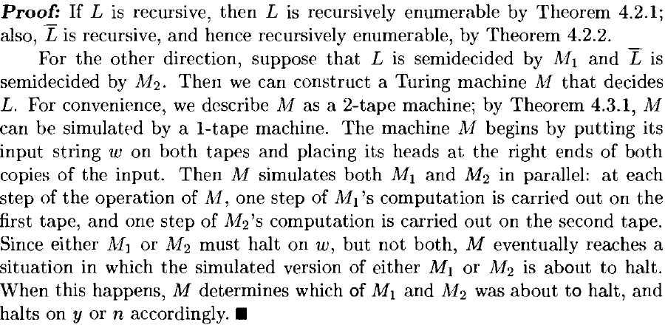
Properties of Recursive Languages

Slide 18
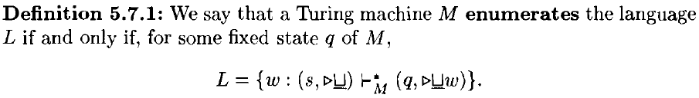
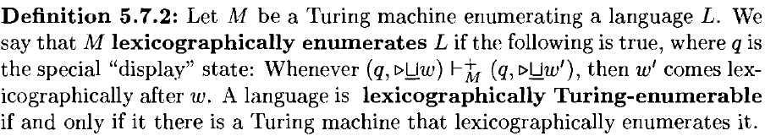
Properties of Recursive Languages

