Slide 1


ED Pediatric performance snapshot
Connecticut
MedSChool Medical Center
Date
simulation: Feb 10, 2018

Slide 2
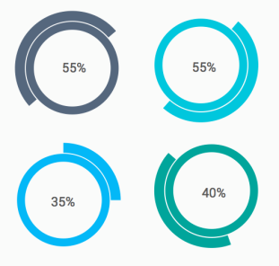

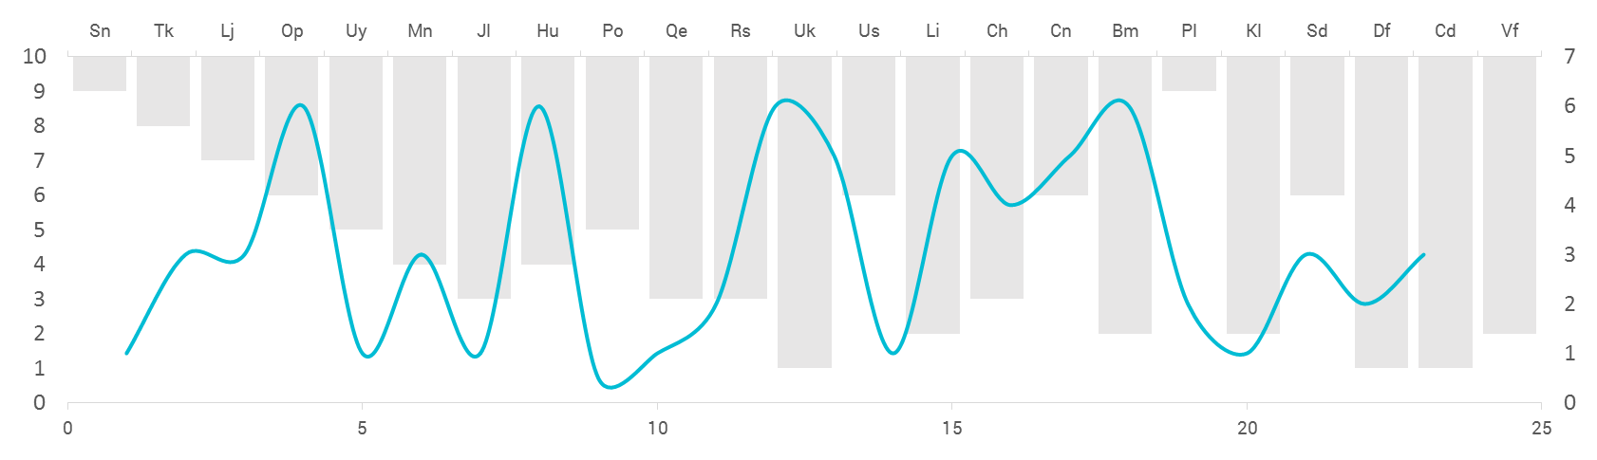
Data Collection
Methodology
In situ simulations were conducted in your ED bay.
Performance checklists were completed in person and via video review.
Data collected at your site were compared to other EDs.
Cases
Foreign body obstruction
Sepsis
Cardiac arrest
Seizure
Score Components
EMSC pediatric readiness score
Teamwork score
Case-performance scores
Teams
1-4 teams each comprised of 1-2 physicians, 3-5 nurses, and 2-3 nursing assistants or EMT personnel

Slide 3

Mission
ImPACTS aims to assess and improve the quality of care delivered to acutely ill and injured children

Slide 4
ImPACTS reach to date
33 EDs visited to date
Variable pediatric patient volume
8
Pediatric EDs
42,000
Pediatric patients annually
Pediatric EDs
55,000
total patients
25
General EDs
4,000
Pediatric patients annually
General EDs
44,000
total patients

Slide 5
What is the next step?
Prioritize Action Items
Set a Timeline
Improve Care
We want you to choose two action items from the next slide which in your opinion are the most important for your site to complete.
We want you to make these two action items your priority and we will support you to achieve them in coming two months.
Please feel free to contact us for any assistance or resources you might need for completing these actions.
We will follow up with you every 4 weeks to assist in your progress and support any roadblocks that you might face.

Slide 6

Contact Us
Patricia Padlipsky, MD, FAAP: patricia.padlipsky@gmail.com
Nancy McGrath, MN, RN, CPNP-AC/PC:
nmcg1@aol.com
Jumie Lee, MSN, RN, CPNP-AC/PC:
jumie1@yahoo.com
Marc Auerbach, MD, FAAP, MSc
Marc.auerbach@yale.edu

Slide 7
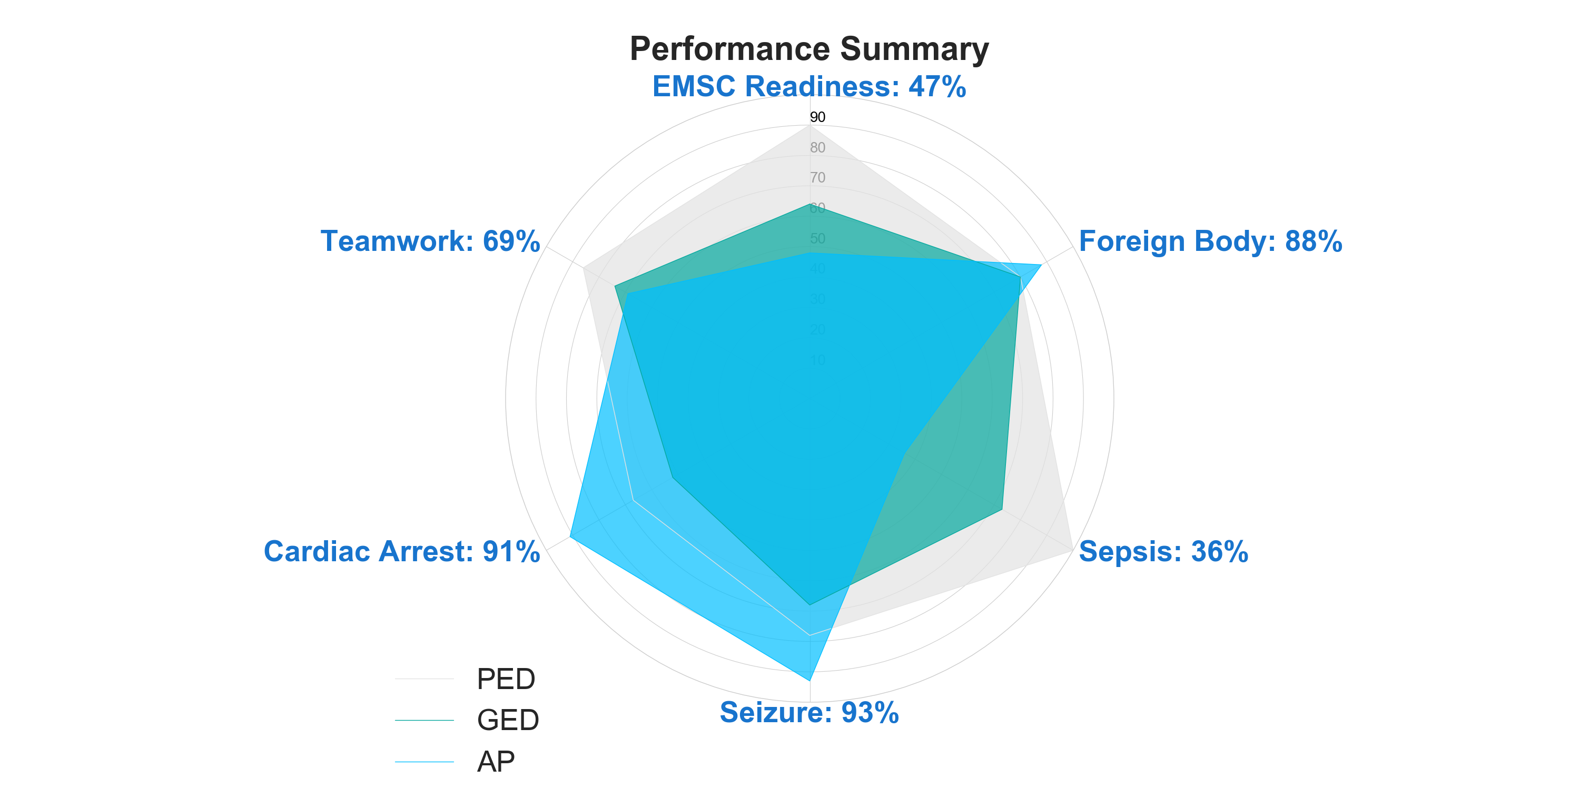

Slide 8
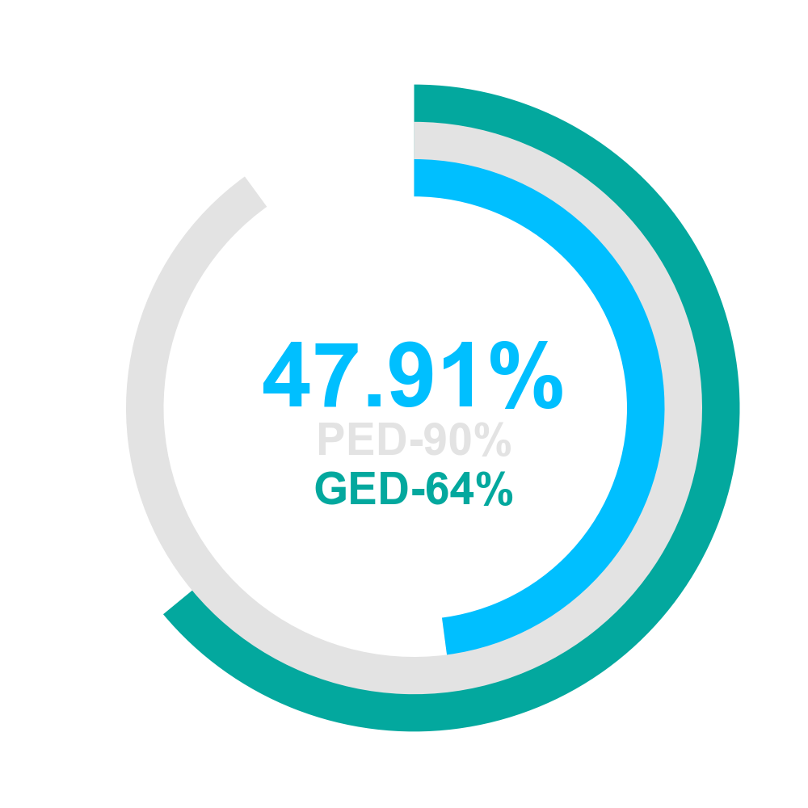
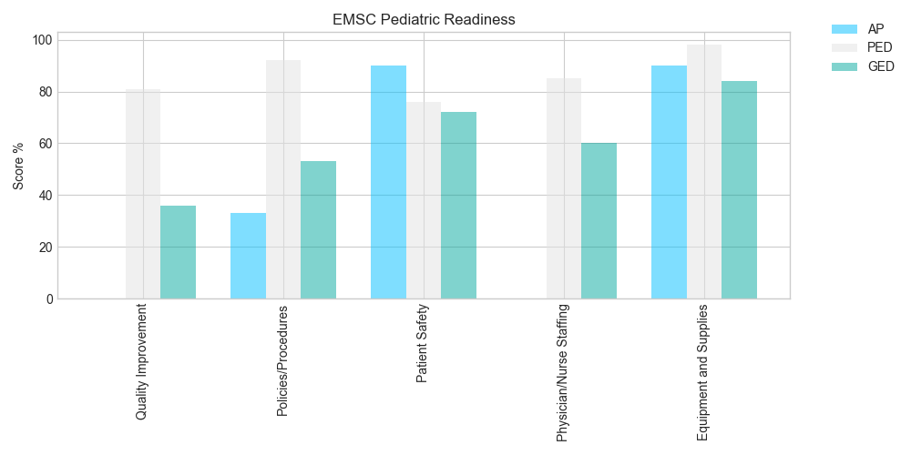

Slide 9
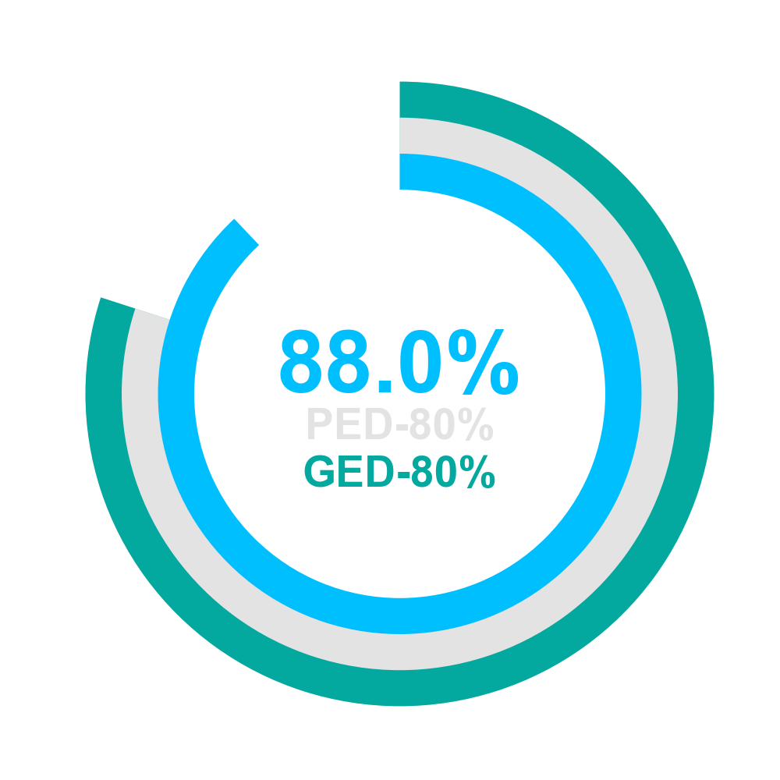
Foreign Body | Team 1 | Team 2
Airway assessed | Yes | Yes
Breathing assessed | Yes | Yes
McGill forceps used | No | Yes
Stridor verbalized | Yes | Yes

Slide 10
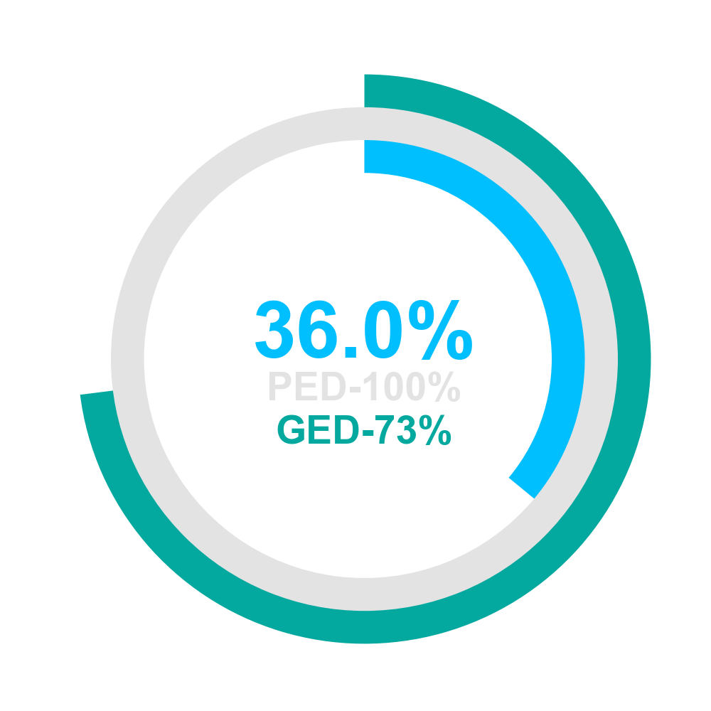
Sepsis | Team 1 | Team 2
60mL/kg given over 15min | No | Yes
Start 3rd vasopressor after 3rd bolus | No | No
Appropriate antibiotics given | No | No
Began high-flow O2 | No | No
Establish 1st IV/IO | Yes | Yes
Establish 2nd IV/IO | No | Yes
Push-pull techniques used | Yes | No

Slide 11
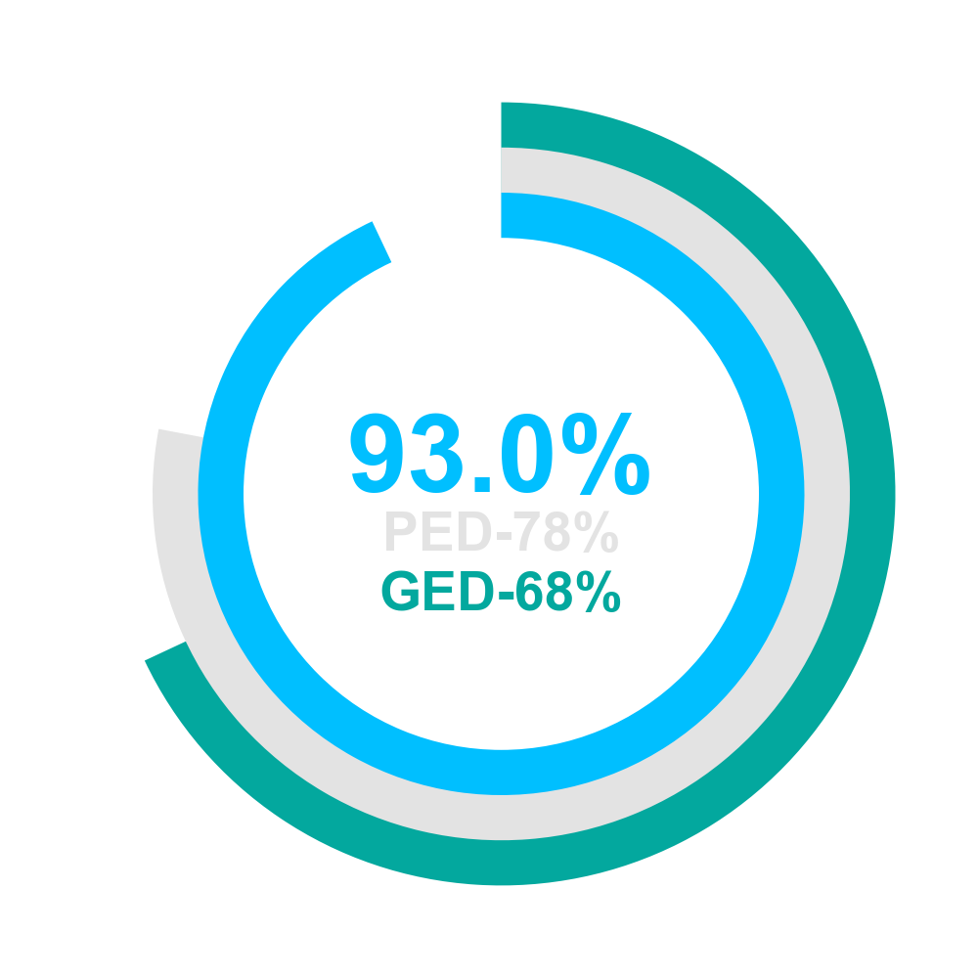
Seizure | Team 1 | Team 2
Maintenance glucose started | Yes | Yes
Correct glucose concentration | Yes | Yes
Bedside glucose checked | Yes | No
Placed on O2 | Yes | Yes
Correct Glucose dose | Yes | Yes
IV/IO placed | Yes | Yes
Respiratory depression recognised | Yes | Yes

Slide 12
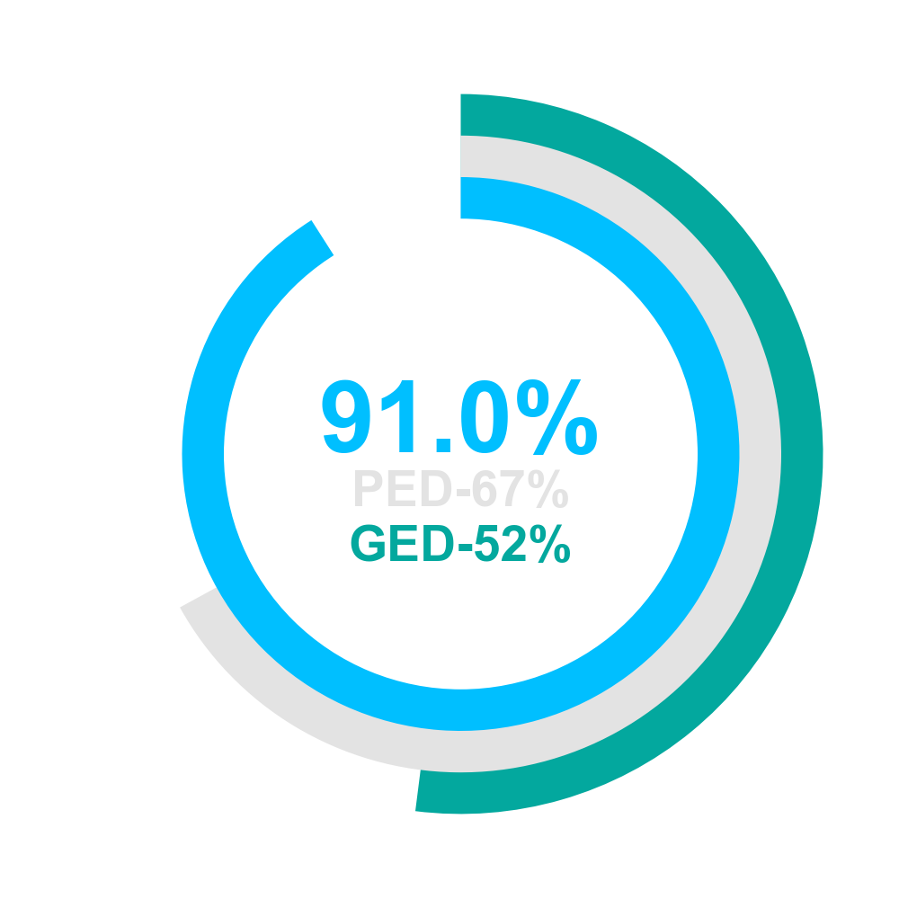
Cardiac arrest | Team 1 | Team 2
<10 sec stop/pause CPR preshock | Yes | Yes
ALL CPR cycles 120 | Yes | Yes
Adequate recoil | Yes | Yes
Backboard used | Yes | Yes
CPR resumed immediately after DEFIB cont 120sec | Yes | Yes
CPR started in <30 sec | Yes | Yes
Compression rate between 100-120/min | Yes | Yes
Continuous ETCO2 monitoring | Yes | No
Correct depth | Yes | Yes
Correct hand location | Yes | Yes
Intubation equipment | Yes | Yes
Defib safety: cleared people/O2 | Yes | Yes

Slide 13
Cardiac arrest | Team 1 | Team 2
Defibrillation dose 32-100J | Yes | Yes
1st dose of Epi in <5min | No | Yes
2nd dose of Epi in 2-3min after 1st | Yes | Yes
IV/IO placed | Yes | Yes
No interruptions > 10 seconds | No | Yes
PEA verbalized | Yes | Yes
Patient intubated pause <10sec | Yes | No
Pulse check < 120 sec into case | Yes | Yes
ROSC stated | Yes | Yes
Ventilation rate between 8-10/min | Yes | Yes
Ventricular fib verbalized | Yes | Yes

Slide 14
Other Elements | Score
Family Presence | 88.0
Proper weight assessed | 86.0
Teamwork Evaluation: CTS Tool | 69.0
Disposition | 100.0
Family centered care | 100.0

